Slide 1

Amazon Sales Data Analysis
By - Harshit Kumar Pathak
Technologies: Business Intelligence
Domain: E-commerce

Slide 2


Problem Statement :
Sales management has gained importance to meet increasing competition and the need for improved methods of distribution to reduce cost and to increase profits. Sales management today is the most important function in a commercial and business enterprise.
Tools Used:

Slide 3
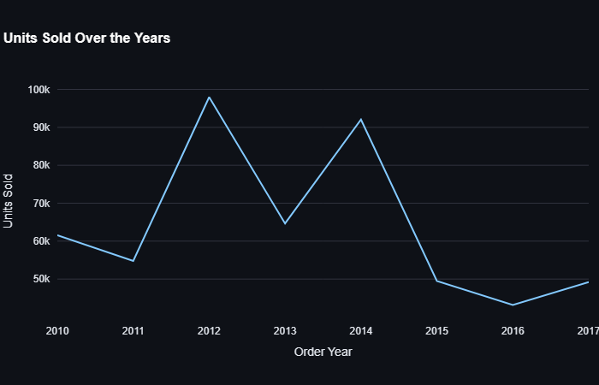

Slide 4
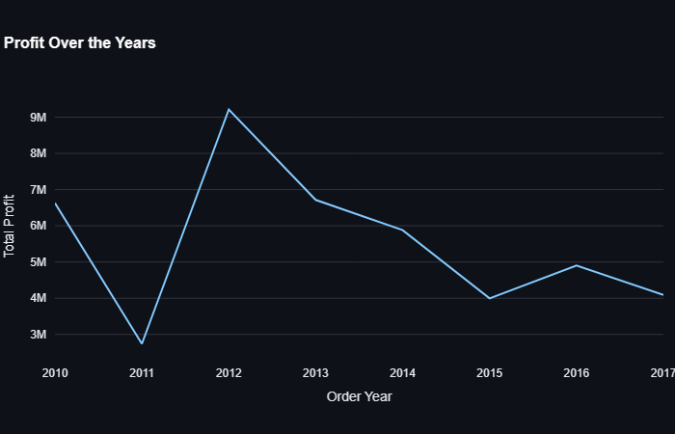

Slide 5
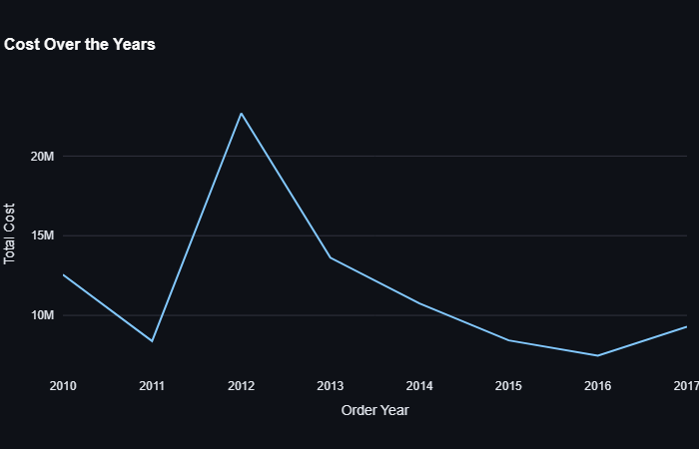

Slide 6
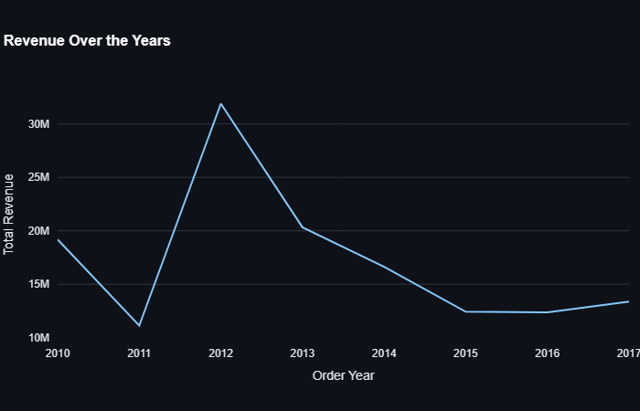

Slide 7
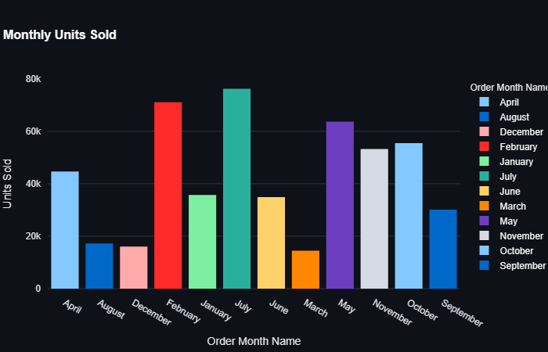

Slide 8
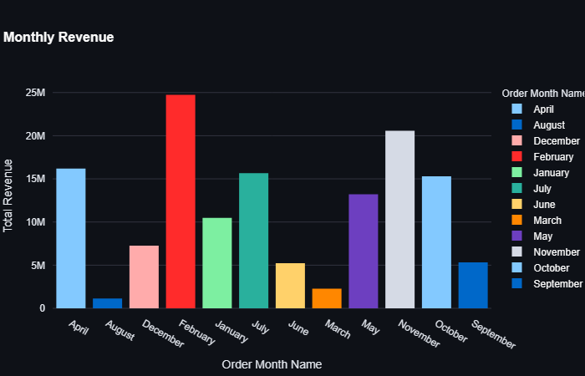

Slide 9
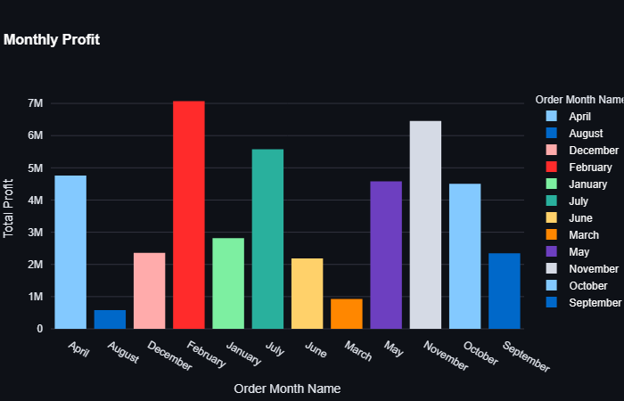

Slide 10
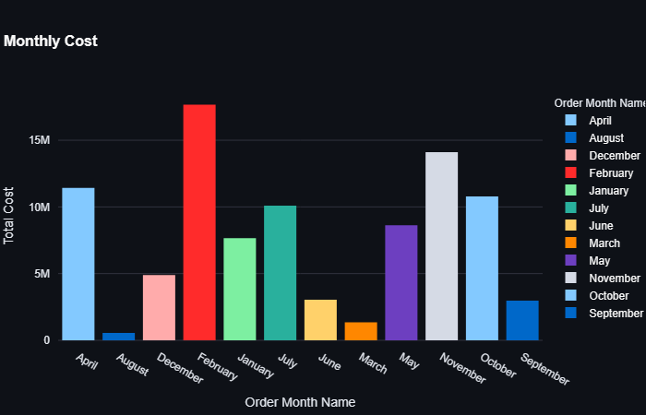

Slide 11
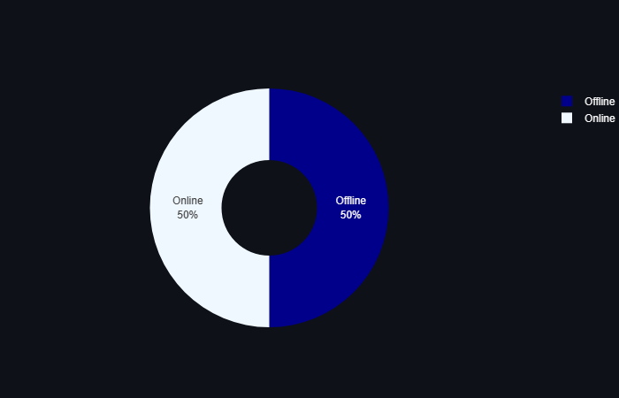

Slide 12
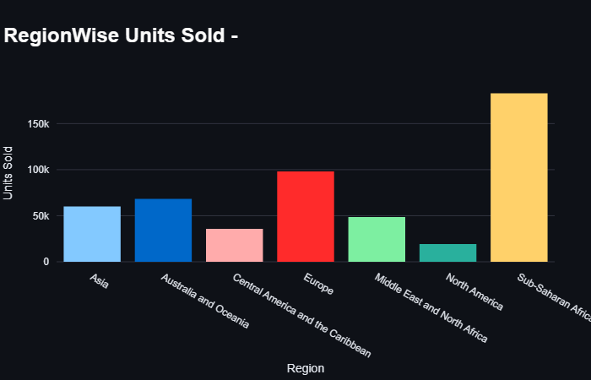

Slide 13
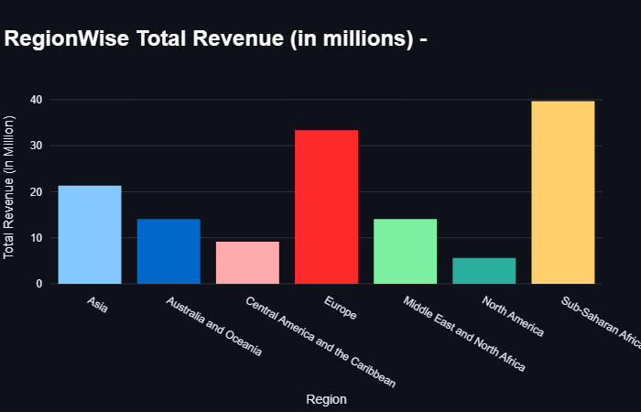

Slide 14
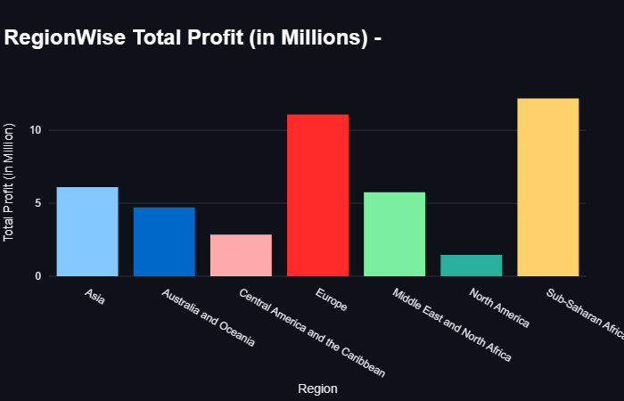

Slide 15
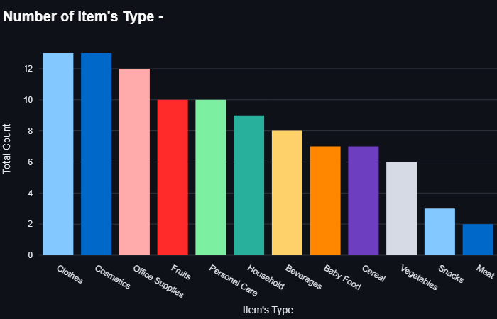

Slide 16
Conclusion
Highest Revenue and Profit was in year 2012 but decline is experienced from 2014 to 2017
From year 2010 to 2014, Consistently 50K+ Units were each year
Highest revenue and profits are in the month of February followed by November and April
July and February month has maximum number of Units Sold
From 2010 to 2017- Distribution of sales between online and offline channels are equal
Sub-Saharan Africa Region has maximum number if units sold and least units are sold to North America
The Sub-Saharan Africa region was the most profitable and revenue generated region, followed by Europe & Asia.
Cosmetics, Office Supplies, Personal Care, Clothes, and Fruits were our top 5 selling product segments.

