Slide 1


NU SCORE ON THE GO
Build ML models with your data
From loan book, bureau and bank-statement files to a validated, explainable Nu Score — and live scoring of new applications — in minutes, on Northern Arc's own servers.
Product overview · 15 September 2026 · Internal
http://10.91.16.86/nuscore_claudecode/
Nu Score On the Go · Northern Arc / AltiFi · Internal
1

Slide 2
EXECUTIVE SUMMARY
Nu Score On the Go turns the data a lender already has into a governed credit score in minutes
Executive summary
The problem
What we built
Why it matters
▪ Building a credit model takes a data-science team weeks: joining sources, cleaning formats, choosing algorithms, validating honestly, packaging for underwriters.
▪ Most lending teams never get beyond a spreadsheet — decisions stay judgemental and inconsistent.
▪ Upload the files you have; the engine matches identifiers, screens for PII and leakage, tunes nine model families on GPUs and selects a champion under model-risk discipline.
▪ Output is a calibrated 0–1000 Nu Score with A+…E bands, reason codes and reports — and the model scores new applications immediately.
▪ Live today on internal infrastructure; a 6,000-row book trains 10 models in 72 seconds.
▪ Data never leaves the host and is deleted once results are delivered; no PII required.
▪ Free during introduction, then ₹10 per case scored — compute included.
9
5
0–1000
20 GB
₹10
model families incl. FT-Transformer
validation cohorts
Nu Score, 6 bands
per file, resumable
per case after launch
Nu Score On the Go · Northern Arc / AltiFi · Internal
2

Slide 3
CONTEXT
Today a usable credit model is a six-week project; the product collapses it to one sitting
The problem we solve
Conventional build
Week 1–2
Week 2–3
Week 3–4
Week 4–5
Week 5–6
Collect & join loan, bureau, bank files by hand
Clean formats, chase missing identifiers
Try 2–3 algorithms in notebooks
Validate, argue about leakage & splits
Package for underwriting; write the committee pack
Nu Score On the Go
Minute 1
Minute 2
Minute 3–6
Minute 6
Minute 7
Drop files; identifiers matched
PII / leakage screened; outcome confirmed
9 families tuned on GPU; champion picked
Nu Score bands, SHAP, warnings, report
Score the next application
Quick tier on a 20,000-row book: about 3 minutes end to end on the current host (2 × Tesla T4 for training).
Nu Score On the Go · Northern Arc / AltiFi · Internal
3

Slide 4
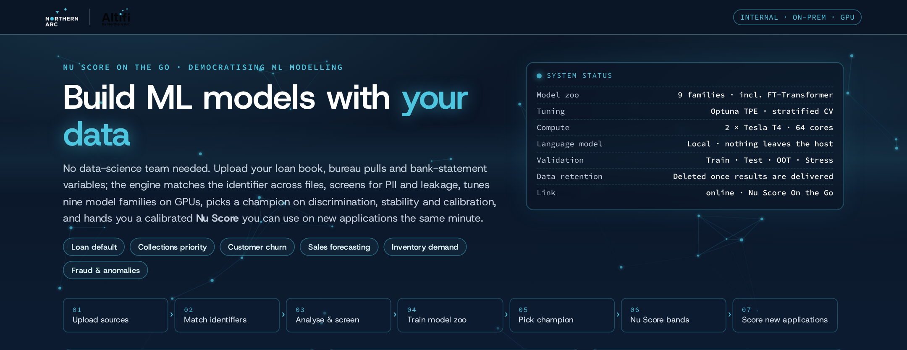
PRODUCT
One guided flow from raw files to a scored application
Product at a glance
01
02
03
04
05
06
07
Upload sources
Match identifiers
Analyse & screen
Train model zoo
Pick champion
Nu Score bands
Score applications
CSV, bureau JSON, Parquet; up to 20 GB; resumable
Roles proposed by a local LLM; keys verified by value overlap
PII, leakage, IDs flagged; IV and WOE bins; clean-up log
Nine families tuned with Optuna on GPUs
Composite on selection-safe cohorts; stacked blend
Calibrated 0–1000 score; bands learned from data
Form or batch file; reason codes; drift check
Nu Score On the Go · Northern Arc / AltiFi · Internal
4

Slide 5
PRODUCT
Bring what you have: a loan dump plus any bureau and bank-statement variables, joined by one identifier
Inputs
REQUIRED · Loan dump
RECOMMENDED · Bureau
RECOMMENDED · Bank statement
▪ loan_id / account_no
▪ Outcome to predict: default flag, DPD bucket, write-off, closure
▪ Product, amount, tenure, rate, EMI, LTV, disbursal date
▪ Repayment history: DPD, overdue, months on book
▪ Applicant profile without PII: age band, income, occupation, pincode
▪ Bureau score, enquiries (3/6/12 m)
▪ Live & closed trade lines, exposure, utilisation
▪ Worst DPD, write-offs, settlements, vintage
▪ Flat CSV or the raw bureau JSON (nested trade lines flattened)
▪ Average / minimum / month-end balances
▪ Credit & debit counts and amounts
▪ Salary regularity, cheque or EMI bounces
▪ Cash withdrawals, existing EMI outflow; monthly rows are fine
Identifier one common key across files; names may differ (loan_id, ref_no, account_number) — the engine finds the match and shows the match rate
Outcome 0/1, yes/no, a class label, or a number to threshold (e.g. DPD > 90); you confirm the positive class
Time column disbursal or snapshot date unlocks true out-of-time validation
Keep out names, mobile, email, address, PAN, Aadhaar, DOB — flagged and dropped if present; not needed for the score
Nu Score On the Go · Northern Arc / AltiFi · Internal
5

Slide 6
HOW IT WORKS
Identifiers are matched by measured overlap and every column is screened before a model sees it
Data intake and screening
Matching a local language model proposes file roles (loan dump / bureau / bank statement); join keys are chosen by actual value overlap between candidate columns and shown with match rate and rows per case
Bureau JSON nested objects become columns; trade-line lists become count / sum / max / min per field
Screening PII by name and value pattern (emails, mobiles, PAN, Aadhaar); leakage by name and implausible IV; identifiers by uniqueness — all excluded by default, overridable
Clean-up ₹ / $ symbols, % signs, 1,23,456 lakh and 1,234,567 grouping, yes/no, NA markers — normalised deterministically and logged for review
Profiling DuckDB summarises millions of rows in seconds: types, nulls, distinct counts, date detection, IV with WOE bins
Check | Trigger | Action
PII | name pattern or value pattern | dropped before training
Leakage | post-outcome name, IV > 1.0 | excluded by default
Identifier | > 95 % unique | kept as key, not a feature
Constant / missing | one value or all null | listed in diagnostics
Correlated pairs | |r| ≥ 0.8 | listed; importances shared
Example from a live run:
loan_id = ref_no · 92 % of cases matched · 1 row per case (bureau)
loan_id = account_number · 85 % matched · 6 rows per case (bank statement, latest kept)
customer_name → PII · mobile → PII · writeoff_amount → leakage (IV 13.9)
Nu Score On the Go · Northern Arc / AltiFi · Internal
6

Slide 7
HOW IT WORKS
Nine model families are tuned automatically; a stacked blend adds the AI-enhanced probability
The modelling engine
Logistic regression
Interpretable baseline every scorecard starts from
Tuning
Random Forest / Extra Trees
Bagged trees; robust to outliers and monotone transforms
▪ Optuna TPE search with median pruning and early stopping per family
▪ Quick 4 trials / 2 folds · Balanced 25 / 3 · Thorough 60 / 3
▪ Tuning on ≤ 200 k rows; final fit on ≤ 1 M rows; evaluation on all rows loaded
Histogram Gradient Boosting
scikit-learn boosting with native missing handling
XGBoost (GPU) / LightGBM
Regularised gradient boosting; fast on wide data
CatBoost
Ordered boosting; strong on small data
Preprocessing
MLP
Neural network on standardised features
▪ Median imputation with missing-value indicators
▪ One-hot for low-cardinality categoricals; out-of-fold target encoding for pincode-like columns
▪ Dates → month and days-to-reference; free text dropped; schema saved for scoring
FT-Transformer (PyTorch)
Attention across tabular features; trained on the T4s
NuScore Blend
Logistic meta-learner on out-of-fold predictions of the top four
Nu Score On the Go · Northern Arc / AltiFi · Internal
7

Slide 8
HOW IT WORKS
Five cohorts keep selection honest: test and out-of-time never influence which model wins
Validation discipline
Train
Validation
Calibration
Test
Out-of-time
55%
12%
10%
10%
13%
fitting & tuning
selection, thresholds
Platt scaling, band cut-offs
untouched estimate + bootstrap CI
latest dates; rows sharing a date never split
used for selection
never used for selection
Champion composite validation AUC 45 % · validation Brier 20 % · validation→calibration consistency 15 % · overfit gap 10 % · simplicity 10 %
Chronological when a time column exists, cohorts follow observation dates and the OOT cohort is the latest period; otherwise it is a random hold-out and the UI says so
Calibration Platt scaling fitted on the calibration cohort — smooth, monotone, never saturating
Warnings engine weak AUC, overfit gap > 0.10, validation→OOT drop, calibration worsening Brier, duplicate rows, correlated pairs, small cohorts
Unit tests prove that flipping test / OOT labels cannot change the champion
Nu Score On the Go · Northern Arc / AltiFi · Internal
8

Slide 9
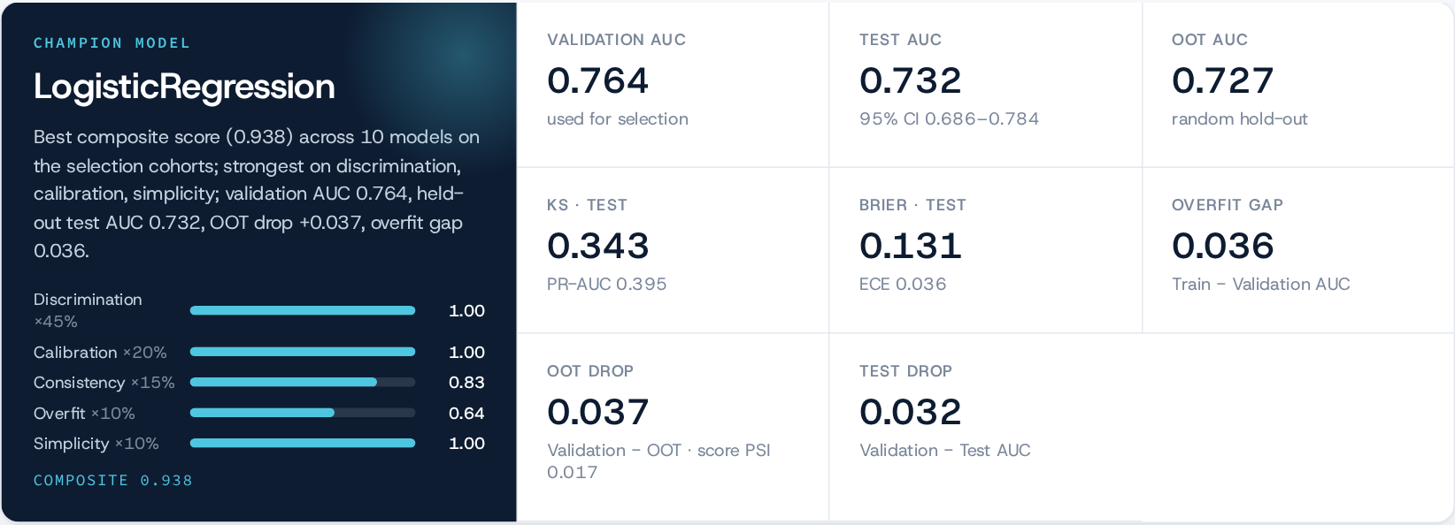
RESULTS
Live run: LogisticRegression won on selection cohorts and held up on the untouched test and OOT cohorts
Results from a training run · 6,000 rows · 10 models · tier: quick
Composite breakdown shows why the champion won; the leaderboard ranks every model on the same composite and reports validation, test and OOT AUC side by side so a reviewer can see stability at a glance.
Bootstrap 95 % interval on the test AUC quantifies sampling uncertainty; the OOT tile states whether it is a true out-of-time cohort.
Nu Score On the Go · Northern Arc / AltiFi · Internal
9

Slide 10
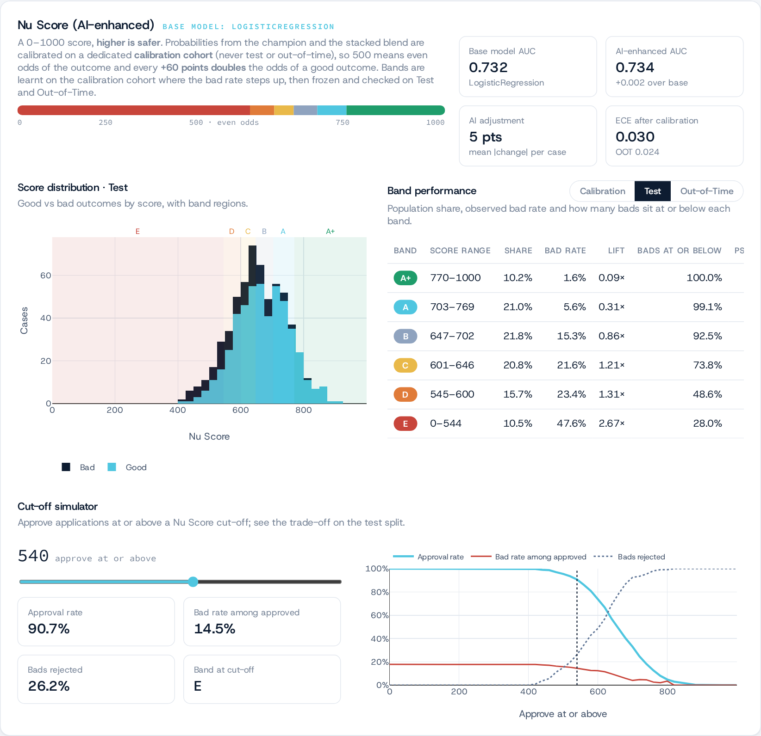
RESULTS
The Nu Score is a calibrated 0–1000 scale with bands learned from the data, not fixed cut-offs
Nu Score (AI-enhanced)
Scale 0–1000, higher = safer; 500 = even odds; +60 points halves the odds of going bad
Calibrated Platt scaling on the calibration cohort, so the score tracks observed bad rates
AI-enhanced probability from the stacked blend; base score and AI adjustment shown separately for governance
Bands A+ … E cut-offs learned on the calibration cohort: quantile seeds merged until bad rate rises monotonically and each band holds ≥ 5 %
Cut-off simulator approval rate vs bad rate among approved vs bads rejected, on the test cohort
Band | Score range | Share | Bad rate | Lift
A+ | 770–1000 | 10.2% | 1.6% | 0.09×
A | 703–769 | 21.0% | 5.6% | 0.31×
B | 647–702 | 21.8% | 15.3% | 0.86×
C | 601–646 | 20.8% | 21.6% | 1.21×
D | 545–600 | 15.7% | 23.4% | 1.31×
E | 0–544 | 10.5% | 47.6% | 2.67×
Nu Score On the Go · Northern Arc / AltiFi · Internal
10

Slide 11
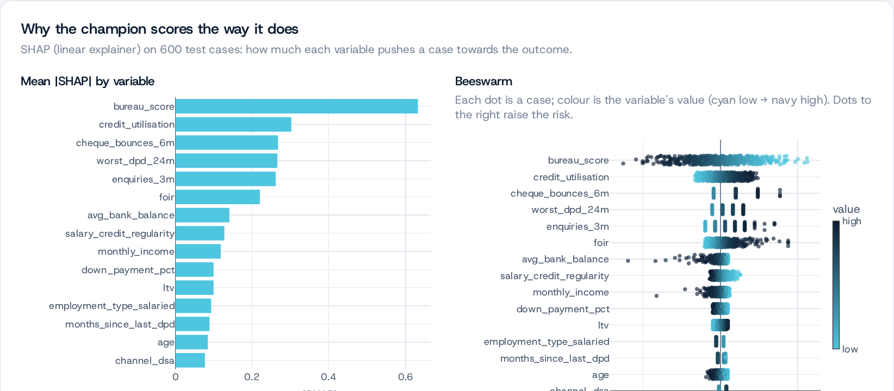
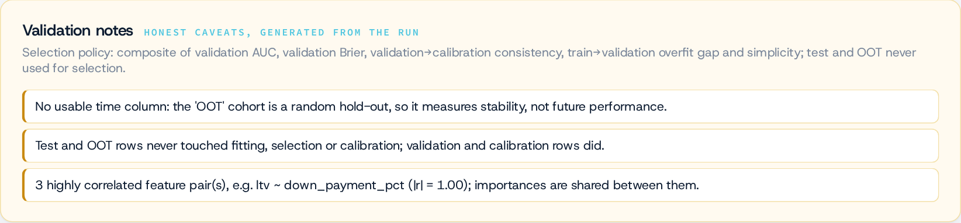
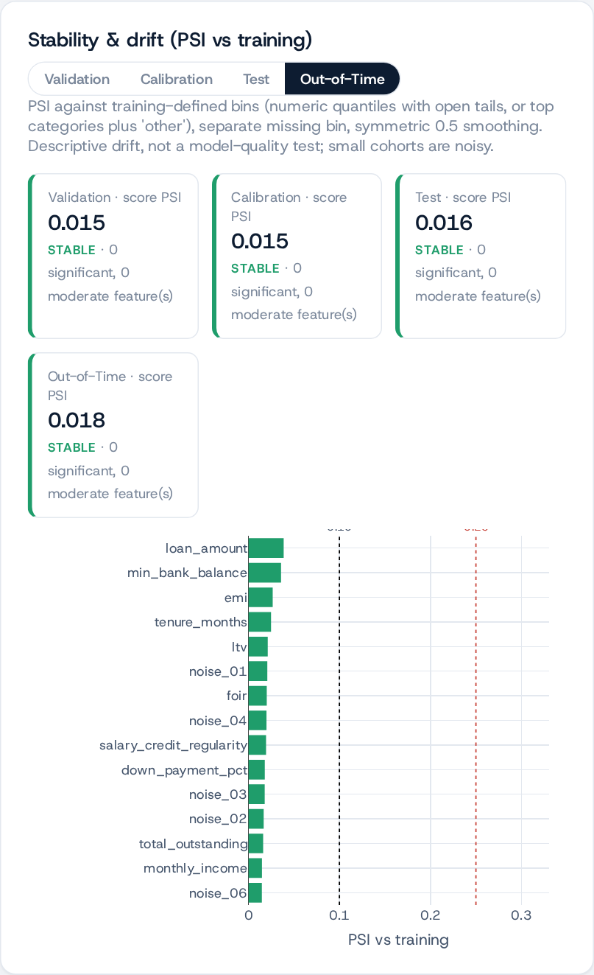
RESULTS
Every score is explainable and every run carries its own validation notes, diagnostics and drift check
Explainability and governance
Explain
Validate
Monitor
▪ SHAP drivers, beeswarm and dependence plots for the champion
▪ Per-record reason codes (adverse-action style) with a plain-English glossary
▪ Permutation importance where a model has no native importances
▪ AI-written narrative from aggregate metrics only
▪ Amber validation notes generated from the data
▪ Bootstrap AUC interval, duplicate-row and correlation checks
▪ WOE bin tables per variable; IV strength flags
▪ Calibration reliability before vs after
▪ PSI drift of score and every feature per cohort vs training
▪ Drift check on every batch scored later
▪ Rows without an outcome scored separately, never in a cohort
▪ HTML / PDF committee report; scored CSV downloads
Nu Score On the Go · Northern Arc / AltiFi · Internal
11

Slide 12
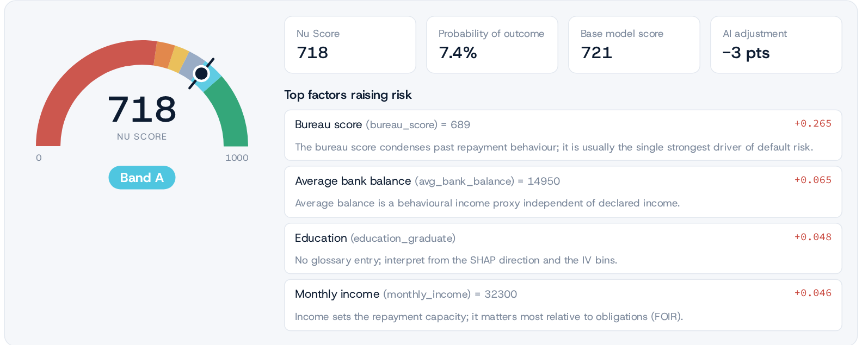
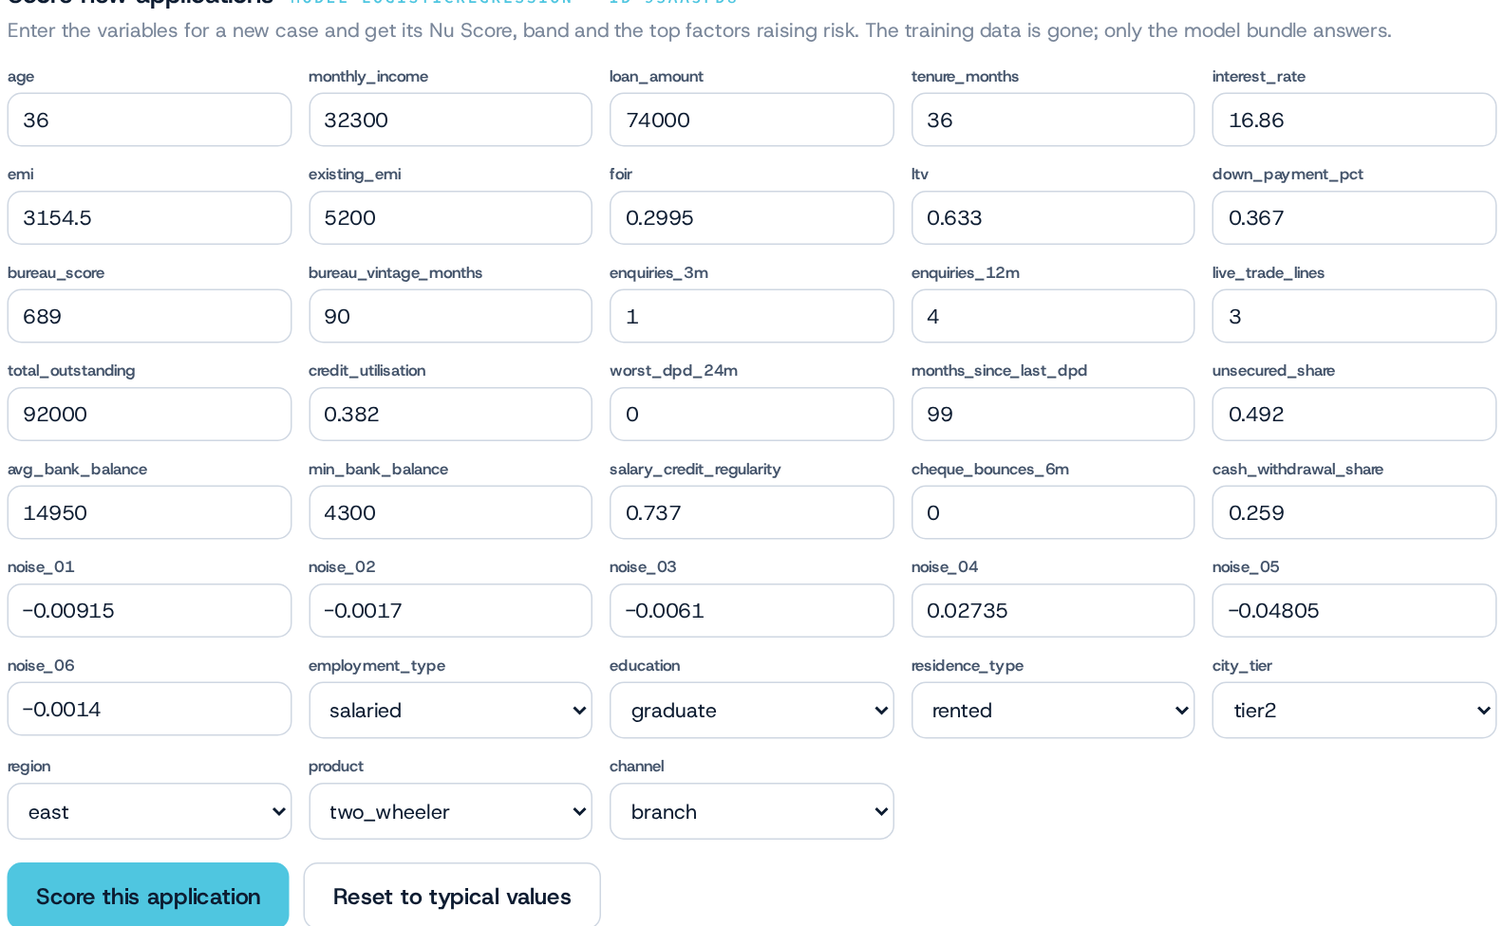
PRODUCT
The trained model scores the next application from a form or a batch file, with columns harmonised automatically
Scoring new applications
Single application form generated from the model's input schema; gauge, band, probability, base vs AI-adjusted score, reason codes
Batch file drop a CSV; exact → normalised → LLM column mapping shown with a method badge per column; values normalised (1,20,000 · 2.5 lakh · yes/no)
Drift score PSI and top drifting inputs versus the training population on every batch
Output scored CSV with nu_score, nu_band, probability, base_score and reasons 1–4
Where the model lives a persisted bundle per training job (preprocessing, champion, blend, calibrator, bands, SHAP background, drift profiles); the training data itself is deleted
Nu Score On the Go · Northern Arc / AltiFi · Internal
12

Slide 13
GOVERNANCE
Privacy by construction: nothing is stored, no PII is needed, and every model runs on Northern Arc hardware
Privacy, security and commercials
Privacy and security
Commercials and positioning
▪ Uploaded files are deleted the moment the training job succeeds; abandoned sessions expire in 24 h
▪ No PII required; PII-looking columns are detected by name and value pattern and dropped
▪ Only aggregate metrics and the model bundle remain; WOE tables anonymise category labels
▪ Local language models only (Ollama on-prem); they see column names and summary statistics, never rows
▪ Internal network only at the reverse proxy; hardened systemd service (memory and CPU fences, no new privileges, private tmp)
▪ GPUs and caches on the 3 TB data volume; nothing leaves the host
▪ Free during the introductory period
▪ Thereafter ₹10 per case scored — compute on Northern Arc servers included
▪ Model building, validation, reports and Nu Score bands included
▪ Positioned as 'democratising ML modelling': loan default, collections priority, churn, sales forecasting, inventory demand, fraud flags
▪ Internal adoption first; partner NBFCs and originators next
Data lifecycle
Upload
Convert
Train
Delete
Keep
chunked, resumable, internal network
Parquet on the data volume
GPUs; local LLM sees metadata only
session data removed on success
aggregate metrics + model bundle
Nu Score On the Go · Northern Arc / AltiFi · Internal
13

Slide 14
TECHNOLOGY
A single hardened service on existing infrastructure: FastAPI, DuckDB, PyTorch and local LLMs behind nginx
Architecture and operations
Browser
nginx
FastAPI service
Training workers
Single-page app · Plotly · no external CDNs
/nuscore_claudecode/ · internal CIDRs · 20 GB uploads
sessions · jobs · models · reports · uvicorn :8096
process pool · 16 threads/job · GPUs 2–3
Disk (/mnt)
DuckDB / Polars
Engine
Ollama (local LLM)
sessions (deleted after training) · job results · model bundles · logs
streaming CSV→Parquet · profiling · joins
scikit-learn · XGBoost · LightGBM · CatBoost · Optuna · PyTorch · SHAP
qwen2.5 · GPUs 0–1 · roles, mapping, narrative
Host 64 cores · 432 GB RAM · 4 × Tesla T4 · 3 TB data volume; two concurrent training jobs
Operations systemd unit nuscore-otg · smoke and end-to-end tests in deploy/ · engine invariants in tests/ · repository github.com/harshitrathi14/ml-on-the-go
Nu Score On the Go · Northern Arc / AltiFi · Internal
14

Slide 15
NEXT
Delivered in one sprint; the next steps deepen the science and widen the use cases
Roadmap
Live today
Next
▪ Chunked multi-file uploads, bureau JSON, identifier matching
▪ PII / leakage screening, IV & WOE, clean-up log
▪ Nine-family tuned zoo incl. FT-Transformer; stacked blend
▪ Five-cohort validation, selection-safe champion, warnings
▪ Nu Score bands, SHAP, reason codes, PSI drift, bootstrap CI
▪ Scoring form & batch with column harmonisation
▪ Reports, tests, hardened deployment
▪ Regression and multi-class outcomes (sales, demand, LGD)
▪ Aggregation windows for monthly bank / repayment rows
▪ Grouped validation for repeated borrowers; reject inference
▪ Monotonic constraints and scorecard export (points per bin)
▪ Monitoring dashboard: PSI over time, band migration, back-testing
▪ Sequence models on transaction histories; text embeddings for narrations
▪ Multi-user workspaces and audit trail when opened to partners
Phases shipped
0 · Go live
1 · Big data
2 · Engine
3 · Nu Score
4 · Governance
brand, jobs, nginx, systemd
chunked uploads, joins, screening
tuned zoo, blend, champion
calibration, bands, scoring
cohorts, drift, diagnostics, tests
Nu Score On the Go · Northern Arc / AltiFi · Internal
15

Slide 16
Build ML models with your data.
Upload a loan book today and score the next application in minutes — validated, explainable, on-prem.
http://10.91.16.86/nuscore_claudecode/
Usage guide: docs/NU_SCORE_USAGE_GUIDE.md · Free during introduction, then ₹10 per case
Nu Score On the Go · Northern Arc / AltiFi · Internal
16

