Slide 1

SQL & RDMS Concepts

Slide 2
Agenda
What is SQL?
What is RDBMS?
Structure
What is Table/ Relation?
Rows and Columns
Degree, Cardinality, Domain
SQL Commands
Commands and their functionality

Slide 3
What is SQL?
SQL stands for Structured Query Language.
SQL is a programming language that is used to manage relational databases and perform various operations on the data in them.
Provides a standard way to interact with data
SQL is extremely accessible across various platforms and generally user-friendly.

Slide 4
What is RDBMS?
RDBMS stands for Relational Database Management System.
RDBMS is a program used to maintain a relational database. RDBMS data is structured in database tables, fields and records. Tables might be related by common fields
RDBMS is the basis for all modern database systems such as MySQL, Microsoft SQL Server, Oracle, and Microsoft Access.
RDBMS uses SQL queries to access the data in the database.

Slide 5
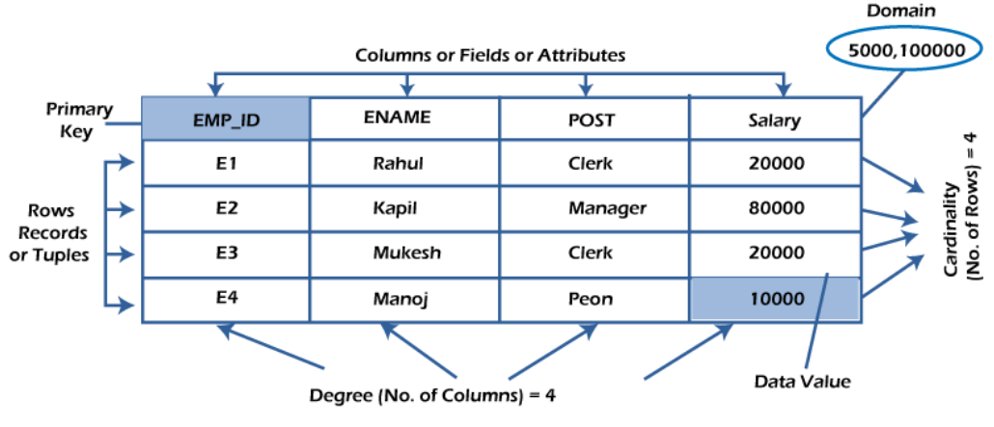
Structure
A relational database has following major components:
1. Table
2. Record or Tuple
3. Field or Column name or Attribute
4. Domain
5. Cardinality
6. Degree

Slide 6

What is table/Relation?
Everything in a relational database is stored in the form of relations. The RDBMS database uses tables to store data. A table is a collection of related data entries and contains rows and columns to store data.
Properties of a Relation:
Each relation has a unique name by which it is identified in the database.
Relation does not contain duplicate tuples.
The tuples of a relation have no specific order.
All attributes in a relation are atomic, i.e., each cell of a relation contains exactly one value.

Slide 7

Rows and Columns
Row:
A row of a table is also called a record or tuple. It contains the specific information of each entry in the table. It is a horizontal entity in the table.
Column/attribute:
A column is a vertical entity in the table which contains all information associated with a specific field in a table.
Properties of an Attribute:
Every attribute of a relation must have a name.
Null values are permitted for the attributes.
Default values can be specified for an attribute automatically inserted if no other value is specified for an attribute.
Attributes that uniquely identify each tuple of a relation are the primary key.

Slide 8
Degree, Cardinality, Domain
Degree:
The total number of attributes that comprise a relation is known as the degree of the table.
Cardinality:
The total number of tuples at any one time in a relation is known as the table's cardinality. The relation whose cardinality is 0 is called an empty table.
Domain:
The domain refers to the possible values each attribute can contain. It can be specified using standard data types such as integers, floating numbers, etc.

Slide 9
SQL Commands

Slide 10
Commands
The standard SQL commands to interact with relational databases are CREATE, SELECT, INSERT, UPDATE, DELETE and DROP.
These commands can be classified into groups based on their nature
DDL(Data Definition Language)
DQL(Data Query Language)
DML(Data Manipulation Language)
DCL(Data Control Language)
TCL(Transaction Control Language)

Slide 11
DDL:
DDL or Data Definition Language consists of the SQL commands that can be used to define the database schema. It simply deals with descriptions of the database schema and is used to create and modify the structure of database objects in database
Examples of DDL commands:
CREATE – is used to create the database or its objects (like table, index, function, views, store procedure and triggers).
DROP – is used to delete objects from the database.
ALTER-is used to alter the structure of the database.
TRUNCATE–is used to remove all records from a table, including all spaces allocated for the records are removed.
RENAME –is used to rename an object existing in the database.

Slide 12
DQL:
DQL statements are used for performing queries on the data within schema objects. The purpose of the DQL Command is to get some schema relation based on the query passed to it. We can define DQL as follows it is a component of SQL statement that allows getting data from the database and imposing order upon it. It includes the SELECT statement.
Examples of DQL:
SELECT – is used to retrieve data from the database.

Slide 13

DML:
The SQL commands that deals with the manipulation of data present in database belong to DML or Data Manipulation Language and this includes most of the SQL statements
Examples of DML:
INSERT – is used to insert data into a table.
UPDATE – is used to update existing data within a table.
DELETE – is used to delete records from a database table.
MERGE – is used to merge tables.

Slide 14

DCL:
DCL includes commands such as GRANT and REVOKE which mainly deals with the rights, permissions and other controls of the database system.
Examples of DCL commands:
GRANT-gives user’s access privileges to database.
REVOKE-withdraw user’s access privileges given by using the GRANT command.

Slide 15

TCL:
TCL commands deals with the transaction within the database.
Examples of TCL commands:
COMMIT– commits a Transaction.
ROLLBACK– rollbacks a transaction in case of any error occurs.
SAVEPOINT–sets a save point within a transaction.
SET TRANSACTION–specify characteristics for the transaction.

Slide 16


Slide 17
Agenda
Select Data
Data Manipulation/Modification
Keys in SQL
Filtering Data
Sorting Data
Aggregating Data
Joins
Aggregating Function

Slide 18

Select Data
Retrieve data from tables
Use SELECT statement
Specify columns to retrieve
Optionally apply WHERE clause for filtering
SELECT *
FROM Table_name;
SELECT Column_name1, Column_name3
FROM Table_name;
SELECT *
FROM Table_name
WHERE <search_condition>

Slide 19
Data Modification
INSERT: Add new data into tables
UPDATE: Modify existing data
DELETE: Remove data from tables
Maintain data integrity
INSERT INTO Table_name (Column_name1, Column_name2) VALUES ('Value1', 'Value2’);
UPDATE Table_name
SET Column_name1 = 'Value1' WHERE Column_name1 = 'Value2’;
DELETE FROM Table_name WHERE Column_name1 = 'Value1';
Photo by Pexels

Slide 20
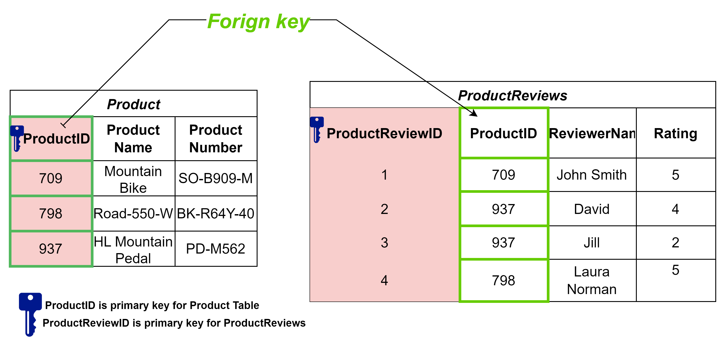
Keys in SQL
Primary Key: Unique identifier for each record
Foreign Key: Establish relationship between tables
Enforce referential integrity
Ensure data consistency

Slide 21

Filtering Data
Use LIKE or IN operator for pattern matching
WHERE clause: Conditionally retrieve data
Filter based on column values
Flexible and powerful filtering options
Select * from Product
where Productid IN ('709','937','798’)
Select * from ProductReviews
where Productid LIKE '%937%'

Slide 22
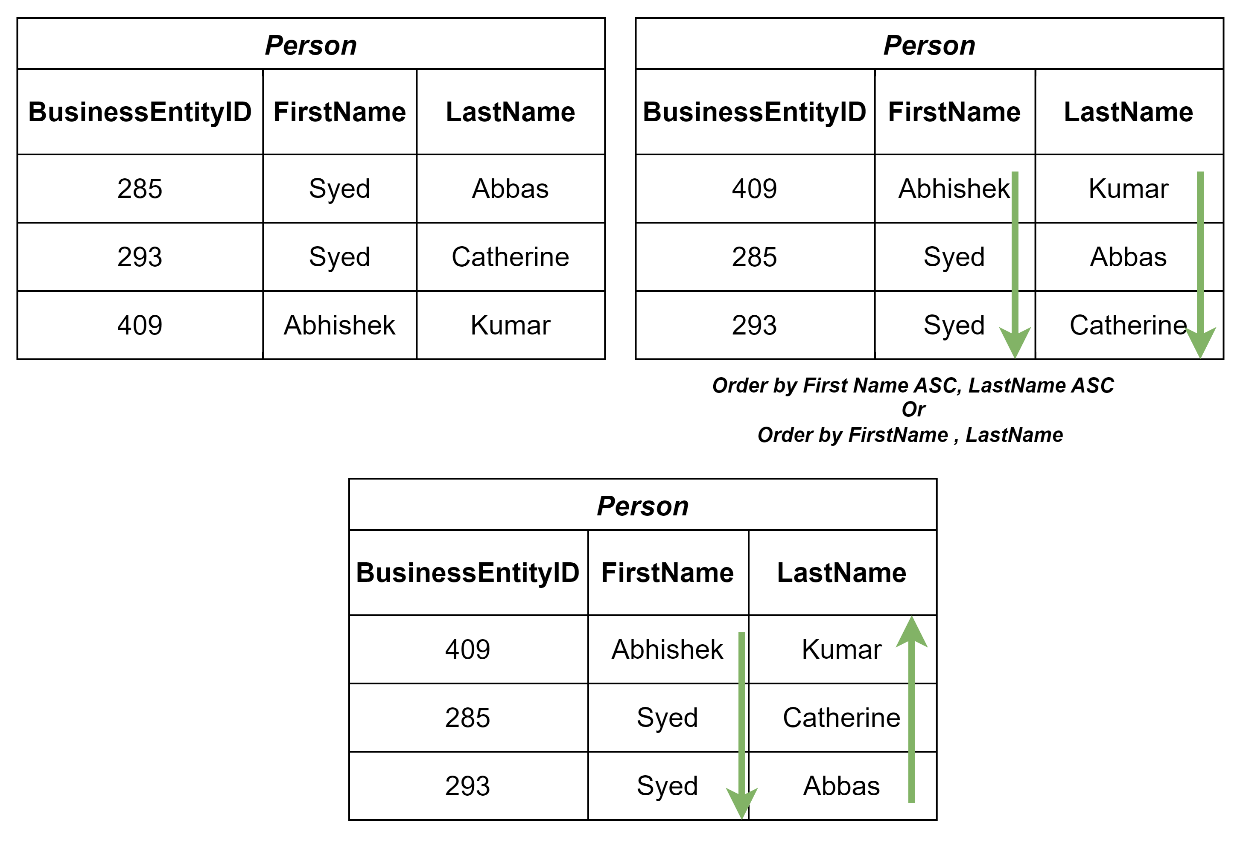
Sorting Data
Ascending or descending order
ORDER BY clause: Sort query results
Sort by one or multiple columns
Control the presentation of data
SELECT BusinessEntityID,
FirstName, LastName
FROM [Person].[Person]
order by FirstName DESC
Photo by Pexels

Slide 23

Aggregating Data
Filter query results based on aggregated values
GROUP BY Statement in SQL is used to arrange identical data into groups
All the column names mentioned after SELECT statement shall be repeated in GROUP BY, in order to successfully execute the query
HAVING clause is used to filter the rows from the groups based on the specified condition.
If you are using HAVING, GROUP BY is necessary
Photo by Pexels

Slide 24
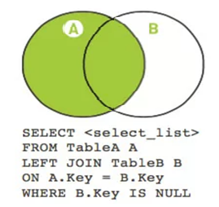
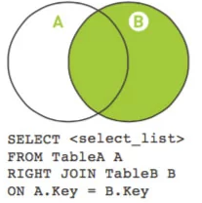
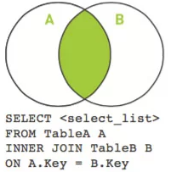
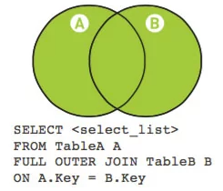
Joins
Joins combine data from multiple tables based on related columns
Type of Joins: Left Join, Right Join, Inner Join, Outer Join
Photo by Pexels

Slide 25
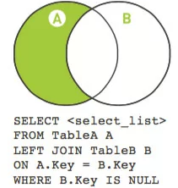
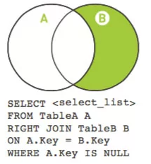
Joins
Scenario: You want to analyze the sales data by joining the Orders table with the Returns table while excluding the records of returned orders.
OrderID | ProductID | CustomerID | OrderDate | TotalAmount
1 | 101 | C101 | 2023-07-01 | 150
2 | 102 | C102 | 2023-07-02 | 200
3 | 103 | C103 | 2023-07-03 | 120
4 | 101 | C104 | 2023-07-04 | 180
5 | 104 | C105 | 2023-07-05 | 250
ReturnID | OrderID | ReturnDate | Reason
1 | 2 | 2023-07-03 | Defective
2 | 4 | 2023-07-06 | Wrong Item
Returns Table (B)
Orders Table (A)
OrderID | ProductID | CustomerID | OrderDate | TotalAmount | ReturnID | ReturnDate | Reason
1 | 101 | C101 | 2023-07-01 | 150 | NULL | NULL | NULL
3 | 103 | C103 | 2023-07-03 | 120 | NULL | NULL | NULL
5 | 104 | C105 | 2023-07-05 | 250 | NULL | NULL | NULL
2 | 102 | C102 | 2023-07-02 | 200 | 1 | 2023-07-03 | Defective
4 | 101 | C104 | 2023-07-04 | 180 | 2 | 2023-07-06 | Wrong Item
Photo by Pexels
Result Set

Slide 26
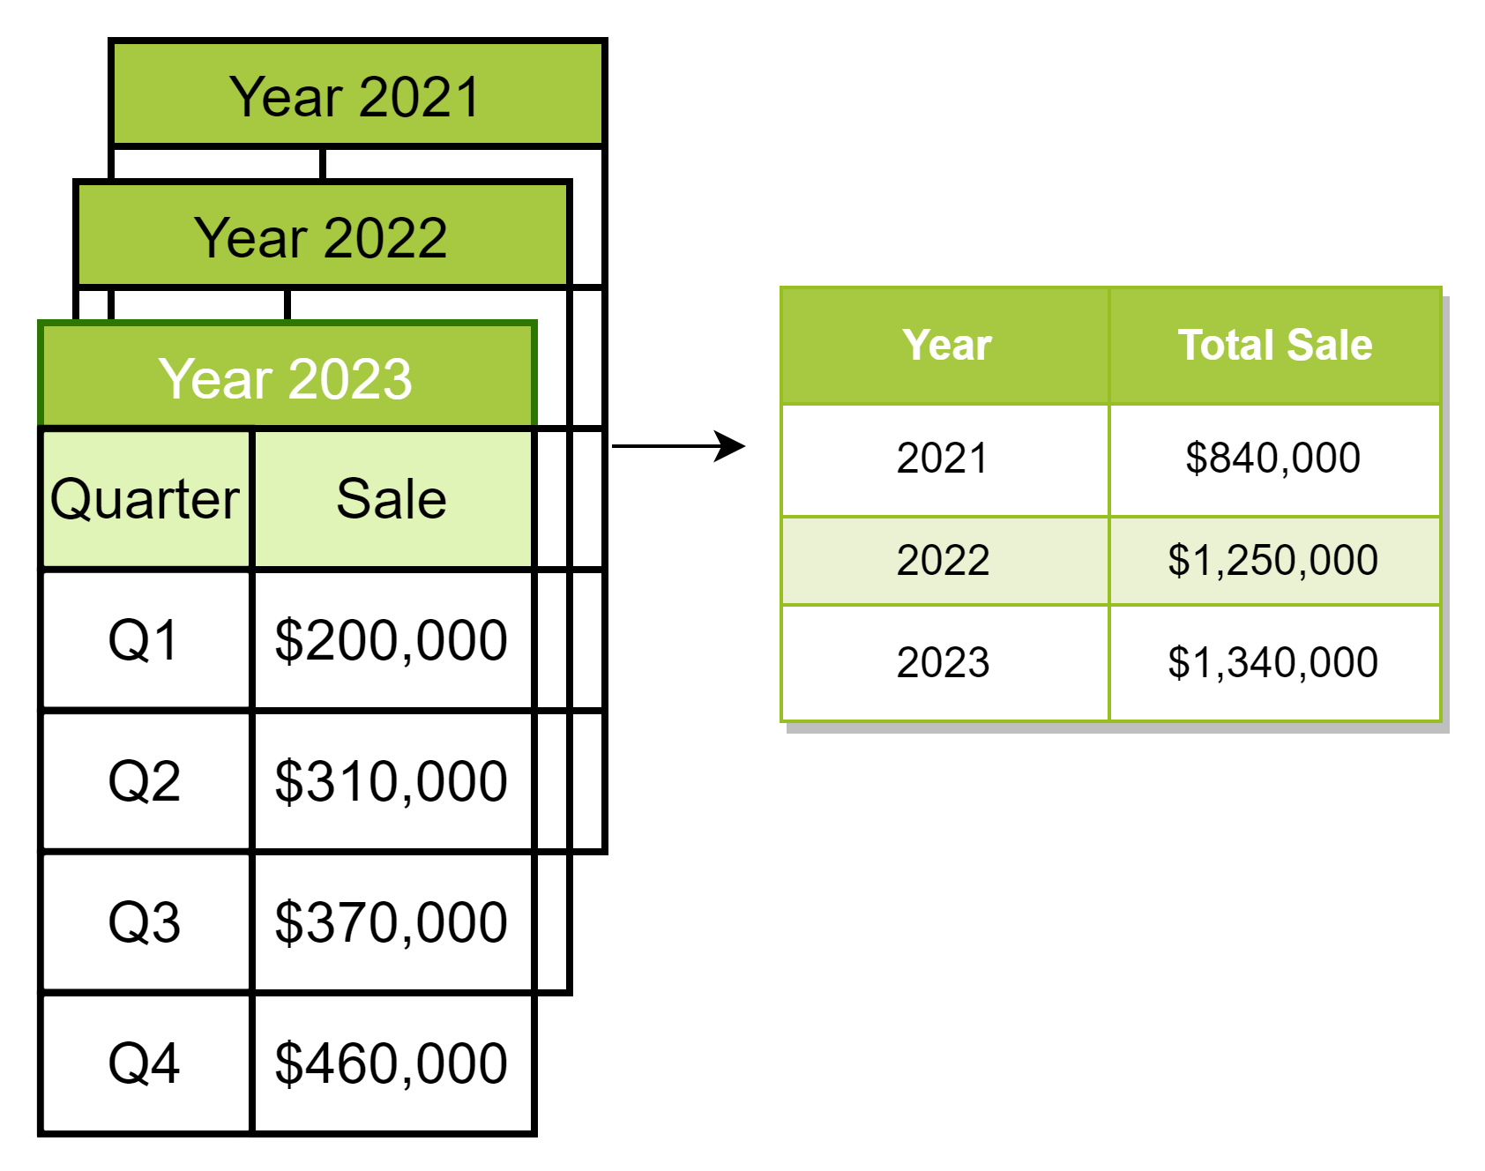
Aggregating Function
Summarizing and analyzing large datasets
Aggregate functions: Perform calculations on grouped data
Identify patterns and trends
Aggregate Functions : Count(), Sum(), Avg(), Min(), Max()
WHERE keyword cannot be used with aggregate functions.
SELECT
Year(ModifiedDate) As [Year],
count (SalesOrderID) as Total_Order,
Sum(LineTotal) as Total_Sales
FROM [Sales].[SalesOrderDetail]
Group by Year(ModifiedDate)
Order by Year(ModifiedDate)

Slide 27
Union
Combines two or more SELECT statements.
Number of column, order of column must be same for table1 and table2
Union - only returns a unique record
Union All - returns all the records (including duplicates)
SELECT * FROM table1
UNION
SELECT * FROM table2;
SELECT * FROM table1
UNION All
SELECT * FROM table2;

Slide 28
Intermediate SQL

Slide 29
Subqueries
Subqueries are queries nested within other queries.
Also known as Inner Query/Nested Query
Inner Query is a subquery that returns a single value and is used within the WHERE clause.
Example: Find customers who made orders on the same day as their first order.
SELECT FirstName, LastName
FROM Person.Person
WHERE BusinessEntityID IN (
SELECT CustomerID
FROM Sales.SalesOrderHeader
WHERE OrderDate = (
SELECT MIN(OrderDate)
FROM Sales.SalesOrderHeader
WHERE CustomerID = Person.Person.BusinessEntityID
)
);

Slide 30
Conditional Logic with CASE Statements
CASE statement is used for conditional logic.
It helps transform data based on specified conditions.
Example: Categorize products based on their stock quantity.
SELECT [ProductID],
[Quantity],
CASE
WHEN [Quantity] > 200 THEN 'High Stock'
WHEN [Quantity] > 100 THEN 'Moderate Stock'
ELSE 'Low Stock'
END AS stock_category
FROM [Production].[ProductInventory];

Slide 31
String Handling Functions
REPLACE: Replace occurrences of a substring in a string.
REPLACE (string_expression, string_pattern, string_replacement )
SUBSTRING: Extract a portion of a string.
SUBSTRING ( expression, start, length )
CHARINDEX: Find the position of a substring in a string.
CHARINDEX ( expressionToFind , expression [ , start_location ] )
COALESCE: Return the first non-null value in a list
Example : SELECT COALESCE(NULL, NULL, 'third_value', 'fourth_value’);
returns the third value because the third value is the first value that isn't null.

Slide 32
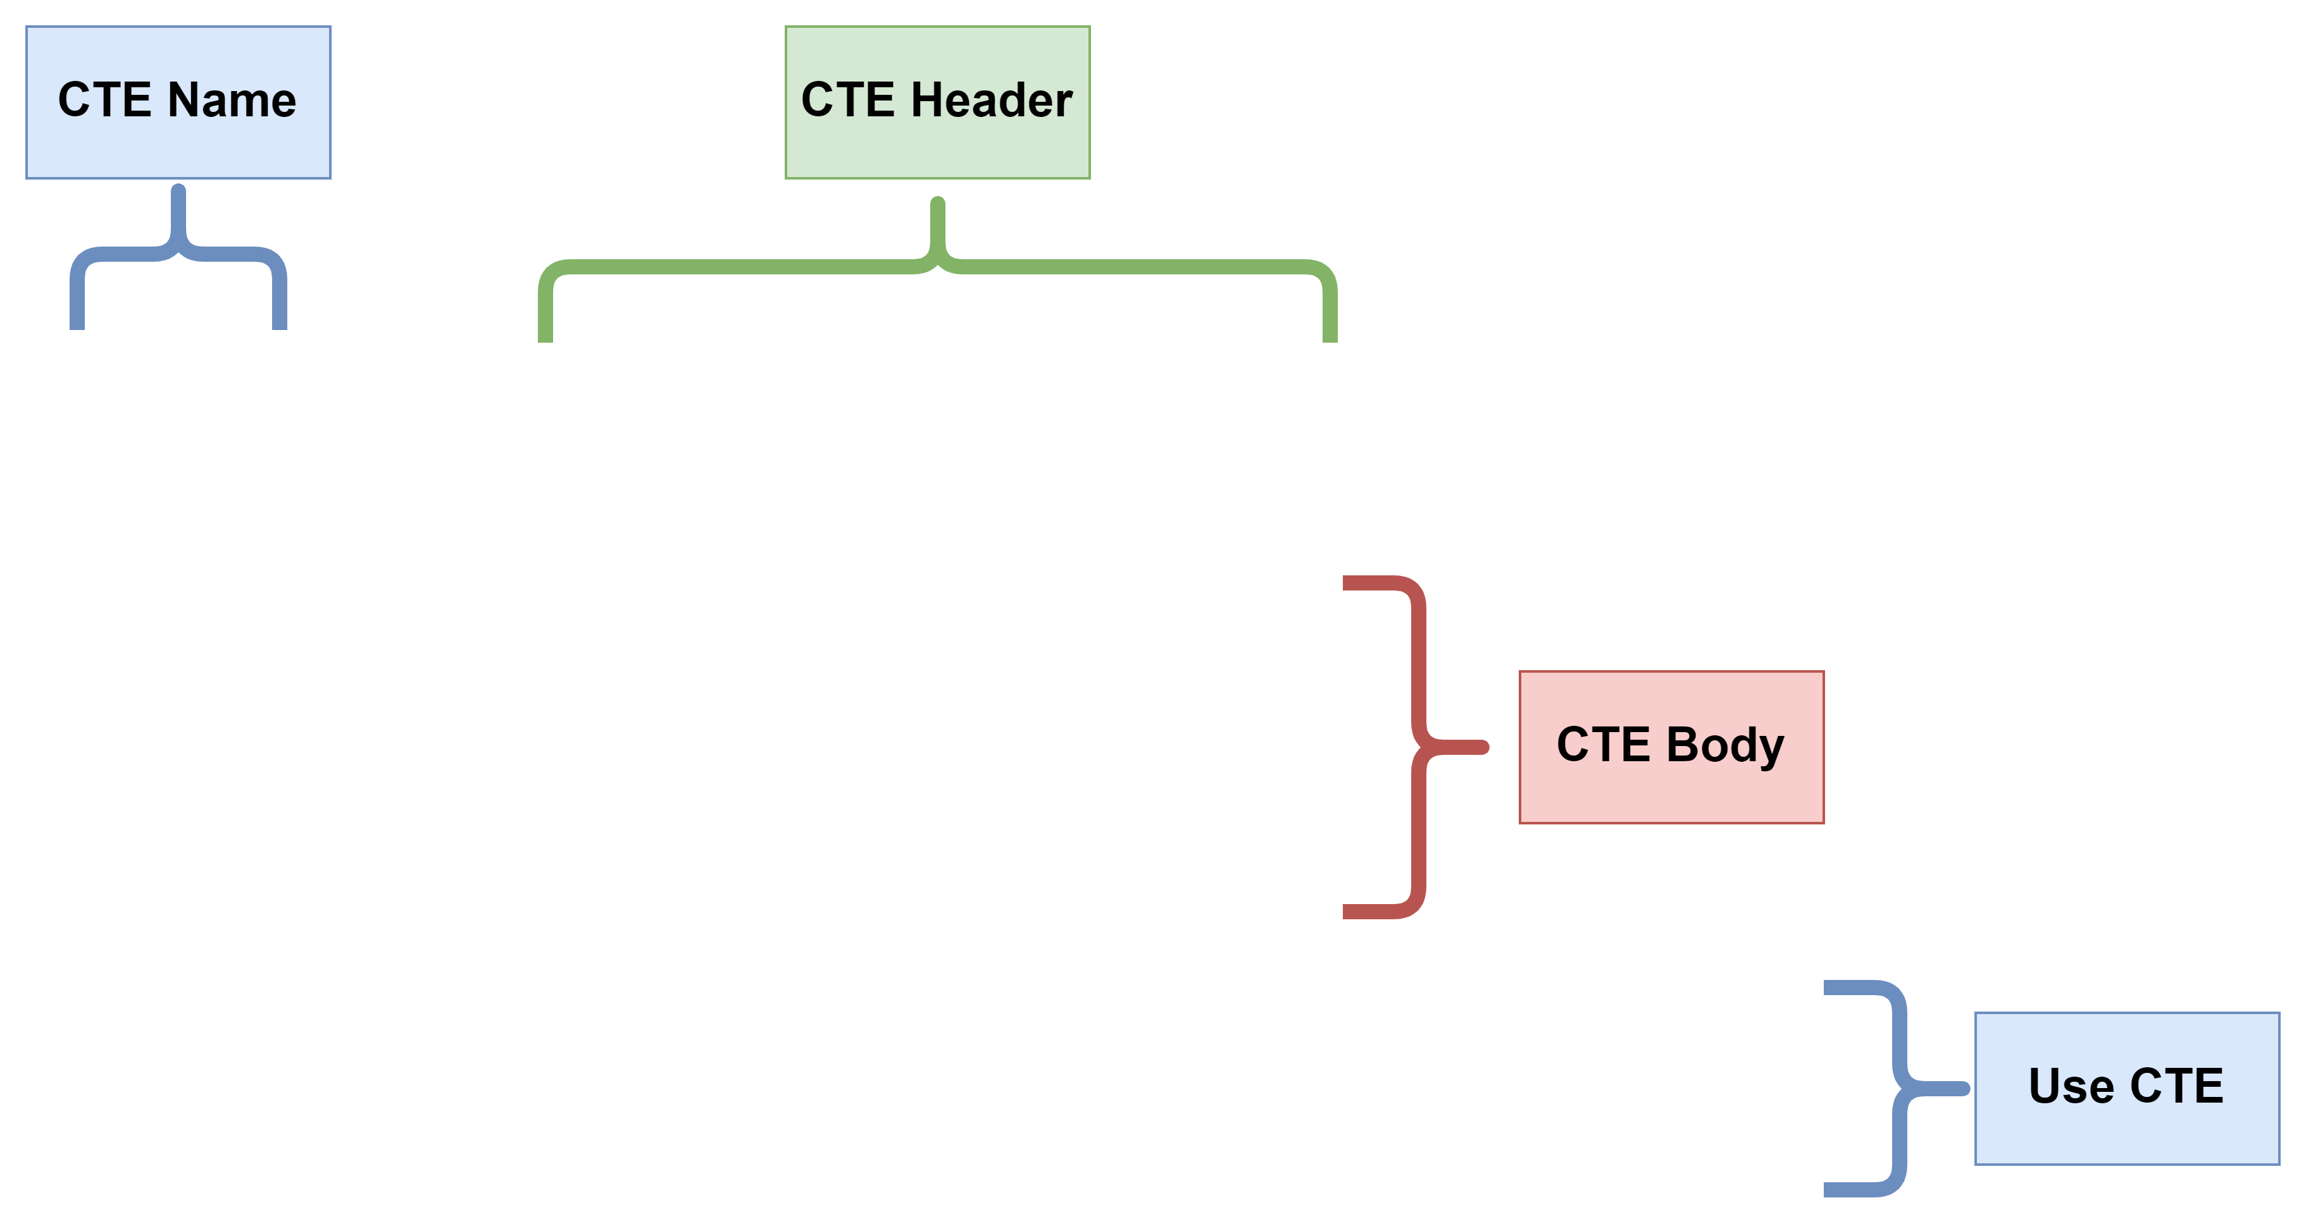
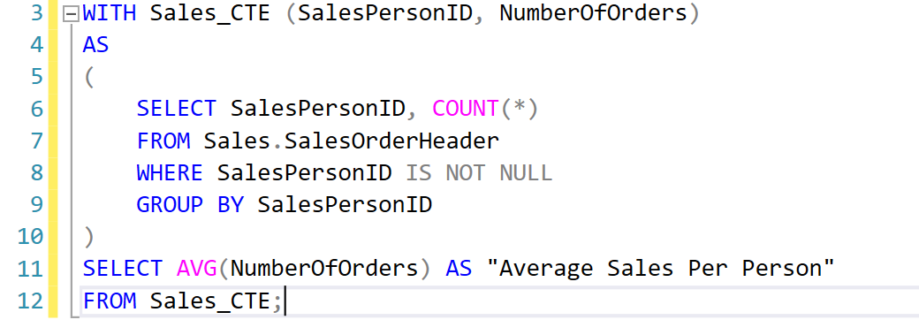
Common Table Expressions (CTE)
CTE is a temporary result set that simplifies complex queries.
It is defined within the query and can be referenced multiple times.

Slide 33
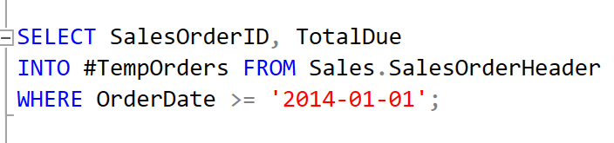
Temporary Tables
Temporary tables are used to store intermediate results during a session.
They are automatically dropped when the session ends.
To create Local Temporary Table Single “#” is used as the prefix of a table name.
Temp table

Slide 34
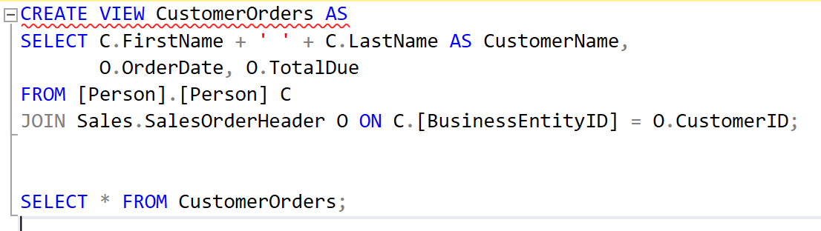
Views
Views are virtual tables based on the result of a query.
They simplify complex queries and provide a logical data abstraction.
Views provide a layer of abstraction by allowing users to access data without directly interacting with the underlying tables.
Create a View
Select data from View CustomerOrders

