Slide 1
INNOTECH’26 • SOFTWARE CATEGORY
ModelMind
M
A machine learning workspace
with a built-in error assistant
Notebook • Visual learning labs • Local-first AI help
ModelMind
LEARN • BUILD • DEBUG
InnoTech 2026 | Project presentation

Slide 2
MODEL MIND × INNOTECH 2026
The machine learning workflow is fragmented
ModelMind brings learning, notebooks, visual explanations and debugging into one workspace.
What slows learners down
One workspace for the full loop
Switching between lessons, notebooks and tools
Errors often show what failed, not how to fix it
Model behavior can be hard to see from code alone
Getting help can mean sending code outside your machine
Learn with guided roadmaps
Experiment in a Jupyter notebook
Explore interactive algorithm visualizations
Diagnose and review fixes with the AI Error Assistant
ModelMind • InnoTech’26 • Prototype overview
2

Slide 3
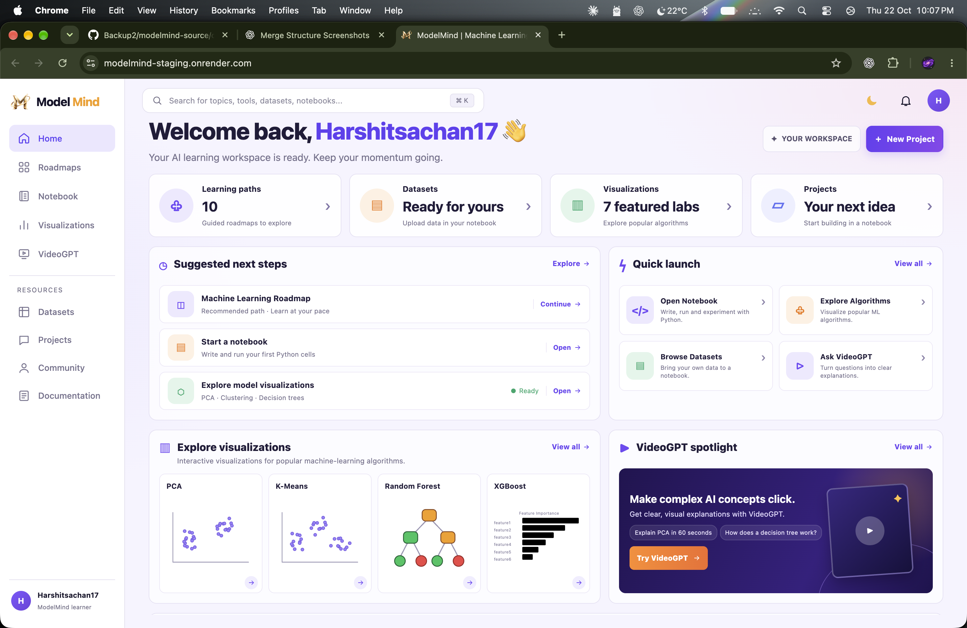
MODEL MIND × INNOTECH 2026
A deployed workspace with clear entry points
The web dashboard connects learning paths, notebook work and visualization labs.
ModelMind • InnoTech’26 • Prototype overview
3

Slide 4
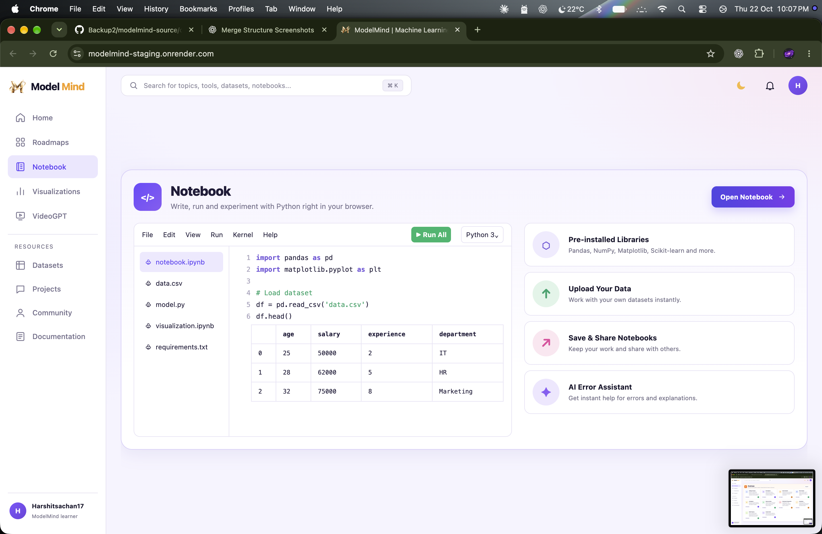
MODEL MIND × INNOTECH 2026
From notebook cell to a better explanation
The assistant starts with deterministic diagnostics and uses local Ollama when a deeper explanation is needed.
Error Assistant flow
1 Detect common Python / ML error patterns
2 Ask local Ollama for complex explanations
3 Validate a proposed change in a sandbox
4 Review the complete suggestion before Apply
Gemini fallback is optional and consent gated
ModelMind • InnoTech’26 • Prototype overview
4

Slide 5
MODEL MIND × INNOTECH 2026
What is distinct about ModelMind
The differentiator is the way notebook help is integrated and controlled.
CAPABILITY
COMMON WORKFLOW
MODELMIND
WHY IT HELPS
AI error support
General-purpose chat or IDE help
ML-focused error assistant
Relevant notebook context
Local model option
Cloud service often required
Ollama runs on the user’s machine
Keep local-model requests local
Fix handling
Suggested edits can be hard to trust
Sandbox validation before Apply
Review before changing a cell
Learning support
Notebook separated from lessons
Roadmaps + notebook + visual labs
Learn and experiment together
Credentials
Keys can end up in code/config
OS credential storage supported
Keep keys out of notebooks
Feature comparison is based on the supplied novelty analysis; competitor coverage may vary by version and configuration.
ModelMind • InnoTech’26 • Prototype overview
5

Slide 6
MODEL MIND × INNOTECH 2026
How people access the product
The hosted workspace and local notebook companion work together; Python execution stays on the user’s computer.
Start from the project download
What runs where
Download the repo, then open its folder in Terminal:
Hosted: modelmind-staging.onrender.com
On your device: JupyterLab, Python and notebook files
Optional local AI: install Ollama, then approve the model download
macOS/Linux: scripts/install-ollama.sh
Windows: scripts/install-ollama.ps1
git clone https://github.com/harshitsachan830-dev/ModelMind-Notebook.git
cd ModelMind-Notebook
./scripts/start-platform.sh
Windows PowerShell (from project folder)
.\scripts\start-platform.ps1
Ollama model download is explicit—not automatic.
Hosted workspace: modelmind-staging.onrender.com
ModelMind • InnoTech’26 • Prototype overview
6

Slide 7
MODEL MIND × INNOTECH 2026
Presentation mapped to InnoTech judging
The deck gives judges direct evidence for each 50-mark category.
JUDGING PARAMETER
EVIDENCE IN THIS PRESENTATION
MARKS
Project showcasing
Product screens • workflow • access steps
10
Innovation & novelty
Rules-first diagnostics • local AI • sandbox check
10
Relevance & application
ML learners and practitioners • notebook workflow
10
Usability & scalability
Hosted dashboard • local companion • modular features
10
Query addressing
Demo-ready architecture and implementation details
10
Live demo: open a notebook → trigger an error → inspect the explanation → review the suggested fix.
ModelMind • InnoTech’26 • Prototype overview
7

Slide 8
MODEL MIND × INNOTECH 2026
Built now—and what comes next
The prototype is available as a product experience, with clear boundaries around local AI and future features.
Available in the prototype
Future scope
Hosted ModelMind dashboard
Learning roadmaps and ML visualizations
Jupyter notebook workflow
ML Error Assistant with local Ollama path
Downloadable project + startup scripts
VideoGPT learning companion
Packaged one-click desktop installers
Wider OS release validation
Additional interactive model visualizations
More guided model-advisor workflows
VideoGPT is planned; it is not claimed as live here.
ModelMind • InnoTech’26 • Prototype overview
8

