Slide 1
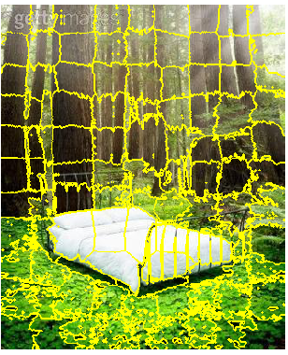
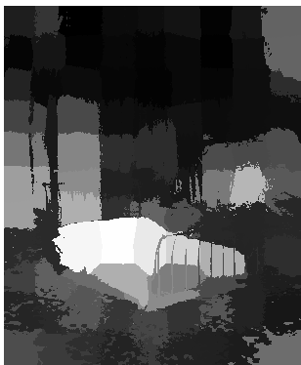

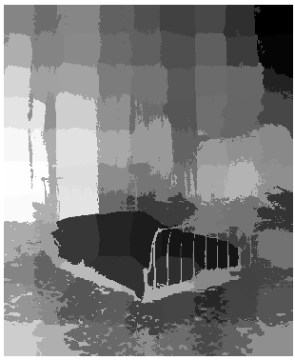
RESULTS-1
SLIC SUPERPIXELS
UNIQUENESS
DISTRIBUTION
FINAL
SALIENCY

Slide 2
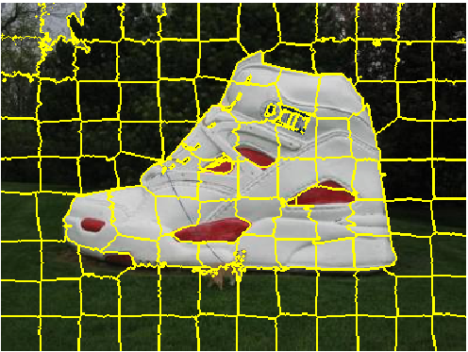
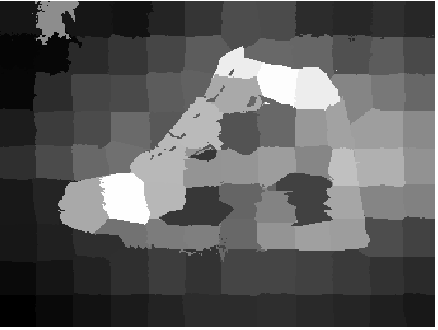
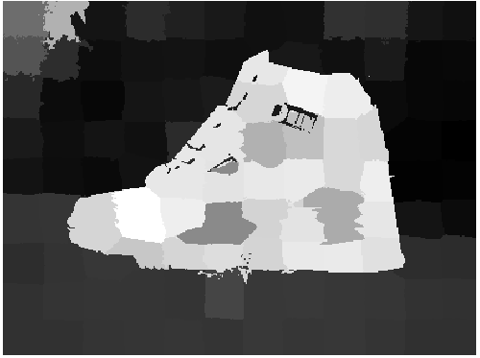
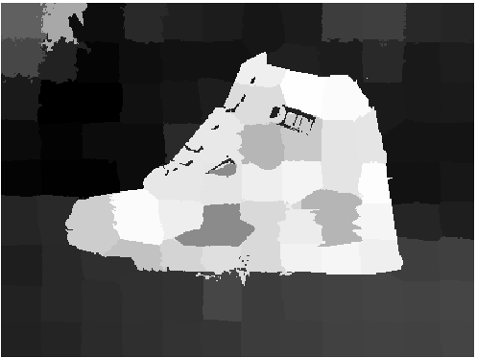
RESULTS-2
SLIC SUPERPIXELS
UNIQUENESS
DISTRIBUTION
FINAL
SALIENCY

Slide 3
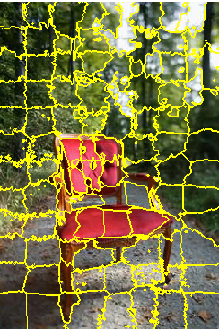
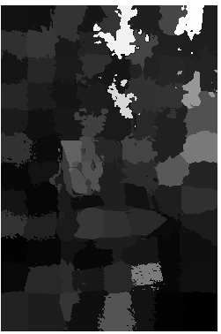
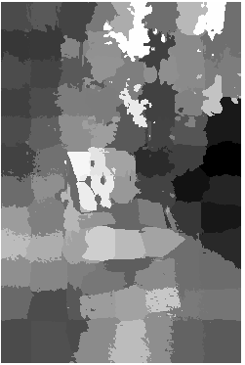
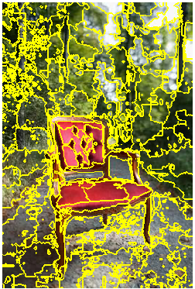


SLIC VS GMM: 1. DISTINCTION FROM BACKGROUND
SLIC SUPERPIXELS
UNIQUENESS
FINAL SALIENCY
GMM SUPERPIXELS
UNIQUENESS
FINAL SALIENCY

Slide 4
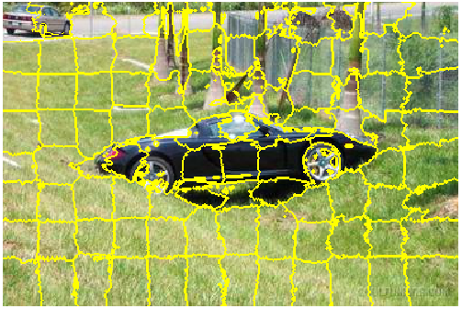
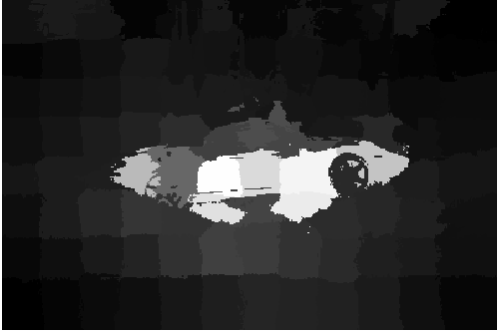
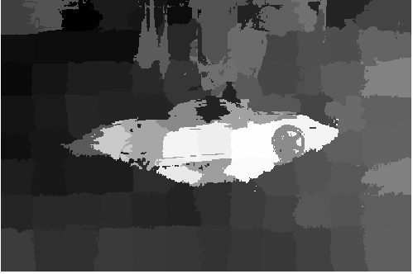
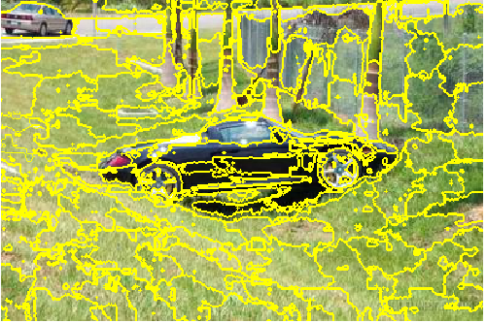
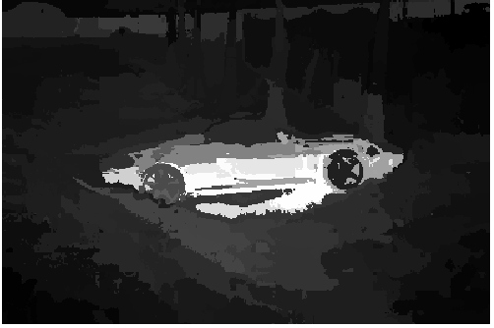
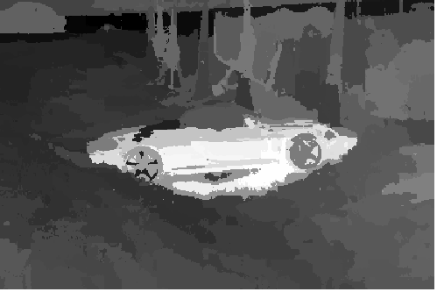
SLIC VS GMM: 2. INTERNAL STRUCTURE
SLIC SUPERPIXELS
UNIQUENESS
FINAL SALIENCY
GMM SUPERPIXELS
UNIQUENESS
FINAL SALIENCY

Slide 5
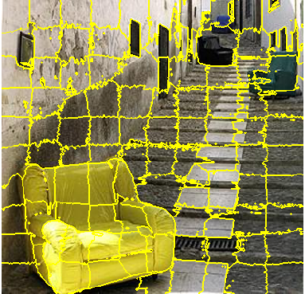


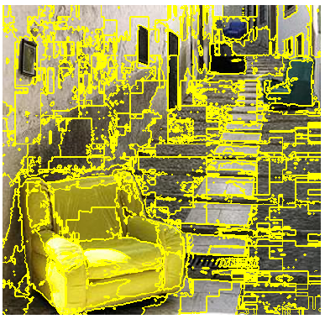
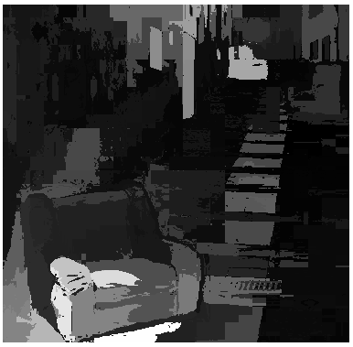
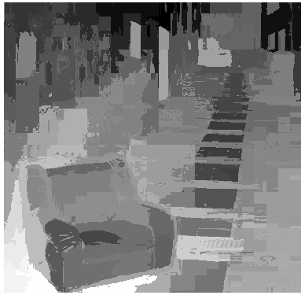
SLIC VS GMM: 3. DISTANT OBJECTS
SLIC SUPERPIXELS
FINAL SALIENCY
UNIQUENESS
GMM SUPERPIXELS
UNIQUENESS
FINAL SALIENCY

Slide 6
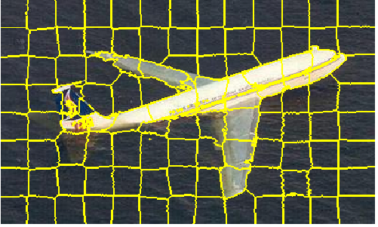

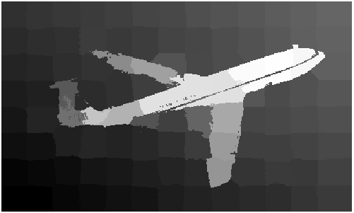



SLIC VS GMM: 4. SHARPNESS ALONG EDGES
SLIC SUPERPIXELS
UNIQUENESS
FINAL SALIENCY
GMM SUPERPIXELS
UNIQUENESS
FINAL SALIENCY

Slide 7

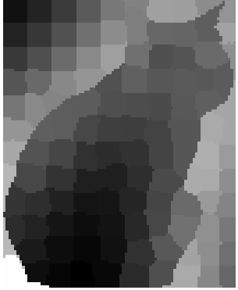




WHY TWO SALIENT MEASUREMENTS

Slide 8

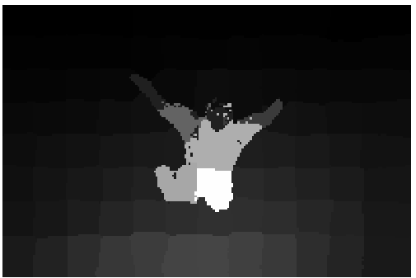






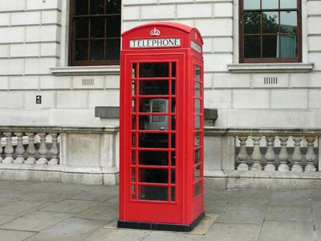
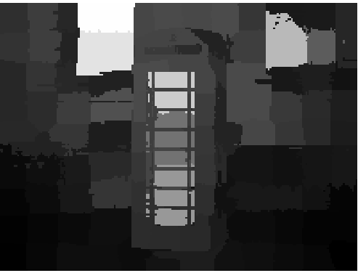


ALL STEPS IN SALIENCY CALCULATION

Slide 9

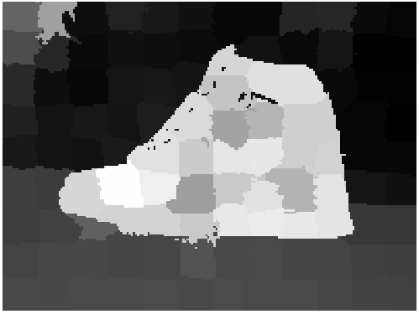
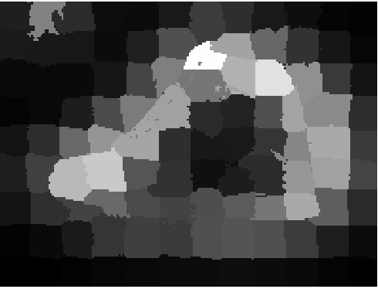

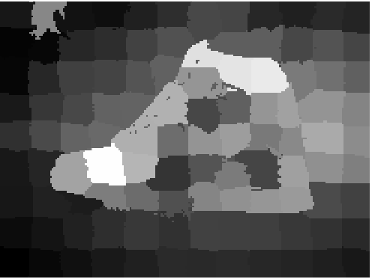
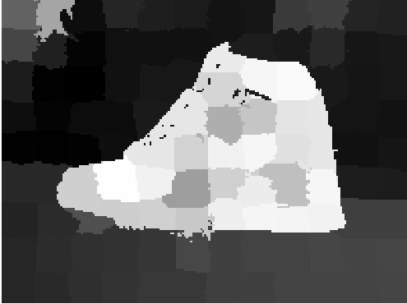
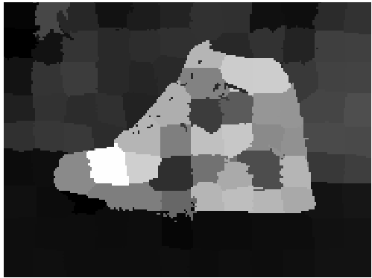

RANGE OF UNIQUENESS

