Slide 1
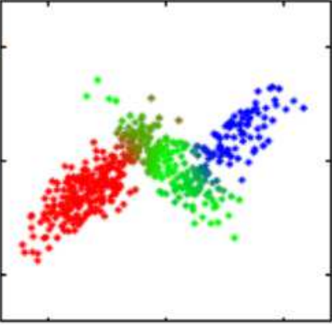
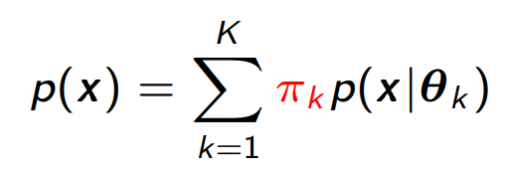
K - MEANS LIMITATIONS
1.Point totally belongs to cluster or not, hard labelling.
2. Fails when clusters are unequal size.
3. Overlapping clusters.
GAUSSIAN MIXTURE MODELS
1. Works on overlapping, unequal size data.
2. Feature vectors experimented on RGB, RGBXY and LABXY space.

Slide 2
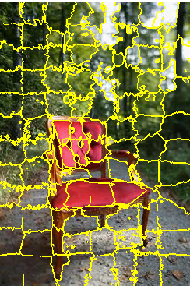
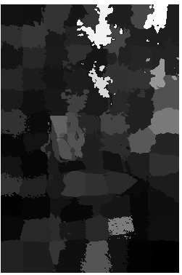
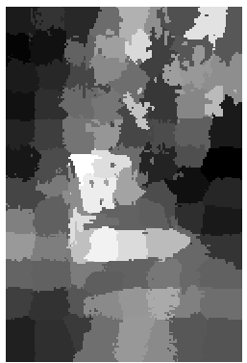
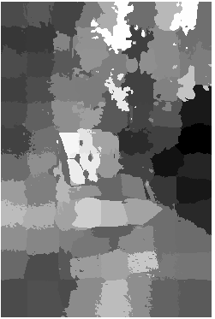
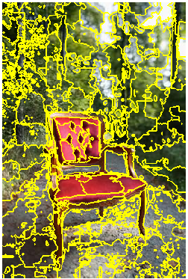
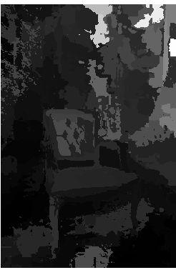
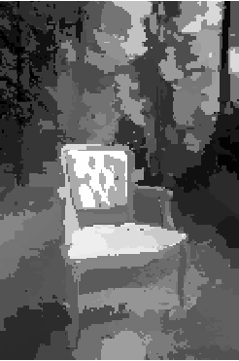
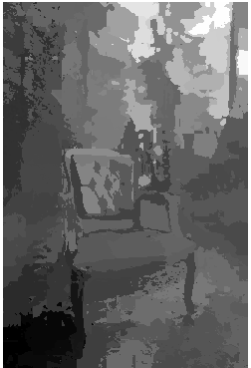
SLIC VS GMM: 1. DISTINCTION FROM BACKGROUND
SLIC SUPERPIXELS
DISTRIBUTION
FINAL SALIENCY
UNIQUENESS
GMM SUPERPIXELS
DISTRIBUTION
FINAL SALIENCY
UNIQUENESS

Slide 3
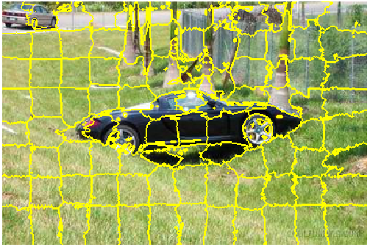
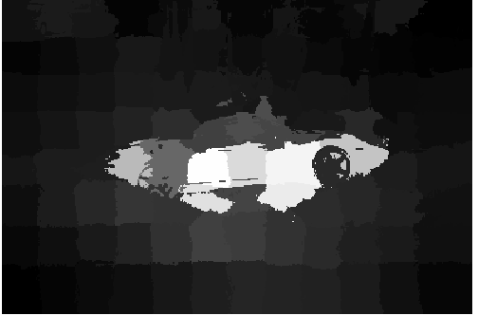
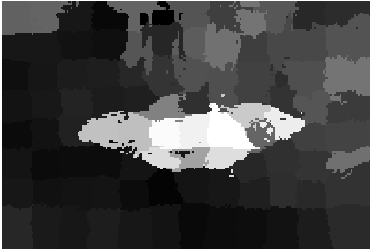
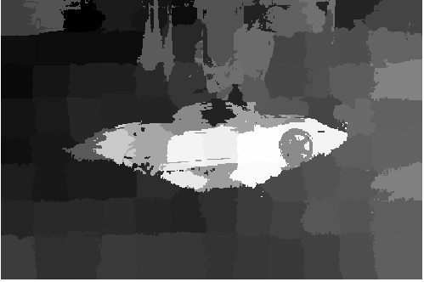
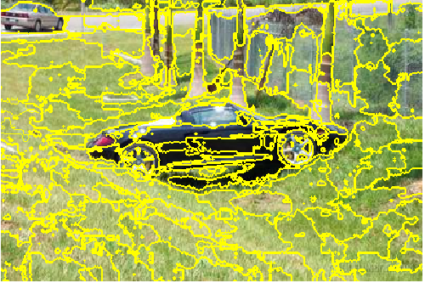
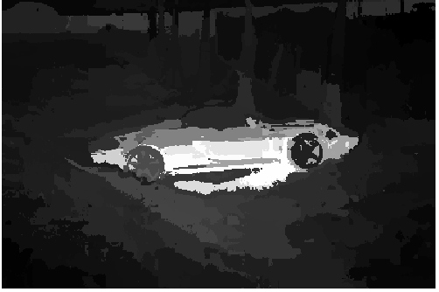
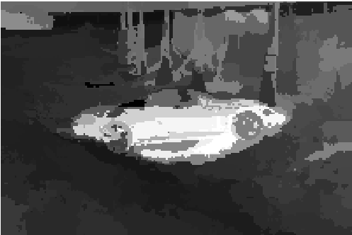
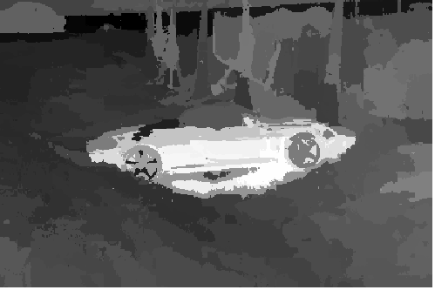
SLIC VS GMM: 2. INTERNAL STRUCTURE
SLIC SUPERPIXELS
UNIQUENESS
DISTRIBUTION
FINAL SALIENCY
GMM SUPERPIXELS
UNIQUENESS
DISTRIBUTION
FINAL SALIENCY

Slide 4
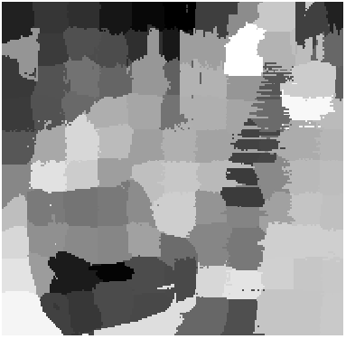

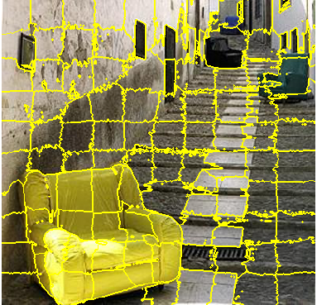
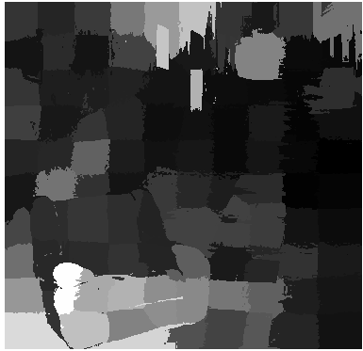
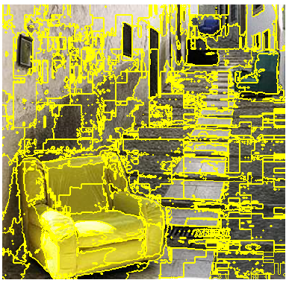
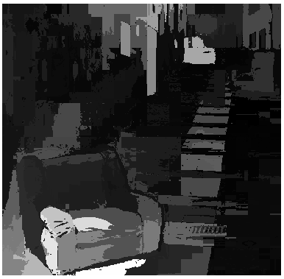
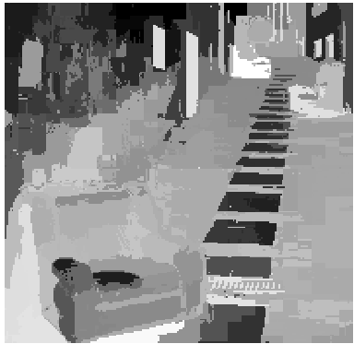
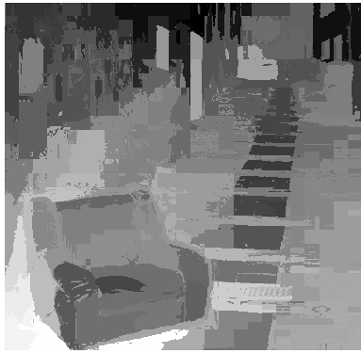
SLIC VS GMM: 3. DISTANT OBJECTS
SLIC SUPERPIXELS
UNIQUENESS
DISTRIBUTION
FINAL SALIENCY
GMM SUPERPIXELS
UNIQUENESS
DISTRIBUTION
FINAL SALIENCY

Slide 5
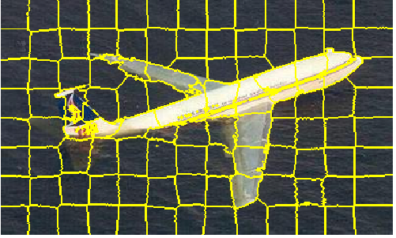


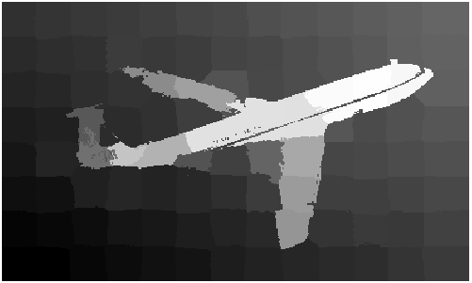
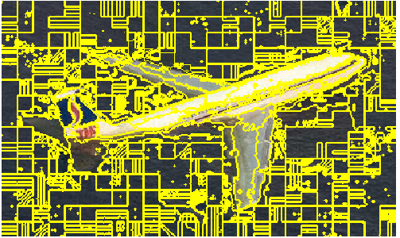
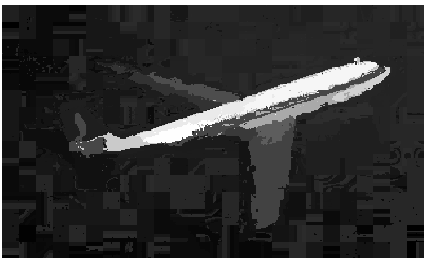
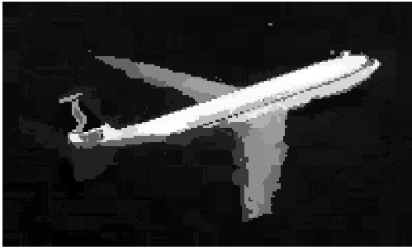

SLIC VS GMM: 4. SHARPNESS ALONG EDGES
SLIC SUPERPIXELS
UNIQUENESS
FINAL SALIENCY
DISTRIBUTION
GMM SUPERPIXELS
UNIQUENESS
DISTRIBUTION
FINAL SALIENCY

Slide 6
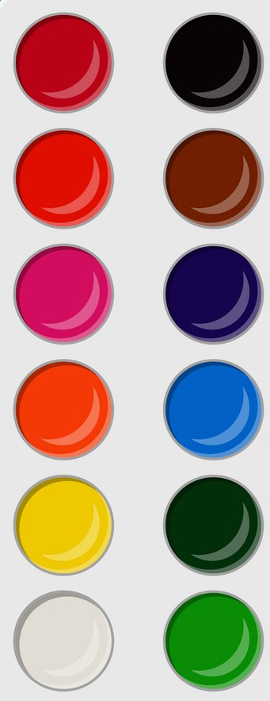
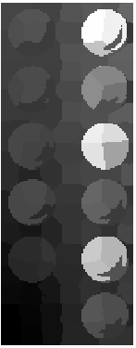
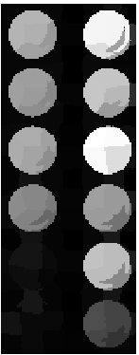
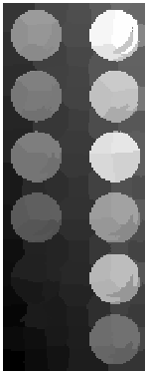
LIMITATION BASED ON CONTRAST
IMAGE
UNIQUENESS
DISTRIBUTION
SALIENCY
1. Color similar to background have low uniqueness, due to low rarity factor.
2. Distribution is able to recover most of the colors lost in uniqueness, due to compactness of region.

