Slide 1
Game Prediction : Cricket
Ajinkya Rode Harshit Shah
Computer Science Rochester Institute of Technology

Slide 2

Agenda
Introduction
Dataset
Classification
Application
Challenges
Future Work

Slide 3
Introduction
What is cricket?
Why we chose this game?
Rules
Teams

Slide 4
Dataset
Type of data : Numeric, Nominal
Teams : 7 datasets for each team
Instances : Average 30 per dataset

Slide 5
Classification
Tools used : Weka
Algorithm used : J48
Decision Tree for each team

Slide 6
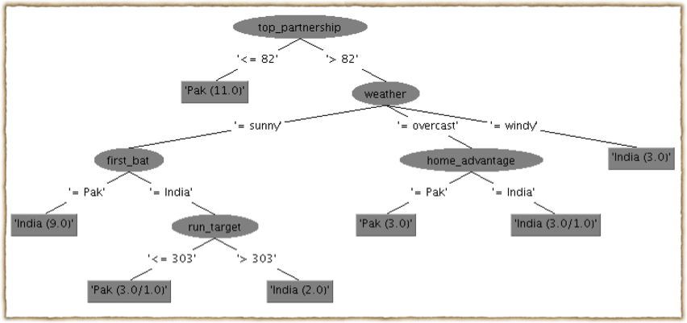
India vs Pakistan
Decision Tree using J48 algorithm in Weka

Slide 7
Analysis
Results : If a top partnership for India is less than or equal to 82 than Pakistan may win. Otherwise, depending on weather, if Indian team score more than 303 runs, then only India can win.

Slide 8
Results
Accuracy: 94.1176%
ICC world cup 2011; a second semi nal match between Ind-Pak resulted in India's win.
The highest partnership was 68, so very close to 82 but our prediction is not valid for this case.
But if we see other half and depending on weather conditions and home advantage india should win.So half of our prediction is valid.
Overall, we say average prediction but fails in the case of target run by 33

Slide 9
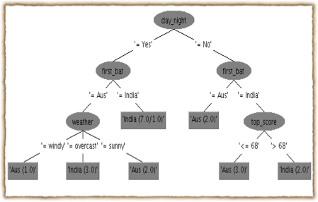
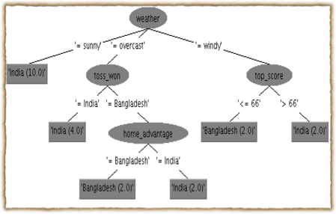
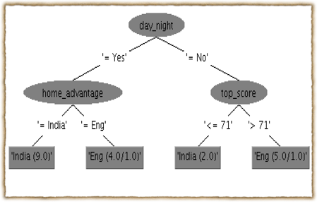
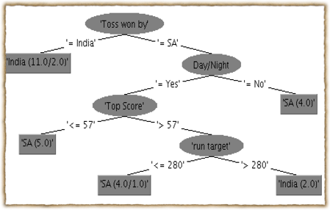
India vs Australia
India vs Bangladesh
India vs England
India vs South Africa

Slide 10
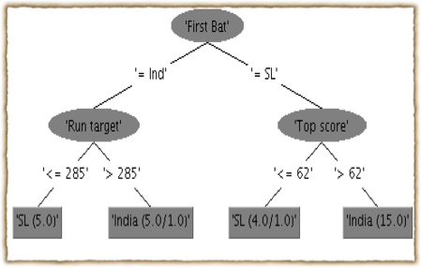
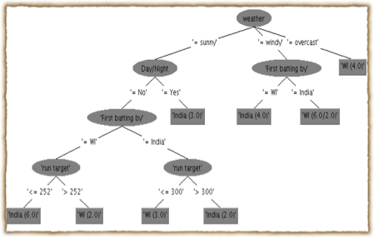
India vs Sri Lanka
India vs West Indies

Slide 11
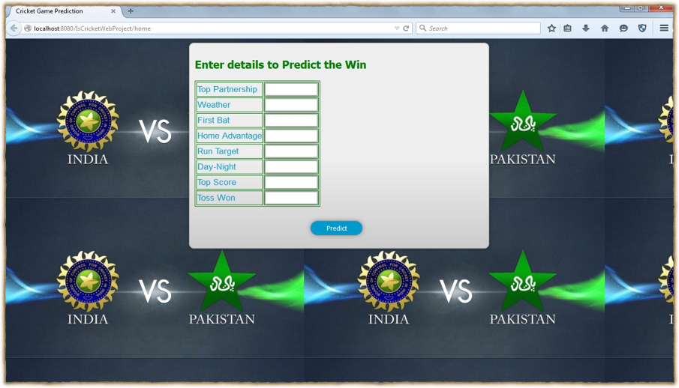
Application
A User Interface Home Page

Slide 12
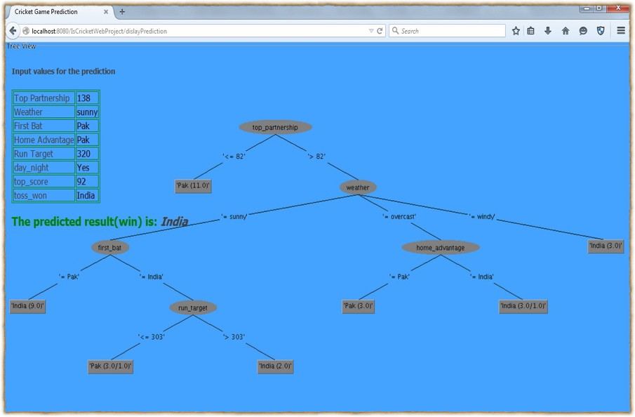
A User Interface Home Page

Slide 13
Challenges
It was difficult to implement the decision tree in RapidMiner as we need to import the .model for the classification.
The attribute "weather" was included later, which was a difficult one to get for a particular city, time and day.

Slide 14
Future Work
Extended for all seven opponents.
Used for all teams playing cricket and not concentrate on only one team versus 7 other.
This model can be used for other sports also.

Slide 15
Thank You !!!

