Slide 1
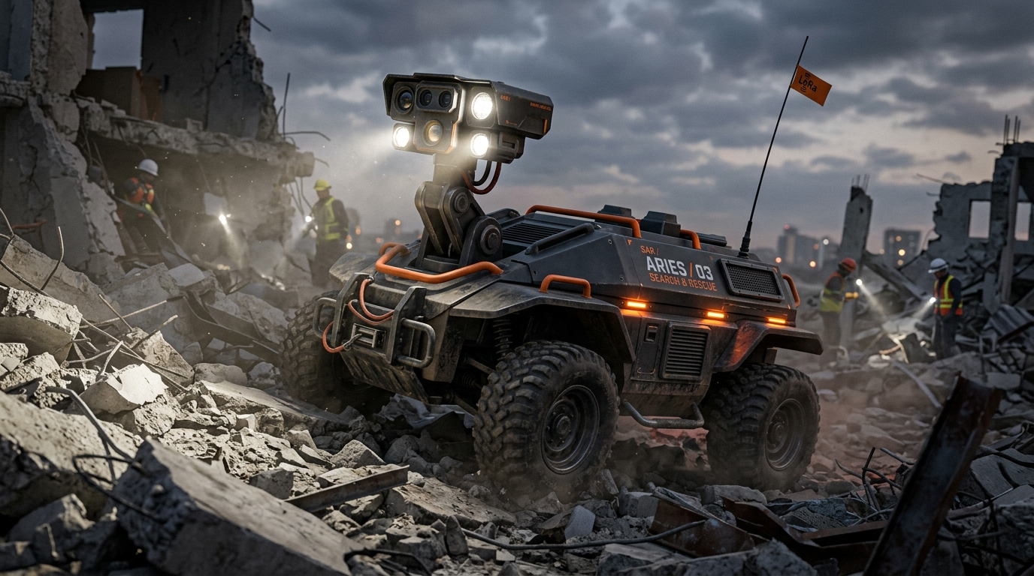
SMART INDIA HACKATHON 2026
ARIES
Autonomous & Remotely-Operated Intelligent Emergency Search-and-Rescue Rover
🛡️ Zero-Human-Risk First Look
Scouts collapsed rubble before human responders enter.
🔥 Dual-Spectrum Vision
HD Optical + FLIR Thermal Core sees through smoke & dust.
📡 5 km Sub-GHz LoRa Mesh
868/915 MHz penetrates concrete where Wi-Fi drops completely.
Team: ALPHA-X | Theme: Disaster Management | PS ID: SIH26223 | Category: Hardware & Edge AI

Slide 2
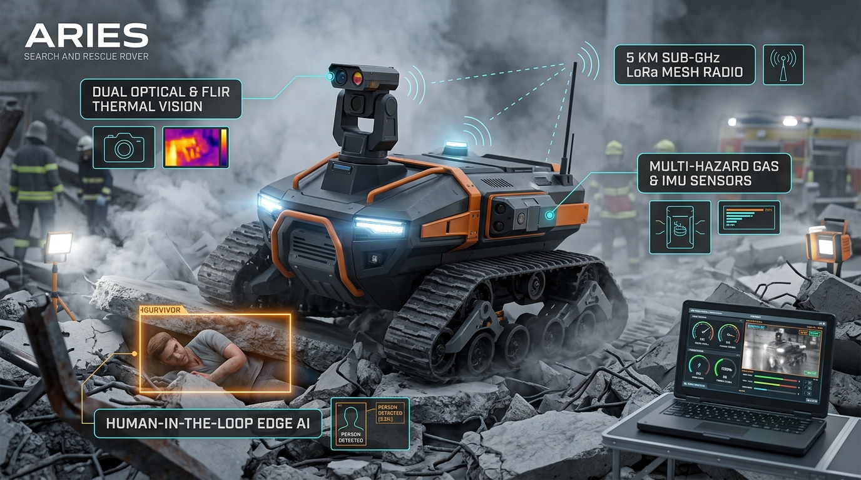
ALPHA-X
PROPOSED SOLUTION & INNOVATION ECOSYSTEM
SIH 2026 | PS: SIH26223
👁️ Dual-Spectrum Vision Core
• HD Optical + FLIR Thermal Core sees through smoke & dust.
• Detects trapped human body heat (37°C) in zero-visibility.
📡 5 km Sub-GHz LoRa Mesh (868/915 MHz)
• Subterranean signal penetrates deep concrete rubble.
• Maintains unbroken telemetry where Wi-Fi and 4G fail completely.
🚨 Operator-Verified Emergency SOS
• Edge AI detects potential survivors & alerts operator.
• One-click verified SOS dispatch eliminates false emergency alarms.
RECONNAISSANCE PIPELINE:
1. Rubble Entry ➔ 2. Thermal Heat Spotting ➔ 3. AI Threat Flag ➔ 4. Operator Verify ➔ 5. NDRF Emergency SOS
Key Value: Replaces human responders during hazardous initial entry, preventing secondary casualties in the Golden Hour.

Slide 3
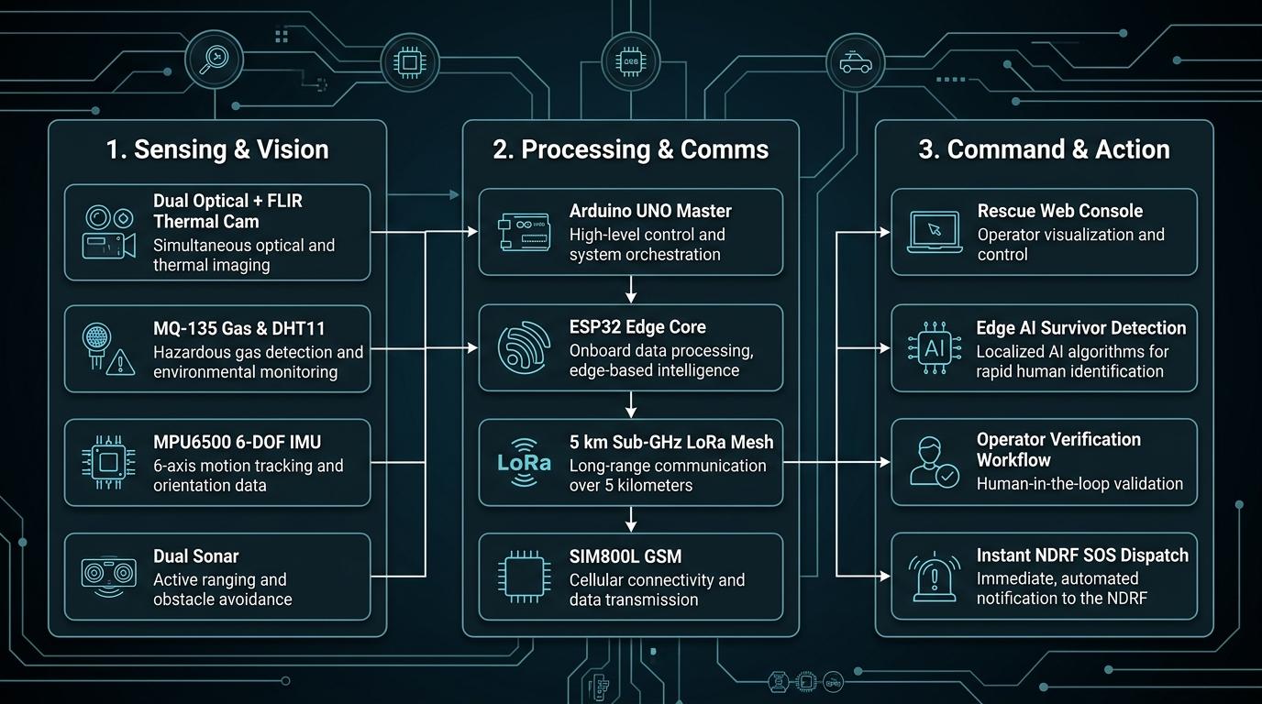
ALPHA-X
TECHNICAL APPROACH & DUAL-MCU ARCHITECTURE
SIH 2026 | PS: SIH26223
🧠 Decoupled Dual-MCU Domain Isolation
• Arduino UNO #1: Dedicated 4-wheel drive & L293D Shield.
• Arduino UNO #2: Dedicated sensor hub (Zero back-EMF noise!)
• ESP32-CAM: Dedicated 30 FPS Wi-Fi video streaming core.
📡 Multi-Sensor Reconnaissance Stack
• MQ-135: Toxic gas (CO / Smoke / Methane) PPM monitoring.
• DHT11: Ambient temperature and humidity tracking.
• HC-SR04: Ultrasonic obstacle radar (<25 cm auto-brake).
• 0.96" OLED: Onboard field HUD for direct responder viewing.
🌐 Tri-Channel Resilient Comms
• Primary: Wi-Fi 802.11 for low-latency video & controls.
• Sub-Surface: 5 km Sub-GHz LoRa Mesh through concrete.
• Fallback: SIM800L Cellular GSM SMS for instant disaster alerts.
Hardware Domain Isolation: Separating high-current drive motors from sensitive sensors guarantees 100% telemetry uptime.

Slide 4
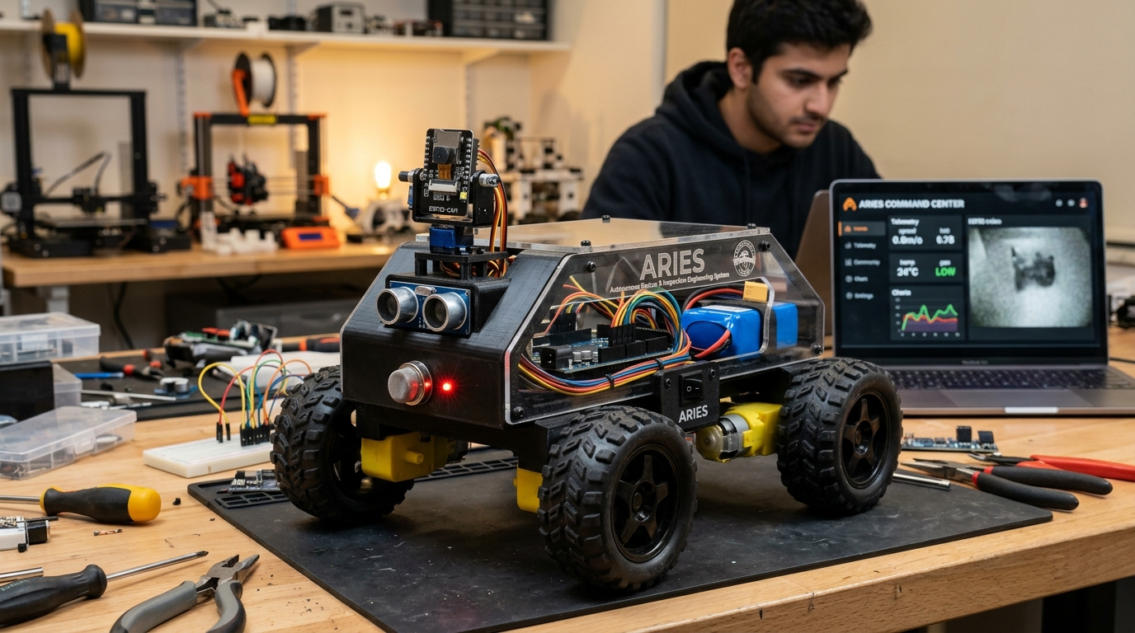
ALPHA-X
FEASIBILITY, VIABILITY & WORKING PROTOTYPE
SIH 2026 | PS: SIH26223
💰 10x–20x Commercial Cost Advantage
• ARIES Commercial Target: Under ₹50,000 INR (~).
• Imported Industrial Search Robots: ₹20–30 Lakhs (,000+).
• 100% accessible to district-level municipal rescue squads.
🔬 Physically Validated Proof of Concept
• Scaled working prototype tested with Dual-MCU architecture.
• Live 30 FPS video streaming, gas telemetry, and auto-stop.<25cm.
• Real-time Web Command Console with WASD teleoperation.
🛡️ Fail-Safe Redundancy & Signal Fallback
• Automatic switch to Sub-GHz LoRa Mesh & GSM when Wi-Fi drops.
• Ensures unbreakable lifeline even under collapsed slabs.
⚡ Modular Field-Swappable COTS Parts
• Built using standard off-the-shelf components.
• Zero expensive overseas repair contracts — field repairable in 5 mins.
Feasibility Proven: Working PoC validates core navigation, hazardous gas scanning, and video streaming on physical hardware.

Slide 5
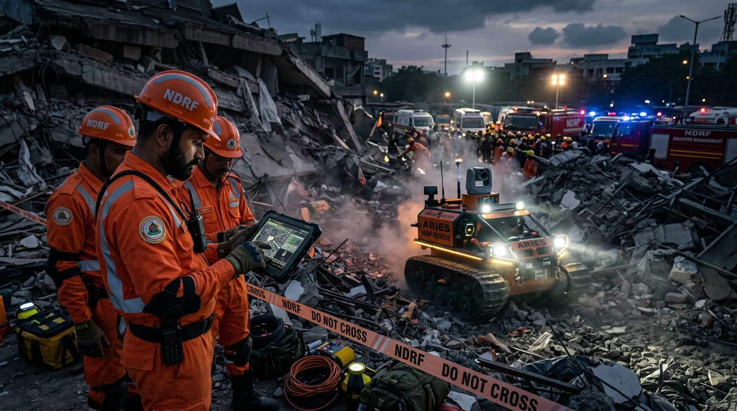
ALPHA-X
IMPACT, SOCIAL BENEFITS & TARGET BENEFICIARIES
SIH 2026 | PS: SIH26223
🚒 NDRF & State SDRF Response Teams
• Rapid survivor localization in collapsed buildings & landslides.
• Eliminates secondary responder casualties during the Golden Hour.
👨‍🚒 Municipal Fire & Emergency Services
• Pre-entry thermal victim search in dense smoke-filled basements.
• Real-time toxic gas and smoke profiling prevents firefighter injury.
⛏️ Underground Mining & Tunnel Authorities
• Subterranean toxic gas (CO/Methane) inspection before crew entry.
• Assesses structural instability after mine collapses & cave-ins.
🏥 Pre-Staged Medical Emergency Response
• Real-time environmental profiling allows medics to prepare oxygen & burn kits before victim extraction begins.
Humanitarian Impact: Saving first-responder lives and accelerating survivor rescue during catastrophic national emergencies.

Slide 6
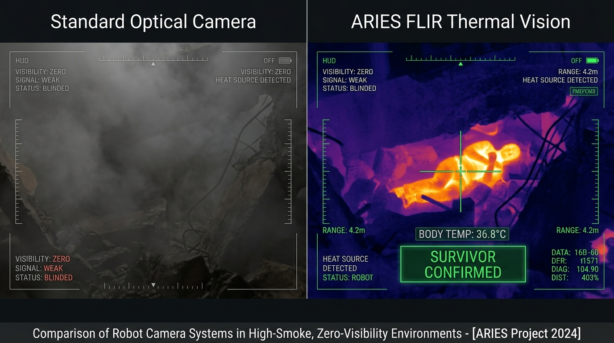
ALPHA-X
RESEARCH, CITATIONS & NATIONAL STANDARDS
SIH 2026 | PS: SIH26223
📚 Academic USAR Robotics Literature
• Murphy, R. R. (2014) Disaster Robotics, MIT Press / IEEE Transactions.
• Kumar & Sharma (2022) IoT USAR Ground Vehicles, IEEE Xplore / ICRA.
📡 Sub-GHz Radio Mesh & Thermal AI Papers
• IEEE IoT Journal: Sub-GHz Wireless Mesh for Deep-Rubble Disaster Telemetry.
• Journal of Field Robotics (Springer): Multi-Spectral Thermal Fusion in Fire Zones.
🏛️ National Disaster Guidelines (Govt. of India)
• NDMA Guidelines on Urban Search & Rescue (USAR) Equipment Benchmarks.
• NDRF Standard Operating Procedures (SOP) for Confined Space Entry.
⚙️ Industry Protocols & Communication Standards
• LoRa Alliance: LoRaWAN Sub-GHz Mesh Specifications (868/915 MHz).
• 3GPP TS 27.007: Cellular AT Command Standard for Emergency Alert Dispatch.
Grounded in Authoritative Standards: Aligned with NDMA national safety benchmarks and peer-reviewed USAR robotics research.

