Slide 1
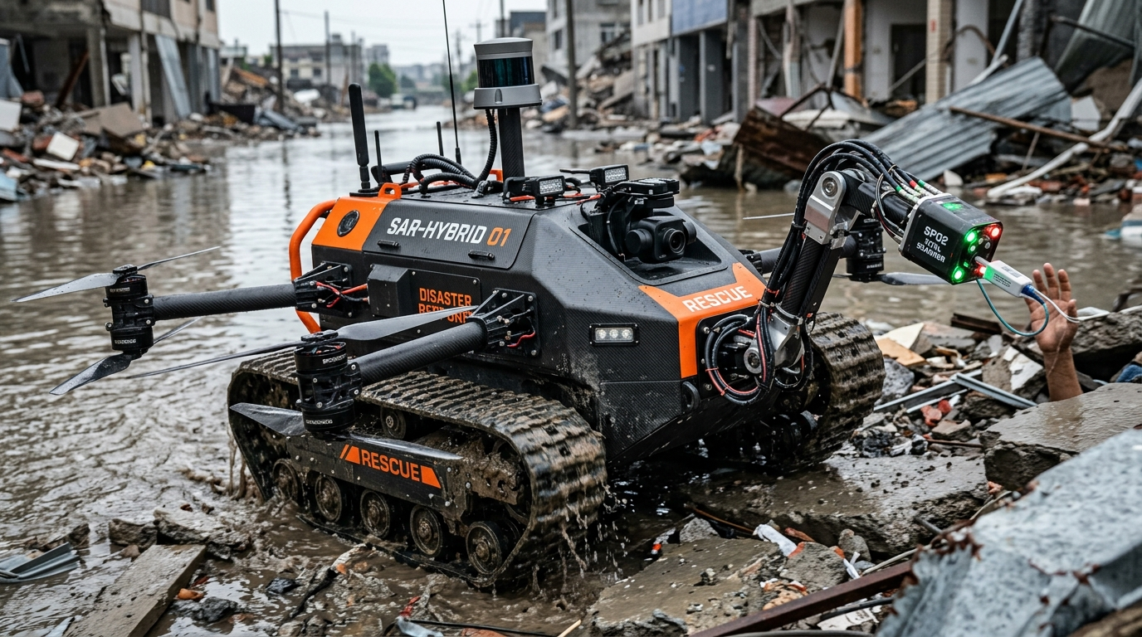
ALPHA-X | SIH_1186
SMART INDIA HACKATHON 2026
PS ID: SIH26223 | HARDWARE
[SIH LOGO]
AICTE STUDENT INNOVATION (DISASTER MGMT)
ARIES 2.0
Tri-Phibian All-Domain Autonomous Search-and-Rescue Robot
🚜 Tank Treads (Rubble)
Continuous tracks climb 45° collapsed debris
🚁 Octocopter Drone
8 integrated rotors hop over deep trenches
🚤 Amphibious Hull
IP68 pontoon floats & steers in floodwaters
🦾 Bionic SpO2 Arm
Scans survivor pulse & blood oxygen in voids
Team Leader: Harshit Sharma | Team: ALPHA-X (ID: SIH_1186)
Institute: Poornima University, Jaipur | Category: Hardware & Edge AI
Motto: 'We don't just build robots, we build hope.'
Poornima University Internal Hackathon RANK 5 Finalist | Theme: Disaster Management | GitHub: github.com/harshitsharma120109-web/ARIES-Search-Rescue-Rover

Slide 2
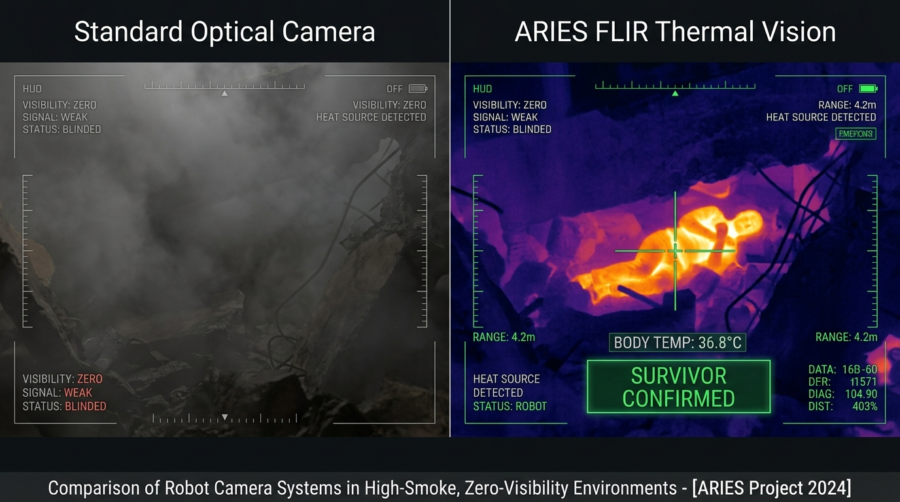
ALPHA-X | SIH_1186
PROPOSED SOLUTION & TRI-PHIBIAN ECOSYSTEM
SIH26223 | SOLUTION OVERVIEW
[SIH LOGO]
10x-20x Cost Disruption
₹50,000 vs ₹25L imported
5 km Deep Rubble LoRa
Sub-GHz concrete mesh
1000°C Fire Armor Shield
Silica Aerogel insulation
Zero Human Ingress Risk
First look in Golden Hour
OPERATIONAL RECONNAISSANCE PIPELINE (HOW IT WORKS):
01
🚜 Rubble & Flood Entry
Tank tracks traverse unstable ruins; pontoon hull floats over flooded waters.
02
🚁 Auto-Trench Air-Hop
Integrated 8-rotor octocopter lifts chassis across deep chasms and cliffs.
03
🦾 Bionic Crevice Vitals
Robotic arm penetrates 10cm holes to scan survivor pulse & SpO2 at tip.
04
🚨 Incident Command SOS
Human-in-the-Loop AI verifies survivor -> Instant SOS beacon to NDRF.
Core Mission Value: Eliminating rescuer fatalities during initial Golden-Hour reconnaissance across all 3 domains (Land, Water & Air).

Slide 3
ALPHA-X | SIH_1186
TECHNICAL APPROACH & DUAL-MCU ARCHITECTURE
SIH26223 | HARDWARE & AI
[SIH LOGO]
🚜 Tri-Phibian Mobility
• Land: Kevlar caterpillar tank tracks with high-torque DC planetary gearmotors.
• Water: IP68 sealed carbon boat hull + twin submersible waterjets.
• Air: 8x heavy-lift carbon-fiber outrigger rotors (lifts full 15kg chassis).
🦾 Perception & Bionic Arm
• Bionic Arm: 4-DOF carbon manipulator (1m crevice void reach).
• Biosensor Tip: MAX30102 pulse oximeter (BPM & SpO2) + BMP280 depth.
• Vision Core: FLIR radiometric LWIR thermal core + 3D LiDAR SLAM.
⚡ Dual-MCU & Fire Shield
• Dual-MCU: Arduino #1 (Drive) + Arduino #2 (Sensors) - Zero EMF freeze!
• Comms: 5 km Sub-GHz LoRa Mesh (868MHz) + Wi-Fi 6 + SIM800L GSM.
• Fire Armor: 10mm Silica Aerogel (blocks 1000°C) + Nitrogen cold purge.
SYSTEM ARCHITECTURE & END-TO-END DATAFLOW PIPELINE:
1. SENSING & ARM
MQ-135, FLIR, SpO2, Sonar
2. DUAL-MCU CORE
Arduino #1 & #2 Isolated Bus
3. RESILIENT COMMS
5 km LoRa Mesh + GSM SMS
4. WEB MISSION HUB
Browser Web Serial Console
Zero-Lockup Guarantee: Dedicated Dual-MCU domain isolation prevents high-current motor EMF noise from disrupting mission-critical gas & vital sensors.

Slide 4
ALPHA-X | SIH_1186
RISK MITIGATION MATRIX & FEASIBILITY ANALYSIS
SIH26223 | FEASIBILITY
[SIH LOGO]
⚠️ CHALLENGE: Deep Rubble Signal Loss
2.4GHz Wi-Fi drops through 2m concrete.
🛡️ ARIES ENGINEERING MITIGATION:
5 km Sub-GHz LoRa Mesh (868MHz) + SIM800L GSM SMS fallback.
⚠️ CHALLENGE: Cliffs & Trench Trap
Rover gets trapped in sudden drop-offs.
🛡️ ARIES ENGINEERING MITIGATION:
Integrated 8-Rotor Octocopter automatically lifts chassis across.
⚠️ CHALLENGE: 500°C Industrial Fire
Extreme heat fries sensitive microcontrollers.
🛡️ ARIES ENGINEERING MITIGATION:
Silica Aerogel Heat Shield (1000°C block) + Nitrogen cold purge.
⚠️ CHALLENGE: Environmental False Alarms
Hot steam pipes/embers falsely flag survivor.
🛡️ ARIES ENGINEERING MITIGATION:
MAX30102 Heartbeat/SpO2 check + Mandatory Human-in-Loop HUD.
💰 ECONOMIC VIABILITY & 10x COST ADVANTAGE:
• Commercial target under ₹50,000 INR vs ₹25-40 Lakhs imported military robots.
• Built on modular COTS hardware, eliminating expensive overseas maintenance.
🔬 WORKING PROOF OF CONCEPT (PoC) VALIDATION:
• Scaled prototype validated on dual-microcontrollers with L293D shield.
• Tested with live gas telemetry, sonar auto-stop, OLED display & Web Serial Hub.
Zero False-Alarm Architecture: Two-tier validation combines physiological SpO2 pulse verification with Incident Commander HUD confirmation.

Slide 5
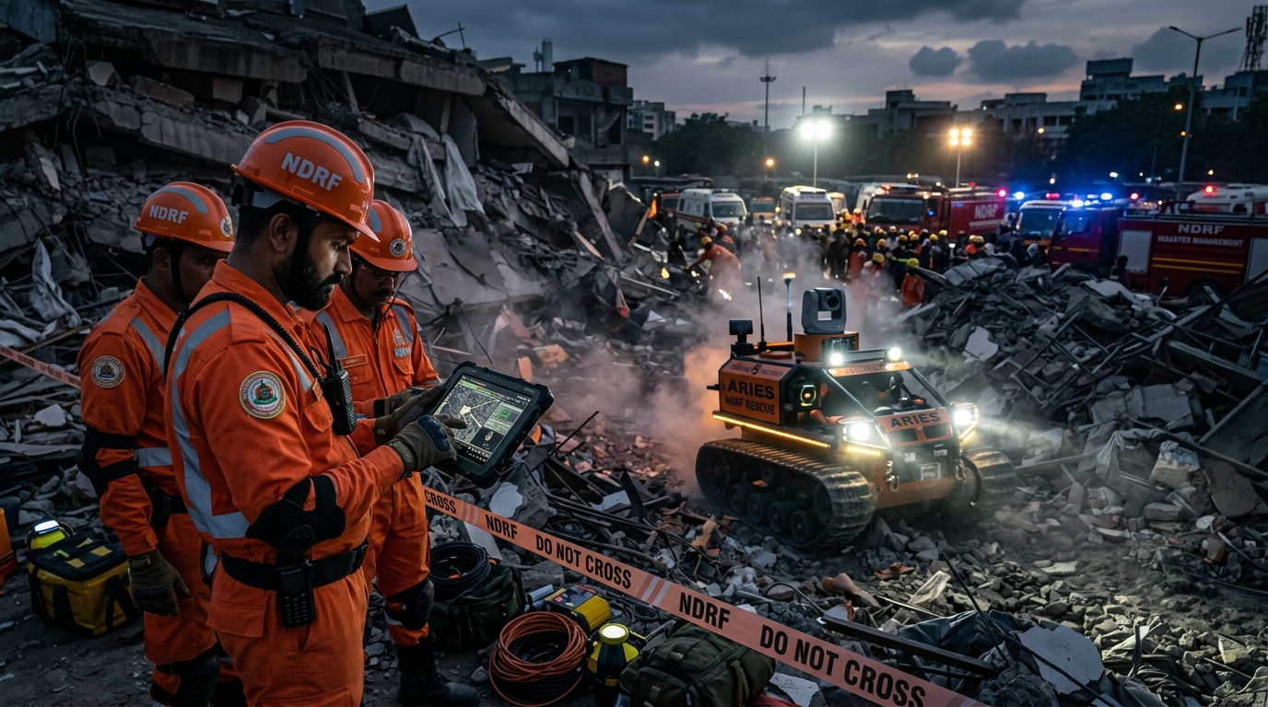
ALPHA-X | SIH_1186
MULTI-DIMENSIONAL IMPACT & TARGET BENEFICIARIES
SIH26223 | NATIONAL IMPACT
[SIH LOGO]
❤️ Social & Life-Saving
• Zero First-Responder Loss: Eliminates sniffer dog & rescuer hazards.
• Golden Hour Acceleration: Spots trapped survivors in minutes via thermal vision.
• Pre-Staged Medical Triage: Medics receive SpO2 & pulse before physical entry.
💰 Economic Democratization
• 10x-20x Cost Reduction: Under ₹50,000 INR vs ₹25-40 Lakhs imported robots.
• COTS Modular Maintenance: Standard parts, zero foreign service lock-in.
• Scalable Pan-India Outreach: Affordable for every municipal fire station.
🌱 Environmental Containment
• Real-Time Hazard Containment: MQ-135 tracks gas diffusion before civilian impact.
• Zero-Emission Electric Locomotion: Safe in combustible & low-oxygen shafts.
• Deep Underground Recon: Safe for subterranean tunnels and coal mines.
🏛️ NDRF & State SDRF
Earthquake & building collapses
🚒 Fire & Emergency
Basement fires & chemical leaks
⛏️ Mining Authorities
Deep coal mine & tunnel collapse
🏭 Industrial Plants
Hazardous industrial plant scouts
Humanitarian Impact: Aligned with National Disaster Management Plan (NDMP) benchmarks to save lives during critical Golden Hour extractions.

Slide 6
ALPHA-X | SIH_1186
BILL OF MATERIALS, NATIONAL STANDARDS & REPO
SIH26223 | STANDARDS & REPO
[SIH LOGO]
💰 Bill of Materials & Cost Disruption
• Basic Working Prototype (Table Model): Under ₹8,000 INR.
• ARIES 2.0 Enterprise Tri-Phibian Model: Under ₹50,000 INR.
• Imported Military Competitors: ₹25,00,000 to ₹40,00,000 INR.
• Result: 10x to 40x Unprecedented Cost Democratization!
🏛️ National Guidelines (Govt. of India)
• NDMA Guidelines on Urban Search & Rescue (USAR) Equipment Standards.
• NDRF Standard Operating Procedures (SOP) for Confined Space Hazards.
• Aligned with National Disaster Management Plan (NDMP 2019).
• Hazardous gas threshold compliance (MQ/PID Standards).
📚 Academic USAR Robotics Literature
• Murphy, R. R. (2014) Disaster Robotics, MIT Press / IEEE Transactions.
• Kumar & Sharma (2022) IoT USAR Ground Vehicles, IEEE Xplore / ICRA.
• IEEE IoT Journal: Sub-GHz Wireless Mesh for Deep-Rubble Disaster Telemetry.
• Journal of Field Robotics: Multi-Spectral Thermal Fusion in Fire Zones.
💻 Open-Source Repositories & Live Hubs
• GitHub Repo: github.com/harshitsharma120109-web/ARIES-Search-Rescue-Rover
• Live Web Mission Hub: melodic-halva-b0fa56.netlify.app
• Full Dual-MCU Firmware, Schematics & Web Serial telemetry open-sourced.
• Validated on functional scaled embedded prototype.
OFFICIAL PROJECT REPOSITORY & LIVE WEB MISSION HUB:
• GitHub: https://github.com/harshitsharma120109-web/ARIES-Search-Rescue-Rover
• Live Console: https://melodic-halva-b0fa56.netlify.app/ | https://joyful-cactus-9b247c.netlify.app/
'WE DON'T JUST BUILD ROBOTS, WE BUILD HOPE.' — Team ALPHA-X (SIH_1186)

