Slide 1
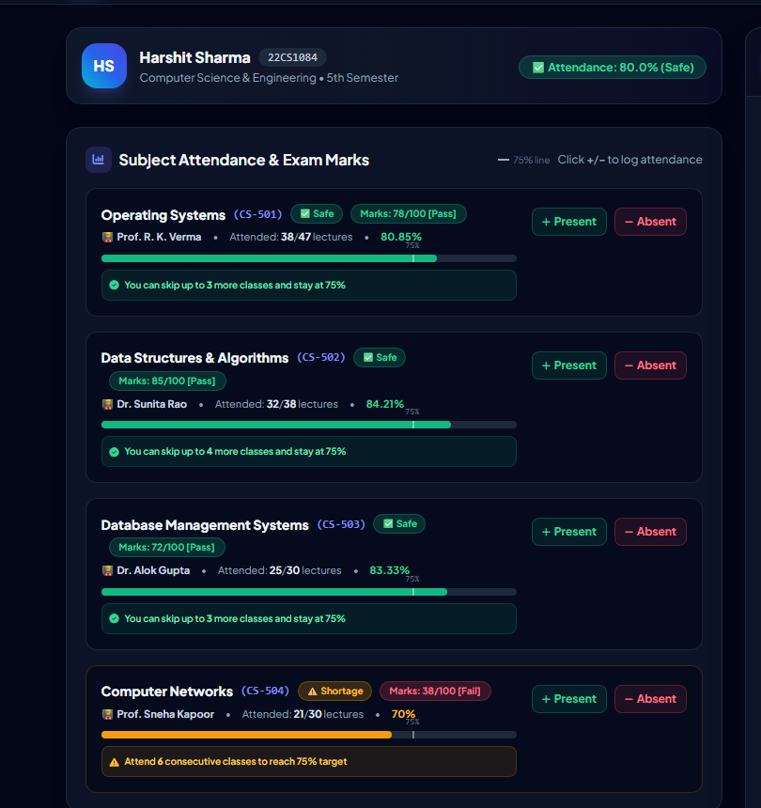
⚡ SKILLUP HACKATHON WITH IBM SKILLSBUILD • STUDENT AI TRACK
CampusGenie
360° AI Student Copilot & Smart Campus ERP Platform
A unified full-stack campus intelligence portal that puts an end to attendance debarment anxiety, fragmented college portals, and late-night study hurdles. Featuring a real-time 75% attendance recovery engine, exam marks grading, live timetable venues, 24/7 CS academic doubt solver, and safe OTC health triage.
• Developer / Author: Harshit Sharma (Roll: 22CS1084)
• Branch / Department: Computer Science & Engineering • 5th Semester
• Core Technology: Python 3.12 Flask, Tailwind CSS, Gunicorn, IBM Bob Technology
• Live Deployed URL: https://campusgenie-g9pi.onrender.com/
• GitHub Repository: https://github.com/harshitsharma120109-web/CampusGenie

Slide 2
CHALLENGE & INNOVATION
The Real Campus Problem & The CampusGenie Solution
🚨 The Critical Campus Dilemma
💡 The CampusGenie 360° Solution
• Strict 75% Attendance Debarment: Students face exam debarment without warning. Existing ERPs show delayed percentages with zero predictive math on how to recover from shortages.
• Fragmented & Outdated College Portals: Marks are on one notice board, lecture schedules on paper circulars, and attendance on clunky legacy portals that fail on mobile.
• Unanswered Midnight Study Doubts: During late-night exam prep, professors are unavailable. Students waste hours browsing scattered forums for quick CS doubt explanations.
• Hostel Late-Night Health Emergencies: Campus medical dispensaries close at evening. Hostellers facing sudden fever, acidity, or migraine have no reliable first-aid triage guidance.
✔ Dynamic 75% Mathematical Recovery Engine: Automated recovery calculator computes exact consecutive classes needed to return to safety, plus safe skip allowances.
✔ Unified Glassmorphic 360° Dashboard: Attendance, exam marks (Pass/Fail grading), timetable with classroom venues, and curated opportunities in one unified screen.
✔ 24/7 AI Academic Copilot (30+ CS Topics): Instant code snippets, time complexities, and intuitive explanations for Data Structures, OS, DBMS, Networks, and OOP.
✔ Safe Campus Health & Symptom Triage: Evidence-backed first-aid OTC guidance (Paracetamol, ORS) and home remedies for 17 campus symptoms with safety guardrails.
✔ Faculty & Administrative Hub: Professors can enroll students, update marks, schedule lectures, and broadcast hackathons with live sync.

Slide 3
STUDENT EXPERIENCE
Student 360° Bio & Multi-Student Switcher
👤 Personalized Student Bio Card
Displays student name, unique Roll No (22CS1084), branch (CSE), and semester. Automatically computes avatar monogram initials (HS).
🔄 Seamless Multi-Student Roster Switcher
Header dropdown enables one-click switching between active student records (Harshit Sharma, Priya Patel, Jay) for instant demoing and administration.
📊 Dynamic Overall Attendance Badge
Real-time percentage calculator. Flags color-coded status pills: '✅ Attendance: 80.0% (Safe)' in emerald green or '⚠️ Shortage' in amber when below 75%.
💎 Responsive Glassmorphism Architecture
Built with Tailwind CSS and modern CSS backdrop blur filters. Fully adaptive across mobile smartphones, tablets, and university desktop screens.

Slide 4
CORE INNOVATION
Subject Attendance Tracking & 75% Recovery Math
📐 The 75% Shortage Recovery Formula
When attendance drops below 75%, CampusGenie calculates the exact consecutive lectures required:
Formula: Consecutive Classes Needed = ceil( (0.75 * Total - Attended) / (1 - 0.75) )
Example: In Computer Networks (21/30 = 70%), it alerts: 'Attend 6 consecutive classes to reach 75% target'.
🛡️ Safe Class Skip Allowance
For subjects above 75%, it calculates permissible cuts:
Formula: Safe Skips = floor( (Attended - 0.75 * Total) / 0.75 )
Example: 'You can skip up to 3 more classes and stay at 75%'. Prevents unwarranted absenteeism.
📝 Automated Exam Marks & Grading Matrix
Tracks mid-term & end-term marks out of 100 with automated Pass/Fail status (40% threshold). In screenshot: OS (78/100 Pass), DSA (85/100 Pass), CN (38/100 Fail).
⚡ Interactive '+ / -' Attendance Simulator
Students can tap '+ Present' or '- Absent' to simulate upcoming attendance impacts in real-time before making decisions.

Slide 5
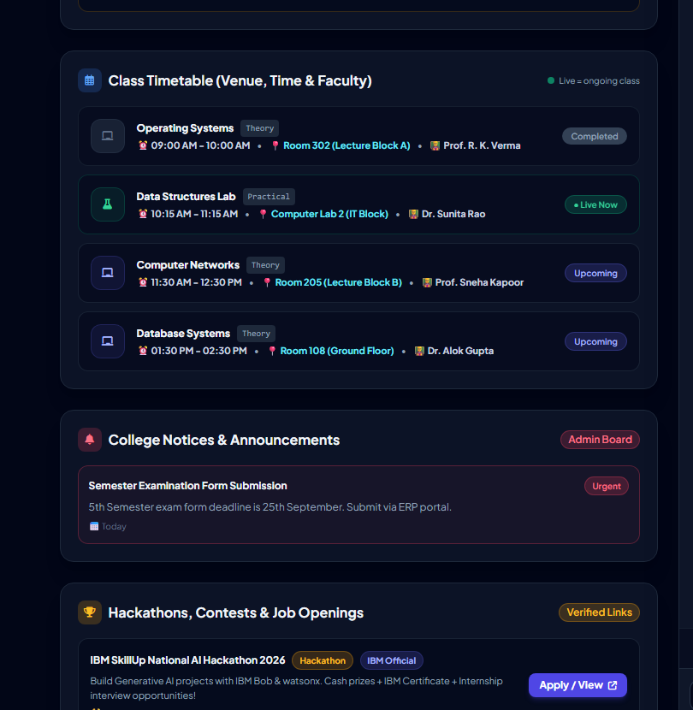
CAMPUS LOGISTICS
Live Class Timetable, Venues & Opportunities
📍 Pinpoint Classroom & Lab Venues
Solves the common student confusion of running across campus. Clearly lists specific rooms: 'Room 302 (Lecture Block A)', 'Computer Lab 2 (IT Block)', 'Room 205 (Lecture Block B)'.
🟢 Live Ongoing Lecture Pulsing Badge
Context-aware status tags: '● Live Now' with an emerald green pulsing animation for ongoing classes, '✅ Completed' for finished lectures, and '⏳ Upcoming' for future slots.
📢 Centralized College Notices Board
Official department circulars broadcast directly from faculty. Categorized with color badges: 'Urgent', 'Exam', 'Notice' (e.g. Semester Exam Form deadline 25th September).
🏆 Curated Hackathons & Internship Board
Empowers students with career growth. Features verified national competitions (IBM SkillUp Hackathon 2026) with deadlines and direct 'Apply / View' outbound links.

Slide 6
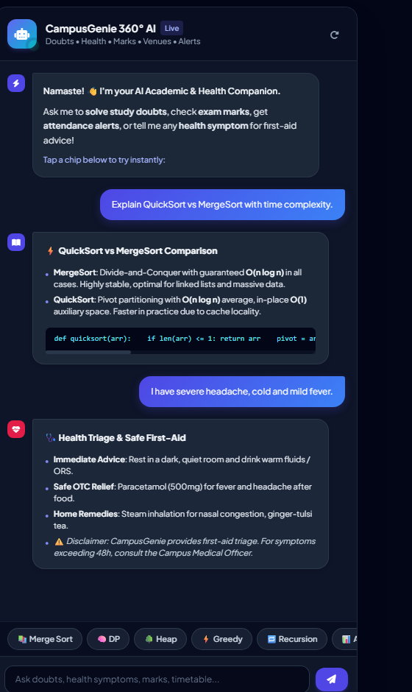
AI INNOVATION
24/7 AI Copilot: Academic Doubt Solver & Health Triage
🎓 30+ Core CS Academic Knowledge Engine
Comprehensive doubt solver spanning 8 Computer Science subjects: DSA (QuickSort, MergeSort, Trees, DP, Heaps), Operating Systems (Deadlocks, Paging, Semaphores), DBMS (ACID, Joins, Normalization), Computer Networks (OSI, TCP/UDP), OOP, COA, Automata, and SE. Generates formatted code snippets & complexity metrics.
🩺 Safe Health Triage & OTC First-Aid Engine
Specially designed for late-night hostel emergencies. Covers 17 common student health issues (fever, migraine, cold/cough, acidity, eye strain, food poisoning, back pain, stress). Provides immediate first-aid, safe OTC medications (Paracetamol 500mg, ORS, Cetirizine), and non-pharmacological home remedies.
⚠️ Responsible Medical Guardrails
Strict safety protocol: Every health recommendation includes explicit disclaimers and emergency escalation advice instructing students to consult the Campus Medical Officer if symptoms exceed 48 hours.
⚡ Instant Interactive Quick Chips
One-tap prompt chips for popular questions (Merge Sort, DP, Heap, Greedy, Recursion) enabling instant academic assistance without typing.

Slide 7
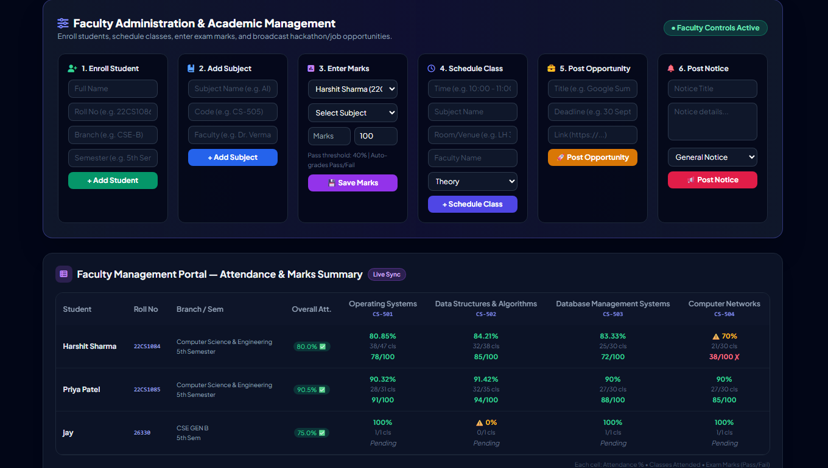
ADMINISTRATION
Faculty Management Hub & Live Student Roster
👨‍🏫 Dedicated Faculty Control Hub
A password-free, secure management portal allowing professors, HODs, and academic proctors to manage campus records in real time.
🛠️ 6 Rapid Academic Operations
1. Enroll Student: Register new student profiles with roll number & branch.
2. Add Subject: Introduce curriculum subjects & assign teachers.
3. Enter Exam Marks: Input test marks with auto Pass/Fail grading.
4. Schedule Classes: Set lecture timings, rooms, and theory/lab type.
5. Post Opportunities: Broadcast verified hackathons & internships.
6. Broadcast Notices: Publish urgent college announcements.
📊 Comprehensive Student × Subject Master Table
Provides professors with an executive summary table of all enrolled students (Harshit, Priya, Jay) cross-matched with every subject's attendance %, attended lectures, and exam scores.
⚡ Instant Two-Way Synchronization
Any grade, class schedule, or notice updated by faculty reflects instantaneously on student dashboards without requiring database restarts.

Slide 8
ENGINEERING & FUTURE
Technical Architecture, IBM Bob Impact & Roadmap
💻 Technical Architecture
• Backend Runtime: Python 3.12 with lightweight Flask REST microservices.
• Server & Deployment: Production WSGI Gunicorn server hosted 24/7 on Render Cloud PaaS.
• Frontend Stack: Semantic HTML5, Tailwind CSS, FontAwesome 6, and Vanilla JavaScript (zero bloat, sub-second load times).
• Data Persistence: Atomic JSON document storage with automatic multi-student schema migrations and fallback recovery.
• Security & Integrity: CORS protection, input sanitization, and safe evaluation pipelines.
🤖 IBM Bob Technology Role
✔ Prompt Engineering Acceleration: Leveraged IBM Bob to formulate structured prompts for multi-subject CS curriculum parsing and heuristic classification.
✔ Medical Safety Rule-Sets: Utilized IBM Bob to design the triage validation pipeline, ensuring strictly safe OTC medicine dosage constraints (e.g. Paracetamol 500mg, ORS).
✔ Data Schema Architecture: Designed normalized student-subject-timetable data structures for clean JSON representation.
✔ Predictive Math Validation: Verified formula boundaries for ceiling/floor attendance calculations to eliminate division-by-zero errors.
🚀 Future Roadmap
★ WhatsApp & SMS Automated Alerts: Trigger automatic Twilio notifications to students and parents when attendance dips below 75%.
★ Voice-Activated AI Assistant: Integrate Web Speech API for voice-driven study doubts and venue inquiries in English and Hindi.
★ AI Hall Ticket Generator: Generate verifiable PDF exam admit cards with cryptographic QR codes only if attendance criteria is satisfied.
★ Biometric RFID Hardware Sync: Direct hardware integration with classroom ESP32 RFID scanners for automated attendance capture.

