Slide 1
Card & Payment Data Engineering - Solution Overview
Using same tech stack as uploaded project
Python, PySpark, ADF, Databricks, SQL
Generated: 2025-09-29 18:23:26

Slide 2
Business Problem
Enable scalable, reliable processing of card & payment data for:
- Real-time fraud detection and alerts
- Regulatory reporting and reconciliation
- Business analytics and revenue insights

Slide 3
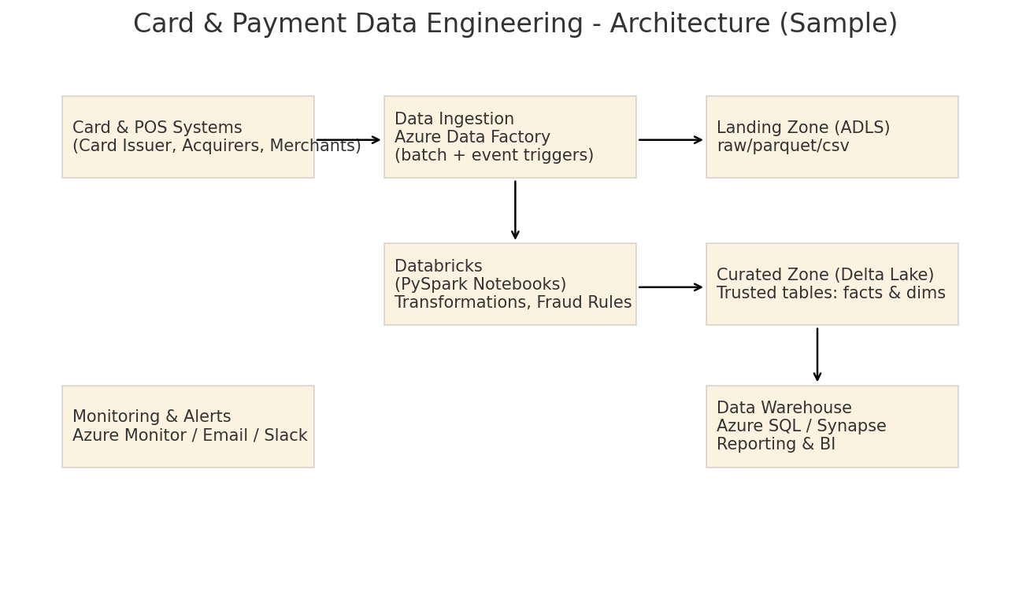
Solution Architecture

Slide 4
Tech Stack & Components
- Azure Data Factory (orchestrations)
- Databricks (PySpark notebooks & jobs)
- Azure Data Lake Storage (raw/curated zones)
- Azure SQL / Synapse (warehouse)
- Monitoring: Azure Monitor / Log Analytics

Slide 5
Pipeline Workflow
1. ADF triggers ingestion from Card/Acquirer feeds to ADLS (landing)
2. Databricks reads raw files, schema handling, cleansing
3. Apply fraud detection rules & enrichment
4. Write to Curated Delta tables (facts/dimensions)
5. Load to Warehouse and update reports/dashboards
6. Alerts via Azure Monitor / Notification

Slide 6
Sample Project Artifacts
- ADF pipeline JSON templates (sample)
- PySpark notebooks (.py) for ingestion & transformations
- YAML config files for env & schema
- SQL DDL/DML & stored procedure templates
- README and run instructions

