Slide 1


B.TECH 3RD YEAR • IILM UNIVERSITY, GREATER NOIDA
Gen AI Virtual
Internship
AICTE • EduSkills • National Internship Portal | Curriculum by AWS Academy
Presented by Harshit Shukla
Duration June 2026 – August 2026 (8 Weeks)

Slide 2
OVERVIEW
What I'll Cover
About the Internship Programme
Objectives & Internship Snapshot
01
02
8-Week Learning Journey
Key Concepts — Generative AI & AWS
03
04
Skills Acquired & Experience
Challenges, Certificate & Conclusion
05
06
Gen AI Virtual Internship | Harshit Shukla, IILM University
2

Slide 3





INTRODUCTION
About the Internship Programme
An 8-week, self-paced virtual internship launched on the National Internship Portal by AICTE and EduSkills under the Ministry of Education, with technical curriculum delivered by AWS Academy — designed to build industry-ready Generative AI skills.
AWS Academy
AICTE
Curriculum partner
Ministry of Education
Why it matters
Bridges the gap between classroom learning and industry-standard cloud & AI practice, boosting employability for engineering students across India.
EduSkills
NIP
Nation Building Through Skills
National Internship Portal
Gen AI Virtual Internship | Harshit Shukla, IILM University
3

Slide 4

GOALS
Objectives of the Internship
Build a strong conceptual foundation in AI, ML & Generative AI
Gain hands-on experience with AWS cloud services for Gen AI
Understand LLM & foundation-model architecture
Learn practical prompt-engineering techniques
Explore real-world Gen AI use cases across industries
Strengthen employability with an industry-recognized credential
Gen AI Virtual Internship | Harshit Shukla, IILM University
4

Slide 5




SNAPSHOT
Internship at a Glance
8 Weeks
AWS Academy
Virtual
Grade O
June – August 2026
Curriculum Partner
Self-Paced Mode
Outstanding (90–100)
Organized under the National Internship Portal by AICTE, Ministry of Education & EduSkills | Student ID: STU69d4b89ed8e141775548574
Gen AI Virtual Internship | Harshit Shukla, IILM University
5

Slide 6


JOURNEY
8-Week Learning Journey
WEEKS 1–2
WEEKS 3–4
WEEKS 5–6
WEEKS 7–8
Cloud & AI Foundations
ML & Deep Learning
Generative AI & LLMs
Applied Gen AI
AWS infrastructure, EC2, S3, IAM, intro to AI/ML
Learning paradigms, neural networks, Amazon SageMaker
Foundation models, transformers, Amazon Bedrock
Prompt engineering, Responsible AI, capstone labs
Gen AI Virtual Internship | Harshit Shukla, IILM University
6

Slide 7




CORE LEARNING
Key Concepts — Generative AI & LLMs
Foundation Models
Transformers & LLMs
Large pre-trained models adaptable to many downstream tasks
Attention-based architecture behind modern language models
Tokenization & Embeddings
Prompt Engineering
Converting text into numerical representations models can process
Zero-shot, few-shot & chain-of-thought techniques for better outputs
Gen AI Virtual Internship | Harshit Shukla, IILM University
7

Slide 8


HANDS-ON
AWS Services Explored
EC2, S3 & IAM
Amazon SageMaker
Amazon Bedrock
Responsible AI Tools
Core compute, storage & access-management fundamentals
Building, training & deploying machine-learning models
API access to foundation models for Generative AI apps
Fairness, bias-mitigation & data-privacy guardrails
Gen AI Virtual Internship | Harshit Shukla, IILM University
8

Slide 9



PRACTICE & PRINCIPLES
Prompt Engineering & Responsible AI
Prompt Engineering Techniques
Responsible AI Principles
Zero-shot prompting for direct instructions
Fairness & bias mitigation in model outputs
Few-shot prompting using guided examples
Transparency in how models generate content
Chain-of-thought prompting for reasoning tasks
Data privacy & security safeguards
Iterative prompt refinement for accuracy
Accountability in deployment decisions
Gen AI Virtual Internship | Harshit Shukla, IILM University
9

Slide 10


TAKEAWAYS
Skills Acquired
Technical Skills
Soft Skills
Cloud computing fundamentals & core AWS services
Self-directed learning in a virtual environment
Machine learning & deep learning concepts
Time management across academics & internship
Generative AI, LLMs & foundation models
Analytical & problem-solving mindset
Amazon Bedrock & SageMaker exposure
Technical documentation & report writing
Practical prompt-engineering techniques
Gen AI Virtual Internship | Harshit Shukla, IILM University
10

Slide 11


REFLECTION
Learning Experience & Challenges
Highlights
Challenges Faced
The self-paced format allowed flexibility to balance semester coursework with internship modules. Hands-on labs with Amazon Bedrock made abstract concepts like transformers and embeddings concrete, offering an industry-relevant, cloud-native perspective on Generative AI.
Adjusting to AWS console & cloud terminology initially
Grasping the math behind transformer models
Balancing internship work with semester deadlines
Overcome through consistent lab practice, revisiting AWS Academy material, and peer discussion.
Gen AI Virtual Internship | Harshit Shukla, IILM University
11

Slide 12
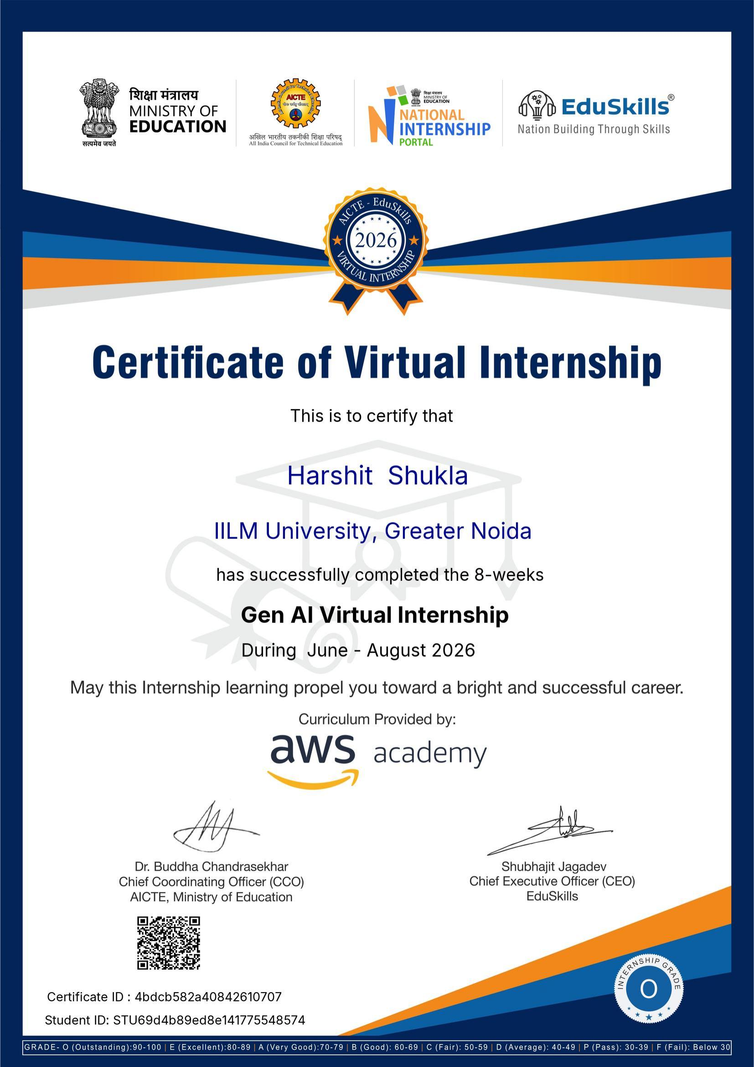
PROOF OF COMPLETION
Certified & Graded
Grade Secured: O – Outstanding
Score band: 90–100
Certificate ID
4bdcb582a40842610707
Student ID
STU69d4b89ed8e141775548574
Issued By
AICTE & EduSkills
Curriculum
AWS Academy
Gen AI Virtual Internship | Harshit Shukla, IILM University
12

Slide 13
WRAPPING UP
Conclusion & Key Takeaways
Structured Growth
Recognized Outcome
Future-Ready
A clear path from cloud basics to applied Generative AI in 8 weeks
Completed with an Outstanding grade & industry-backed certification
Strengthened confidence to pursue further Gen AI projects & career goals
Gen AI Virtual Internship | Harshit Shukla, IILM University
13

Slide 14
THANK YOU
Questions & Discussion
Harshit Shukla | B.Tech 3rd Year | IILM University, Greater Noida

