Slide 1
Azure Hotel Bookings Analysis

Slide 2

Dataset Overview
→ The dataset contains information about bookings in two types of hotel. One of the hotels is a Resort Hotel and the other is a City Hotel. → Both share the same structure, with 36 variables describing the 40,060 observations of Resort Hotel and 79,330 observations of City Hotel.
→ Each observation represents a hotel booking.
→ Bookings recorded from July 1, 2015 to August 31, 2017, include successful and canceled bookings. → All data elements related to hotel and customer identification have been removed to ensure data privacy.

Slide 3
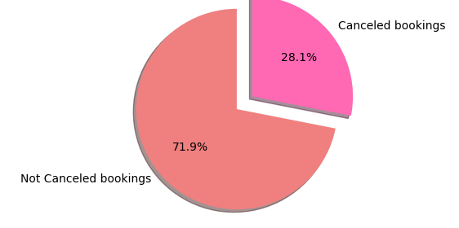
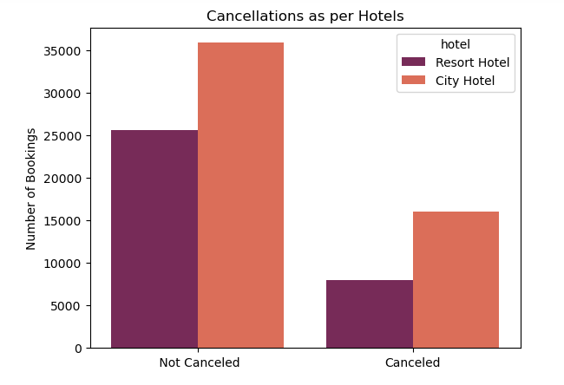
Summary Of Analysis
Using the data we can clearly say that the average cancellation percentage of our hotels is much higher than the industry average cancellation rate which is around 20 %. So, if this cancellation rate continues or increases in the future this will lead to major problems for the hotels
Number of canceled bookings in the City hotel is much higher when compared to Resort hotel. Average cancellation rate of both hotels combined is 27.5% whereas cancellation rate of City hotel is 30% which is higher than average percentage but in resort hotel cancellation percentage is 23.48% which is less than average percentage

Slide 4
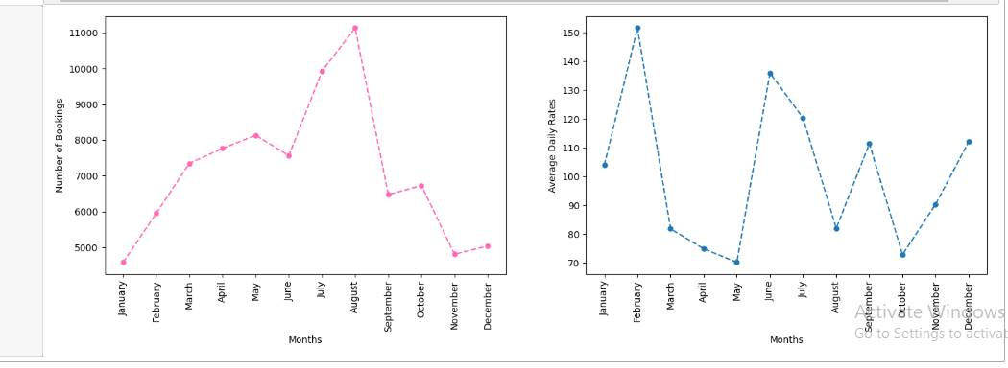
Most of the bookings are coming from the Online TA , Offline TA/TO and the Adr of the Direct Bookings is greater than or equal to the bookings coming from the other market segments. We should focus more on increasing the number of bookings coming from the direct and online TA segment as they have high ADR and this will help in growing revenue.
We can see that the number of bookings are increasing during the summer months and are decreasing in winter months and ADR is also high in the summer months .The trend is that bookings are increasing from January to August making a peak in August months and then it starts decreasing making the foot of the graph in december month

Slide 5
Overall Analytical Approach / Architecture
Data Collection:
Historical booking data (2 years), competitor pricing, demand trends.
Data Preprocessing:
Handling missing values, feature encoding (e.g., categorical to numerical).
Normalization for clustering.
Machine Learning Model:
Random Forest Regressor: Analyze the factors that drive room pricing, including demand, and other factor using this algorithm and used the same for analyzing which factors influence the price of the hotels.
K-means Clustering: Customer segmentation based on booking behavior (e.g., stay duration, cancellation behavior, lead time).
Pricing Drivers Analysis:
Feature importance derived from variables such as room type, meal plans, and market segment.

Slide 6
Pricing Drivers Identification and Analysis
ADR Prediction Model:
Utilized Random Forest Regressor to predict the Average Daily Rate (ADR).
Features included: room type, lead time, customer type, market segment, seasonal demand, and others.
Key Drivers of ADR (Feature Importance):
Lead Time: Significant impact on ADR; shorter lead times lead to higher prices.
Room Type: Luxury suites and higher-tier rooms drive the largest share of revenue.
Booking Changes: Frequent amendments to bookings resulted in price adjustments.
Market Segment: Business travelers tend to pay higher ADRs compared to leisure or budget travelers.
Seasonal Demand: Higher prices during peak holiday seasons and local events.
Impact: These key factors shape dynamic pricing, allowing Azure Hotels to adjust rates for maximum profitability based on demand and customer behavior.

Slide 7
Customer Segment Analysis and Profiling
Segmentation Methodology: K-means clustering
Input features: stay duration, booking lead time, cancellation behavior, customer type.
Key clusters:
Budget Travelers: Short stay, low lead time.
Business Travelers: High repeat customers, more weekday stays.
Family Vacationers: Longer stays, weekend focus, larger groups.
Cluster Insights:
Differing price sensitivity and booking behaviors across clusters.
Recommendations for segment-specific pricing and promotions.

Slide 8
Recommended Pricing Strategy and Expected Impact
Dynamic Pricing Model:
Price adjustments based on customer segment, lead time, and seasonal demand.
Competitor pricing integrated for competitive positioning.
Revenue Maximization:
Higher prices for last-minute bookings and premium room types.
Discounts for early bookings and low-demand periods.
Segmentation-based Promotions:
Tailored offers for different customer segments, such as family packages for vacationers and loyalty perks for repeat business travelers.
Expected Impact:
Improved occupancy rates during off-peak times.
Enhanced customer satisfaction through personalized pricing strategies, leading to higher retention and lifetime value.

Slide 9
Conclusion and Next Steps
Conclusion:
A dynamic pricing strategy tailored to customer segments and demand factors will maximize Azure Hotels' revenue and profitability.
Next Steps:
Implement pricing strategy in the booking system.
Monitor and adjust the model based on real-time data.
Explore further segmentation or additional features for refinement.
Future Opportunities:
Incorporate external factors such as customer feedback for further optimization.

