Slide 1
Design of Complex gate AOI32 Domino Logic
Group Number: 27
Group Members :
Anushree Agrawal –MT20174
Kaustubh Wankhede – MT20199
Harshit – 2018145

Slide 2
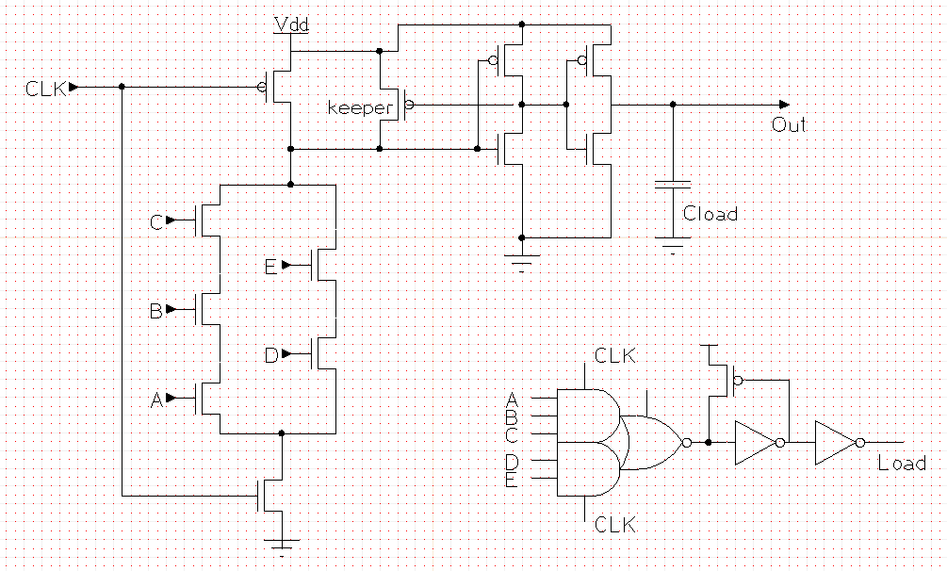
Schematic using XCircuit.
Sizing of Complex Gate​
PMOS : W=0.2u​
L=0.06u​
NMOS (A,B,C,clk):
W=0.54u​
L=0.06u​
NMOS (D,E):
W=0.36u
L=0.06u
Sizing of Keeper​
PMOS: W=0.135u​
L=0.09u​
Sizing of Inverter1​
PMOS: W=1.90u​
L=0.06u​
fin = 2
NMOS: W=1u​
L=0.06u​
​ fin =2
Sizing of Inverter2​
PMOS: W=5.7u​
L=0.06u​
fin = 6
NMOS: W=2.73u​
L=0.06u
fin = 5
Fig. Schematic AOI32

Slide 3
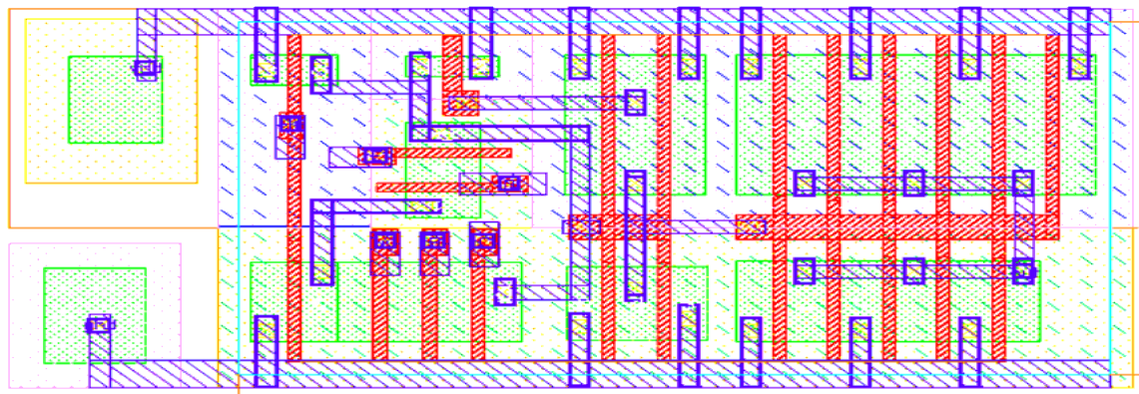
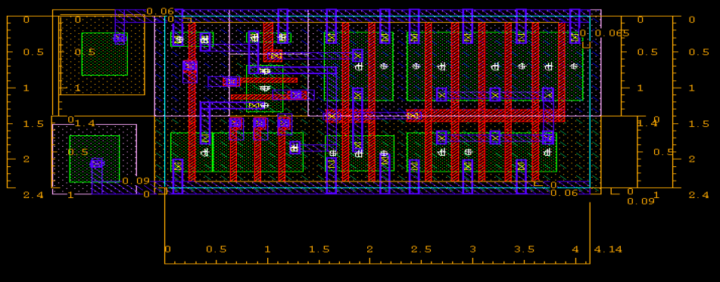
Layout showing all the layers

Slide 4
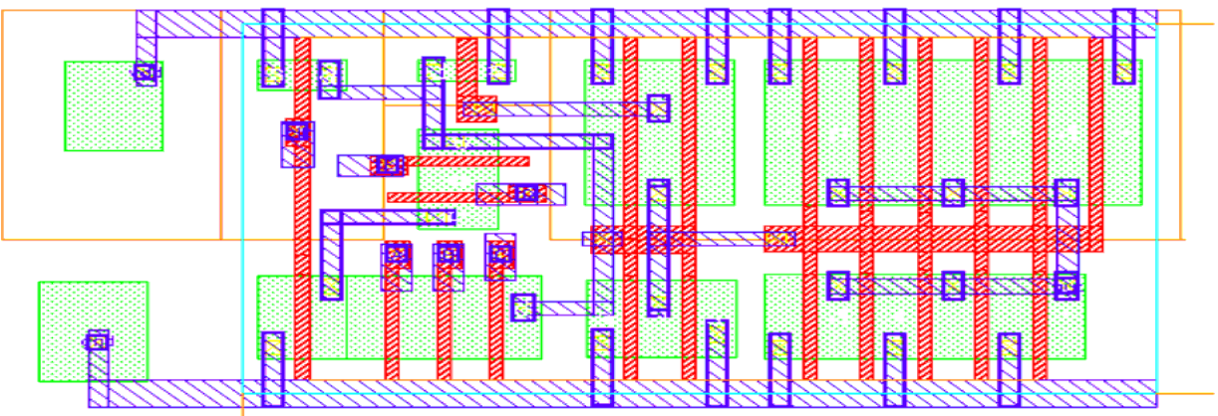
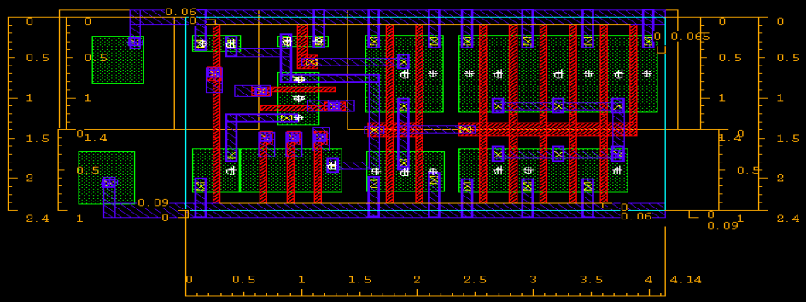
Layout with PP , NP, and VTN_L and VTP_L off
Fig 3.
Area: 9.936 sq. um.

Slide 5
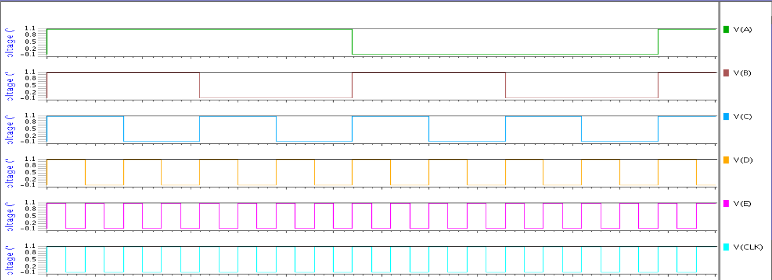
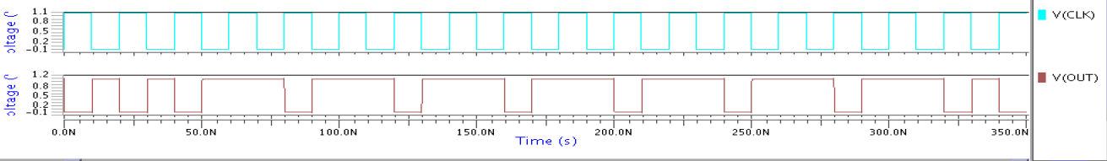
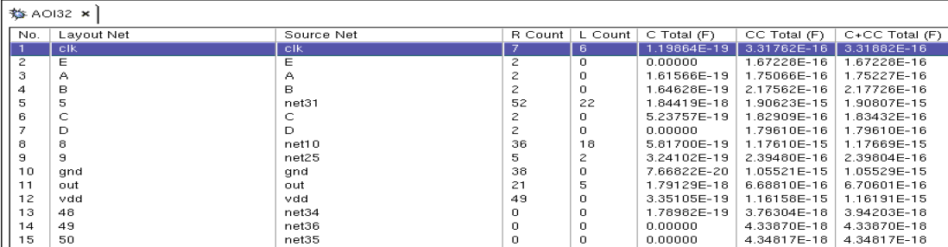
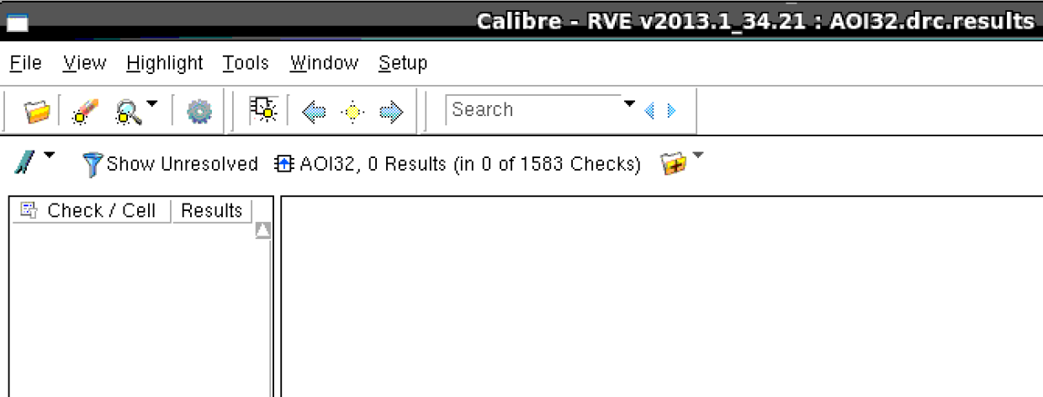
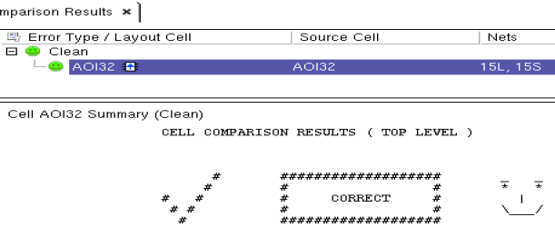
Simulation Waveform (with all inputs toggling)/DRC/LVS/PEX

Slide 6
Comparison of Pre and Post Layout Results
PVT : SS, 1.08V, -40C | Pre Layout | Post Layout
Worst Case Input(A,B,C,D,E: 0→1,1,1,0,1)
Trise (psec) | 36.45 | 38.29
Tfall (psec) | 35.36 | 36.20
Tpd Fall (psec) | 149.93 | 138.66
Pstatic (pW) | 60 | 60.03
Pdynamic (uW) | 3.88 | 3.82
Best Case Input(A,B,C,D,E : 1,1,0→1,0,0)
Trise (psec) | 36.16 | 38.10
Tfall (psec) | 35.13 | 36.08
Tpd Fall (psec) | 132.27 | 127.05
Pstatic (pW) | 53.92 | 53.96
Pdynamic (uW) | 3.86 | 3.79
PVT : SS, 1.08V, 125C | Pre Layout | Post Layout
Worst Case Input (A,B,C,D,E : 0→1,1,1,0,1)
Trise (psec) | 48.35 | 49.74
Tfall (psec) | 48.35 | 48.58
Tpd Fall (psec) | 203 | 183.52
Pstatic (nW) | 66.22 | 66.31
Pdynamic (uW) | 3.97 | 3.88
Best Case Input (A,B,C,D,E : 1,1,0→1,0,0)
Trise (psec) | 47.60 | 49.22
Tfall (psec) | 47.85 | 48.31
Tpd Fall (psec) | 175.27 | 166.
Pstatic (nW) | 66.18 | 66.25
Pdynamic (uW) | 3.93 | 3.86

Slide 7
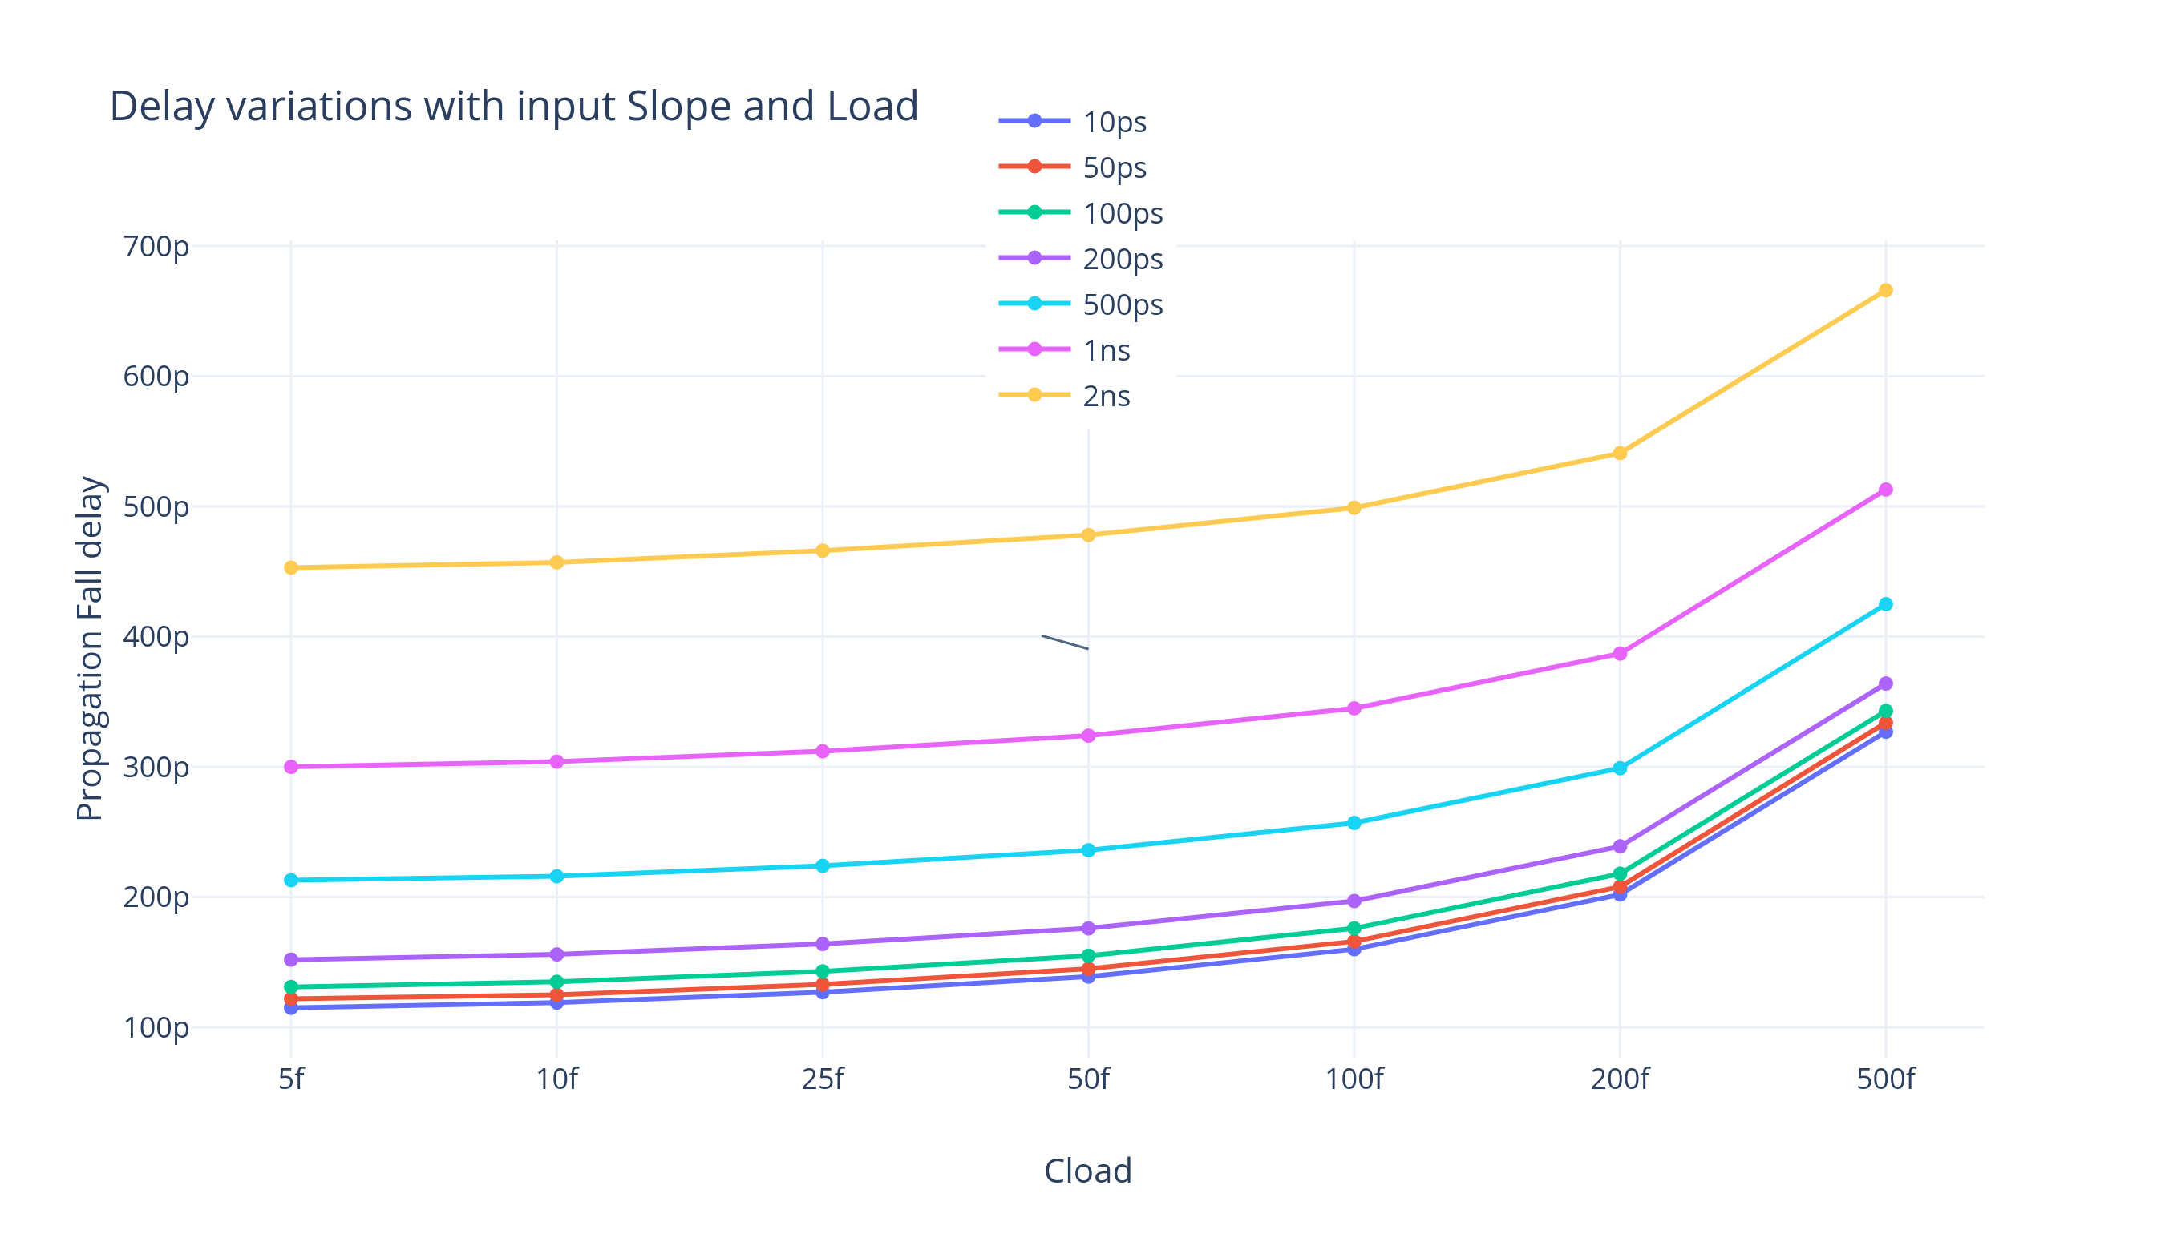
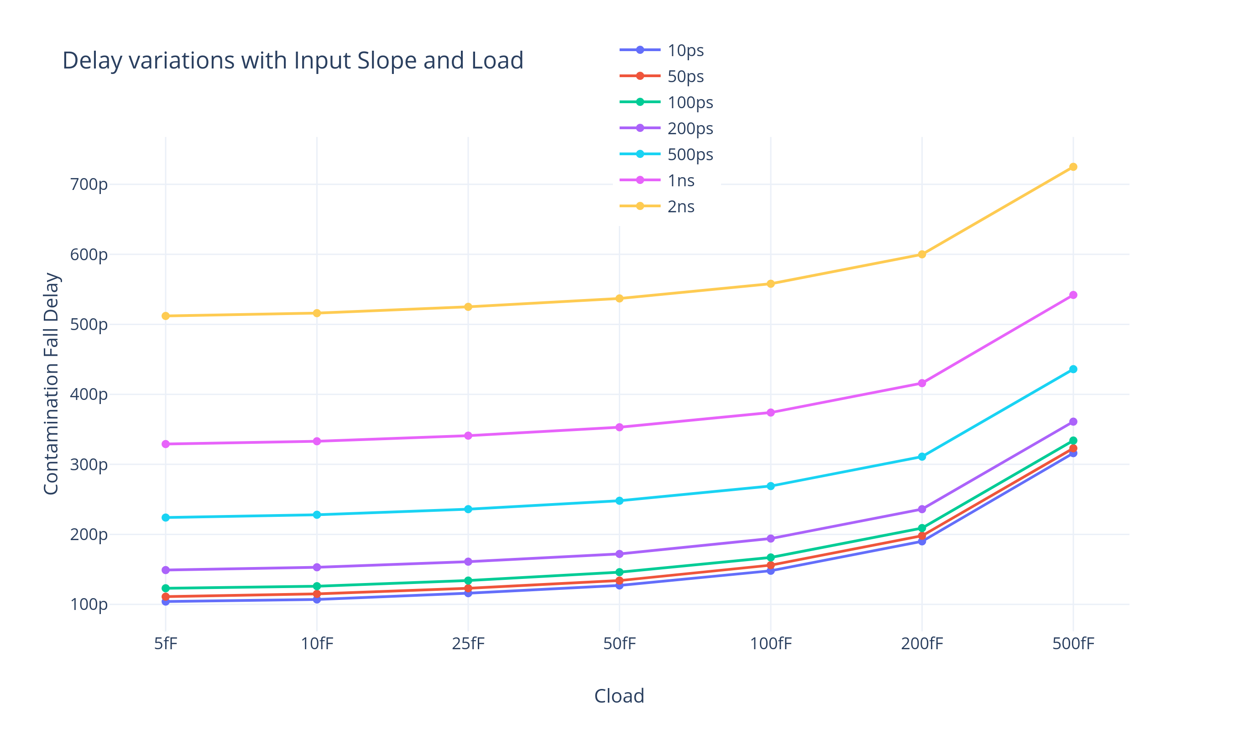
Variations with Input slope and Load

Slide 8
Analysis
Designing done at SS, 1.08V, 125C (Worst case for delay) for Rise/Fall Time < 50pSec.
Low Vt devices to improve performance. Priority Area, Performance > Power.
Sizing and Layout progression (Area and Performance optimization) :
Single stage Domino AOI32 → large sized PDN network to drive 50fF load.
Added buffer stages, sizing by stage ratio(~1/3) to reduce AOI sizes to achieve required Rise/Fall times.
Tried to use the fixed 12T height of cell to further increase widths and reduce the fingers. (Could not reduce further due to rise/fall time constraints and fingers take integer values). This improved temperature performance as device can meet 125C condition for rise/fall times.
Requirement of 7T(PMOS), 5T(NMOS) at the sides of cell, so put a notch in the n-well in middle to accommodate NMOS to further reduce width of standard cell.
Floor planning was done to the extent of critical DRC as much as possible. Increased the density of layout.
Decrease in delays in post layout : Shared diffusion, decreased diffusion capacitance.
Decrease in dynamic power in post layout : Decreased capacitances.

Slide 9
Individual Contribution
1. Sizing and Schematic Design :- Anushree, Kaustubh, Harshit
2. Characterization :- Anushree, Kaustubh, Harshit
3. Layout Design :- Anushree, Kaustubh

