Slide 1
Quantization and Pruning-Aware Deep Recurrent Models for Real-Time Human Activity Recognition on Android
Harshit Singh
Trisha Ghali

Slide 2
Problem Statement
The project addresses the core challenge of implementing Real-Time Human Activity Recognition (HAR) using deep learning models on resource-constrained smartphones.
The motivation is to enable scalable applications in mobile health, safety monitoring, and context-aware computing
The input consists of raw inertial signals
The output is a classification into one of six physical activities
Deep models are computationally expensive despite their accuracy

Slide 3
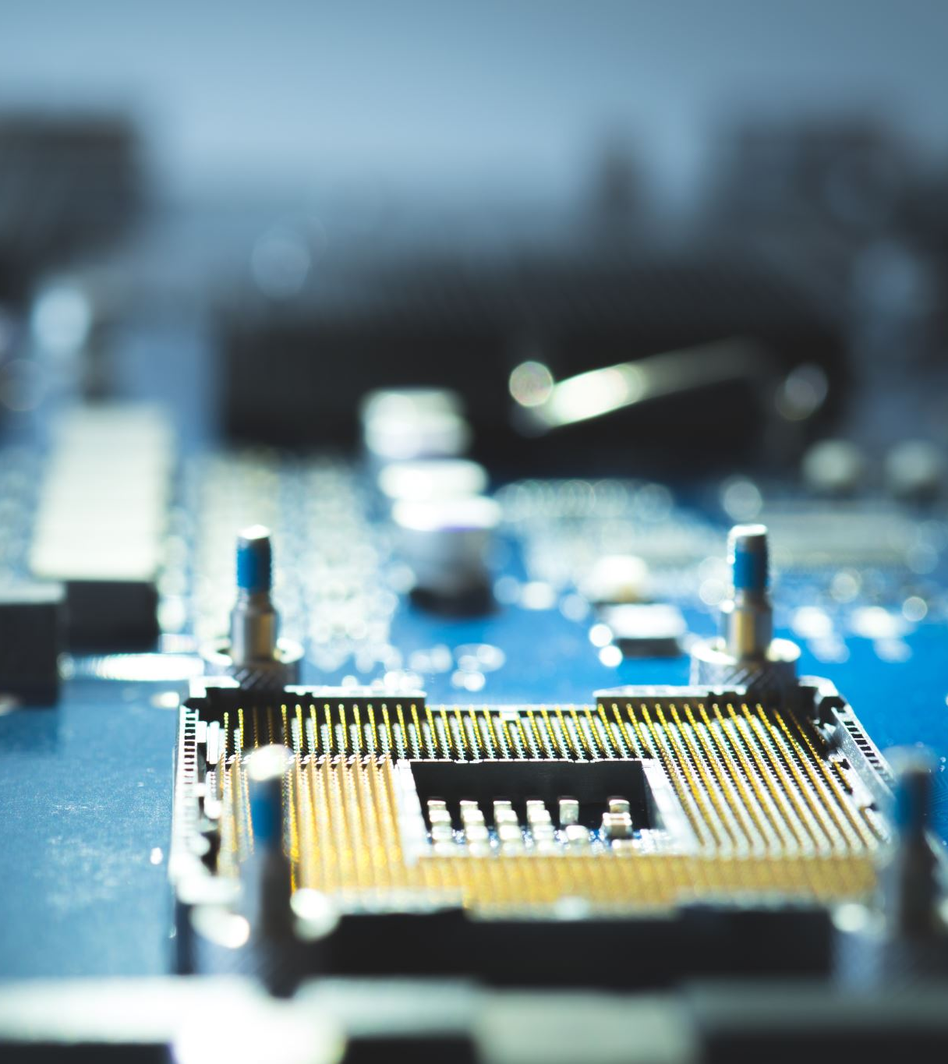
Technical Challenges
The problem is technically challenging due to the high parameter counts of CNN-LSTM/GRU models
Deployment stability is a major issue because recurrent layers (LSTMs/GRUs)
Toolchain constraints within TFLite present a significant challenge
Ensuring runtime reliability is difficult

Slide 4
Related Work
Previous HAR research successfully evolved from manual feature engineering to the use of deep learning models
The use of recurrent architectures has been widely adopted due to their effectiveness in modeling the inherent temporal structure
Prior deployment studies have focused on analyzing the runtime behavior and energy consumption of deep LSTM models on mobile platforms

Slide 5
Approach
We designed and evaluated two compact architectures: a CNN-LSTM model and a lightweight GRU model as an efficiency-focused alternative.
We applied different quantization techniques to make models mobile-friendly
We handled TFLite QAT constraints by applying QAT only to the final Dense layers.
Deployment stability was ensured by using Concrete Function Signatures during TFLite export.
We enhanced robustness by using an Autoencoder-based Anomaly Rejection mechanism

Slide 6
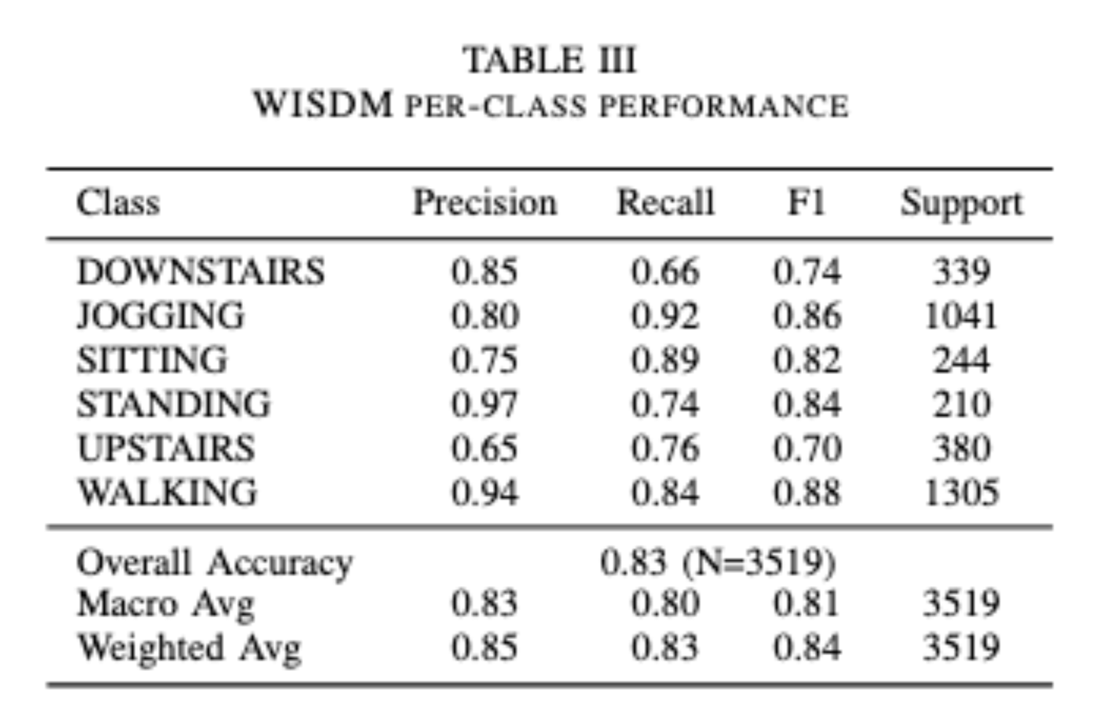
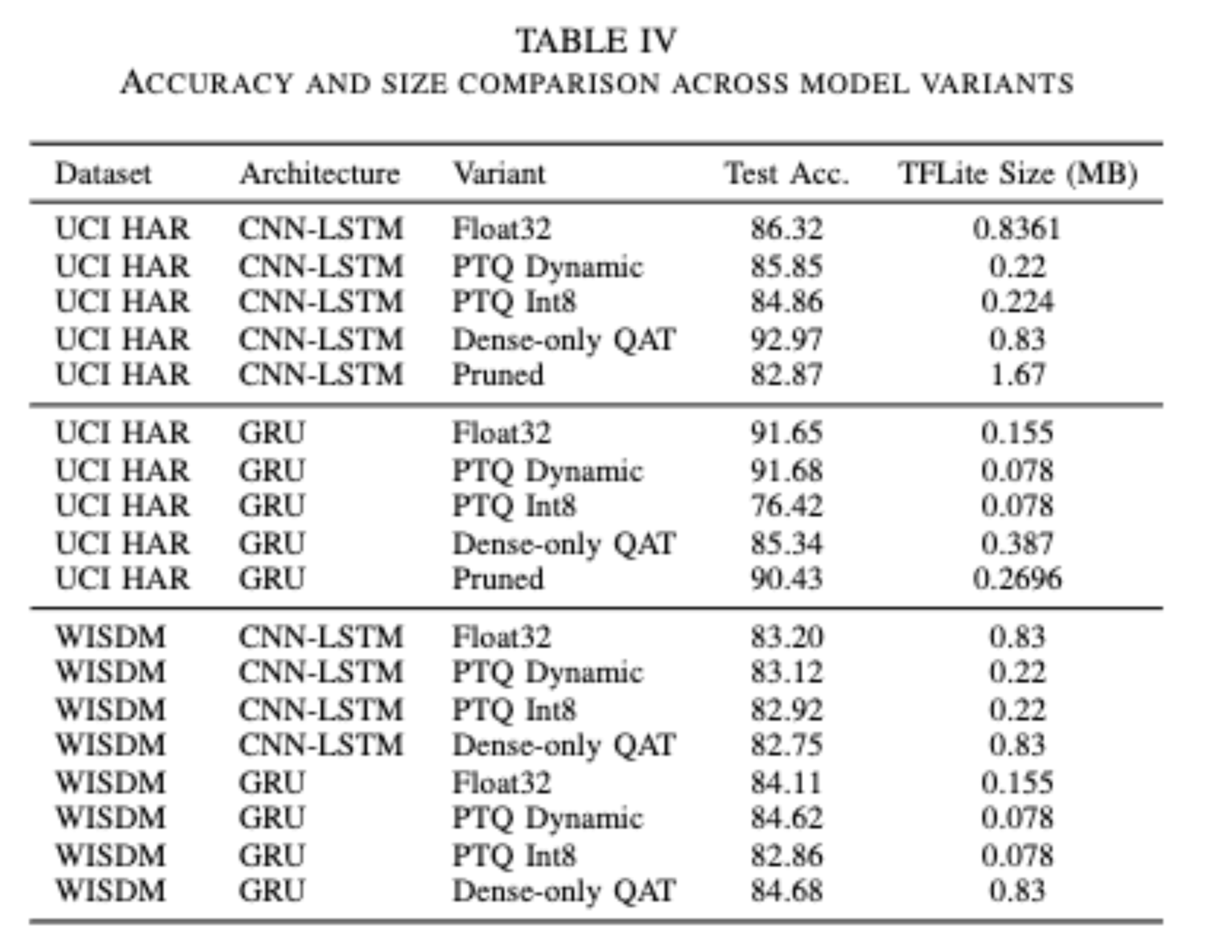
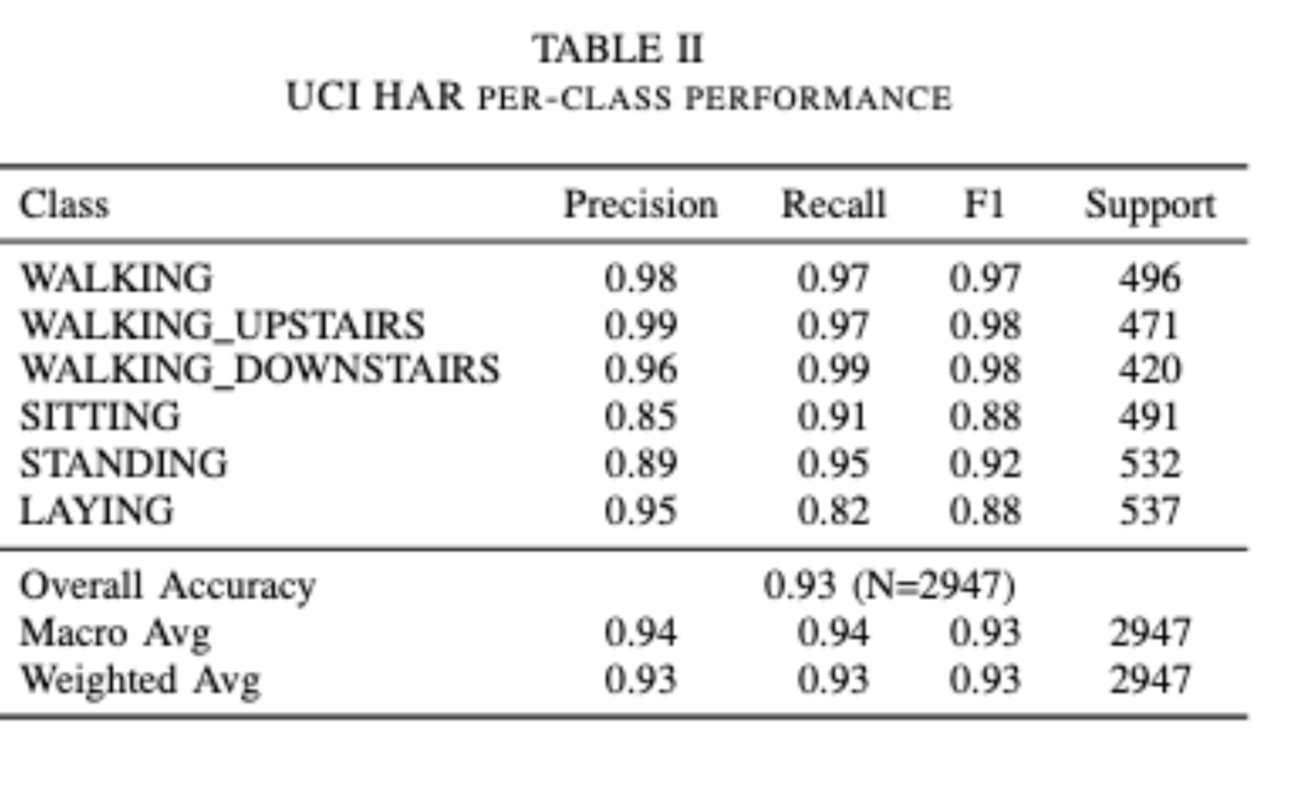
Results

Slide 7
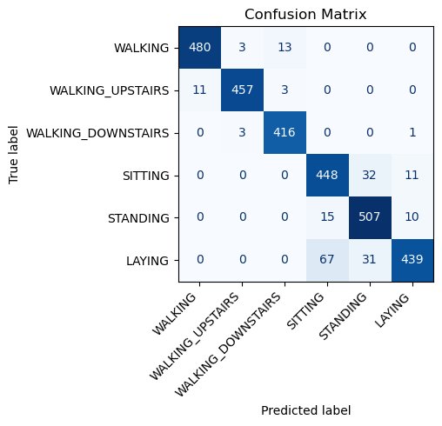
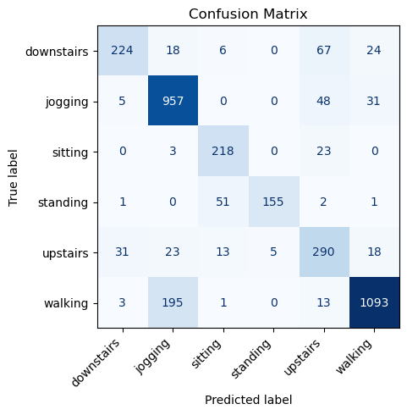
Results

Slide 8
Broader Impact
The work enables practical, low-power Human Activity Recognition (HAR) on commodity smartphones, supporting scalable health and fitness applications.
The optimization pipeline (PTQ, stable TFLite export) can be generalized to other resource-constrained mobile ML tasks, such as gesture detection.
Current limitations involve TFLite toolchain constraints that prevented full-model QAT on recurrent layers and limited the benefits of sparsity from pruning.
Future work will focus on investigating updated toolchains for full QAT support and integrating multimodal sensors for improved personalization and robustness.

