Slide 1

HOSPITAL MANAGEMENT SYSTEM
SUPERVISED BY- DR. VINAL PATEL
SUBMITTED BY-
SANKET KUMAR DAWAR(2019BCS-054)
HARSHIT SINGH(2019BCS-025)

Slide 2
CONTENTS
INTRODUCTION
EXISTING SYSTEM
PROPOSED SYSTEM
HOW DOES OUR PROGRAM WORK?
MODULE
DOCTOR.H
PATIENT.H
USED TECHNOLOGIES
ADVANTAGES

Slide 3
INTRODUCTION
EXISTING SYSTEM:
The current scenario is Hospital use manual system for management and maintenance of critical information of patient and doctors.

Slide 4
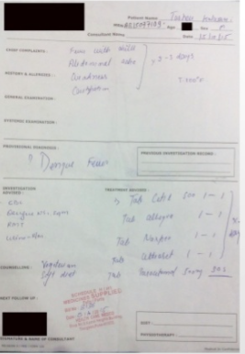
Introduction(Existing system)
which looks like this:

Slide 5
Introduction(PROPOSED SYSTEM)
THE HMS is designed for replacing all these paper works
Our HMS can control
Patient information
Doctor information
These services are provided in an efficient, cost effective manner, with the goal
of reducing the time and resources currently required for such tasks.

Slide 6
How Does Our Program Work?
The whole program is written in C++ language, and has mainly 5 files to execute successfully. These are:
1.hospitalmanagement.cpp (which is a driver code for this project)

Slide 7
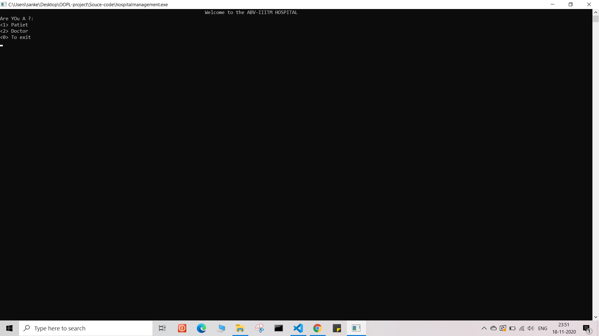
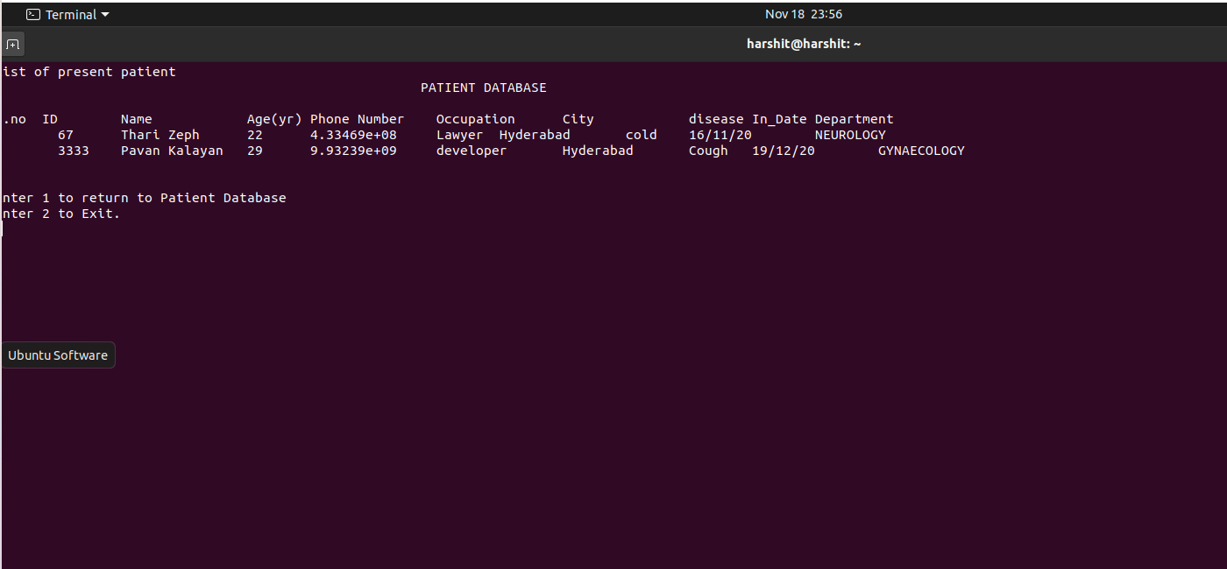

Slide 8
2. doctor.h (which is a header file containing class ‘doctor’ and has access to doctor’s data.
3. doctor.txt (where all the doctor’s data is saved in a proper manner so that data can be accessed carefully)

Slide 9
4. patient.h (which is a header file containing a class ‘patient’ and haas access to the patient’s data)
5. patient.txt (where all the patient’s data is stored and can be accessed by patient.h)

Slide 10
Modules
So we divided our project in 2 Modules:
doctor module(doctor.h)
patient module(patient.h)

Slide 11
Module(doctor.h)
So this module includes:
Adding new doctor (add_doc())
Availability of doctor(avail())
Getting info of Doctors(doc_info(),list_doc(),getSpec())
Removing Doctor(removedoc())

Slide 12
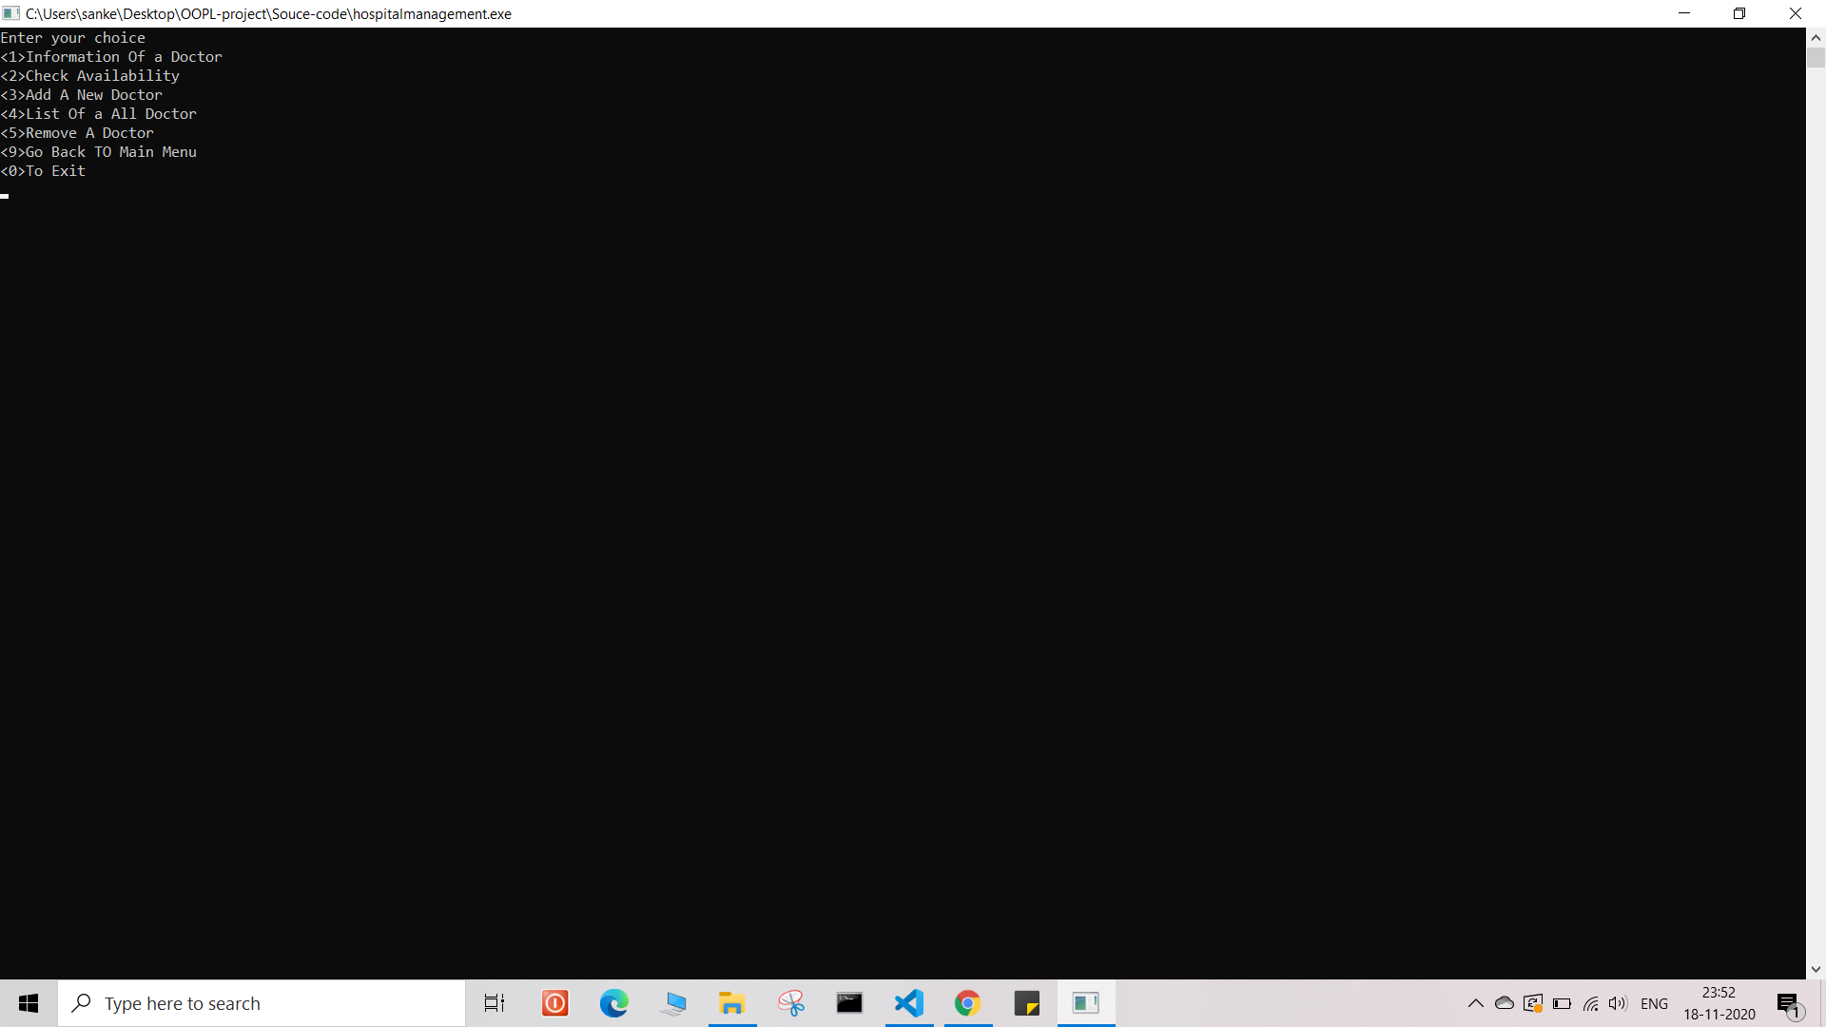

Slide 13
Module(patient.h)
So this module includes:
Adding new patient (new_p())
Checking Availability of doctor(avail())
Getting info of patient(p_info(),list_p())
Discharging Patient(discharge())
Generating bills(bill())

Slide 14


Slide 15
Used technologies
Our project is made with pure c++.This project covers following topics of C++:
Classes using as a header file
file system in C++
friend function
new function
and many more...

Slide 16
ADVANTAGES
Immediate access of data of patient and doctor
Friendly user interface
Time saving
Data can be easily insert/delete
Saving paper work
Data’s are easily approachable

Slide 17
THANKS!!

