Slide 1

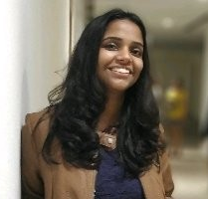

Garden Nerd : Flower Recognition Data Science Competition HackerEarth
Harshit Singhai | Shriya Garg | Devansh Pushkarna
E16CSE147 | E16CSE054 | E16CSE167
Applied Machine Learning

Slide 2
Presentation Agenda
Pre-processing of data set
Algorithm and hyper-parameter
Feature engineering
Summary
First working model
Further improvements

Slide 3

1
Pre-processing

Slide 4
Pre-processing
Image Scaling: Resized all the image from (500,500,3) to (224, 224, 3) using pre-trained VGG19 and Inception-v4 models
Data augmentation: Basic augmentation like cropping, padding and horizontal flipping were used to increase the amount of data available.
Normalizing image inputs: All the input images were rescaled to 1./255 to make sure all images have similar data distribution and make convergence faster while training network, hence improving time and complexity of the neural network.

Slide 5
2
Feature Engineering

Slide 6
Feature Engineering
Neural Network
Deep Learning
Neural network shifts the burden of feature engineering to CNN
Max-Pooling, drop out regularizations to make the model easier for Deep learning models
Deep learning has yielded amazing results by learning features and hierarchies on its own.
The network extracts features during training.

Slide 7
3
Included and excluded features

Slide 8
Included and Excluded features
Zero, zilch, zip, nada, nothing.
We had no features in our original dataset.
Hence, we did not have the liberty to add or drop features from the dataset.

Slide 9
4
First working model

Slide 10

First working model
Model from scratch
Model type used was Sequential() .
Series of Conv2D and MaxPooling2D layers were used .
Number of neurons were gradually increased from 32, 64, 128 to 256 for Conv2D layer.
“relu” activation function was used for all the layers in Conv2D layer
(3,3) filter matrix was used for all the Conv2D layers
(2,2) window sized was used for MaxPooling2D layer
Flatten layers was used to flatten the matrix before the Dense layers

Slide 11
First working model
Model from scratch
Dense layers were responsible for the classification
3 Dense layers were used with 512, 256 and 128 neurons respectively.
“Relu” activation used for the first 2 dense layers
“Softmax” activation was used for the last Dense layer. Softmax makes the output sum up to 1 so the output can be interpreted as probabilities. The model will then make its prediction based on which option has the highest probability.
For compilation of the model: ‘binary_crossentropy’ was used as a loss function, RMSprop with lr=1e-4 for optimizer and ‘acc’ for matrix was used

Slide 12
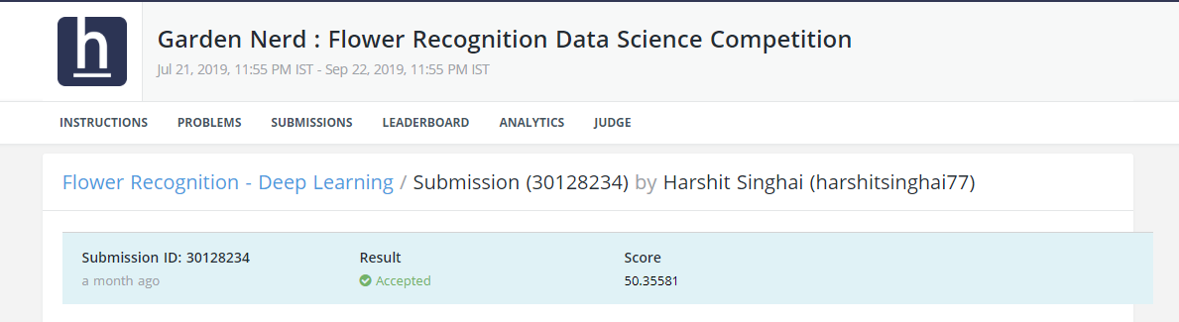
First working model
Model from scratch
train_generator, steps_per_epoch=100, epochs=30, validation_data=validation_generator, validation_steps=50

Slide 13
5
Selection of Algorithm

Slide 14
Selection of Algorithm
Built from scratch
Feature extraction
Fine-tuning
Initially, data augmentation was not used
Series of Conv2D and MaxPooling 2D was used to build the model.
Score was 50%
Pre trained models were used for feature extraction
VGG19
Resnet 50
Inception-v3
Results were not satisfactory
Unfreezed few of the top layers of VGG19 model and fine tuned the classifier as per our needs.
The newly created classifier was used for further training.

Slide 15
6
Process of hyper paramter tuning

Slide 16
Hyper parameter tuning
Learning rate
Number of epochs
Learning rate was crucial in determining how much to update the weight in the algorithm. We tried different learning rate while using RMSprop and Adam optimizer
Number of epochs are important as they hold a very fine line in underfiting and overfiting the model. More number of epochs can overfit the model which results in model not able to predict the test set accurately.
Batch size
Dropout
Batch size is imporant for learning process of of convnet. Mostly batch size of 64 and 128 is typically used. We chosed different batchs size for different pre trained model .
Dropout is a l2 regularization techniqoe to avoid overfiiting in deep neural networks,. Mostly a default value of 0.5 works good in most of the image classification task.

Slide 17
7
List of hyper parametered values

Slide 18
Tuned hyper-parameter
Batch Size
Batch size with 32 gave the best results.
Steps_per_epochs
Dropout
Steps_per_epochs around 100 was giving results in reasonable time.
Four Dropout Layers with rate of 0.2 and 0.3 were used.
Number of epochs
Number of unfreeze layers
Epoch range between 40-60
For VGG19, last 5 layers were freezed.

Slide 19
8
How many algorithms tried?

Slide 20
Algorithms Tried
Model From Scratch
VGG 19
The first model was built from scratch without data augmentation.
Pretrained VGG model was used and was fine tuned as per our needs by freezing some layers
Inception v3
Fine tuning
Inception was used for feature extraction. The results were quite ok but not great..
Transfer learning combined with Fine tuning was used on most of the pre-trained model ti improve the results.
Data Augmentation
Resnet50
Basic augmentation of the dataset was used to improve the accuracy
Resnet was used for feature extraction. and further fine tuned.

Slide 21
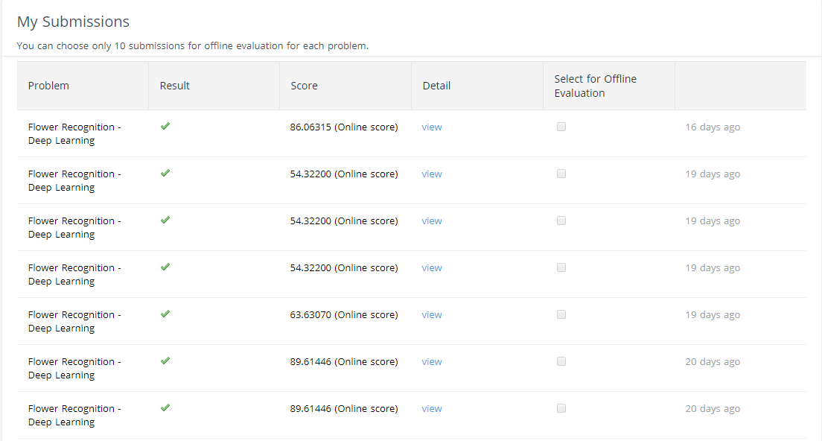
Attempts (26)

Slide 22
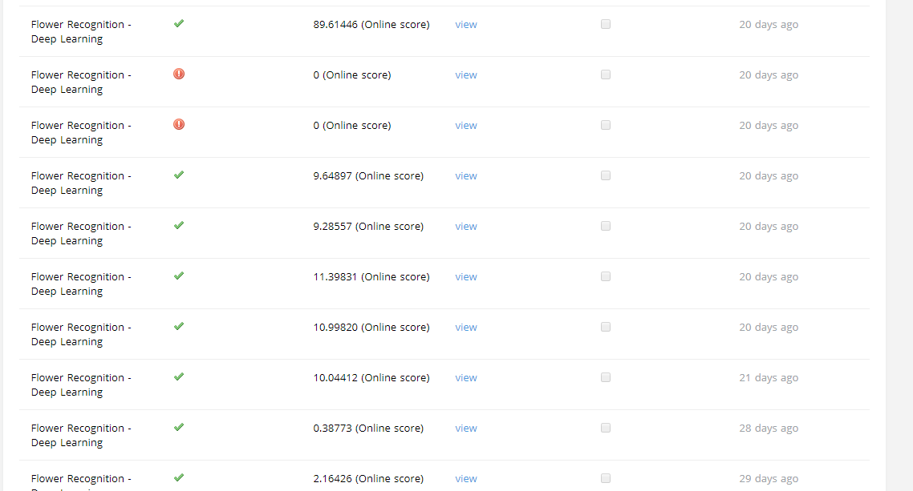
Attempts (26)

Slide 23
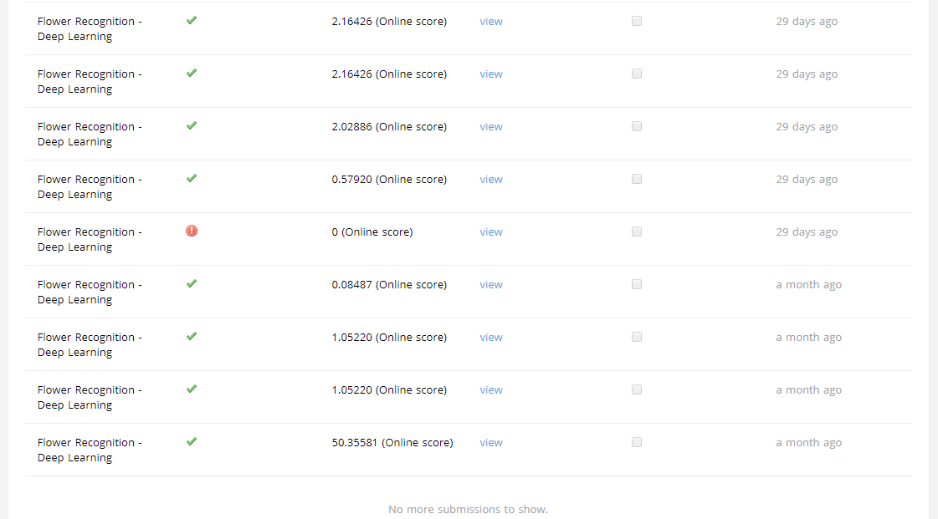
Attempts (26)

Slide 24
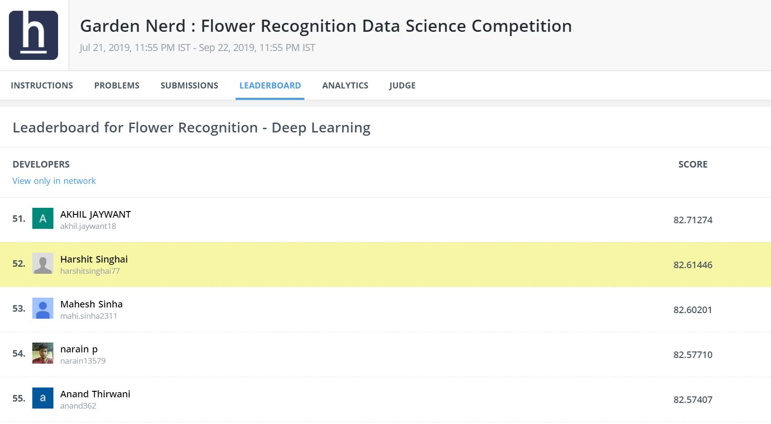
All time best Rank

Slide 25
9
Summarize the project

Slide 26
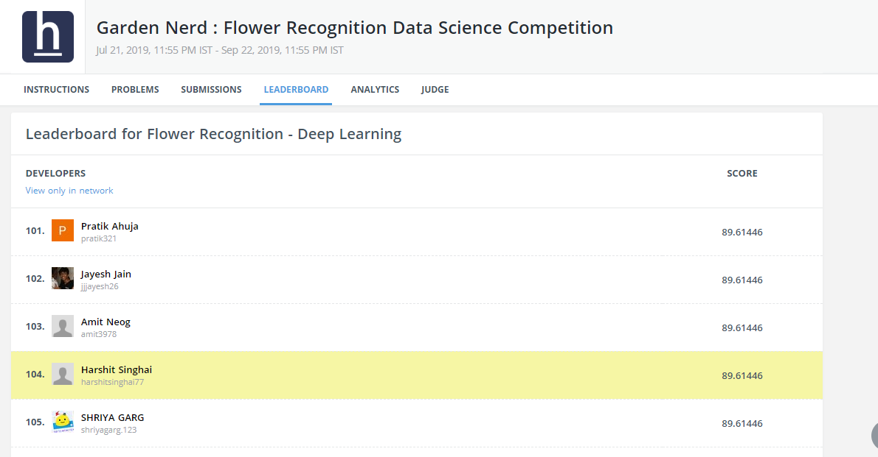
Final Leaderboard

Slide 27
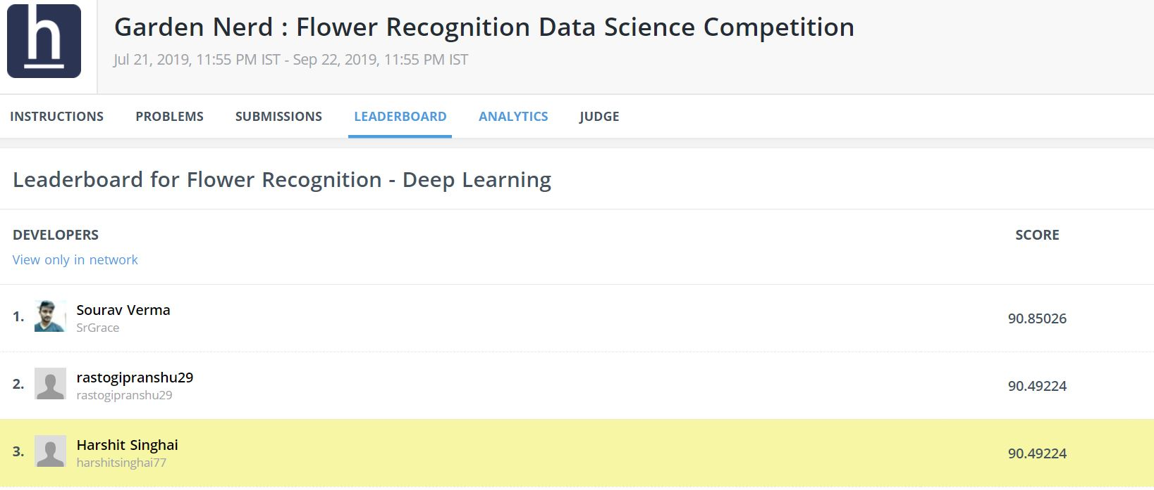
Final Leaderboard After Competition Over

Slide 28
Advantages
Helping botanist save time and effort classifying species of flowers.
Same model architecture can be trained again with more data to classify images other than the initial 102 categories.
No need for specialist to collect data, hence resources can be saved.

Slide 29
Drawbacks
Even if the flower belongs to a category beyond the trained 102, it will still be categorized among the given 102.
Model would not work well for bad or low light picture quality.
The flowers will be classified based on their scientific names, which might be irrelevant to common public.

Slide 30
10
Approach to further improve the project outcome

Slide 31
Scope of further improvements in project
Common names of flowers can be added in the dataset, hence making the project more user friendly.
Time complexity can be further improved to give faster results.
Trying different combinations.

Slide 32
Thank you!
Any questions ?

