Slide 1

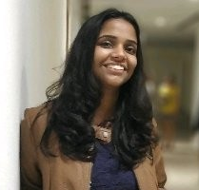

Garden Nerd : Flower Recognition Data Science Competition HackerEarth
Harshit Singhai | Shriya Garg | Devansh Pushkarna
E16CSE147 | E16CSE054 | E16CSE167
Applied Machine Learning

Slide 2
Presentation Agenda
Pre-processing of data set
Algorithm and hyper-parameter
Feature engineering
Summary
First working model
Further improvements

Slide 3

1
Pre-processing

Slide 4
Pre-processing
Data has no missing values
Number of sold items declines over the year
There are peaks in November and similar item count zic-zac behaviors in June-July-August. This inspires me to look up Russia national holiday and create a Boolean holiday features.

Slide 5
2
Feature Engineering

Slide 6
Pre-processing
Generate all shop-item pairs and Mean Encoding: Since the competition task is to make a monthly prediction, we need to aggregate the data to monthly level before doing any encodings
Generate lag features: Lag features are values at prior time steps. All sale record before 2014 are dropped, since there would be no lag features before 2014 as we have a 12-month lag.
Holiday Boolean features: I look up few Russia national holidays and created few 5 more features: December (to mark December), Newyear_Xmas (for January), Valentine_Menday (February), Women_Day (March), Easter_Labor (April). This might help boosting my score a little since December feature seems to be helpful

Slide 7
3
Included and excluded features

Slide 8
Included and Excluded features
List of included and excluded features
There are items with strange prices and sales. After detailed exploration I decided to remove items with price > 100000 and sales > 1001 (1000 is ok).
Several shops are duplicates of each other (according to its name). Fix train and test set.
We are asked to predict total sales for every product and store in the next month, and our data is given by day, so we remove unwanted columns and aggregate the data by month.

Slide 9
4
First working model

Slide 10
First working model
Initially, I tried XGBoost model.
XGBoost is a decision-tree-based ensemble Machine Learning algorithm that uses a gradient boosting framework.
XGBRegressor with max_depth=8, n_estimators=500 and subsample =0.7 was used
The evaluation metric used was “rmse” and early_stopping_rounds=20
After training the result were as follows Train rmse: 0.6921620336737511
Validation rmse: 0.7898067075909768

Slide 11
5
Selection of Algorithm

Slide 12
Selection of Algorithm
XGBoost
LightGBM
Random Forest
I ran the XGBoost with GPU version, and I follow the same tuning procedures as mentioned in LightGBM.
For some reason, I can’t seem to get a consistent result while running XGBoost, even with the same parameters.
Light GBM grows tree vertically while other algorithm grows trees horizontally meaning that Light GBM grows tree leaf-wise while other algorithm grows level-wise.
RandomForestRegressor(n_estimators=50, max_depth=7, random_state=0, n_jobs=-1).
Train rmse: 0.6985868322226099 Validation rmse: 0.776123635046122

Slide 13
6
Process of hyper paramter tuning

Slide 14
Hyper parameter tuning
n_estimators
Cross validations
early_stopping_rounds
random_state

Slide 15
7
List of hyper parametered values

Slide 16
Tuned hyper-parameter
n_estimators
The value of n_estimators for XGBRegressor is 500
early_stopping_rounds
booster
early_stopping_rounds = 20 gave the best results
booster='gbtree'
max_depth
min_child_weight
max_depth=10
The best value is 0.5

Slide 17
8
How many algorithms tried?

Slide 18
Algorithms Tried
Random Forest
Lightgbm
XGBoost
Catboost
Linear Regression
KNN Regressor

Slide 19
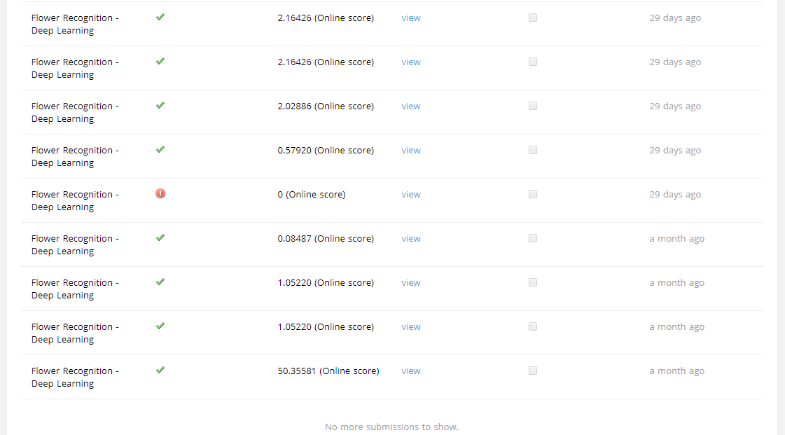
Attempts (26)

Slide 20
9
Summarize the project

Slide 21
Advantages
Predicting futures sales is huge asset for any company or organization.
Companies use sales forecasting to predict business performance in the coming quarters
Have a positive impact on stock prices and investor perceptions. Inversely, failing to meet the forecasted goal can significantly hurt stock prices

Slide 22
Drawbacks
More better EDA can be done
More time to try different algorithms and parameters.
Steep learning curve using XGBoost, Catboost, LightGBM

Slide 23
10
Approach to further improve the project outcome

Slide 24
Scope of further improvements in project
Implement neural network
Time series
LSTM neural network

Slide 25
Thank you!
Any questions ?

