Slide 1

[Samsung PRISM] Preliminary Discussion
AI Watermark Detection
Team
College Professor(s):
Dr. Parvathi R - parvathi.r@vit.ac.in
Dr. Pavithra Sekar - pavithra.sekar@vit.ac.in
2. Students:
Harshit Kumar Singh / harshitkumar.singh2022@vitstudent.ac.in
Pranav Seelam / Pranav.seelam2022@vitstudent.ac.in
Soumya Ranjan Nayak / soumyaranjan.nayak2022@vitstudent.ac.in
Ridhi / ridhi.2022@vitstudent.ac.in
Harsha Kumar A / harshakumar.a2022@vitstudent.ac.in
3. Worklet ID: 24OD16
Date: 5 Aug 2019

Slide 2
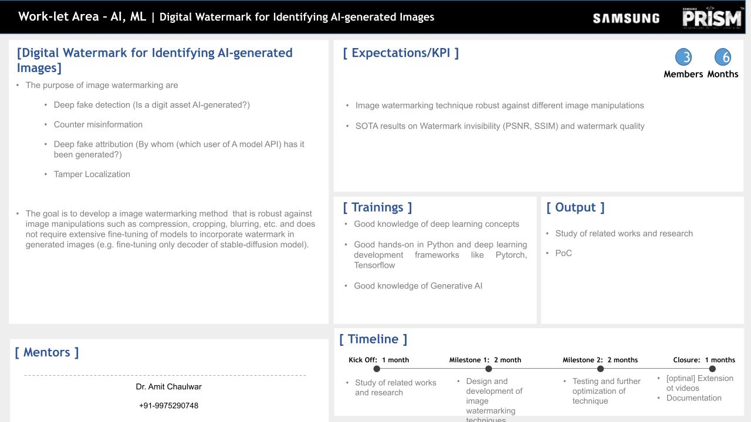
Notes:
-

Slide 3
Literature survey and study
Major Observations / Conclusions:
1. Feature extraction for detection of watermarking algorithm
Published – 2024 (2024 20th IEEE International Colloquium on Signal Processing & Its Applications (CSPA)
Algorithm – Least Significant Bit (LSB) + Discrete Cosine Transform (DCT) for freq. embeddings
Tech - TensorFlow/Keras, PyTorch
Model – Convolutional Neural Networks (CNNs) for image analysis.
Datasets – Custom Datasets of varying watermark positions, and styles.
2. Review on Digital Watermarking Techniques and Its Retrieval
Published – 2023 (2022 International Conference on Fourth Industrial Revolution Based Technology and Practices (ICFIRTP))
Algorithm –Steganography, DCT-DWT-SVD
Tech – TensorFlow, Cryptography
Model – Convolutional Neural Networks (CNNs) for image analysis.
Datasets – Custom Datasets of varying watermark positions, and Video, Images and Audio
3. Digital Image Watermarking using DWT and Encryption with RGB Pixel Shuffling and PWP Techniques
Published – 2023 3rd International Conference on Intelligent Technologies (CONIT)
Algorithm DCT, PWP and RGB Pixel Shuffling
Tech - MATLAB
Model – Watermarking with Cryptography
Datasets – Custom Datasets of varying watermark positions, and styles.

Slide 4
Literature survey and study
Major Observations / Conclusions:
4. Image Watermarking Technique Using Convolutional Autoencoder Published – 2023 International Conference on Advances in Electronics, Control and Communication Systems (ICAECCS)
Algorithm – CNN with Autoencoders
Tech - TensorFlow, Crypyography
Model – Convolutional Neural Networks (CNNs) for image analysis.
Datasets – Custom Datasets of varying watermark positions, and styles.
5. Efficiency Evaluation Parameters of Digital Image Watermarking Techniques Published – 2023 9th International Conference on Advanced Computing and Communication Systems (ICACCS)
Algorithm –Steganography, DCT-DWT-SVD
Tech – TensorFlow, Crypyography
Model – Convolutional Neural Networks (CNNs) for image analysis.
Datasets – Custom Datasets of varying watermark positions, and Video, Images and Audio
6. Digital Image Watermarking using DWT and Encryption with RGB Pixel Shuffling and PWP Techniques
Published – 2023 3rd International Conference on Intelligent Technologies (CONIT)
Algorithm DCT, PWP and RGB Pixel Shuffling
Tech - MATLAB
Model – Watermarking with Cryptography
Datasets – Custom Datasets of varying watermark positions, and styles.

Slide 5
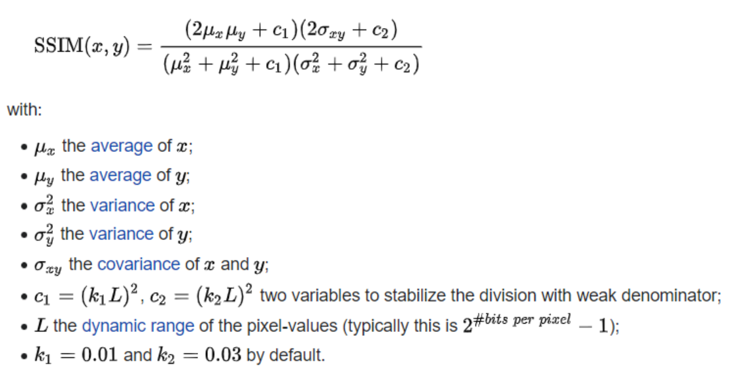
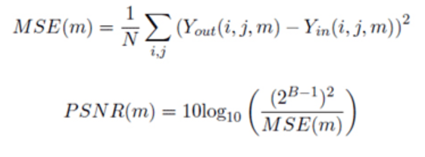
Literature survey and study
Major Observations / Conclusions:
Metrics Used for Calculation:-
PSNR:- SSIM:-
PSNR is a derivative of the Signal to Noise Ratio
comparing the maximum possible signal energy to
the noise energy.

Slide 6
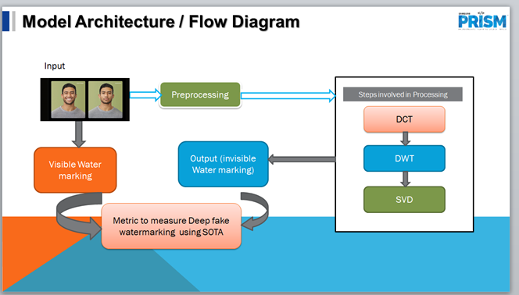

Slide 7
Identified Resource Requirements
Mention any GPU/Device etc requirement here clearly.
Also mention which of these can be fulfilled at college level (Lab etc).
We have High Configuration Lab to complete the allotted project.

Slide 8
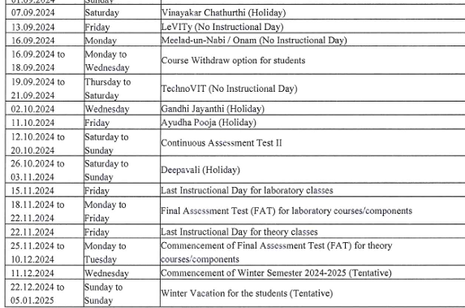
Academic Calendar Breaks (If Any)
Mention any planned academic activity (Internals/Exams/Holidays/Events/Other Internships etc) in next 6 months which will impact project timeline.
This helps in setting up the expectation of delivery timeline.

Slide 9
Queries
Challenges :
(Discuss in the form of bullets, what are the next action steps, any road blocks / bottlenecks)
1.Maintaining Image Quality (Invisibility of Watermark)
- Trade-off Between Invisibility and Robustness
- AI-Generated Image Characteristics
2. Robustness Against Attacks
- Susceptibility to Transformations
- Adversarial Attacks
3. Distinguishing Between Original and AI-Generated Images
- Similarity in Visual Quality
- Overfitting to Specific Image Types
4. Computational Complexity
- Efficiency in Embedding and Detection
- Real-Time Processing
5. Ethical and Legal Considerations
-Watermarking Bias
- Legal Implications
6. Perceptual Adaptation
- Human Perception Limitations
- Adaptation to AI-Generated Artifacts
7. Differentiating Similar AI Models
- Multiple AI Models Producing Similar Outputs
8. Scalability
- Handling Large-Scale Datasets
9. Ensuring Compatibility with AI-Driven Image Modifications
- Post-Processing by AI

Slide 10
Professor Comments
Slide to be filled in by professor (Either of two)
Please mention below points at the least:
Proposed monthly progress approach
Latest paper reviewed regarding the problem statement area
Professor Expert Insights
Literature Survey (G-sheet)
System Design & Development (1 Month)
Coding and Implementation (2 Months)
Testing & Optimization (2 Months)
Documentation & Demo (1 month)

Slide 11
Thank you

