Slide 1

[Samsung PRISM] Preliminary Discussion
AI Watermark Detection
Team
College Professor(s):
Dr. Parvathi R - parvathi.r@vit.ac.in
Dr. Pavithra Sekar - pavithra.sekar@vit.ac.in
2. Students:
Harshit Kumar Singh / harshitkumar.singh2022@vitstudent.ac.in
Pranav Seelam / Pranav.seelam2022@vitstudent.ac.in
Soumya Ranjan Nayak / soumyaranjan.nayak2022@vitstudent.ac.in
Ridhi / ridhi.2022@vitstudent.ac.in
Harsha Kumar A / harshakumar.a2022@vitstudent.ac.in
3. Worklet ID: 24OD16
Date: 5 Aug 2019

Slide 2
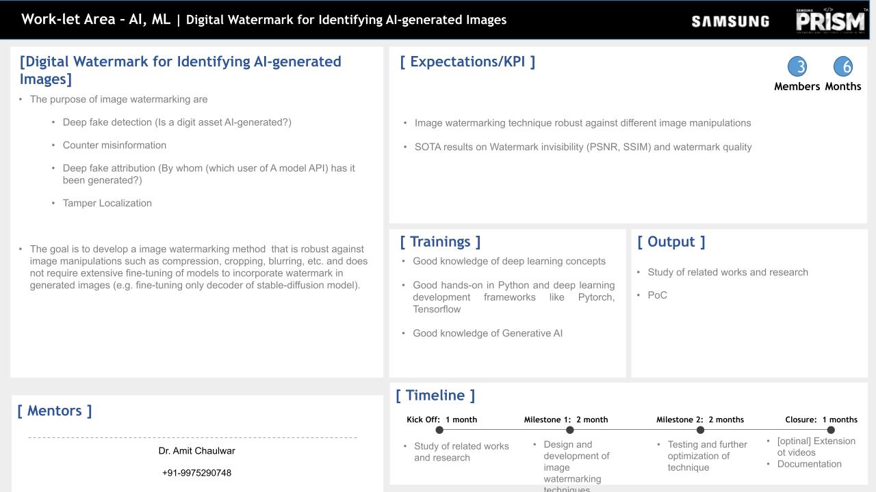
A Comparative Analysis and Proposed Approach

Slide 3
1. Introduction
This presentation provides a comprehensive analysis of digital watermarking techniques applicable to AI-generated images. It explores the challenges of digital rights management and proposes a hybrid approach that integrates traditional signal processing and modern deep learning methods.

Slide 4
2. Literature survey and study
2.1 HiDDeN: Hiding Data With Deep Network
HiDDeN (Hiding Data With Deep Networks) represents a paradigm shift in digital watermarking by leveraging the power of deep learning.
This approach moves away from traditional signal processing techniques and instead utilizes neural networks for both the embedding and extraction of watermarks in images.

Slide 5
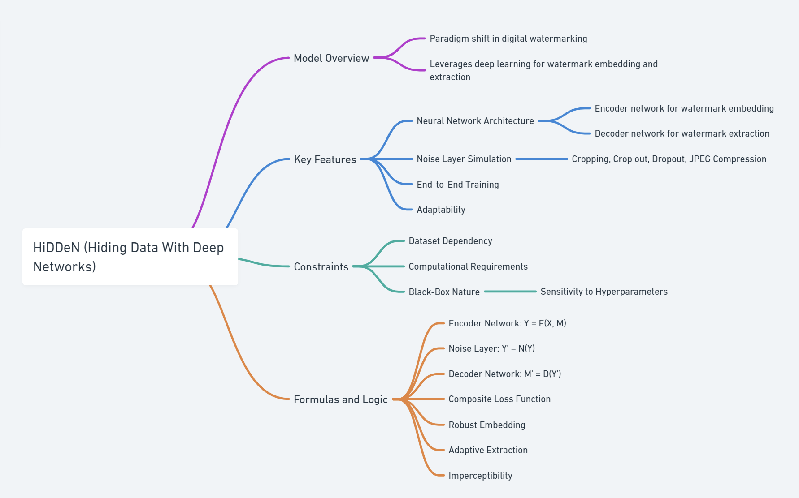
Literature survey and study
Key Features
Notes:
-

Slide 6
Literature survey and study
Key Features
Neural Network Architecture: HiDDeN employs a dual-network structure:
An encoder network for watermark embedding
A decoder network for watermark extraction
Noise Layer Simulation: The model incorporates various noise layers that simulate real-world image manipulations, including:
Cropping: Randomly removing portions of the image
Crop out: Setting random image regions to zero
Dropout: Randomly zeroing individual pixels
JPEG Compression: Simulating lossy compression artifacts
End-to-End Training: The entire system is trained end-to-end, allowing it to learn optimal strategies for both embedding and extracting watermarks under various distortions.
Adaptability: The neural network approach allows the system to adapt to different types of images and watermarks, potentially making it more versatile than traditional methods.

Slide 7
2.2 Invisible-Digital-Watermarking
The Invisible-Digital-Watermarking project focuses on developing a robust system for protecting digital images from unauthorized use and distribution. This approach aims to embed imperceptible signatures within images while maintaining resilience against common image processing operations and attacks.

Slide 8
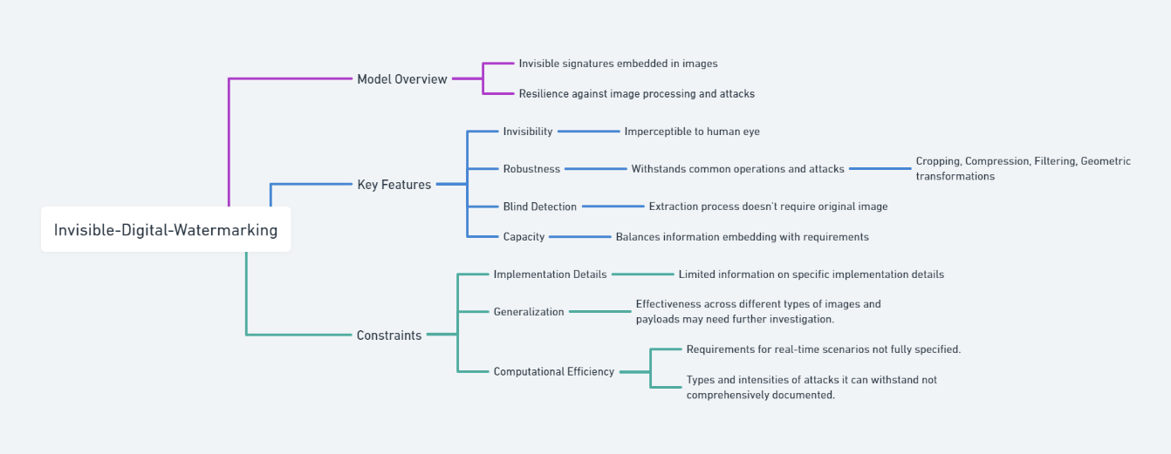
Literature survey and study
Key Features
Notes:
-

Slide 9
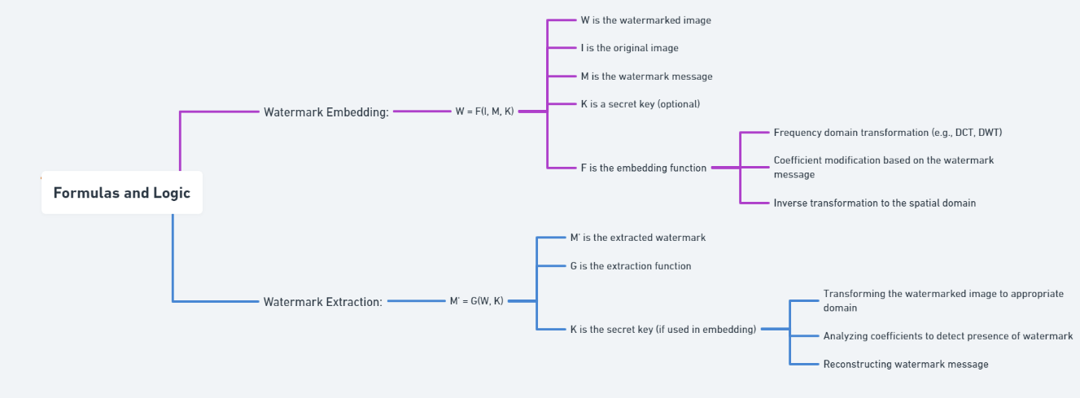
Literature survey and study
Formula and Logic
Notes:
-

Slide 10
2.3 DWT-SVD-digital-watermarking
The DWT-SVD-digital-watermarking project implements a digital watermarking technique that combines two powerful mathematical tools: Discrete Wavelet Transform (DWT) and Singular Value Decomposition (SVD). This approach leverages the multi-resolution analysis capabilities of DWT and the numerical properties of SVD to create a robust watermarking system.

Slide 11
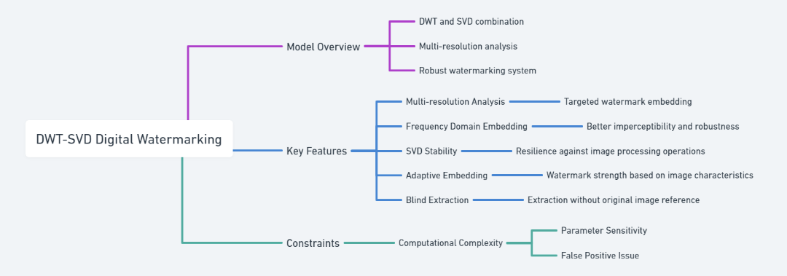
Literature survey and study
Key Features
Notes:
-

Slide 12
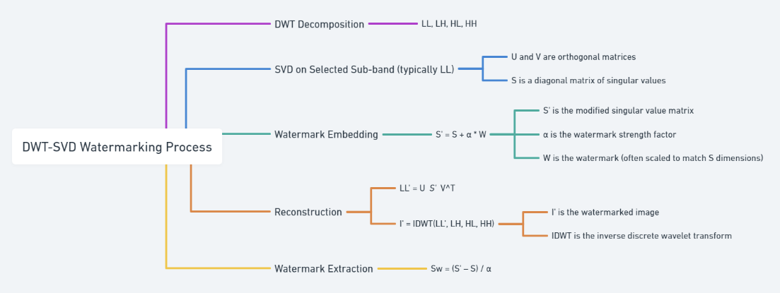
Literature survey and study
Formula and Logic
Notes:
-

Slide 13
2.4 Digital-Watermark
The digital-watermark project presents a unique approach to digital watermarking by incorporating principles from visual cryptography. This method splits the watermark into shares, providing an additional layer of security and flexibility in the watermarking process.

Slide 14
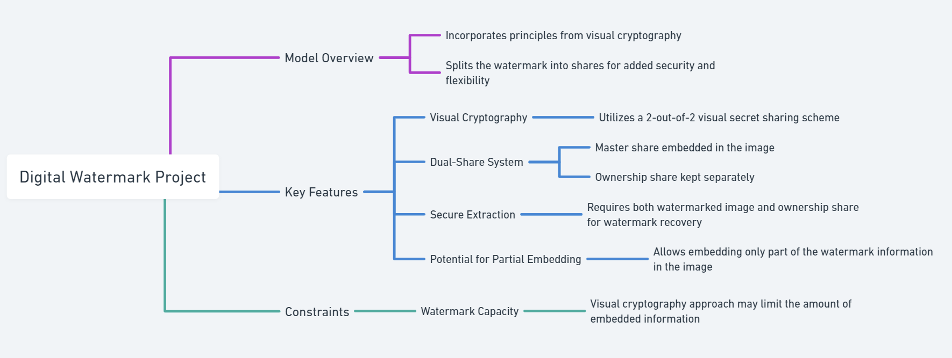
Literature survey and study
Key Features
Notes:
-

Slide 15
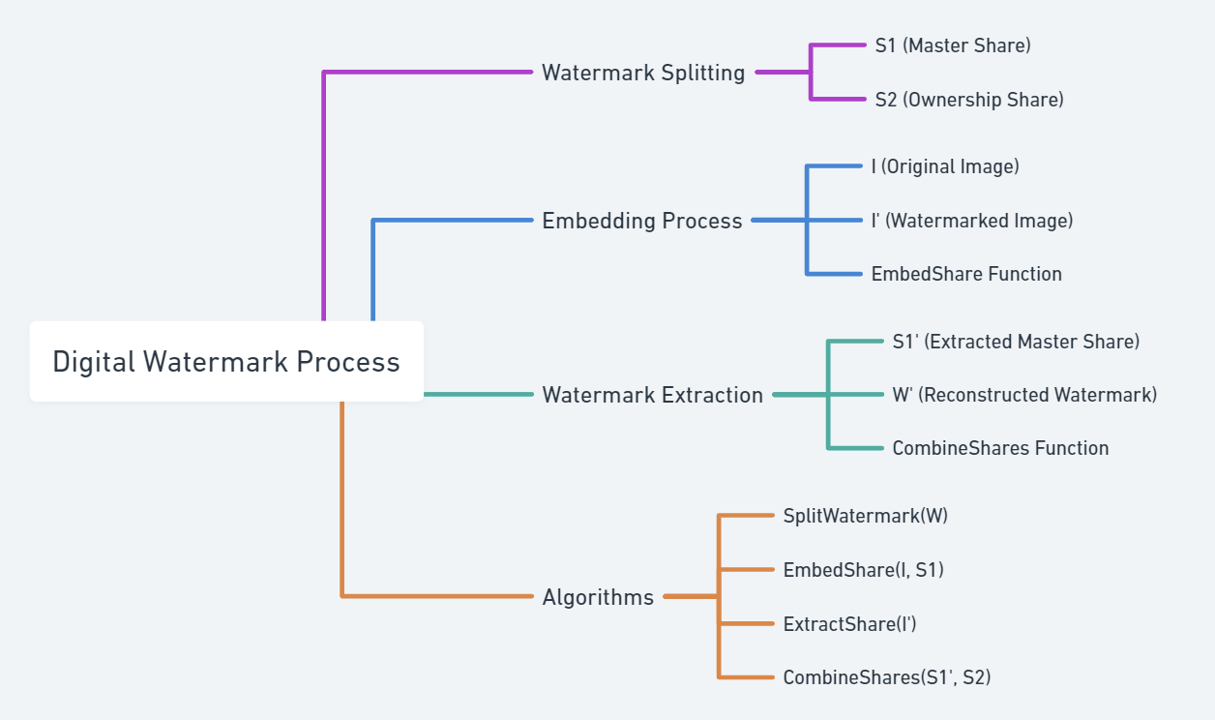
Literature survey and study
Formulas and Logic
The digital-watermark process can be described in the following steps:
Watermark Splitting: [S1, S2] = SplitWatermark(W) Where:
W is the original watermark
S1 is the master share (to be embedded)
S2 is the ownership share (kept separately)
Embedding Process: I' = EmbedShare(I, S1) Where:
I is the original image
I' is the watermarked image
EmbedShare is the function that embeds S1 into I
Watermark Extraction: S1' = ExtractShare(I') W' = CombineShares(S1', S2) Where:
S1' is the extracted master share
W' is the reconstructed watermark
The specific algorithms for Split Watermark, Embed Share, Extract Share, and combine Shares would depend on the chosen visual cryptography scheme and embedding technique.

Slide 16
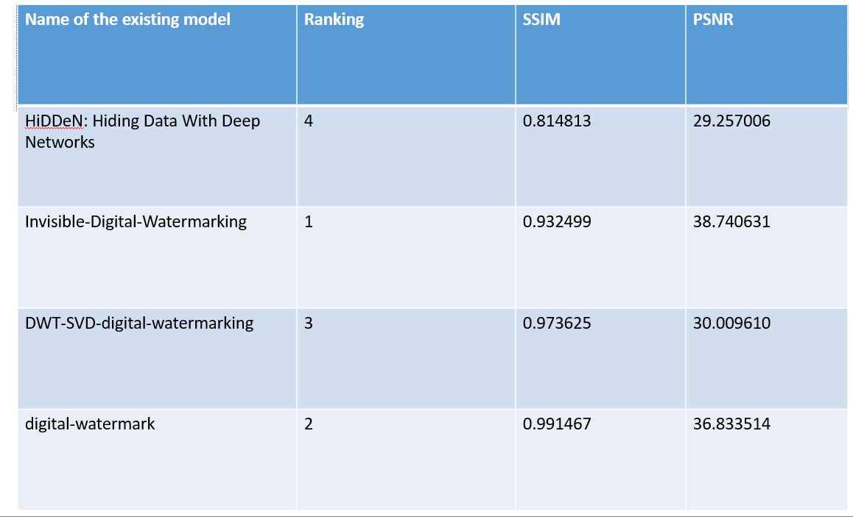

Slide 17
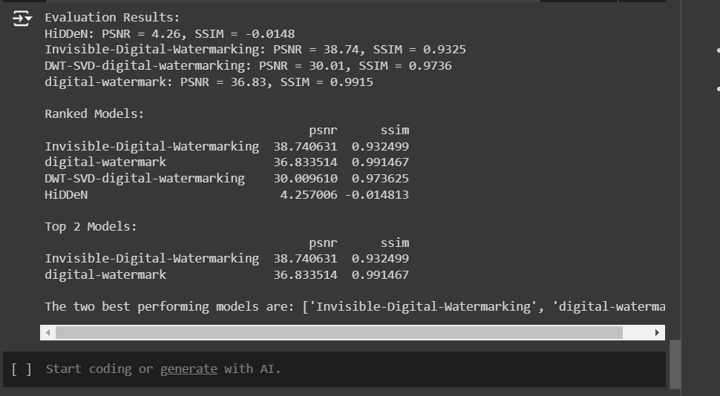
Output from Comparison
DATASET : COCOhttps://github.com/ultralytics/yolov5/releases/download/v1.0/coco128.zip

Slide 18
5. Conclusion
After comparing the existing watermarking models, our analysis reveals that traditional approaches often struggle with robustness against AI-generated image manipulations. In terms of performance metrics, models typically show limitations in maintaining high Peak Signal-to-Noise Ratio (PSNR) and Structural Similarity Index (SSIM) under complex transformations. While some models achieve moderate success in specific conditions, none consistently balance security, image quality, and resilience across various use cases, highlighting the need for further innovations in this field.

Slide 19
Thank you

