Slide 1

[Samsung PRISM] Preliminary Discussion
AI Watermark Detection
Team
College Professor(s):
Dr. Parvathi R - parvathi.r@vit.ac.in
Dr. Pavithra Sekar - pavithra.sekar@vit.ac.in
2. Students:
Harshit Kumar Singh / harshitkumar.singh2022@vitstudent.ac.in
Pranav Seelam / Pranav.seelam2022@vitstudent.ac.in
Soumya Ranjan Nayak / soumyaranjan.nayak2022@vitstudent.ac.in
Ridhi / ridhi.2022@vitstudent.ac.in
Harsha Kumar A / harshakumar.a2022@vitstudent.ac.in
3. Worklet ID: 24OD16
Date: 5 Aug 2019

Slide 2
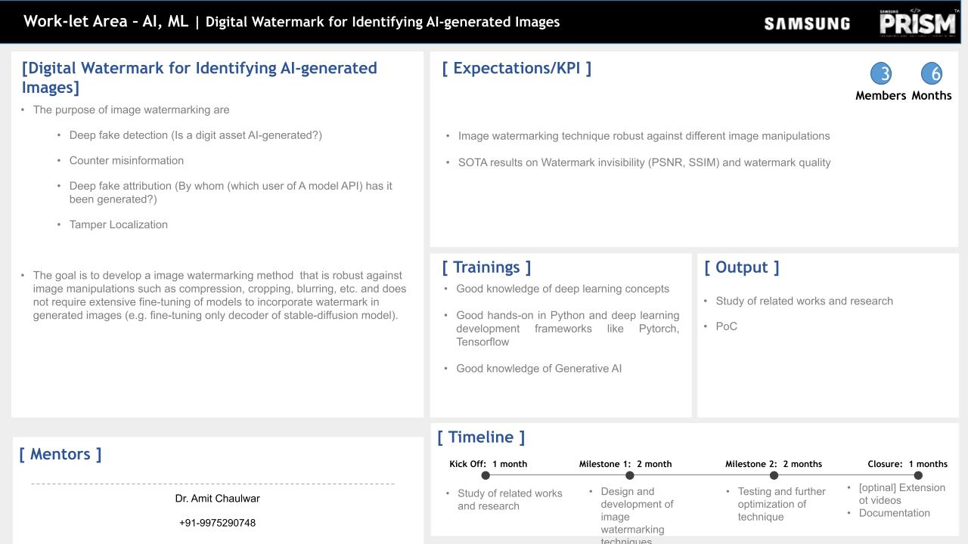
A Comparative Analysis and Proposed Approach

Slide 3
Outline -
Till previous meeting, we had explored different methods of Watermarking like DWT (Discrete Wavelet Transforms), SVD (Singular Valued Decomposition) etc. , and got the clarity about implementing the concept with the required outcomes.
Feedback from [Samsung PRISM] | VITC_Monthly Connect-2 –
Suggested Stable signature.
Improve handling of social media cropping and partitioning.
Add guardian noise to address compression, cropping, and scaling issues.
Enhance tamper localization – consider cases where only a part of the image is tampered with.

Slide 4
Why Existing Learning-Based Models Aren’t Good Enough
Static Watermarking Issues:
Fixed, unchanging watermarks are predictable and easier to remove or tamper with.
Example techniques: DWT, SVD (e.g., DwDctSVD). These methods embed watermarks in low-frequency bands but are vulnerable to compression and cropping attacks.
Learning-Based Watermarking Issues:
Example: Stable Signature (LDM-based watermarking).
Embeds watermarks in latent space but has high computational costs and requires fine-tuning.
Produces both watermarked and dewatermarked images, which is counterproductive.

Slide 5
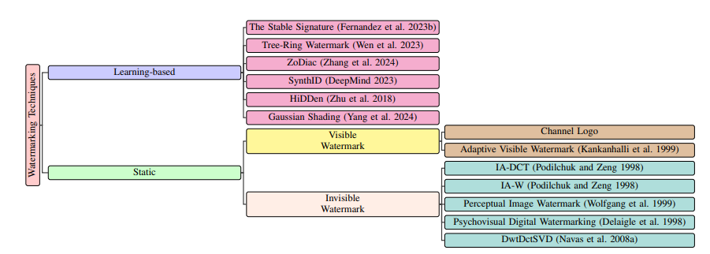
Key Limitations of Existing Models:
Lack robustness against tampering.
High computational complexity for LDM-based models.
Dewatermarking undermines security.
Why Existing Learning-Based Models Aren’t Good Enough

Slide 6
Outcomes of the existing models
Output of Current Watermarking Models
Watermarked Image:
The model embeds an invisible watermark into the AI-generated image.
This watermark is typically designed to be imperceptible to the human eye but detectable through specialized verification models.
Dewatermarked Image:
Some existing models allow the removal of the watermark from the image.
This means an attacker could potentially extract a clean version of the image without the watermark, rendering the watermarking process ineffective.
If an unauthorized user can dewatermark the image, the watermark loses its purpose as a security and ownership verification tool.

Slide 7
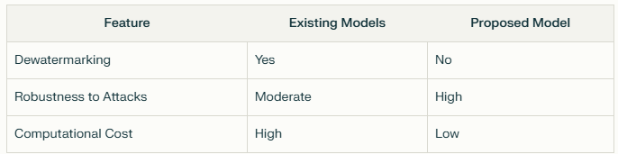
Outcomes of the existing models
Why is this Problamatic?
Compromised Integrity: If watermarks can be easily removed, they fail to ensure authenticity, traceability, and ownership of AI-generated images.
Vulnerability to Attacks: Common techniques like cropping, compression (JPEG), and blurring can erase or distort watermarks, making them ineffective
2. Advantages of Our Model Over Existing Models:
No dewatermarking; only extraction for verification.
Higher robustness to tampering due to ViT’s global dependency modeling. Faster inference compared to LDM-based methods.

Slide 8
Why not LDM(s)?
Limitations of LDMs for Watermarking:
Operates in latent space, requiring significant computational resources.
Embedding in latent space ensures high PSNR/SSIM but complicates tamper detection at pixel level.
Requires fine-tuning for specific datasets.
Why CNN + ViT is Better:
Combines local feature extraction (CNN) with global dependency modeling (ViT).
Directly embeds watermarks in pixel space, making it faster and simpler.
Robust against common manipulations like cropping, compression, and blurring.

Slide 9

System Architecture and Pipeline
Pipeline Stages:
Input Processing :
Normalize input image I(raw) ​ to standard size (224x224) and pixel range.
Watermark Embedding:
Embed watermark W into image I using CNN encoder.

Slide 10

System Architecture and Pipeline
Pipeline Stages:
Watermark Extraction:
Extract watermark W ′ from watermarked image I ′ .
Verification:
Compute similarity metrics:

Slide 11


Importance of CNN and ViT Detector
Role of CNN (Convolutional Neural Network):
CNN is responsible for local feature extraction during watermark embedding and extraction.
It embeds watermarks in low-frequency components of the image, ensuring robustness against compression-based attacks like JPEG.
Mathematical Representation:
Watermark embedding:
Watermark extraction:

Slide 12
Importance of CNN and ViT Detector
Role of ViT (Vision Transformer):
ViT captures global dependencies in the image by splitting it into patches and analyzing their relationships using a self-attention mechanism.
It ensures robustness by detecting distortions or tampering in the extracted watermark, such as cropping or blurring.
ViT also classifies the extracted watermark into categories like "Intact," "Degraded," or "Destroyed."
ViT Workflow:
Patch embedding:Mathematical Representation:
Where Pi represents image patches.

Slide 13

Importance of CNN and ViT Detector
Self-attention mechanism:
Where:
Q,K,V: Query, Key, and Value matrices.
dk : Dimensionality of key vectors.
Combined Benefits of CNN + ViT:
CNN ensures imperceptibility by embedding watermarks locally.
ViT enhances robustness by analyzing global image structure and identifying tampering.

Slide 14


Evaluation Metrics & Results
Perceptual Image Quality:
PSNR (Peak Signal-to-Noise Ratio):
Measures invisibility of the watermark (higher is better).
SSIM (Structural Similarity Index):
Evaluates perceptual similarity between original and watermarked images (closer to 1 is better).

Slide 15
Evaluation Metrics & Results
Experimental results demonstrate the method's robustness against common image transformations like blurring and cropping, with high message recovery rates.
Metrics Used for Evaluation: The watermark remains intact even when the image is blurred using Gaussian filters, ensuring message integrity.
High PSNR (Peak Signal-to-Noise Ratio): Achieved a PSNR value that indicates minimal distortion to the original image, preserving visual quality.
Recovers from Image Cropping: Cropping the image does not disrupt the watermark recovery process, showing resilience to spatial attacks.
Message Integrity: Despite transformations, the watermark can be reliably decoded, ensuring high accuracy in message recovery.

Slide 16

Attack Resilience and Performance
Experimental results demonstrate the method's robustness against common image transformations like blurring and cropping, with high message recovery rates.
Survives Gaussian Blur: The watermark remains intact even when the image is blurred using Gaussian filters, ensuring message integrity.
High PSNR (Peak Signal-to-Noise Ratio): Achieved a PSNR value that indicates minimal distortion to the original image, preserving visual quality.
Recovers from Image Cropping: Cropping the image does not disrupt the watermark recovery process, showing resilience to spatial attacks.
Message Integrity: Despite transformations, the watermark can be reliably decoded, ensuring high accuracy in message recovery.

Slide 17
Results Achieved (Perpetual Image Quality):

Slide 18
Future Implementation with Cryptography
Planned Enhancements with Cryptography:
Introduce cryptographic techniques to enhance watermark security:
Use Elliptic Curve Cryptography (ECC) for secure key generation:
Where: P : Public key. k: Private key. G: Base point on the curve.
Embed cryptographic keys into watermarks using hashing:
Where K is the cryptographic key, and W W is the watermark.

Slide 19
Future Implementation with Cryptography
Dual-Layer Security:
Embed cryptographic keys into both:
The watermark during image embedding.
Text captions during caption generation
Benefits of Cryptographic Integration:
Increased robustness against tampering.
Enhanced security through cryptographic protection.
Future Work:
Implement advanced cryptographic methods like ECC to secure keys used in watermark embedding.
Explore hybrid cryptographic-watermarking schemes for text captions.

Slide 20
Summary of Contributions
Conclusion:
Proposed a novel hybrid model combining CNN + ViT for digital watermarking in AI-generated images.
Demonstrated robustness against various manipulations while maintaining good PSNR/SSIM values.
Planned cryptographic enhancements for future implementation to further secure the watermarking process.

Slide 21
Thank you

