Slide 1

[Samsung PRISM] Preliminary Discussion
AI Watermark Detection
Team
College Professor(s):
Dr. Parvathi R - parvathi.r@vit.ac.in
Dr. Pavithra Sekar - pavithra.sekar@vit.ac.in
2. Students:
Harshit Kumar Singh / harshitkumar.singh2022@vitstudent.ac.in
Pranav Seelam / Pranav.seelam2022@vitstudent.ac.in
Soumya Ranjan Nayak / soumyaranjan.nayak2022@vitstudent.ac.in
Ridhi / ridhi.2022@vitstudent.ac.in
Harsha Kumar A / harshakumar.a2022@vitstudent.ac.in
3. Worklet ID: 24OD16
Date: 5 Aug 2019

Slide 2
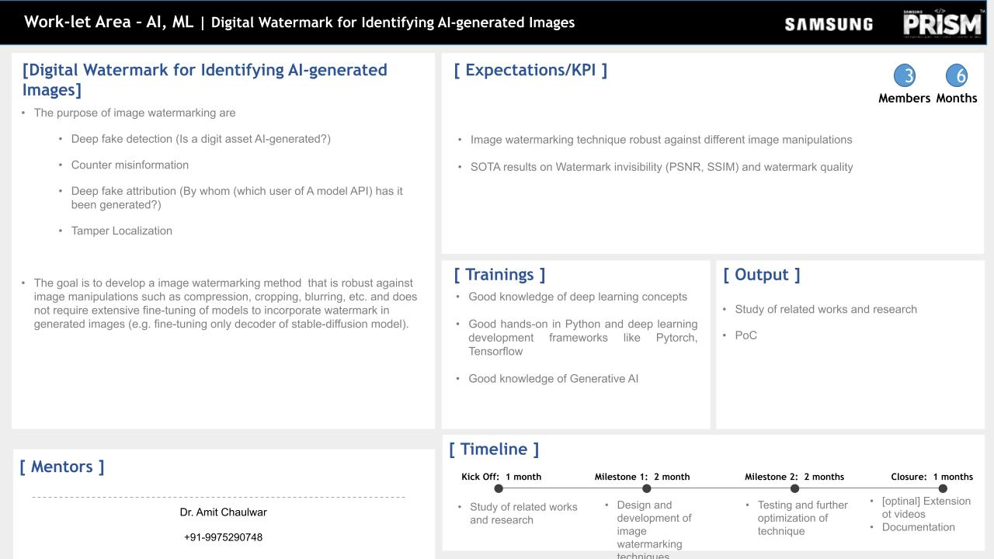
A Comparative Analysis and Proposed Approach

Slide 3
Outline -
Till previous meeting, we showed the implementation and results using VIT and CNN. We got the feedback of implementing for the scenario of multi-tampering ie – While uploading on Social Media, the photos are uploaded and get compressed and slightly blurred then manipulated and then also it should retain the watermark.
Feedback from [Samsung PRISM] | VITC_Monthly Connect-3 –
Suggested for Multi-Level Tampering
Suggested for Multi Level Encoding.

Slide 4
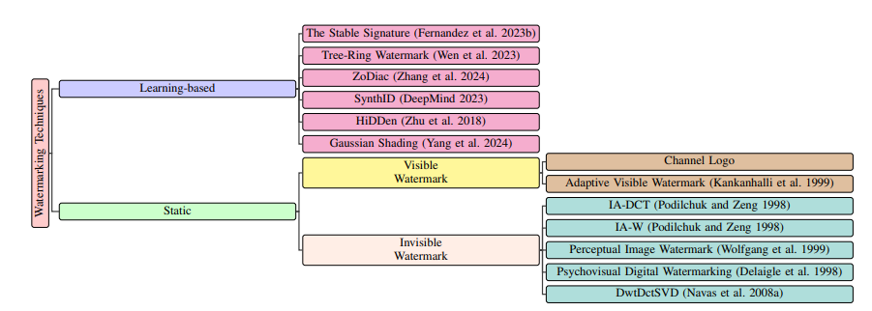
Key Limitations of Existing Models:
Lack robustness against tampering.
High computational complexity for LDM-based models.
Dewatermarking undermines security.
Why Existing Learning-Based Models Aren’t Good Enough

Slide 5
Why not LDM(s)?
Limitations of LDMs for Watermarking:
Operates in latent space, requiring significant computational resources.
Embedding in latent space ensures high PSNR/SSIM but complicates tamper detection at pixel level.
Requires fine-tuning for specific datasets.
Why CNN + ViT is Better:
Combines local feature extraction (CNN) with global dependency modeling (ViT).
Directly embeds watermarks in pixel space, making it faster and simpler.
Robust against common manipulations like cropping, compression, and blurring.

Slide 6

System Architecture and Pipeline
Pipeline Stages:
Input Processing :
Normalize input image I(raw) ​ to standard size (224x224) and pixel range.
Watermark Embedding:
Embed watermark W into image I using CNN encoder.

Slide 7

System Architecture and Pipeline
Pipeline Stages:
Watermark Extraction:
Extract watermark W ′ from watermarked image I ′ .
Verification:
Compute similarity metrics:

Slide 8


Importance of CNN and ViT Detector
Role of CNN (Convolutional Neural Network):
CNN is responsible for local feature extraction during watermark embedding and extraction.
It embeds watermarks in low-frequency components of the image, ensuring robustness against compression-based attacks like JPEG.
Mathematical Representation:
Watermark embedding:
Watermark extraction:

Slide 9
Importance of CNN and ViT Detector
Role of ViT (Vision Transformer):
ViT captures global dependencies in the image by splitting it into patches and analyzing their relationships using a self-attention mechanism.
It ensures robustness by detecting distortions or tampering in the extracted watermark, such as cropping or blurring.
ViT also classifies the extracted watermark into categories like "Intact," "Degraded," or "Destroyed."
ViT Workflow:
Patch embedding:Mathematical Representation:
Where Pi represents image patches.

Slide 10

Importance of CNN and ViT Detector
Self-attention mechanism:
Where:
Q,K,V: Query, Key, and Value matrices.
dk : Dimensionality of key vectors.
Combined Benefits of CNN + ViT:
CNN ensures imperceptibility by embedding watermarks locally.
ViT enhances robustness by analyzing global image structure and identifying tampering.

Slide 11
Evaluation Metrics:
PSNR comparison under blur, compression, and Gaussian noise attacks.
Model | Blur (PSNR dB) | JPEG Compression (PSNR dB) | Gaussian Noise (PSNR dB)
DCT-DWT-SVD | 35.5 | 36.12 | 33.3
Hidden | 37.07 | 32.21 | 36.21
Stable Signature | 38.64 | 39.91 | 38.91
Tree Ring | 40.98 | 37.91 | 38.09
Zodiac | 41.47 | 38.09 | 38.82
Gaussian Shading | 34.27 | 32.45 | 32.45
DCT-DWT + CNN + ViT | 38.27 | 32.45 | 38.41

Slide 12
Evaluation Metrics:
SSIM comparison under blur, compression, and Gaussian noise attacks.
Model | Blur Accuracy | JPEG Compression Accuracy | Gaussian Noise Accuracy
DCT-DWT-SVD | 0.84 | 0.88 | 0.89
Hidden | 0.95 | 0.88 | 0.88
Stable Signature | 0.931 | 0.85 | 0.85
Tree Ring | 0.98 | 0.97 | 0.97
Zodiac | 0.96 | 0.90 | 0.90
Gaussian Shading | 0.961 | 0.94 | 0.90
DCT-DWT + CNN + ViT | 0.961 | 0.94 | 0.90

Slide 13
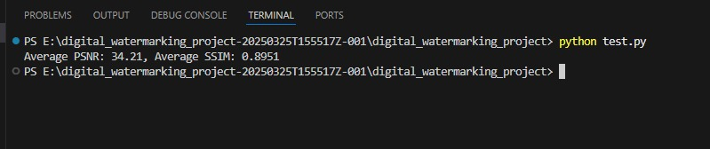
Evaluation Metrics:
PSNR (Peak Signal-to-Noise Ratio): Measures image fidelity after watermark embedding.
SSIM (Structural Similarity Index): Quantifies perceptual quality.
Bit Recovery Accuracy: Indicates robustness against tampering.
Dataset Used: Flickr8k (AI-generated and natural images)
Attacks Simulated:
Gaussian Noise
JPEG Compression
Cropping
Blurring

Slide 14
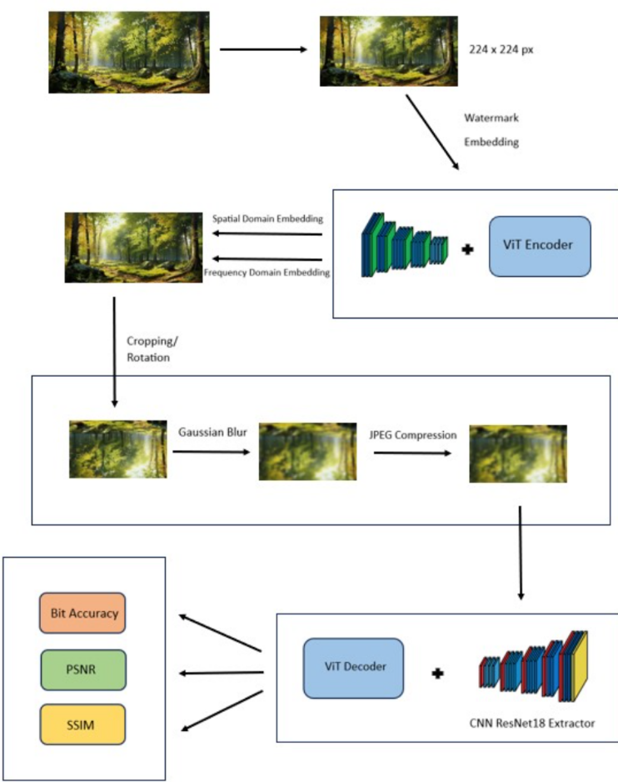
Evaluation Metrics:
PSNR: 34.21 dB (High fidelity)
SSIM: 0.8951 (Close to original image quality)
Our model maintains visual quality after watermark embedding.
Bit Recovery Rate: 92.4% after adversarial attacks
Resilient to: Cropping, Gaussian noise, JPEG compression, and blurring
Note: Slight dip in accuracy under cropping due to pixel removal

Slide 15
Summary of Contributions
Conclusion:
1. Combines CNNs for local features and ViTs for global attention
2. Achieves high imperceptibility + robust watermark recovery
3. Viable solution for AI-generated content authentication

Slide 16
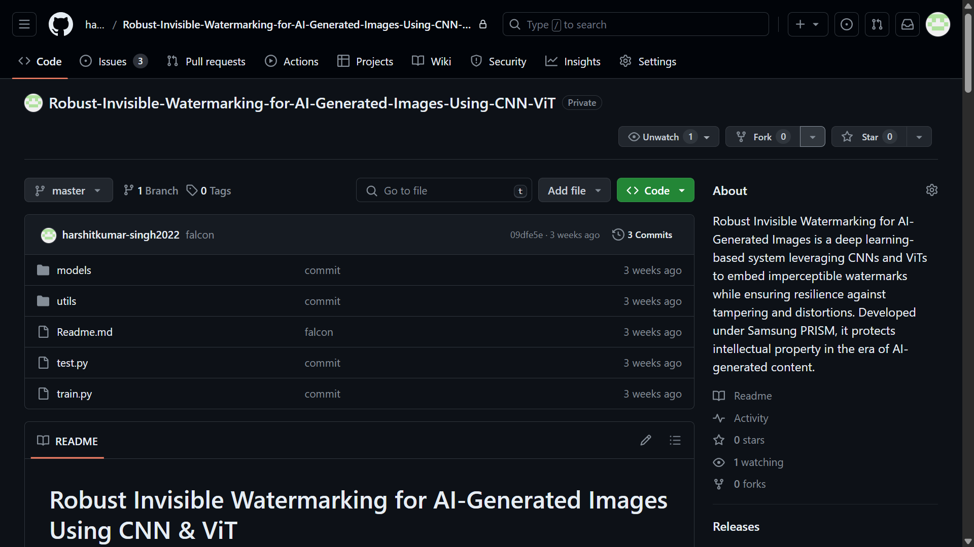
Code uploaded on GitHub
https://github.ecodesamsung.com/harshitkumar-singh2022/Robust-Invisible-Watermarking-for-AI-Generated-Images-Using-CNN-ViT/tree/master

Slide 17
Thank you

