Slide 1

[Samsung PRISM] End Review Report
AI Watermark Detection
Team
College Professor(s):
Dr. Parvathi R - parvathi.r@vit.ac.in
Dr. Pavithra Sekar - pavithra.sekar@vit.ac.in
2. Students:
Harshit Kumar Singh / harshitkumar.singh2022@vitstudent.ac.in
Pranav Seelam / Pranav.seelam2022@vitstudent.ac.in
Soumya Ranjan Nayak / soumyaranjan.nayak2022@vitstudent.ac.in
Ridhi / ridhi.2022@vitstudent.ac.in
Harsha Kumar A / harshakumar.a2022@vitstudent.ac.in
3. Worklet ID: 24OD16
Date: 5 Aug 2019

Slide 2
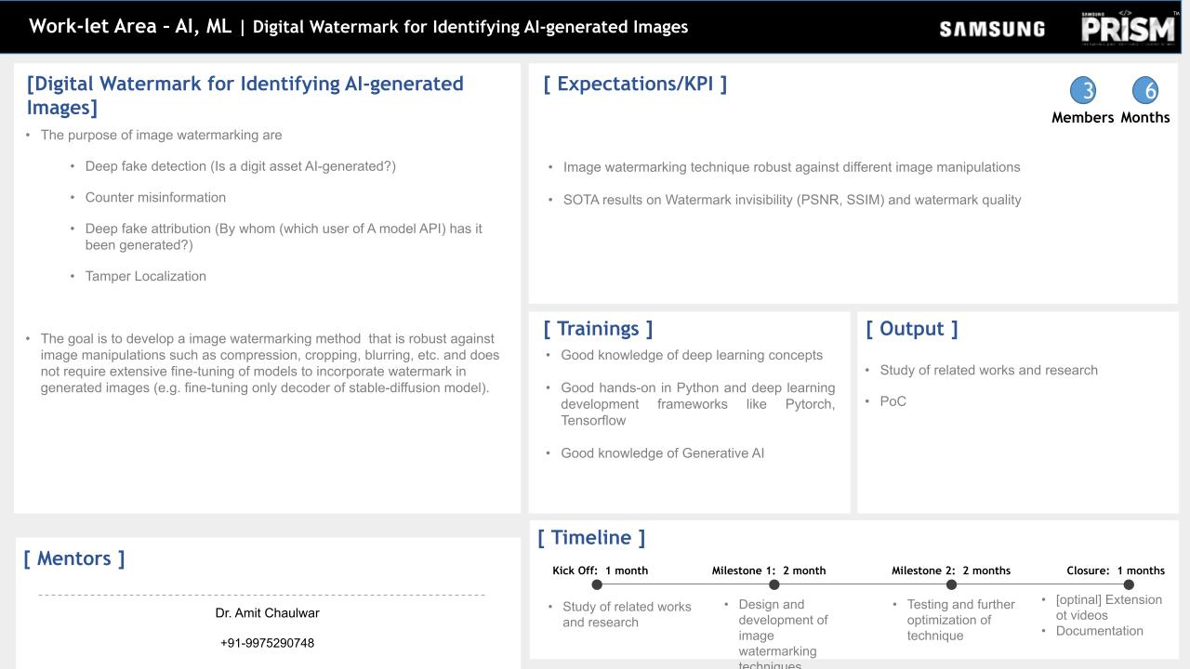
A Comparative Analysis and Proposed Approach

Slide 3
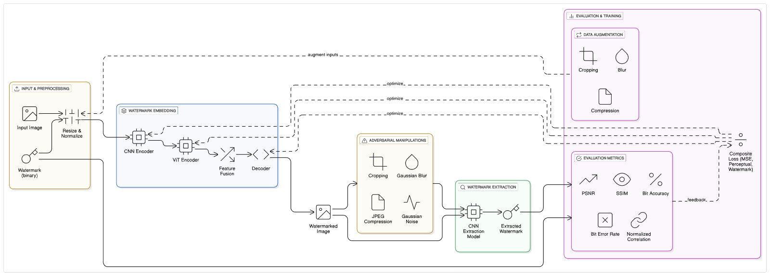
Approach / Solution
Concept Diagram :
( Clear detailed schematic / block diagram / flow chart depicting the proposed concept / solution )

Slide 4
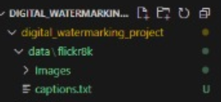
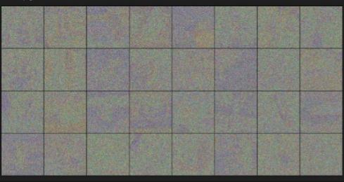
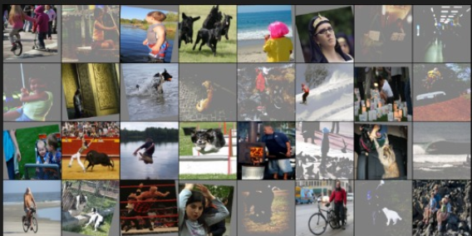

Dataset(s) Analysis / Description
Dataset Capture / Preparation / Generation :
(Discuss the dataset generation process or if downloaded data provide details of what data & from where it was obtained etc… - 2 to 3 bullets only)
Flicker8k -> Images -> Captions.txt
Dataset Understanding / Analysis :
(Provide 2 to 3 bullets about what is your understanding of the data / opinion about the data)
Watermark added to the images
Dataset Pre-Processing / Related Challenges (if any) :
(List out the challenges you fore see in data handling wrt problem definition – 2 to 3 bullets only)
->10 epochs are trained in the same process.

Slide 5
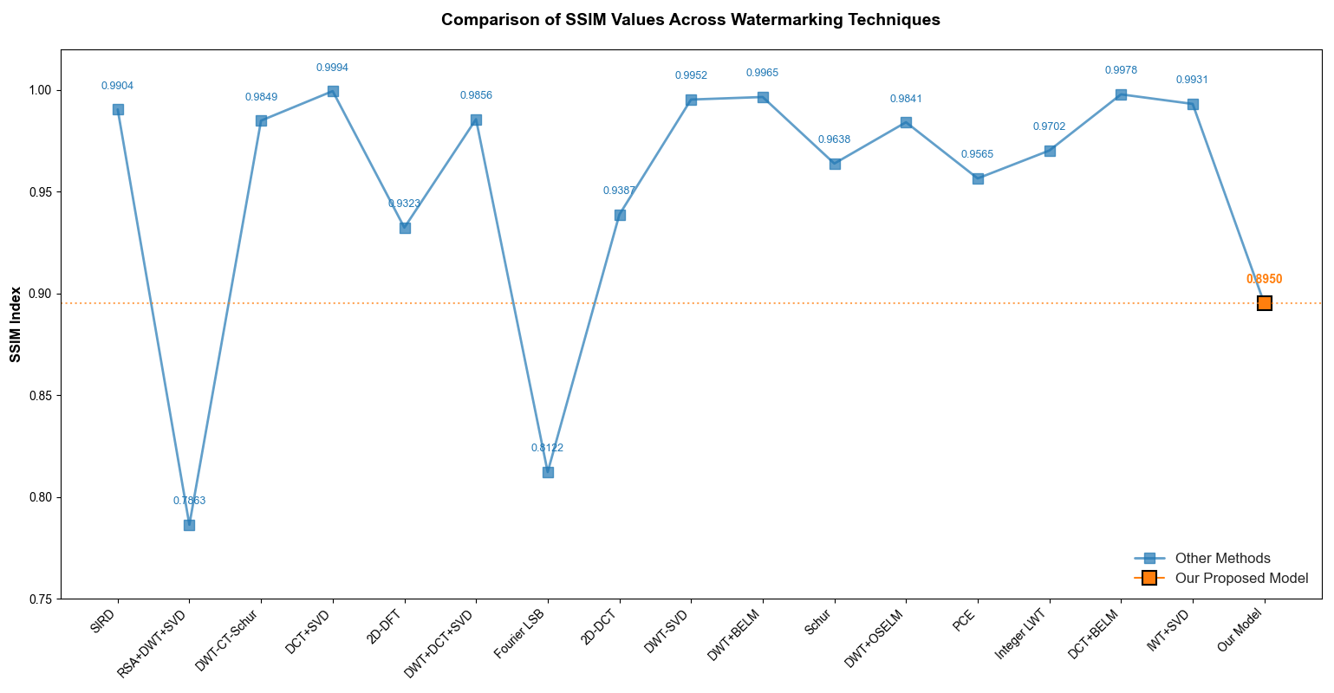
Results - Evaluation Metrics:
SSIM comparison .

Slide 6
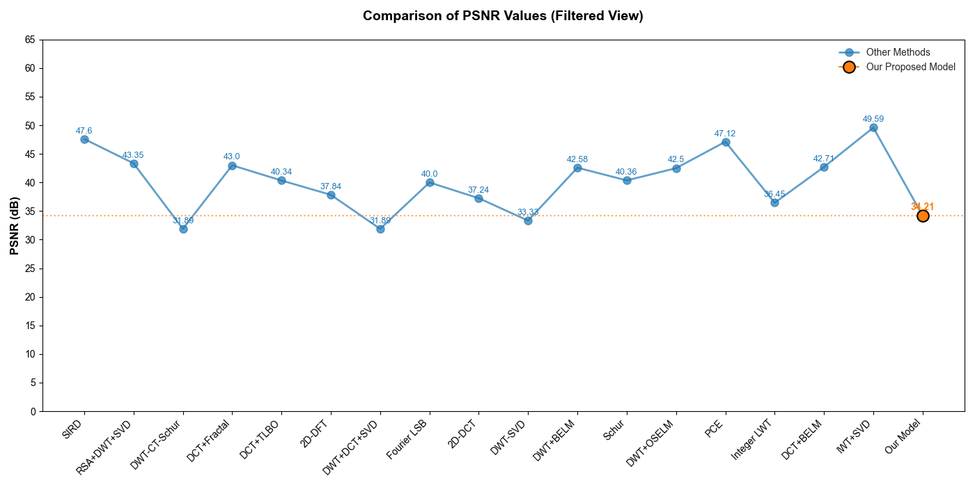
Results - Evaluation Metrics:
PSNR comparison.

Slide 7
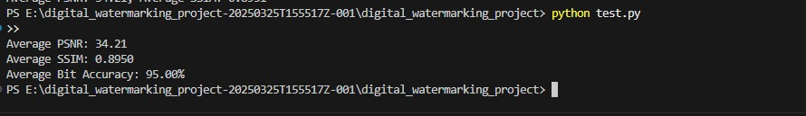
Results
PSNR: 34.21 dB (High fidelity)
SSIM: 0.8951 (Close to original image quality)
Our model maintains visual quality after watermark embedding.
Dataset Used: Flickr8k (AI-generated and natural images)
Attacks Simulated:
Gaussian Noise
JPEG Compression
Cropping
Blurring
Resilient to: Cropping, Gaussian noise, JPEG compression, and blurring
Bit Recovery Rate: 95.00% after adversarial attacks
Note: Slight dip in accuracy under cropping due to pixel removal

Slide 8
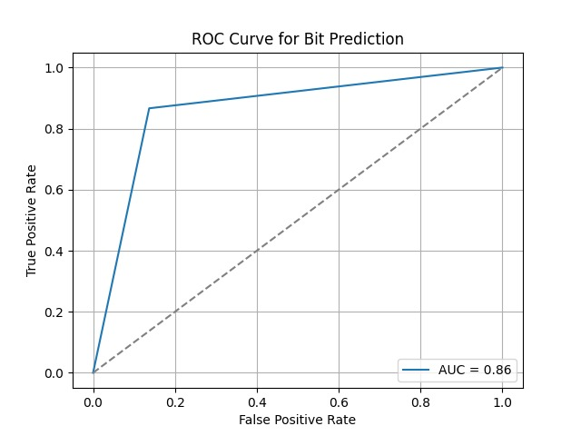
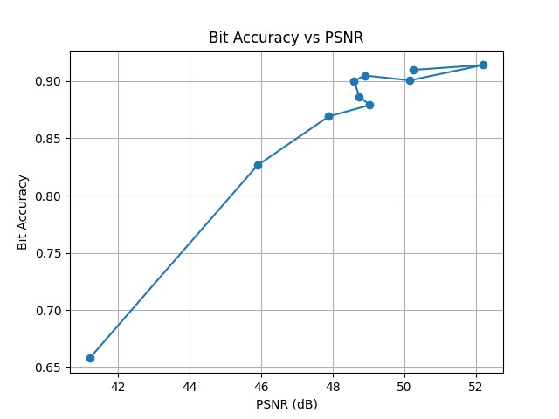
Experimental Results / Simulations / Observations
Results :
(provide numerical data / bar charts / plots / images / videos / tabulated results etc. Use full slide or multiple slides up to max 3 slides to demonstrate the results)

Slide 9
Work-let Closure Details
Code Upload details:
Items | Details
KLOC (Number OF Lines of codes in 000’s)
Model and Algorithm details | CNN + ViT
Is Mid review, end review report uploaded on Git ? | Yes
Link for Git | https://github.ecodesamsung.com/SRIB-PRISM/Robust-Invisible-Watermarking-for-AI-Generated-Images-Using-CNN-ViT/blob/main/README.md
Data details (if applicable):
Items | Data folder 1 | Data folder 2 | Data Folder 3……..
Name & Type of Data (Audio/Image/Video) | Flicker 8K
Number of data points
Source of Data (self collected, Scrapped, available on open source) | Open Source Datasets used.
Google drive link/ git link to access data
Note: If data uploaded on google drive, access to be shared to prism.srib@gmail.com

Slide 10
Conclusion
1. Combines CNNs for local features and ViTs for global attention
2. Achieves high imperceptibility + robust watermark recovery
3. Viable solution for AI-generated content authentication

Slide 11
Deliverable
Final Deliverables :
(Discuss in the form of bullets, what are the next steps to complete the solution, any road blocks / bottlenecks, any support needed from SRIB)
We have completed the assigned work mentioned in our worklets results have been attached and the code is uploaded in github successfully.
IP / Paper Publication Plan :
(Details of papers / patentable ideas / innovative aspects that can lead to patentable ideas)
-> waiting to find reputed journals to submit our work.
-> we will complete our work and submit it in the journal.
KPIs delivered/Expectations Met:
(Planned Expectations shared in Work-let vs Delivered Results)
Digital Watermarking for AI generated Images. We discovered a new method (CNN +ViT) and solved the problem statement given to us achieving accuracy of 95%.

Slide 12
Thank you

