Slide 1
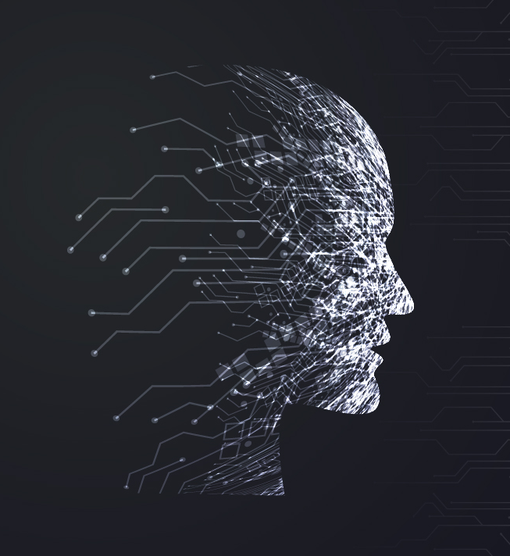
From Pixels to Poetry:
The Art of Generating
Captions
By :
Harshit Sharma(102103461)
Vineet Jain (102103465)
Akshita (102103470)
To: Ms. Chandani Kumari

Slide 2
Introduction
Platforms
Objectives
Challenges
Future Developments
Conclusion

Slide 3
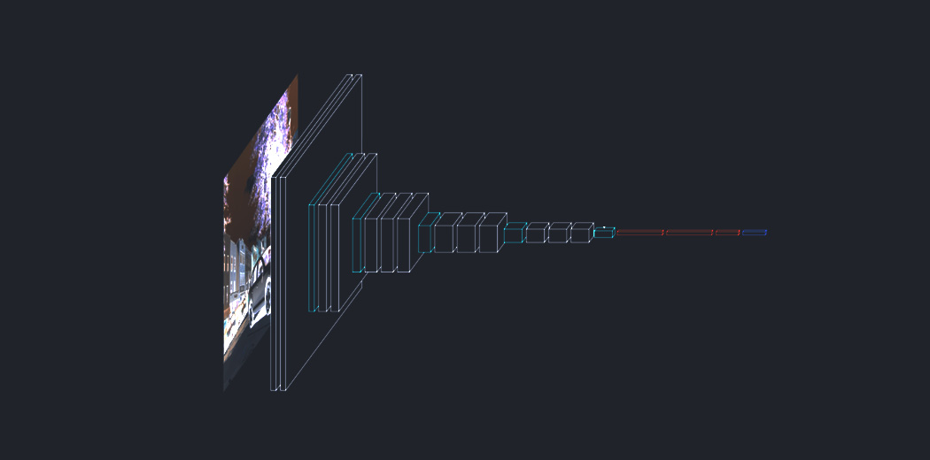
Introduction of Image – Caption Generator
In the age of social media, images have become a powerful tool for communication. However, sometimes the message behind an image can be lost without proper context. This is where image to caption generators come in.
An image to caption generator is a tool that uses artificial intelligence to analyze an image and generate a caption that accurately describes it. This technology has numerous applications, from improving accessibility for visually impaired individuals to aiding in content creation for businesses.

Slide 4
Platforms
Python
Libraries
Flask, flask_upload, numpy, keras
Input:
Image
Caption

Slide 5
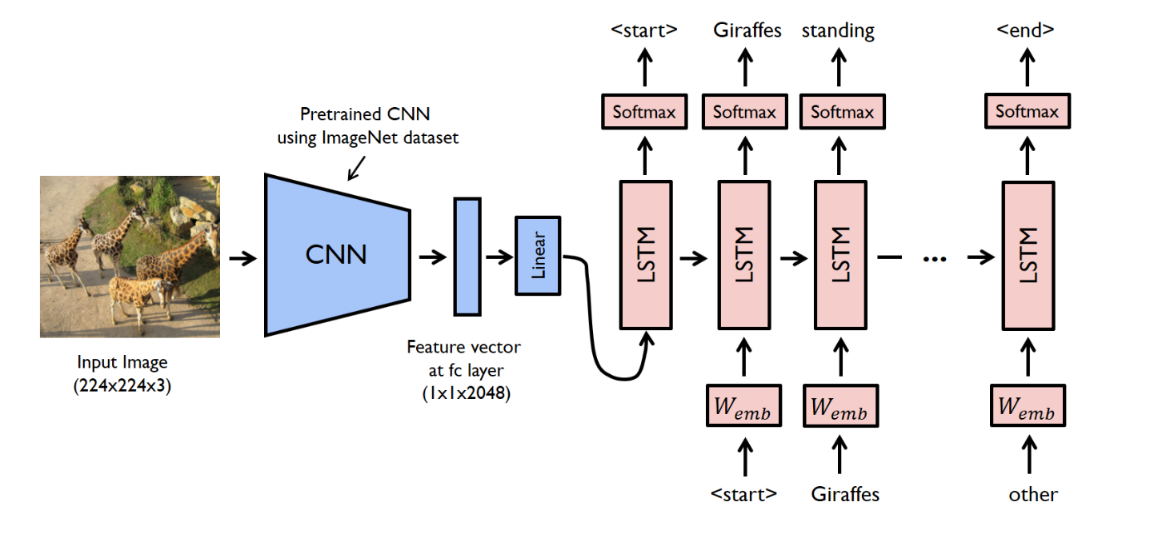

Slide 6
Objectives
Generate natural language descriptions of images
Accurately reflect the content of the image
Analyze the visual content of the image
Translate the visual content into a coherent sentence or phrase
Produce informative and relevant captions
Produce captions that are easily understood by humans
Assist people with visual impairments
Enhance image search and retrieval
Improve the accessibility of digital media

Slide 7
Challenges
While image to caption generators have numerous benefits, there are also challenges and limitations to consider. One of the main challenges is ensuring that the generated captions are not biased or offensive.
Additionally, image to caption generators may struggle with certain types of images, such as abstract art or images with multiple interpretations. It's important to recognize the limitations of this technology and use it in conjunction with human oversight and input.

Slide 8
Future Developments
As technology continues to evolve, so too will image to caption generators. One area of development is improving the accuracy and nuance of the generated captions.
Another area of development is expanding the capabilities of image to caption generators to include other forms of media, such as video and audio. These advancements have the potential to revolutionize the way we consume and create content.

Slide 9
Conclusion
Image to caption generators are a powerful tool that have numerous applications in improving accessibility and aiding in content creation. While there are challenges and limitations to consider, the future developments in this technology have the potential to revolutionize the way we interact with and create content.
As this technology continues to evolve, it's important to approach it with a critical eye and recognize the need for human oversight and input to ensure accuracy and avoid bias.

