Slide 1








SightSeeker
TEAM
Tell it what to find. It sees, decides and drives there.
SYNTAX TERROR (COS)
Harshit · solo builder
Problem Statement 01 · Vision-Based Autonomous Robot
Vision AI: YOLO26 + goals
YOLO26
30 / 30
Wokwi
Autonomy and steering
real detection on my webcam
missions in the 3D rover twin
rover firmware simulated
Firmware and circuit
Simulation and 3D twin
Notes:
I'm Harshit from team Syntax Terror, and I built SightSeeker on my own. It's for Problem Statement 01: you tell the robot what to find, it looks with a camera, decides where to go and drives there. Everything in this deck is a screenshot of something that runs: real YOLO26 on my webcam, the rover firmware in Wokwi, and a 3D twin of the rover.

Slide 2




PROBLEM STATEMENT & THEME
PS 01 · VISION-BASED AUTONOMOUS ROBOT
Most mobile robots follow a fixed map. When the room changes they get stuck, and only an engineer can give them a new task.
What happens today
Impact Small warehouses, labs and hospitals can't afford a mapping project for every change. A camera rover that understands its goal works the same day.
✕ STUCK: route blocked
moved
box
Theme alignment: what PS 01 asks for, and where it is in SightSeeker
planned route (map)
✓ Object detection
✓ Scene understanding
✓ Language goals
YOLO26
objects + distance
“find the bottle”
✓ Obstacle avoidance
✓ Motor control
✓ Real-time decisions
Maps go stale
Hard to re-task
Costly sensing
camera + HC-SR04
L298N wheel PWM
state machine
one moved box breaks the route
new job = engineer reprograms
LiDAR robots cost lakhs
✓ Autonomous navigation
✓ Sensors
✓ Safety
search → reach
camera, ultrasonic
watchdog, 25 cm stop
Notes:
The problem: most mobile robots drive along a fixed map. If someone moves one box, the route is blocked and the robot just stops. Giving it a new job means an engineer has to reprogram it, and the LiDAR sensors they use are expensive. So small warehouses, college labs and hospitals mostly can't use them. On the right is how SightSeeker covers each direction in Problem Statement 01.

Slide 3




SOLUTION
Say what to find. SightSeeker sees it, decides how to get there and drives, with safety checks on the rover itself.
Ask
See
Decide
Drive
Arrive
“find the bottle”, typed or spoken
YOLO26 on the phone's video
state machine picks a steering
“L120,R-80” to the Arduino
stops about 50 cm away
Unique value: compared with today's options
Key features
Line follower
Map-based robot
SightSeeker
Plain-English and voice goals
Setup
tape on the floor
mapping run
none: just a camera
New task
re-lay the tape
engineer reprograms
say it in English
Walk mode: guides a person by voice
Moved objects
✕ stops
re-map needed
✓ sees and avoids
Digital twin and 3D rover twin
Cost
low
lakhs
≈ ₹1,500 + laptop
3 safety layers on the Arduino
Notes:
My solution works in five steps. You ask for something, like 'find the bottle'. YOLO26 looks for it in the phone camera's video. A state machine on the laptop decides how to steer. The laptop sends two wheel speeds to the Arduino as a short text line. The rover stops about half a metre from the target. Compared with a line follower or a map-based robot, there is no setup, you give it a new task in plain English, and the parts cost around 1,500 rupees.

Slide 4
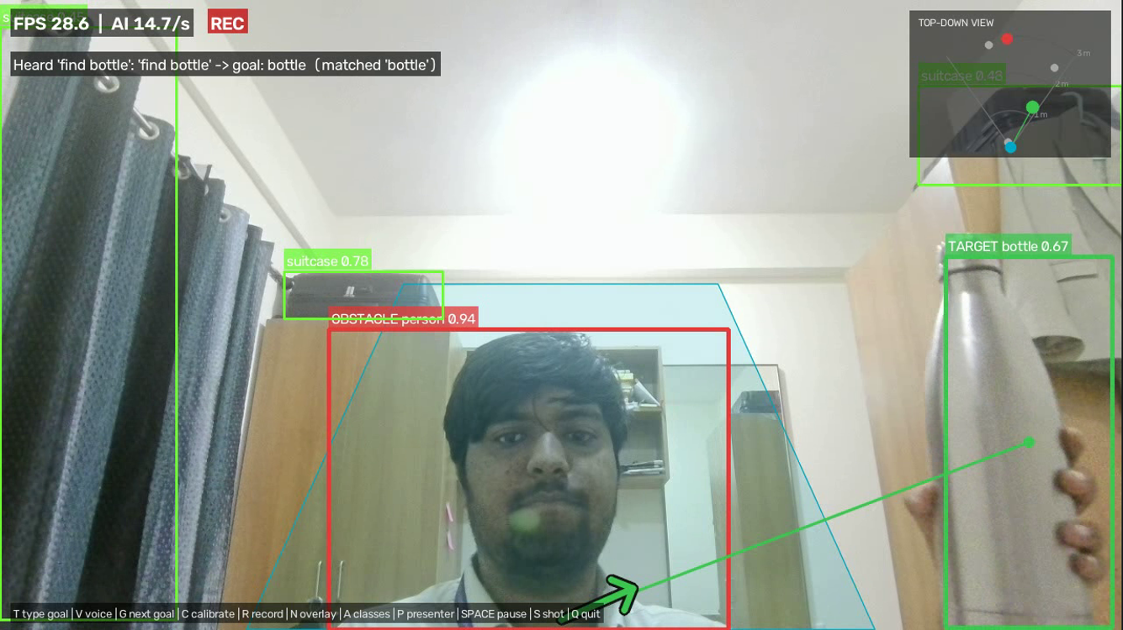
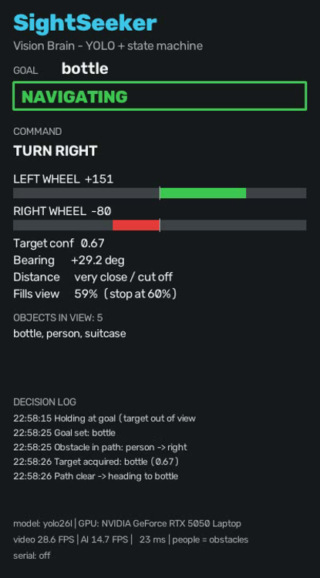
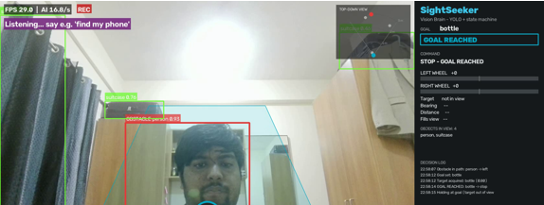
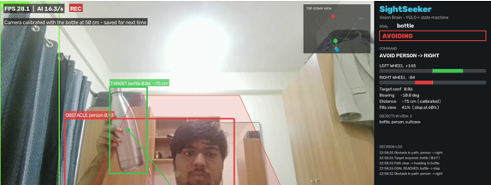
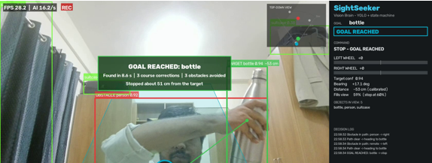
PROTOTYPE: HOW IT WORKS
A real run on my laptop: YOLO26 on the GPU, 28 frames per second, webcam as the robot's eye
1
1
Hears the goal
“find bottle” → class bottle
2
Person in the path
marked as an obstacle
3
5
3
Target locked
bottle, 67% confidence
2
4
Steering line
heading to the bottle
5
Wheel commands
left +151, right −80: turn right
4
The same run, start to finish
Decision loop (state machine)
SEARCHING
NAVIGATING
GOAL REACHED
AVOIDING
1 Waiting for a goal
2 Avoiding the person
3 Goal reached in 8.6 s, 51 cm away
Notes:
This is a real run on my laptop with my webcam. One: I said 'find bottle' and it matched the word to the bottle class. Two: I'm in the way, so it marks me as an obstacle. Three: it locked onto the bottle. Four: the green line is where it wants to go. Five: the panel shows the wheel commands, left plus 151 and right minus 80, which means turn right. At the bottom is the same run from start to finish: it reached the bottle in 8.6 seconds and stopped about 51 centimetres away. The logic is a simple state machine: searching, navigating, avoiding, goal reached.

Slide 5

ARCHITECTURE
The phone sees, the laptop thinks, the rover acts. One short text line connects them.
PHONE · the eye
LAPTOP · Vision Brain (Python)
ROVER · Arduino Uno (C++)
YOLO26
finds objects + boxes
Parser + watchdog
HC-SR04
distance
Wi-Fi
video
HC-05
Bluetooth
State machine
search / go / avoid / stop
L298N driver
blocks forward motion under 25 cm
IP Webcam / DroidCam
720p video
Steering
smooth wheel speeds
2 BO motors
Serial line, 20× a second: L120,R-80 (left, right: −255…255)
Tech stack
Safety runs on the rover, not the laptop
APIs and data
Python
OpenCV
Ultralytics YOLO26
No command for 500 ms → motors stop
No cloud and no paid APIs: everything runs offline on the laptop.
The same commands drive the digital twin and walk mode.
PyTorch + CUDA
Arduino C++
Three.js
Obstacle under 25 cm → no forward
Every value clamped to ±255
Wokwi
Notes:
Three parts. The phone is only a camera; it streams video over Wi-Fi with an app like IP Webcam. The laptop runs my Python program: YOLO26 finds the objects, a state machine decides what to do, and the steering is smoothed into two wheel speeds. Those go to the Arduino over Bluetooth as a text line like L120,R-80, twenty times a second. The safety rules live on the Arduino, so even if the laptop freezes or the Bluetooth drops, the rover stops on its own.

Slide 6
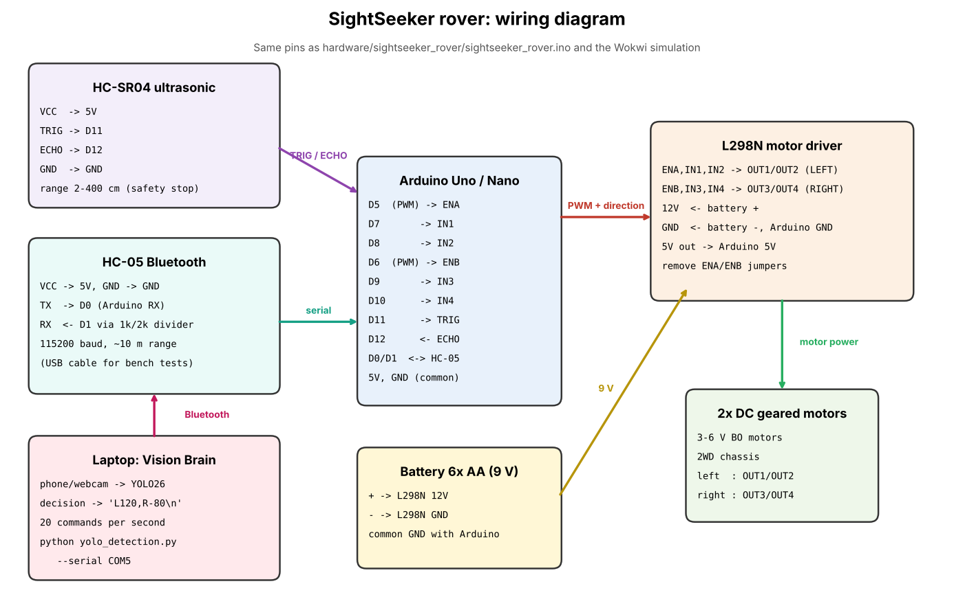
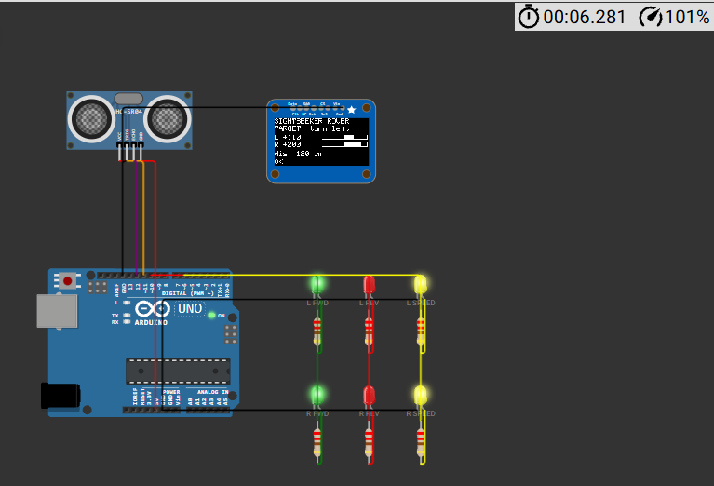
HARDWARE: CIRCUIT & SIMULATION
Arduino Uno + L298N + HC-SR04 + HC-05, wired on paper and running in Wokwi
Wokwi serial monitor
[demo] SEARCH: scan right
[demo] TARGET: turn left
[demo] NAVIGATE: forward
[demo] LINK LOST: no cmds
[safety] no command for
500 ms -> motors stopped
My Wokwi run: Uno, HC-SR04, OLED and LEDs on the L298N pins
Wiring diagram: the same pins are used in the firmware, Wokwi and the 3D twin
Notes:
Here's the circuit. The Arduino drives the L298N motor driver: pins 5 and 6 set the speed and pins 7 to 10 set the direction of each wheel. The HC-SR04 on pins 11 and 12 measures the distance ahead, and the HC-05 gives a wireless serial link to the laptop. I couldn't buy parts in time, so I ran the firmware in Wokwi. The OLED and the serial monitor are from my own run: you can see the demo commands and the watchdog stopping the motors when the link is lost. All the parts together cost about 1,200 to 1,900 rupees.

Slide 7
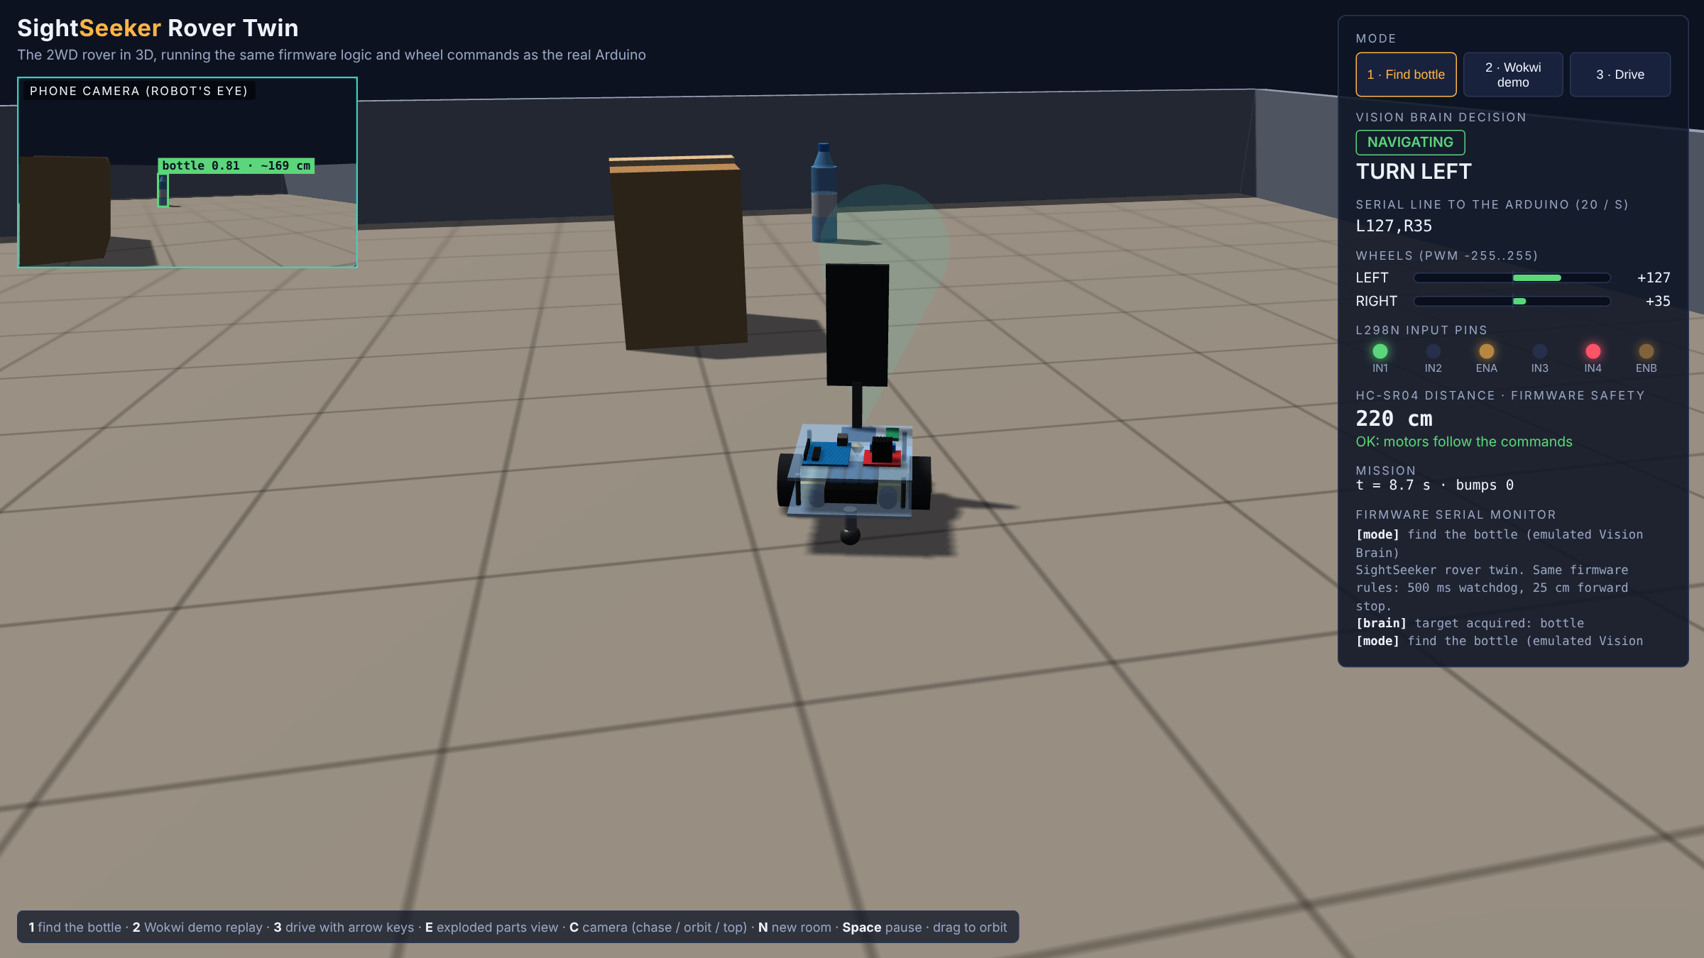
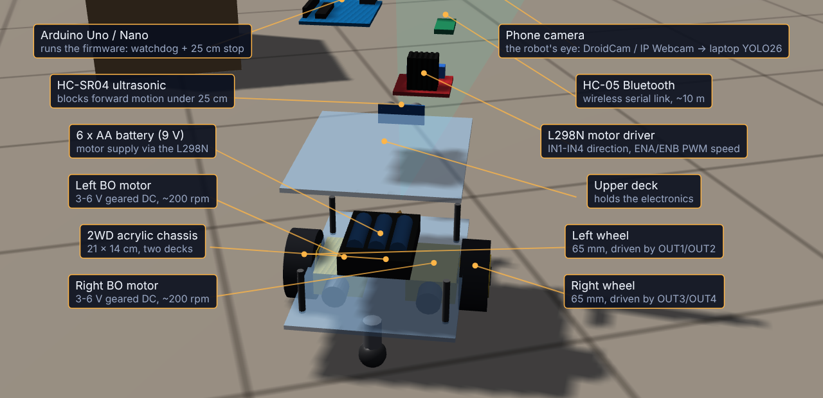
CURRENT PROGRESS: WHAT WORKS TODAY
Software, firmware and simulations are built and tested. The physical rover is the next step.
✓
✓
✓
✓
✓
→
Vision Brain
Rover firmware
Wokwi simulation
3D rover twin
Walk mode + twin
Physical rover
30 / 30
3D twin missions reached the bottle
8.6 s
real webcam run: goal to target, 3 obstacles avoided
1,000 / 1,000
earlier warehouse simulation, 0 collisions
3D rover twin, mode 1: phone view, serial line and L298N pins
Exploded view: every part, with its job and pins
Notes:
Here's where the project stands. The Vision Brain, the rover firmware, the Wokwi simulation, the 3D rover twin, and walk mode with the digital twin are all done and tested. In the 3D twin, the rover follows the same rules as the Arduino: the 500 millisecond watchdog and the 25 centimetre stop. It found the bottle in 30 out of 30 random rooms. The 8.6 seconds is from my real webcam run. The physical rover is next: the parts are listed and the build steps are in the GitHub repo.

Slide 8



MARKET RESEARCH / ANALYSIS
Mobile robots are spreading from big factories to smaller sites, and cost is what holds them back
Target users
Revenue model
Colleges and labs
low-cost autonomy kit
1
Education kits
rover + software for colleges (first market)
Small warehouses
fetch without a mapping job
2
Software licence
vision navigation for existing robots
Hospitals
move supplies around people
3
Custom training
detect a client's own objects
Factories
shuttle parts between stations
4
Fleet dashboard
monthly subscription
Visually impaired users
walk mode: voice guidance
21.8% a year (2022–2032). Source: Allied Market Research. Other firms forecast less, e.g. MarketsandMarkets $7.1B by 2032.
Notes:
Allied Market Research puts the autonomous mobile robot market at 2.2 billion dollars in 2021, growing to about 18.9 billion by 2032. Other firms forecast less, so I show the source. The big companies sell to large warehouses. I'd start where cost blocks people: colleges and labs first, then small warehouses and hospitals. Walk mode also opens a second use: guiding visually impaired people by voice. Revenue would come from education kits first, then software licences, custom training and a fleet dashboard.

Slide 9

FUTURE SCOPE
From simulation to a real rover, then to any object and many robots
NOW · Oct 2026
NEXT · Build
THEN · Smarter
LATER · Scale
YOLO26 Vision Brain
Assemble the ₹1,500 rover
Any object by name (YOLOE, prototyped)
On-board Jetson / Raspberry Pi
Firmware in Wokwi
Tune on a real floor
Phone app for goals
ROS 2 and warehouse systems
3D rover twin, walk mode
Record the real demo
Custom-trained objects
Fleets sharing one map
The roadmap covers: mobile app · AI model improvement · enterprise integrations · scaling to many users
Notes:
Now: the software, firmware and simulations are done. Next is the physical build, about 1,500 rupees of parts, then tuning on a real floor. After that I want it to find any object by name. I already have a prototype with YOLOE, an open-vocabulary model, that works on the webcam. Then a phone app to give it goals. Later: on-board compute like a Jetson so it doesn't need a laptop, ROS 2 and warehouse integrations, and several robots sharing one map.

Slide 10
Thank
you!
Code + docs
github.com/harshittalreja/SightSeeker
Live Wokwi simulation
wokwi.com/projects/479147376881059841
Notes:
Thank you. I'm happy to show the 3D rover twin, the Wokwi simulation or the webcam demo live.

