Slide 1
Views
In some cases, it is not desirable for all users to see the entire logical model (that is, all the actual relations stored in the database.)
Consider a person who needs to know a customer’s loan number but has no need to see the loan amount. This person should see a relation described, in SQL, by
(select customer_name, loan_number
from borrower, loan
where borrower.loan_number = loan.loan_number )

Slide 2
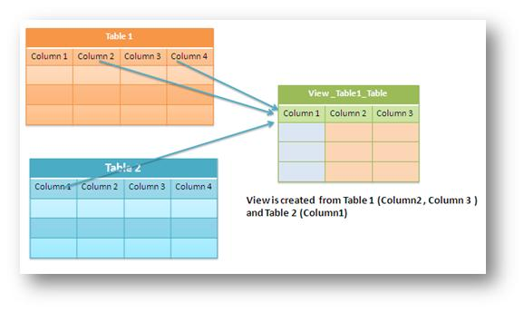
A View is a "Virtual Table". It is not like a simple table, but is a virtual table which contains columns and data from different tables (may be one or more tables)

Slide 3

View Definition
View is Virtual relation that does not necessarily actually exist in the database but is produced upon request, at time of request.

Slide 4
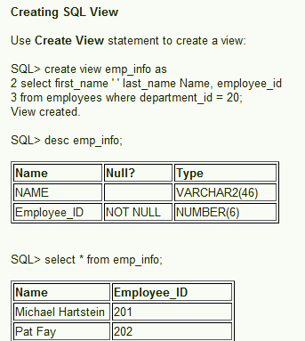

Slide 5
The best view for a particular purpose depends on the information the user needs.
For example, in a telephone directory, a user might want to look up the name associated with a number, without concern for the street address. The best view for this purpose would have two columns: the phone numbers (in numeric sequence) in the first column, and the name associated with each number
in the second column. Another user might want to look up the phone number associated with a street address, without any need to know the name. The best view for this purpose would have two columns: the street addresses (in alphanumeric order) in the first column, and the phone number in the second column.

Slide 6
Advantages of views
Security Each user can be given permission to access the database only through a small set of views that contain the specific data the user is authorized to see
Query Simplicity A view can draw data from several different tables and present it as a single table, turning multi-table queries into single-table queries against the view.
Structural simplicity Views can give a user a "personalized" view of the database structure, presenting the database as a set of virtual tables that make sense for that user.

Slide 7
Consistency A view can present a consistent, unchanged image of the structure of the database, even if the source tables are split, restructured, or renamed.
Data Integrity If data is accessed and entered through a view, the DBMS can automatically check the data to ensure that it meets the specified integrity constraints.

Slide 8
Following is an example to update the age of Ramesh:
1. SQL > UPDATE CUSTOMERS_VIEW
SET AGE = 35
WHERE name='Ramesh';
2. SQL > DELETE FROM CUSTOMERS_VIEW
WHERE age = 22;
3. You need a way to drop the view if it is no longer needed.
DROP VIEW CUSTOMERS_VIEW;

