Slide 1
Terrain Classification for Small Legged Robots
8 TERRAIN CLASSES
Asphalt
Cork
Grass
Gravel
Deep learning on tactile data
Lab
Laminate wood
Team B-29 | B.Tech CSE (AI & ML)
Pebble
Sand
Harshit Vaish | PES1UG24AM116
Gayathri Priya V | PES1UG24AM105
Machine Learning mini-project
Notes:
Project: terrain classification for small legged robots using tactile data. Team B-29 (team size 2). Eight terrain classes: asphalt, cork, grass, gravel, lab, laminate wood, pebble, sand. Source: repository README.

Slide 2
Problem and objectives
OBJECTIVES
THE PROBLEM
A legged robot needs to recognize the surface under its feet to move reliably.
1
Classify 8 terrain types from tactile sensor data
2
Compare three classical models against a CNN
Tactile signal
Classifier
3
Evaluate on a held-out test set using accuracy and macro F1
1 of 8 terrains
Notes:
Problem statement and objectives are taken from the README and the existing report (sections 1 and 3).

Slide 3
Dataset
5,990
samples
WHAT EACH SAMPLE CONTAINS
414 tactile readings (6 channels × 69)
33
33 engineered features
447
features per sample
STRATIFIED SPLIT (70 / 15 / 15)
Train
Val
Test
8
terrain classes
4,193
898
899
Asphalt
Cork
Grass
Gravel
Lab
Laminate wood
Pebble
Sand
Notes:
Dataset: 5,990 samples, 447 features (414 tactile readings arranged 6 x 69, plus 33 engineered features), 8 classes. Stratified 70/15/15 split gives 4,193 / 898 / 899 samples (split sizes from the existing report; the notebook uses train_test_split with seed 42). The dataset's original source is not documented in the repository (data/README.md is empty), so it is deliberately not named on the slide.

Slide 4
Methodology
1
2
3
4
5
Load data
Split
Normalize
Train
Select and test
5,990 × 447
Stratified 70/15/15
Fit on train data only
4 models
Validate, then final test
VALIDATION AND TEST
METRICS AND SEED
Validation set for model selection; test set held out for final evaluation
Accuracy and macro F1; fixed random seed (42)
Notes:
Pipeline follows the notebook (Terrain_CNN_Clean.ipynb): load, stratified split (seed 42), normalization parameters estimated from training data only, train four models, select on validation, evaluate on the held-out test set.

Slide 5
Four models compared
Logistic Regression
SVM (RBF)
Random Forest
CNN
Linear baseline
C = 10, gamma = scale
400 trees, min leaf 2, balanced weights
Conv layers on tactile signal + 33 engineered features
Standardized 447 features
Standardized 447 features
All 447 features
Adam, early stopping
CNN ARCHITECTURE
Tactile input
4 × Conv
Merge
Dense 50
Output
6 × 69
1×5, 24 filters, pool, dropout 0.5
flatten + 33 engineered features
ReLU
8 classes
Notes:
Hyperparameters from the notebook. LR: StandardScaler, max_iter 2000. SVM: StandardScaler, RBF, C=10, gamma='scale'. Random Forest: 400 trees, min_samples_leaf=2, class_weight='balanced'. CNN: four Conv2d layers with (1,5) kernels and 24 filters, max-pool (1,2) stride 1, dropout 0.5, concatenated with all 33 engineered features, dense layer of 50 units, 8 outputs. Adam lr 1e-4, batch 64, up to 100 epochs, early stopping on validation accuracy (patience 12); best-validation weights restored before testing.

Slide 6
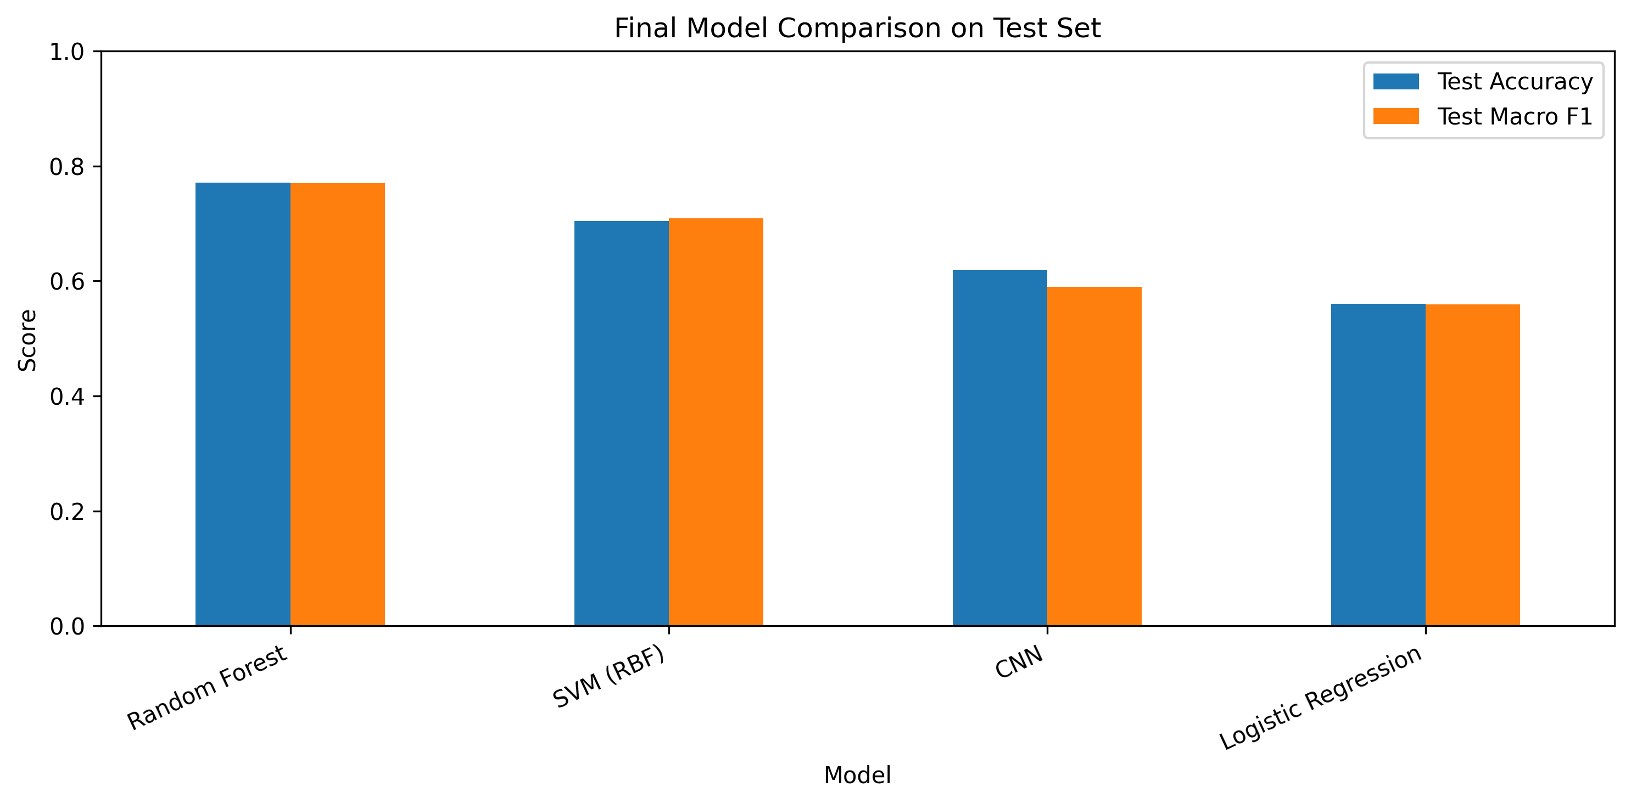
Results
TEST SET RESULTS
Model | Accuracy | Macro F1
Random Forest | 77.09% | 0.7698
SVM (RBF) | 70.41% | 0.7093
CNN | 61.96% | 0.5900
Logistic Regression | 56.06% | 0.5593
77.09%
Random Forest: best on both test metrics, +15.13 pp over the CNN
899 held-out test samples | single stratified split
Notes:
Table values from results/test_model_comparison.csv and the README. The figure is the original results/model_comparison.png from the repository, unmodified. The 15.13 percentage-point gap is 77.09 - 61.96. Results come from a single split, so no claim of statistical significance is made.

Slide 7
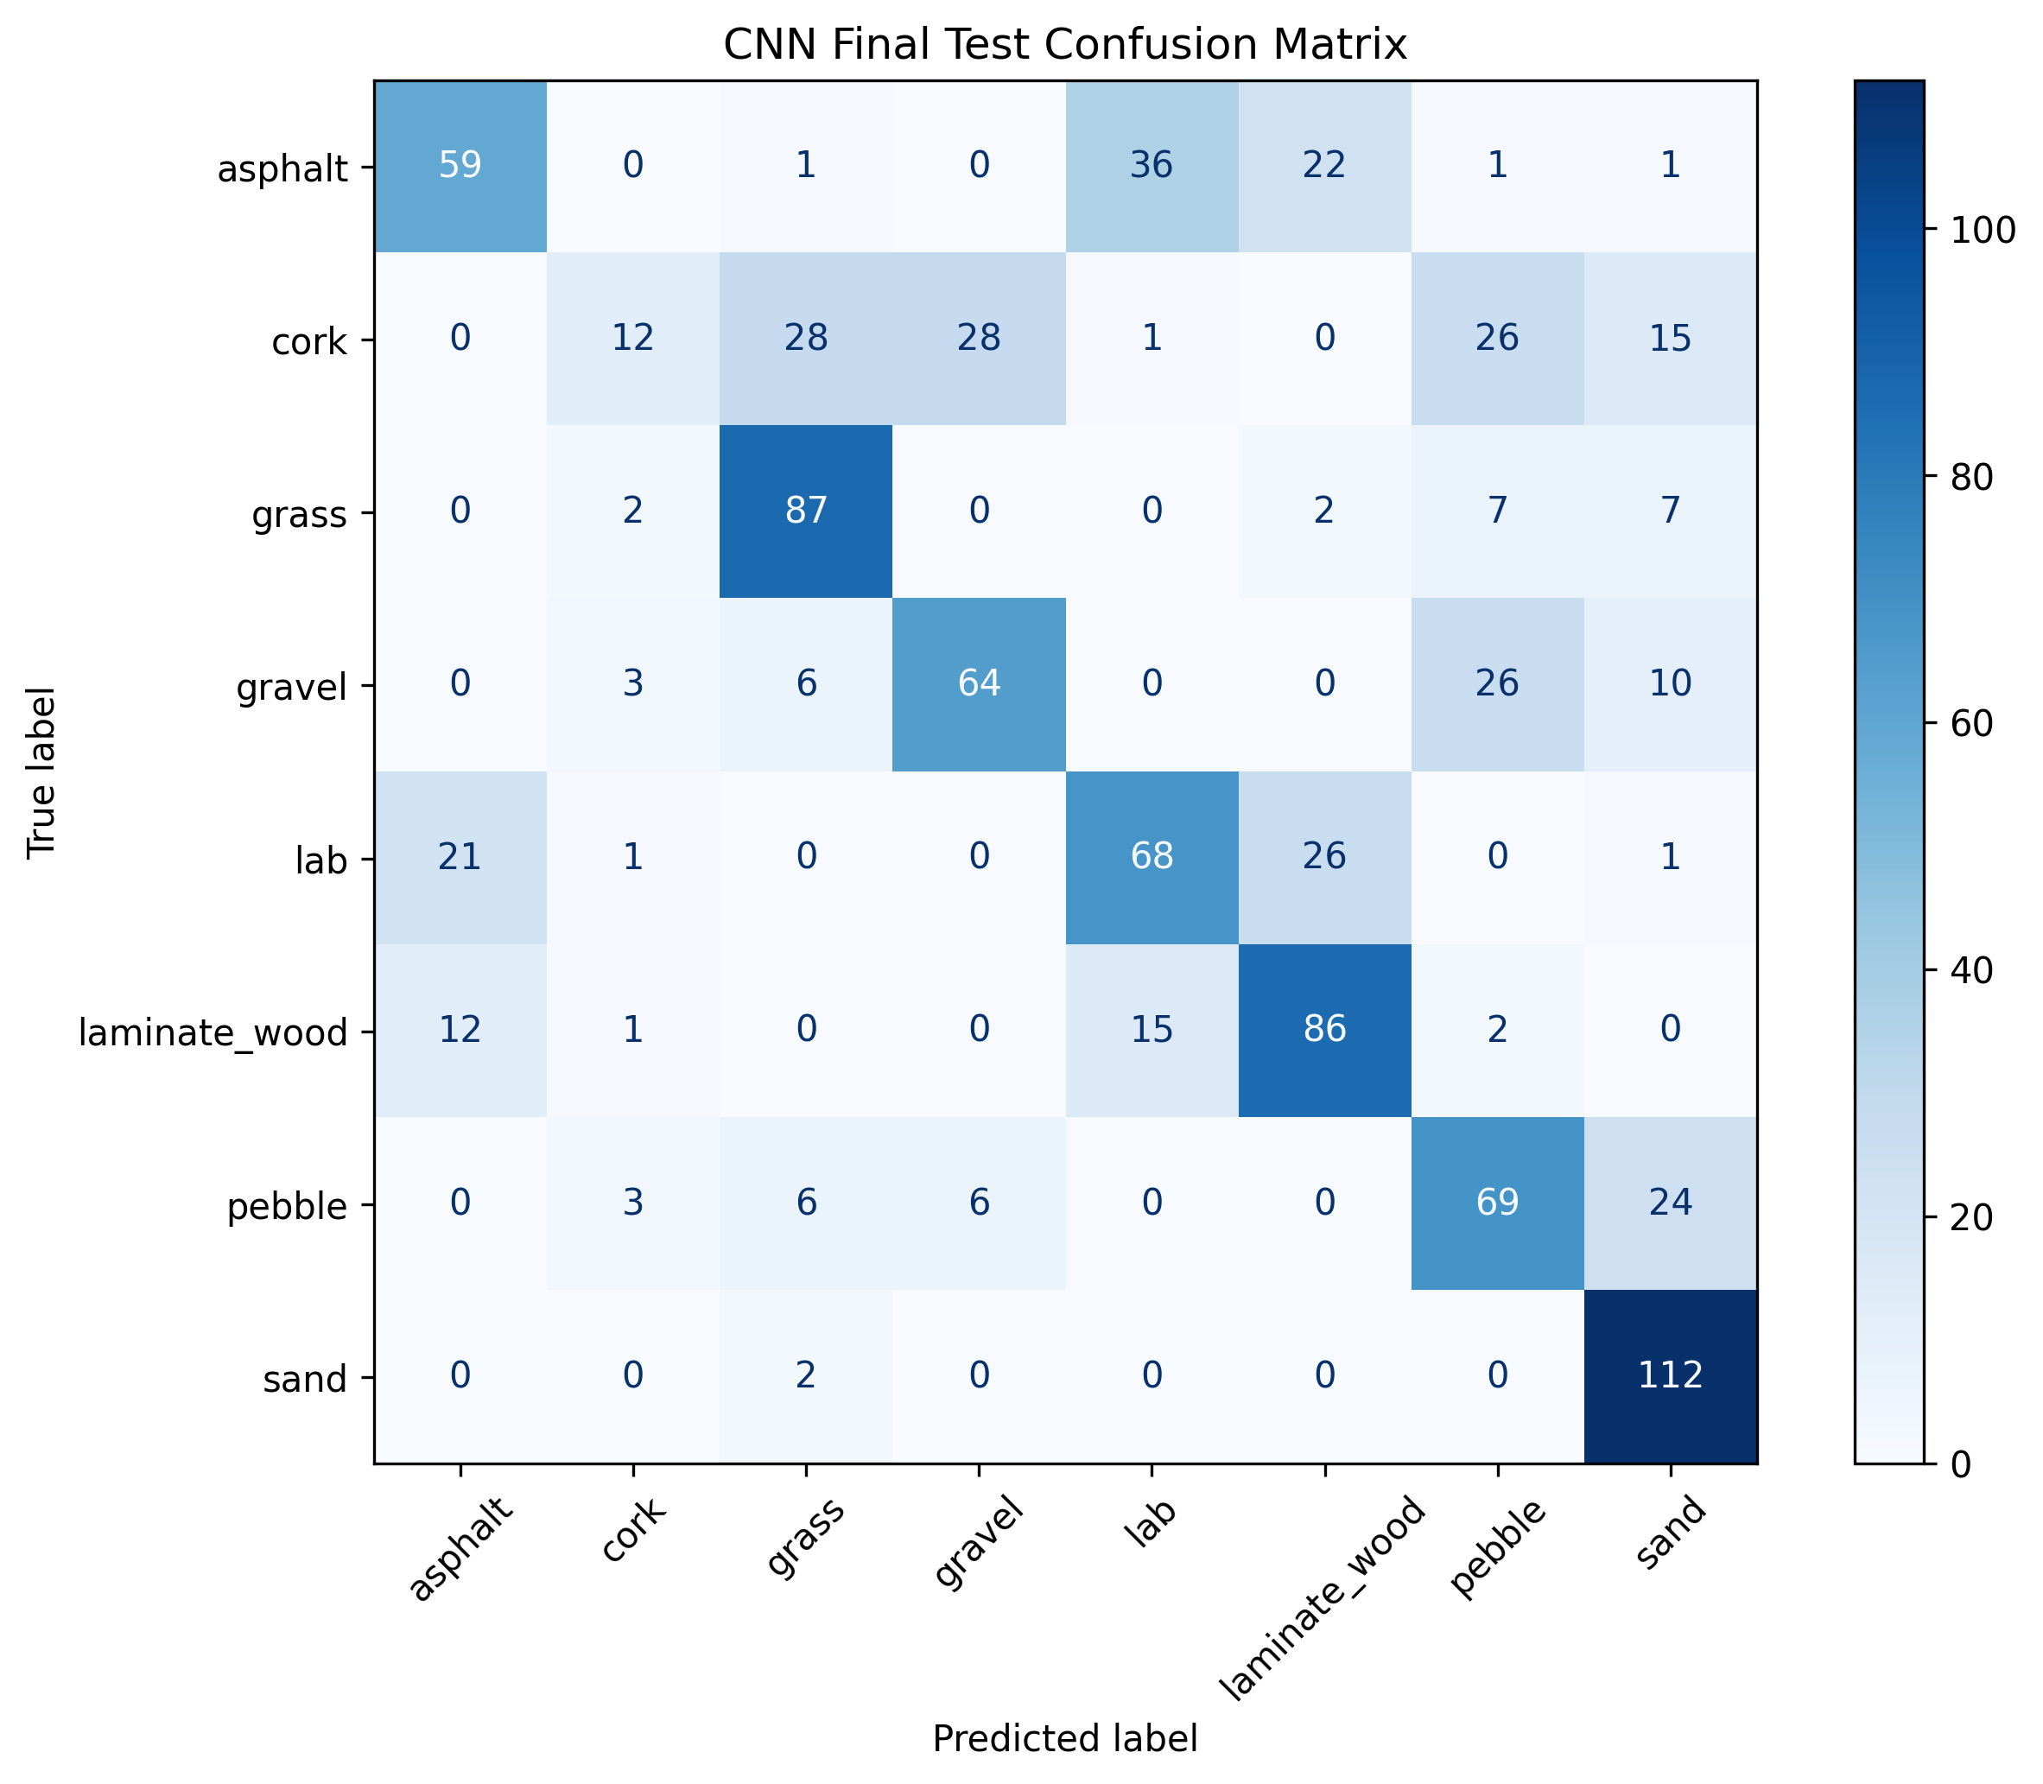
CNN errors and limitations
One stratified split and one run; results may vary
CNN struggles with cork (11% recall)
No cross-validation or real-robot testing yet
Conclusions limited to this dataset and setup
Next: repeated splits or cross-validation, feature importance, other architectures
Notes:
The figure is the original results/cnn_confusion_matrix.png from the repository, unmodified. Per-class recall from it matches the existing report: sand 98%, grass 83%, laminate wood 74%, pebble 64%, gravel 59%, lab 58%, asphalt 49%, cork 11%. Limitations and future work follow the existing report (sections 6 and 7).

Slide 8
Conclusion
Random Forest performed best of the four models on this test split
77.09%
1
CNN reached 61.96%: strong on sand and grass, weak on cork
2
Random Forest test accuracy
Macro F1 0.7698
Benchmark deep learning against classical baselines before assuming it wins
3
Findings apply to this dataset, split and model configuration only.
Notes:
Conclusion mirrors the existing report. The result does not show that Random Forest is universally better than CNNs; it is limited to this dataset, split, preprocessing and model configuration.

