Slide 1
ONLINE BANKING SYSTEM

Slide 2
Our Team- “Team A.C.H.I.E.V.E.R.S”
Team Lead | Team Member | Team Member | Team Member | Team Member
Harshit Verma 10683301 | Pritesh Gavhane 10684055 | Ponugoti Sai Nikhila 10683742 | Himanshu Pundir 10683468 | Gopikrishna Revindran 10684076

Slide 3
Problem Statement
Online banking system is specifically developed for internet banking for balance enquiry, funds transfer to another account, change of profile information and account statement.
The traditional way of maintaining details of a user in a bank was to enter the details and record them.
Every time the user needs to perform some transaction they have to go to bank and perform the necessary actions, which may not be so feasible all the time.

Slide 4
Our Take On The Problem
As a one stop solution for the stated problem, we provide an automation for banking system through Internet.
The aim is not only automation but also a better customer experience by providing a User Interface which is easily comprehendible by any person.
The website should also provide customer support so that the users get responded to their queries immediately and maintain the transparency so that the users should be aware of all the charges associated with the transaction.

Slide 5
Approach Used
Agile Methodology:
Project Roadmap Creation-
Planned for a basic solution and decided what technologies we can use to deliver our solution.
Sprint Planning-
Divided tasks in sprints and tried to get it all done within decided timeframe.
Daily Stand-Ups(Online)-
Daily team discussion on what tasks were completed/backlogs, if any and planned our day ahead.
Sprint Review and Retrospections-
Testing of all completed tasks and planning for impediments from previous sprint.

Slide 6
Technologies Used
Oracle DBMS – for Database creation and management
Core Java – for basic logics and OOPs concepts
Spring – for RESTful web services
Hibernate – as ORM tool
HTML – Content display for application
CSS – Styling our content
Angular – SPAs and Client side logics
Maven – as project management tool
Git – for Versioning control

Slide 7
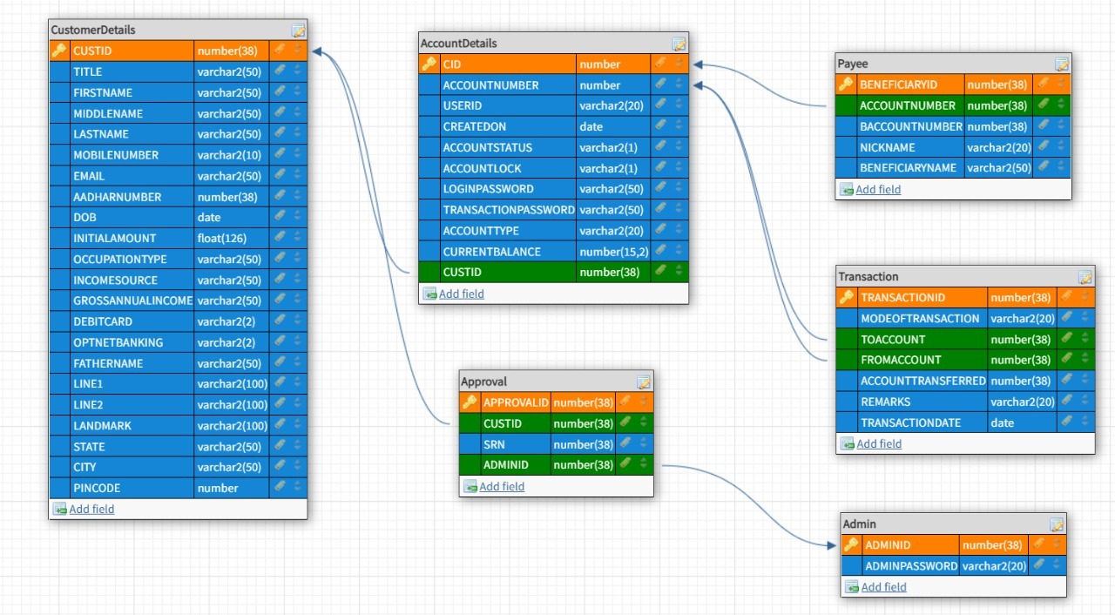
Database Schema

Slide 8
Entities | Repositories | Services | Controllers
Accountdetail Admin Approval Customerdetail Payee Transaction | AccountRepo BaseRepo CustomerRepo PayeeRepo TransactionRepo | AccountService ApprovalService CustomerDetailsService FundTransferService LoginService PayeeService SetNewPasswordService TransactionService | AccountController ApprovalController CustomerController FundTransferController LoginController PayeeController SetNewPasswordController TransactionController

