Slide 1



MBA BA · 2026
Instagram Usage Intensity
& Psychological Well-being
Social
Media
An MBA BA Internship Project exploring how social media usage patterns affect user stress, happiness, and overall well-being.
User
99,999
56
Analysis
User Records
Data Variables
Harshit Pandey · Trisha Patnam
31
0.83
Guide: R. Renuka | 02/04/2026
EDA Charts
Usage–Stress Correlation
MBA BA Internship Project · School of Management

Slide 2




Problem Statement
Slide 02
Instagram's 2B+ users spend excessive time on reels, feeds & sessions daily — yet there is no clear data-driven understanding of how these usage patterns impact psychological well-being. Heavy users report rising stress and declining happiness, but neither users nor platforms have actionable insight.
2B+
188
49%
Users Globally
Avg. Daily Minutes
Users Report High Stress
Heavy users report stress scores up to 3.7× higher than low-usage peers
Users spend 3+ hours/day on Instagram with no awareness of its impact
No tools exist to identify which usage patterns cause the most harm
Slide 2 · Problem Statement

Slide 3



Key Findings
99,999 Users
High Usage = High Stress
3.7×
Moderate Use → Happiness
↑ Happy
Strongest Stress Predictor
r=0.83
Heavy users: 270 min/day vs 73 min — nearly 4× more active with far higher stress scores
Balanced users show higher happiness; controlled engagement leads to positive well-being
Daily active minutes correlates with stress at r = 0.83 — single strongest variable
Reels Drive Overuse
222/day
Engagement ≠ Well-being
r=−0.37
Youth Most Vulnerable
13–25
High-stress users watch 222 reels/day vs 109 — addictive consumption loop confirmed
Happiness negatively correlates with usage intensity — active ≠ mentally healthy
Age 13–18 avg 222 min/day; 19–25 avg 213 min — highest usage and highest risk group
Slide 3 · Key Findings

Slide 4
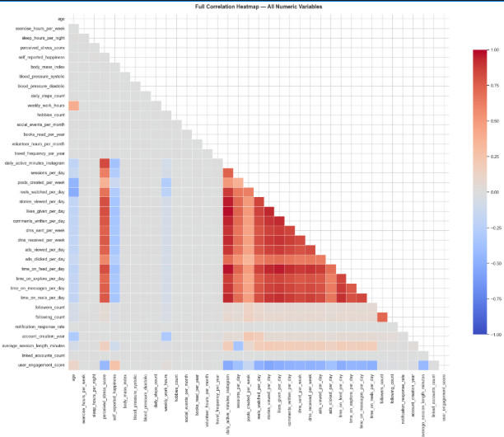
Correlation Analysis — Usage vs Well-being
Top Drivers of Stress Score
Pearson correlation (r) with Stress Score
Daily Active Minutes
r = 0.834
Likes Given / Day
r = 0.819
Time on Feed
r = 0.814
Comments Written
r = 0.788
Reels Watched / Day
r = 0.761
Sessions Per Day
r = 0.741
Happiness Score negatively correlates with usage at r = −0.37 — heavier users are measurably less happy.
Correlation Heatmap — Key Variables
Slide 4 · Correlation Analysis

Slide 5

Insights & Recommendations
Excessive Instagram usage drives higher stress & lower happiness — platforms must balance engagement with user well-being.
01
Usage Control Features
02
Smart Content Filtering
03
Mental Health Indicators
Screen time alerts, daily limits & 'Take a Break' reminders to reduce overuse-related stress
Reduce reel-heavy feeds for heavy users; promote educational & positive content for well-being
Weekly usage reports and in-app mood tracking — help users become self-aware of their digital habits
04
Target High-Risk Users
05
Ethical Algorithm Design
06
Lifestyle Integration
Identify high usage + high stress patterns; proactively send personalized wellness notifications
Avoid addictive loops; redesign algorithms to balance engagement KPIs with well-being metrics
Encourage offline activities & fitness challenges; connect digital behaviour with healthy real-world habits
Slide 5 · Insights & Recommendations · Data: Kaggle Instagram Dataset (n=99,999)

Slide 6
Project Summary
Social Media User Analysis
Instagram Usage Intensity & Psychological Well-being
Dataset: 99,999 users · 56 variables · 31 EDA charts
Key Finding: Usage–Stress correlation r = 0.83
THANK
YOU!
01
High usage → High stress
02
Moderate usage → More happiness
We appreciate your time & attention.
Harshit Pandey · Trisha Patnam
03
Engagement ≠ Well-being
Guide: R. Renuka | MBA BA · 2026
Questions & Discussion Welcome!
Social Media User Analysis · MBA BA Internship Project · School of Management · 2026

