Slide 1
Credit Risk Evaluation Using Logistic Regression
Predictive Modeling | ROC/AUC Analysis | Financial Risk Management

Slide 2
Objective
• Build a predictive model to evaluate credit risk of loan applicants
• Use Logistic Regression to classify applicants into risk categories
• Validate the model using ROC/AUC metrics
• Provide insights for financial risk management

Slide 3
Tools & Technologies Used
• Python (NumPy, Pandas, Scikit-learn)
• Logistic Regression
• ROC Curve & AUC Evaluation
• Matplotlib/Seaborn for Visualization

Slide 4
Methodology / Workflow
1. Data Collection & Cleaning
2. Feature Engineering (e.g., income, credit history, loan amount)
3. Train-Test Split
4. Logistic Regression Model Training
5. Model Evaluation (ROC, AUC, Accuracy)
6. Risk Categorization of Applicants

Slide 5
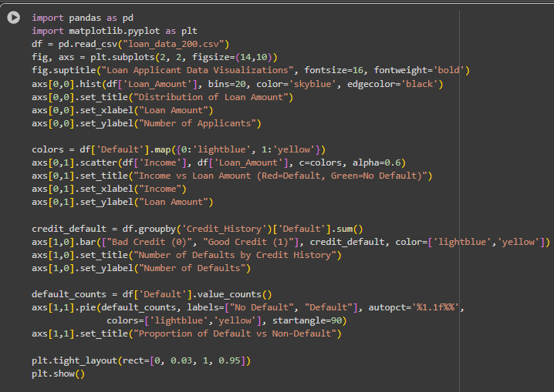
CSV file code

Slide 6
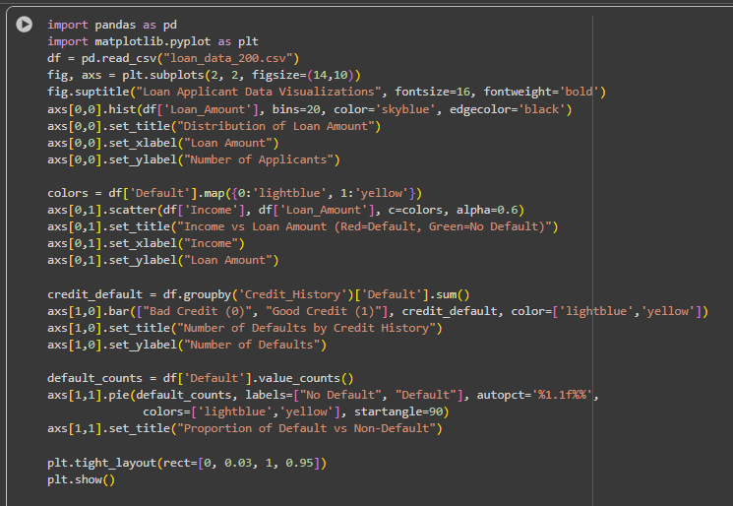
Implementation

Slide 7
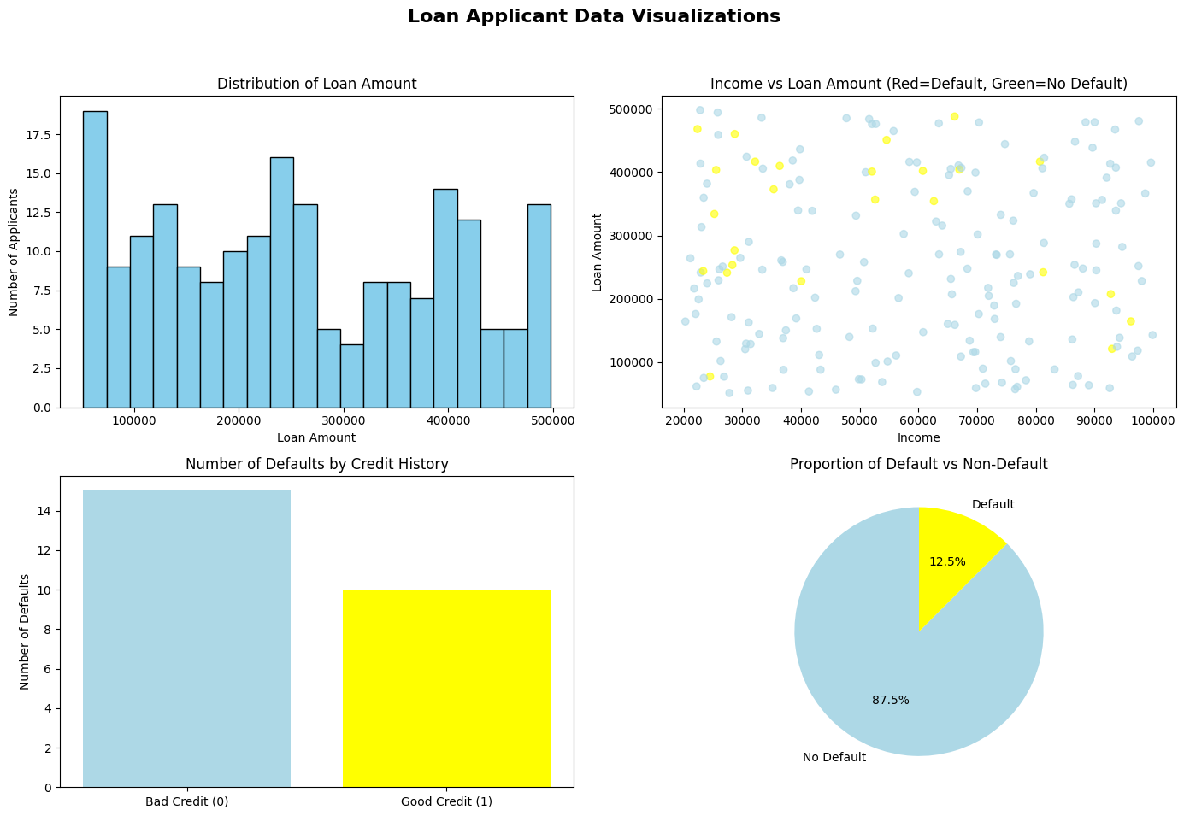
Output

Slide 8
Output & Results
• ROC Curve plotted for model evaluation
• AUC value indicates model performance
• Applicants categorized as High Risk or Low Risk
• Insights help lenders reduce default probability

Slide 9
Conclusion
• Logistic Regression provides an effective way to predict credit risk
• ROC/AUC metrics validate model reliability
• Helps financial institutions in risk management & decision making
• Future scope: Ensemble Models, Deep Learning approaches

