Slide 1
Hypothesis Testing Exercise
A F&B manager wants to determine whether there is any significant difference in the diameter of the cutlet between two units. A randomly selected sample of cutlets was collected from both units and measured? Analyze the data and draw inferences at 5% significance level. Please state the assumptions and tests that you carried out to check validity of the assumptions.
Minitab File : Cutlets.mtw
Ans.->
Alpha = 0.05
H0 = There is difference
Ha = There is no diffrence

Slide 2
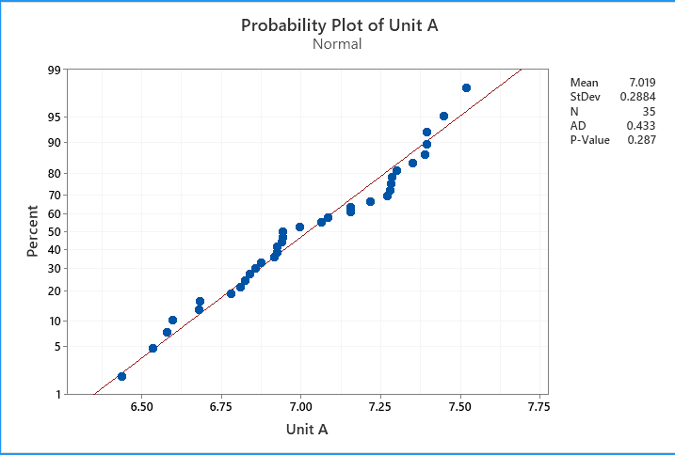
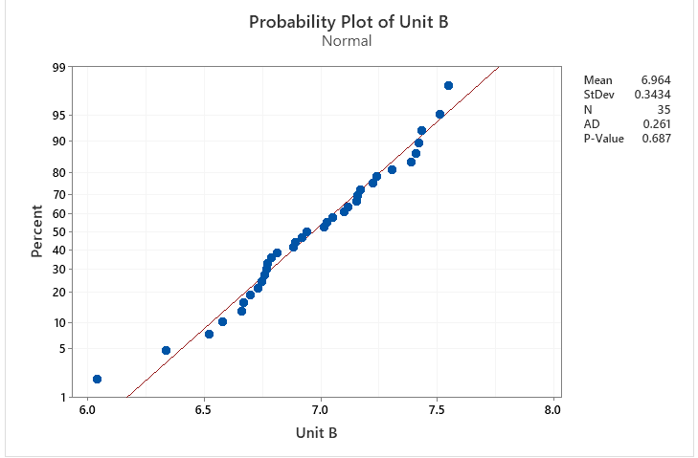
I performed this operations using minitab.
P value for Unit A > 0.05 ( We accept Null Hypothesis)
P value for Unit B > 0.05 ( We accept Null Hypothesis)

Slide 3
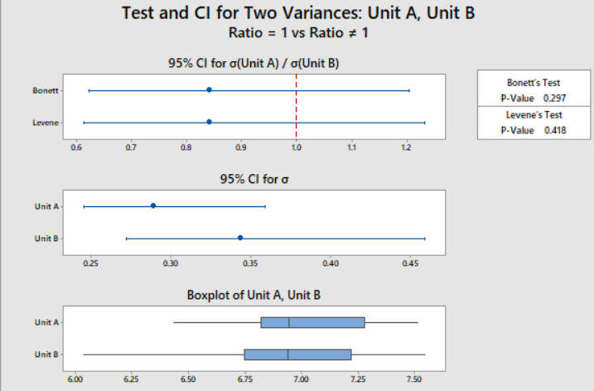
P High Ho fly. We fail to reject Null hypothesis. So we will accept it and hence Variances of A is equal to Variances of B.
3) As A and B are 2 Discrete variables and output variable diameter is a continuous, we will go with 2-sample T test
2 sample t- test is equality of Means test. Sample Mean will tell us which program is better.
Ho= Averages of diameters of Unit A is equal to Averages of diameters of unit B
Ha= Averages of diameters of Unit A is not equal to Averages of diameters of unit B
Inference is that there is no significant difference in the diameters of Unit A and Unit B.

Slide 4
Hypothesis Testing Exercise
A hospital wants to determine whether there is any difference in the average Turn Around Time (TAT) of reports of the laboratories on their preferred list. They collected a random sample and recorded TAT for reports of 4 laboratories. TAT is defined as sample collected to report dispatch.
Analyze the data and determine whether there is any difference in average TAT among the different laboratories at 5% significance level.
Minitab File: LabTAT.mtw
Ans.->
Alpha = 0.05

Slide 5
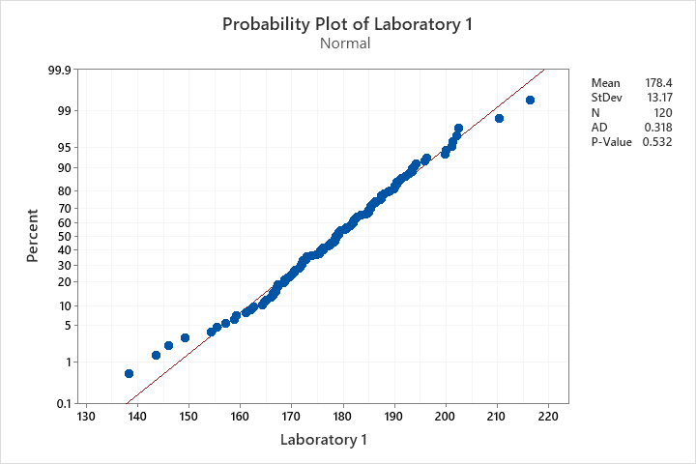
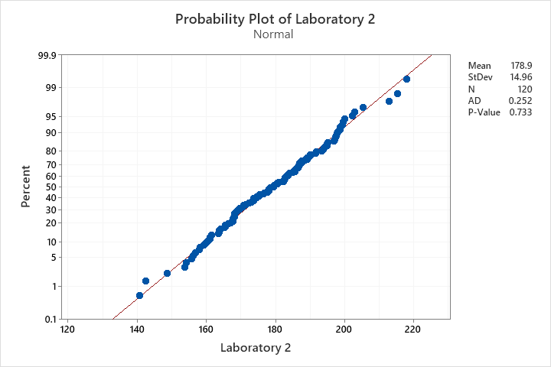
P- value for Laboratory 1 and Laboratory 2 > 0.05
Ho= Data is normally distributed
Ha=Data is not normally distributed

Slide 6
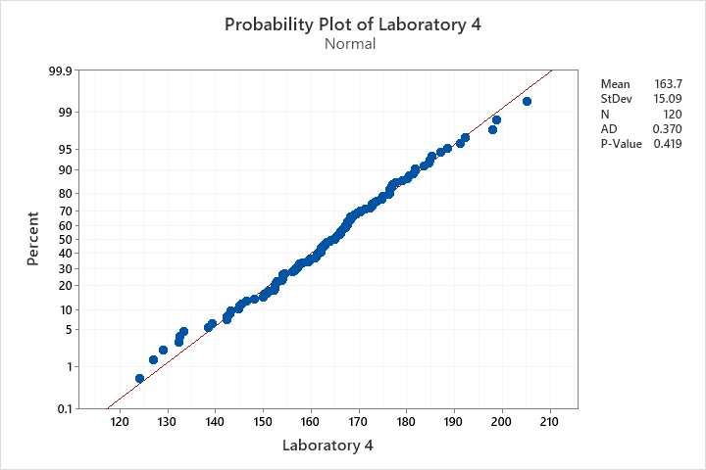
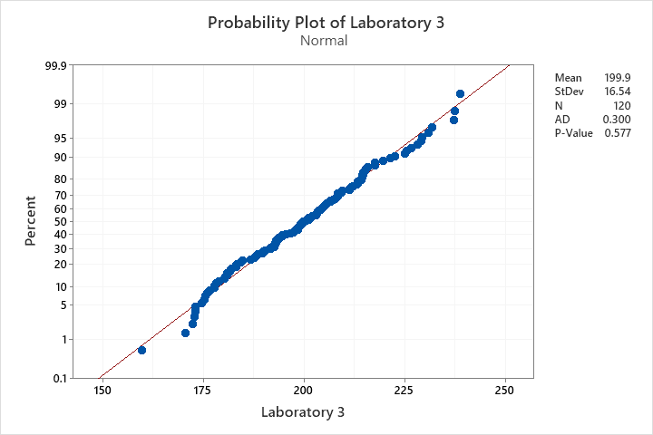
p- value for Laboratory 3 and Laboratory 4 > 0.05
Ho= Data is normally distributed
Ha=Data is not normally distributed

Slide 7
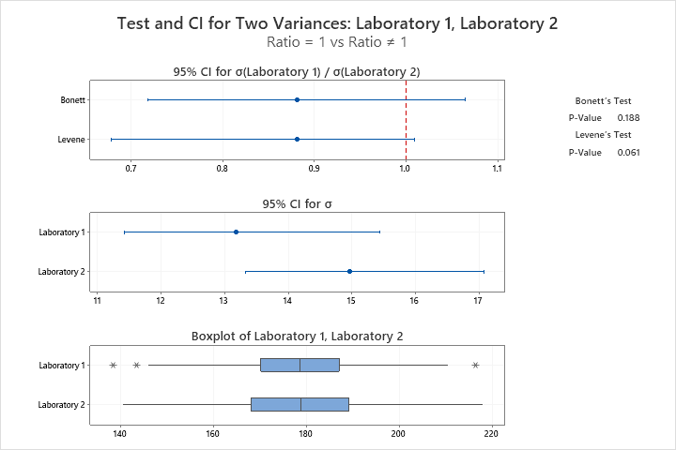
Ho= Variance of TAT of Lab 1 is equal to variance of TAT of Lab 2
Ha= Variance of TAT of Lab 1 is not equal to variance of TAT of Lab 2
P-value>0.05. P High Ho fly. We fail to reject Null hypothesis.

Slide 8
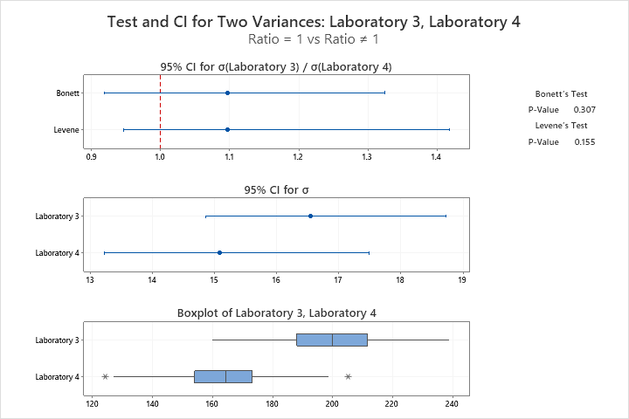
Ho= Variance of TAT of Lab 4 is equal to variance of TAT of Lab 3
Ha= Variance of TAT of Lab 4 is not equal to variance of TAT of Lab 3
P-value >0.05. P High Ho fly. We fail to reject Null hypothesis.

Slide 9
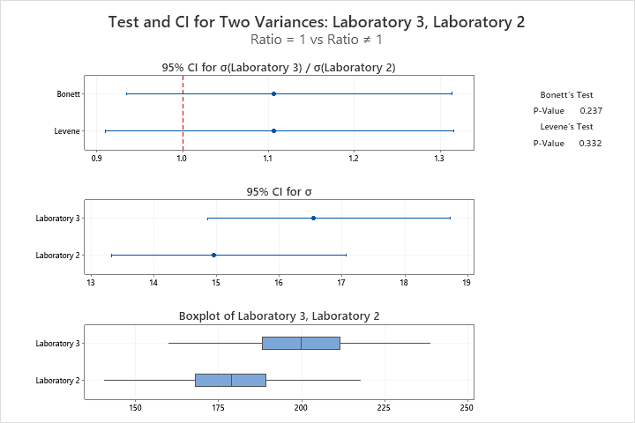
Ho= Variance of TAT of Lab 2 is equal to variance of TAT of Lab 3
Ha= Variance of TAT of Lab 2 is not equal to variance of TAT of Lab 3
P-value >0.05. P High Ho fly. We fail to reject Null hypothesis.

Slide 10
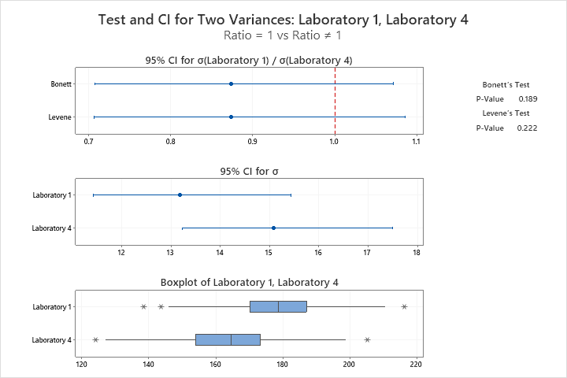
Ho= Variance of TAT of Lab 4 is equal to variance of TAT of Lab 1
Ha= Variance of TAT of Lab 4 is not equal to variance of TAT of Lab 1
P-value>0.05. P High Ho fly. We fail to reject Null hypothesis. So we will accept it and hence Variances of lab 4 is equal to variances of lab 1
As there are more than 2 discrete variables and output variable TAT is a continuous variable. Hence we will go with Anova one way test.

Slide 11
Method
Null hypothesis All means are equal
Alternative hypothesis Not all means are equal
Significance level α = 0.05
Equal variances were assumed for the analysis.
Factor Information
Factor Levels Values
Factor 2 Laboratory 1, Laboratory 2
Analysis of Variance
Source DF Adj SS Adj MS F-Value P-Value
Factor 1 17.6 17.58 0.09 0.766
Error 238 47273.8 198.63
Total 239 47291.4
Model Summary
S R-sq R-sq(adj) R-sq(pred)
14.0936 0.04% 0.00% 0.00%
SImilarly by doing for different lab combinations you can see that P -value is > 0.05. P High and Ho Fly.
Hence there is no significant difference in the average TAT for all the labs.

Slide 12
Hypothesis Testing Exercise
Sales of products in four different regions is tabulated for males and females. Find if male-female buyer rations are similar across regions.
 | East | West | North | South
Males | 50 | 142 | 131 | 70
Females | 550 | 351 | 480 | 350
Check p-value
If p-Value < alpha, we reject Null Hypothesis
H0
All proportions are equal
Ha
Not all Proportions are equal
Buyer Ratio.mtw

Slide 13
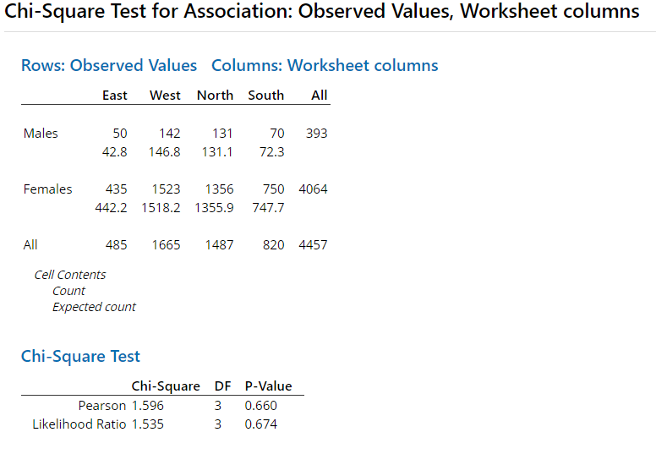
Inputs are 4 discrete variables(east,west,north,south).
Output is also discrete. We are trying to find out if proportions of male and female are similar or not across the regions
We proceed with chi-square test
Create hypothesis
Ho= Proportions of Male and Female are same
Ha= Proportions of Male and Female are not same
P-value>0.05.Hence we fail to reject Null.
Hence proportion of male and female across regions is same.

Slide 14
Hypothesis Testing Exercise
TeleCall uses 4 centers around the globe to process customer order forms. They audit a certain % of the customer order forms. Any error in order form renders it defective and has to be reworked before processing. The manager wants to check whether the defective % varies by centre. Please analyze the data at 5% significance level and help the manager draw appropriate inferences
Minitab File: CustomerOrderForm.mtw
Fantaloons Sales managers commented that % of males versus females walking in to the store differ based on day of the week. Analyze the data and determine whether there is evidence at 5 % significance level to support this hypothesis.
Minitab File: Fantaloons.mtw

Slide 15
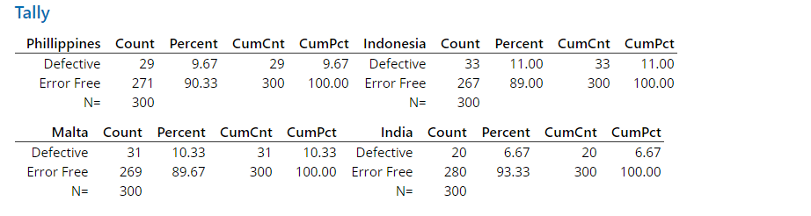
1) Inputs are 4 discrete variables.
We proceed with Chi Square Test
Create hypothesis
Ho= Proportions across all country are almost same
Ha= Proportions of at least one country is different
P- value = 0.625
P- value is greater than .05 so we can say that Proportions across all country are almost same

Slide 16
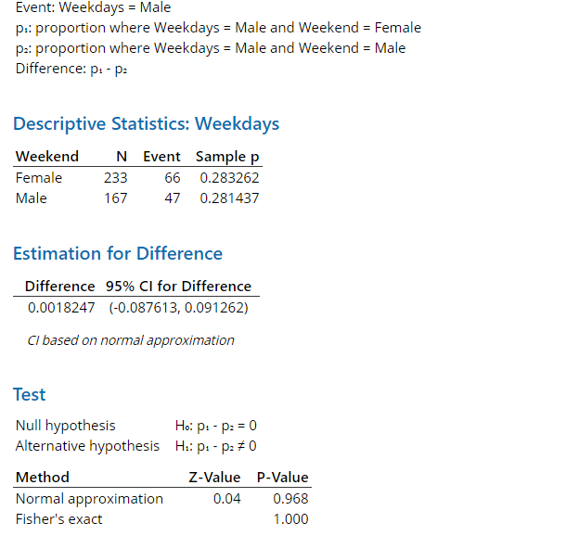
2) Inputs are 2 discrete variables.
Output is Discrete as we are trying to find out if proportions of male and female walking in to the store is same or not
We proceed with 2-proportion test
Create hypothesis
Ho= Proportions of Male and Female are same
Ha= Proportions of Male and Female are not same

Slide 17

P-value is less than 0.05 and hence we fail to reject Null.Hence proportions of Male and Female are not same
Now we will try to find out whose proportion is higher. We create another hypothesis
Ho= Proportions of Male is less than or equal to Female
Ha= Proportions of Male is greater than Female
P-value <0.05 and hence we reject null. Hence proportion of Male is greater than Female

