Slide 1
N-Queens Visualizer Project Report

Slide 2
Overview
The N-Queens Visualizer is a Java application that visualizes the process of solving the N-Queens problem. The N-Queens problem is a classic combinatorial problem where the goal is to place N chess queens on an N×N chessboard such that no two queens threaten each other. This means no two queens can share the same row, column, or diagonal.

Slide 3
1. NQueensVisualizer Class
This class extends JPanel and serves as the main visual component of the application. It handles the board's graphical representation and the logic for placing the queens.
Key Variables
size: The size of the board (N×N).
board: A 2D array representing the board, where 1 indicates the presence of a queen, and 0 indicates an empty cell.
CELL_SIZE: The size of each cell in pixels.
PADDING: The padding around the board to center it within the window.
SLEEP_TIME: The delay in milliseconds between moves to visualize the process.

Slide 4
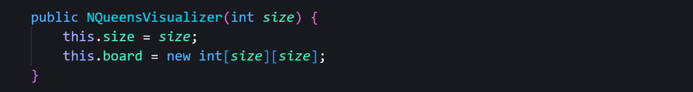
2. Constructor

Slide 5
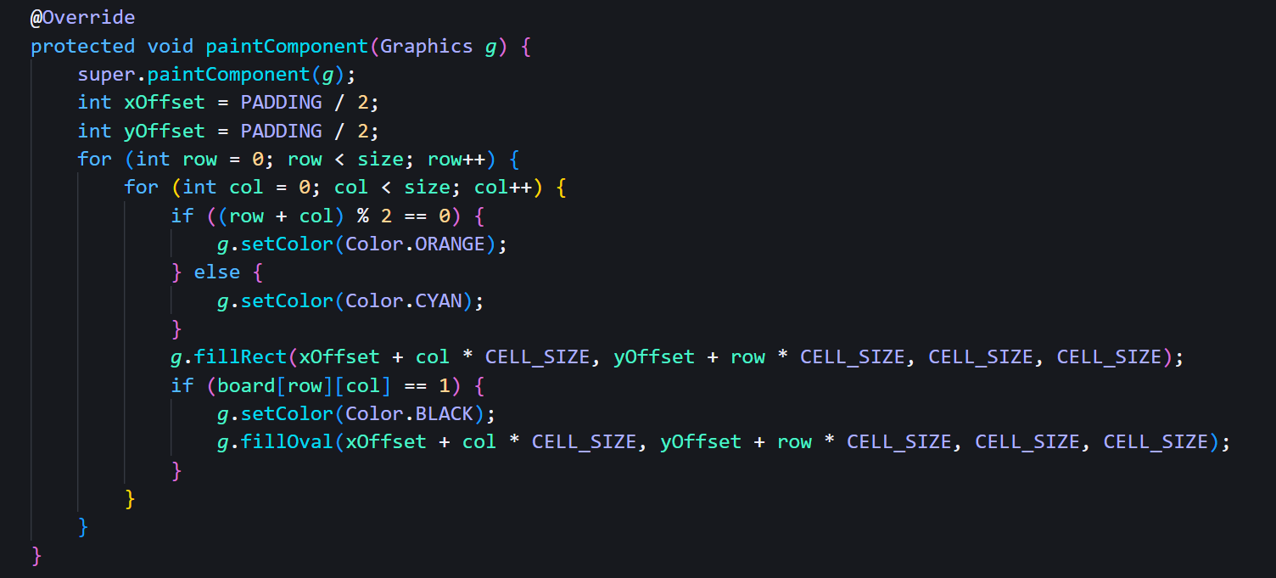
2. Constr3. paintComponent Method uctor

Slide 6
4. placeQueens Method

Slide 7
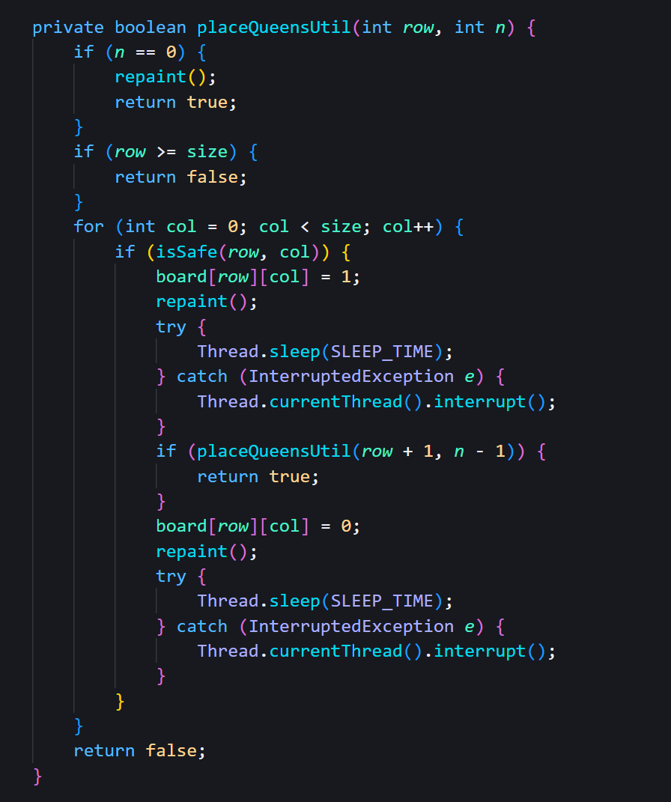
2. Construct5. placeQueensUtil Method or

Slide 8
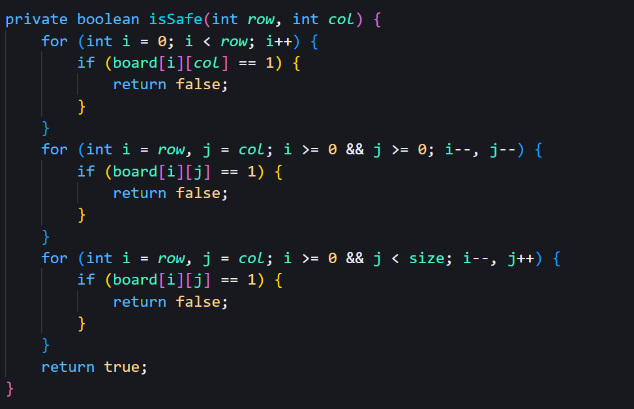
6. isSafe Method

Slide 9
Execution Flow
Initialization: The user inputs the board size and the number of queens. The application initializes the board and GUI components.
Placing Queens: The placeQueens method starts the recursive process in a new thread.
Recursive Backtracking: The placeQueensUtil method attempts to place queens row by row, using the isSafe method to check for valid positions. If a conflict arises, it backtracks and tries a different column.
Visualization: The paintComponent method is called to update the GUI after each move, with a delay to visualize the process.

