Slide 1


EDA on Food Demand Forcasting Dataset
BY : Harshvardhan Joshi ;
12302

Slide 2
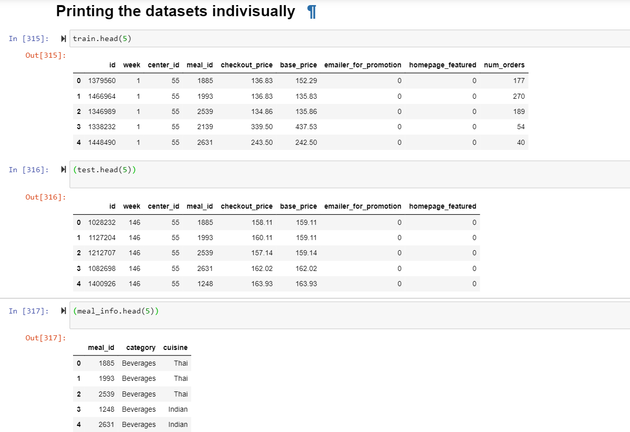
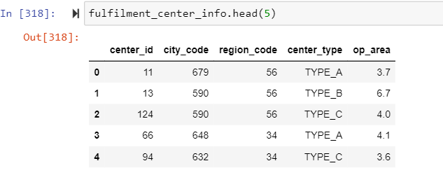
The dataset is basically has 4 csv files: train, test, meal_info, fulfilment_center_info.
About the Dataset

Slide 3
Merging the datasets:
Merging the fulfilment center and meal with csv file with train and test:
So I merged the 2 csv file with both train and the test set.
Using centerid as the key for fuilfilment center dataset and mealid for mealinfo dataset.
The following line of codes were executed
train = pd.merge(train,fulfilment_center_info, on='center_id')
test = pd.merge(test,fulfilment_center_info, on='center_id')
train = pd.merge(train,meal_info, on='meal_id')
test = pd.merge(test,meal_info, on='meal_id')

Slide 4
About the features :
Int64Index: 456548 entries, 0 to 456547
Data columns (total 15 columns):
# Column Non-Null Count Dtype
--- ------ -------------- -----
0 id 456548 non-null int64
1 week 456548 non-null int64
2 center_id 456548 non-null int64
3 meal_id 456548 non-null int64
4 checkout_price 456548 non-null float64
5 base_price 456548 non-null float64
6 emailer_for_promotion 456548 non-null int64
7 homepage_featured 456548 non-null int64
8 num_orders 456548 non-null int64
9 city_code 456548 non-null int64
10 region_code 456548 non-null int64
11 center_type 456548 non-null object
12 op_area 456548 non-null float64
13 category 456548 non-null object
14 cuisine 456548 non-null object
dtypes: float64(3), int64(9), object(3)
memory usage: 55.7+ MB
In [323]:
Features after merging the datasets:
There are around 450,000 rows in the dataset and none of the column has null values so there is no need for null imputation in these columns.
train.isnull().sum()
The output of this was 0 for all the columns it means that there are no null values.

Slide 5
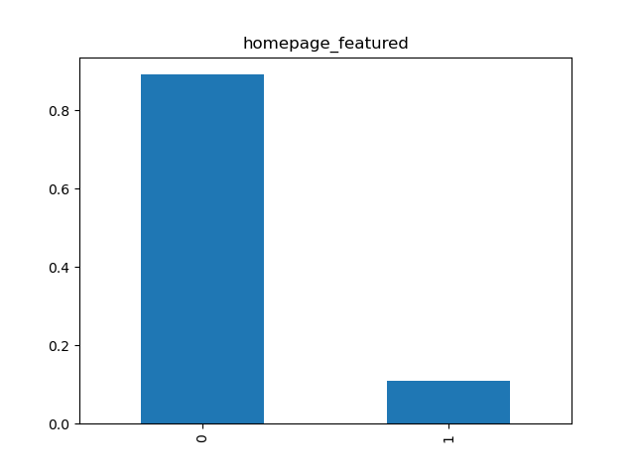
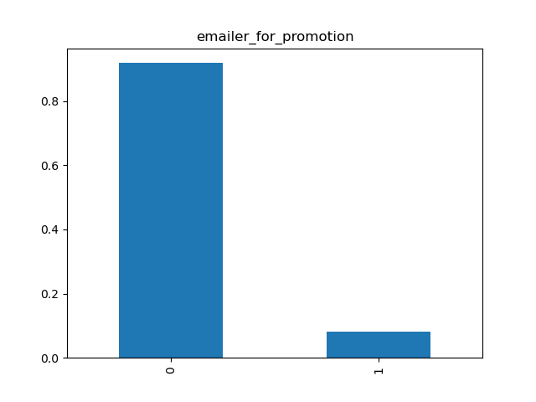
Checking for unique values:
From the output we can see that emailer_for_promotion, homepage_featured and center_type has only 2 unique values so we’ll visualise these two features.
From the graphs we can see that 0 is the maximum value in both the features with more than 90% occurrence so We’ll drop these features.
train.apply(lambda x: len(x.unique()))
id 456548
week 145
center_id 77
meal_id 51
checkout_price 1992
base_price 1907
emailer_for_promotion 2
homepage_featured 2
num_orders 1250
city_code 51
region_code 8
center_type 3
op_area 30
category 14
cuisine 4

Slide 6
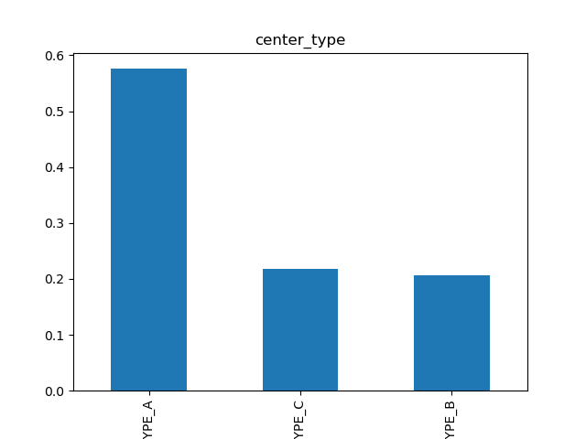
Checking for unique values pt2:
Also analysing center_type as it also has 3 unique values:
But we can see though Type A has 55% of the values from the whole row still Type C and Type B have some significant value.
train.apply(lambda x: len(x.unique()))
id 456548
week 145
center_id 77
meal_id 51
checkout_price 1992
base_price 1907
emailer_for_promotion 2
homepage_featured 2
num_orders 1250
city_code 51
region_code 8
center_type 3
op_area 30
category 14
cuisine 4

Slide 7
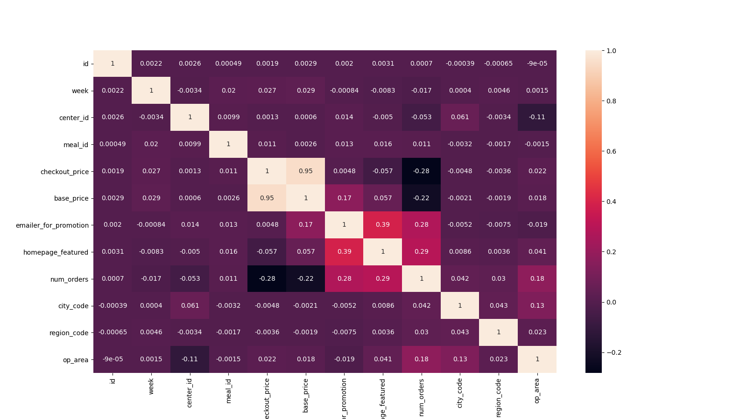
Analysing the heat map
We can see the correlation matrix at our left and none of the features in our data set is correlated to each other as the value is very close to 0 in most of the square boxes.

Slide 8

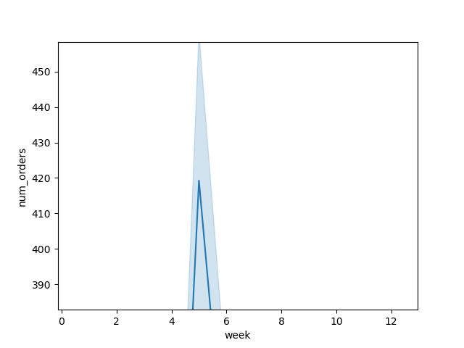
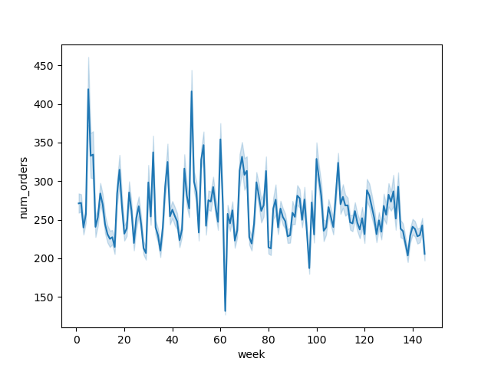
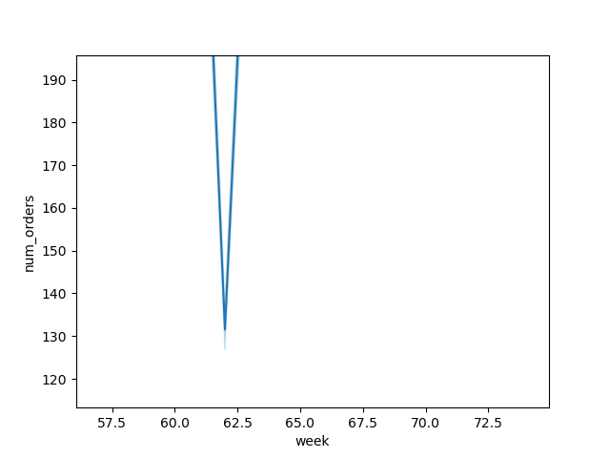
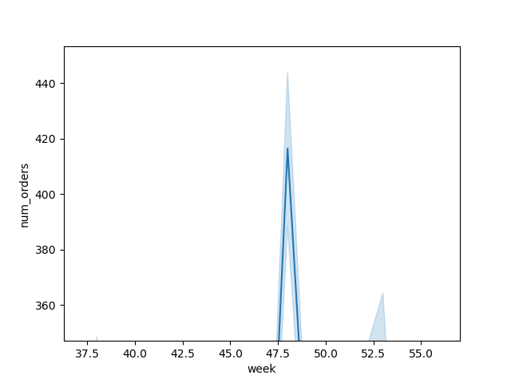
Analysing the num_of_orders:
i.e. our target coloumn
We can see see that there was a sudden increase in number of orders in week 5 and week 48 as the graph showed sudden peaks in increasing direction.
Similarly in week 62 there was a huge downward trend which shows that number of orders were minimum in week 62.

Slide 9
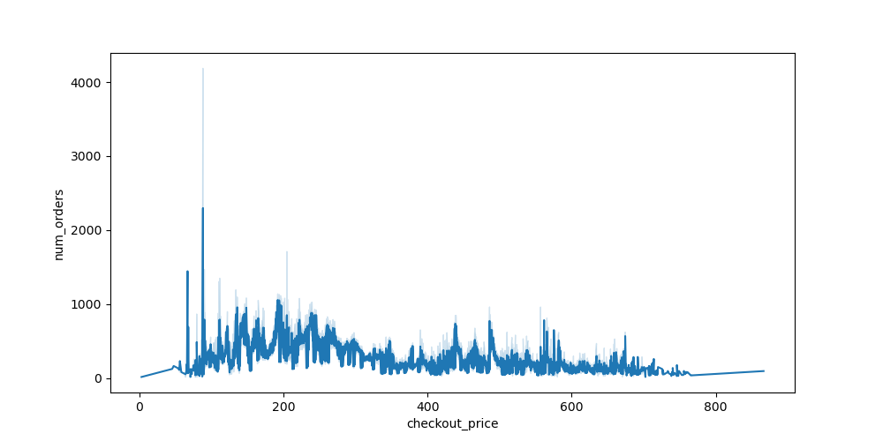
Analysing the check_out_price:
It can be seen that the checkout price is showing an inverse relationship with the number of orders.
As we can see when the checkout price was low or less the number of orders were in large numbers.

Slide 10
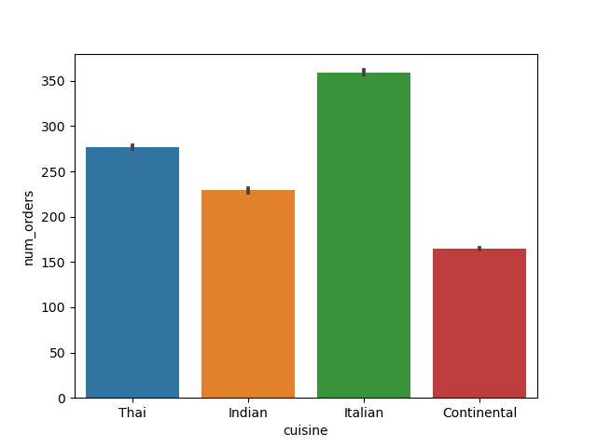
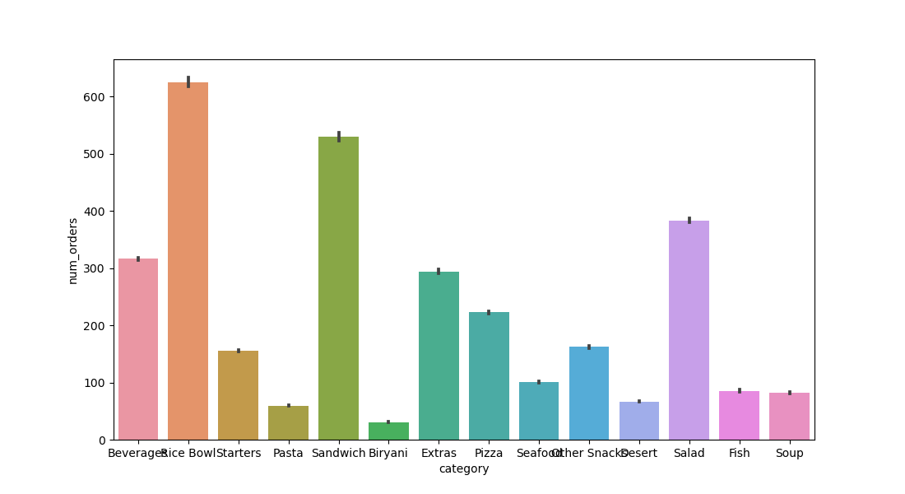
Analysing cusines and catagories :
When we are analysing the cuisines grah we can see that Italian was the most consumed cuisine and continental was the least referred or consumed.
Similarly in the category column Rice is the most consumed category followed by sandwich and Biryani being the least consumed.

Slide 11

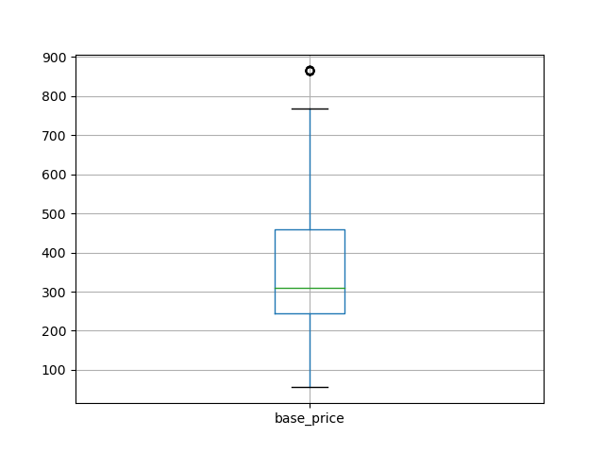
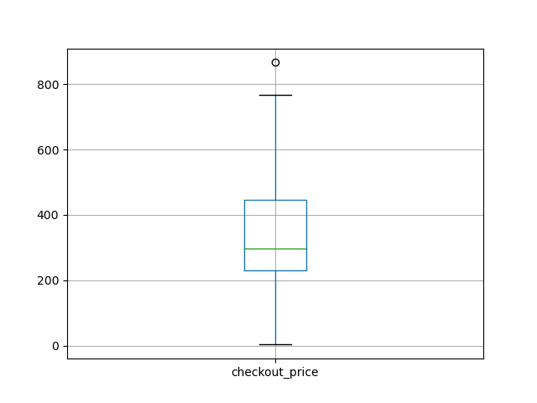
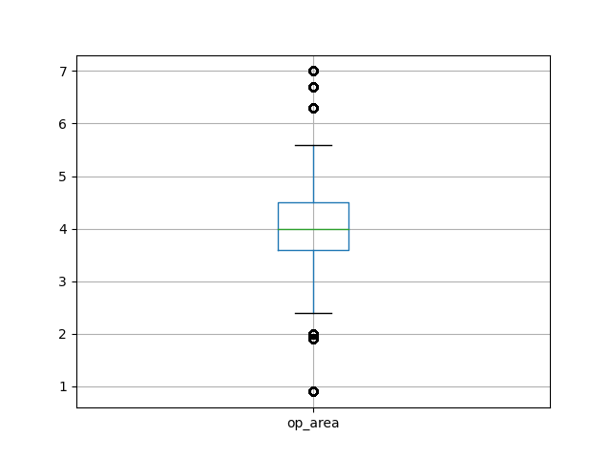
Checking for Outliers
Outliers are the part of observation which differ from the other observation in our dataset. They can either be mistake or variance in the dataset. They need to be handled as they can play a major role in efficiency of our model.
From our observation we can see that we need to deal with outliers in the following features:
Checkout price
Base price
OP area

Slide 12
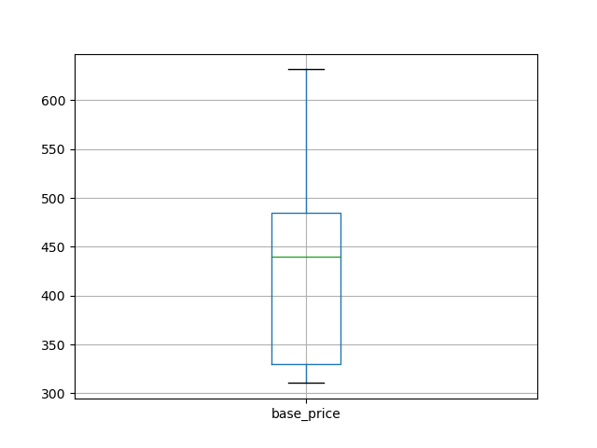
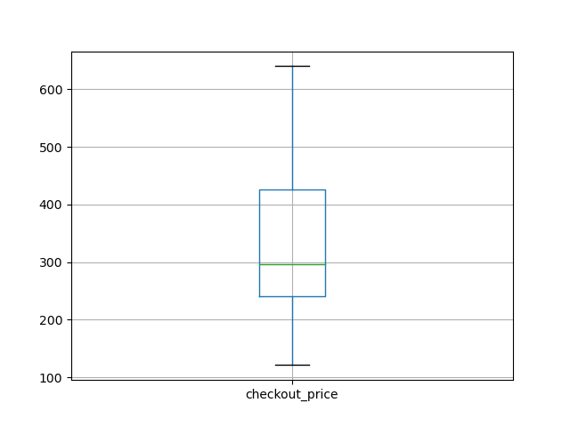
Handling Outliers:
So I made a new variable num_cols where I stored all the numeric features and checked for outliers.
After finding the outliers in base price and checkout price I handled them using:
upper_lim = train['checkout_price'].quantile(.95)
lower_lim = train['checkout_price'].quantile(.05)
train = train[(train['checkout_price']<upper_lim)&(train['checkout_price']>lower_lim)]
where the quantile range was set to 0.5 to 0.95 as it suited best for these 2 columns.

Slide 13
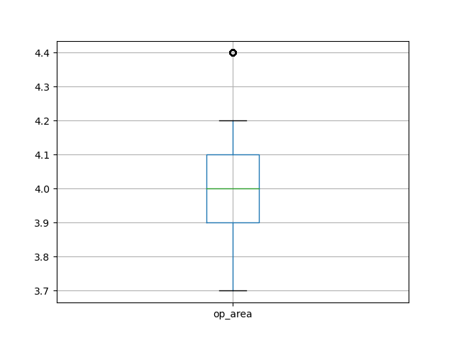
Handling Outliers pt 2 :
And for op area the range was set between 0.75 and 0.25 as it showed better results.
upper_lim = train['checkout_price'].quantile(.75)
lower_lim = train['checkout_price'].quantile(.25)
train = train[(train['checkout_price']<upper_lim)&(train['checkout_price']>lower_lim)]

