Slide 1
Final Project: Nexus (i.e., Reddit-like platform)
Name: Harsh Patel
Hawk ID (A-Number #): A20369913
Subject: ITMD 555 Intelligent Device Apps Android
Professor: James Papademas
Test Emulator: Pixel 7 pro API 35
Language: Java

Slide 2
Understanding the Idea Behind the Project
Nexus is a community platform, like Reddit, that bridges fragmented social discussions to deliver high-quality information and meaningful discourse.
Users can join or start community pages, create posts on any community, and view posts from others.
i.e., Business, Entertainment, Health, Science, Sports, Technology, Gaming, Traveling, MacBook, or any random topic, etc.
Groups: Users begin by customizing their post feed through filtration (e.g., select/deselect Creative Design, Retro). This ensures the "Nexus Dashboard" is relevant from the very first login.
Current Features:
Like, dislike (posts/comments), comments (based on threads), and share posts.
Bookmark posts with “Recaps” for quick access later.
Search content directly from the main feed.
Community-based feed with filtering options.
Share posts with other users easily.
Create and engage across multiple communities.
Backend powered by Firebase (NoSQL database).
Firebase:
Firebase Authentication (for user login & identity management)
Cloud Firestore (for database operations like storing users, likes, comments, etc.)
APIs:
Google Firebase APIs
Firebase Authentication
Cloud Firestore
Web-based routing API for cross-platform sharing (i.e., currently on localhost)
Notes:
- So, Nexus is a community platform—like Reddit—but designed to bridge fragmented social discussions and bring high-quality information into one place.
- The idea is simple: instead of scattered conversations across the internet, Nexus helps users find meaningful discussions in a structured way.
- Users can join or create communities on almost any topic like business, entertainment, health, science, sports, technology, gaming, or even very niche interests like MacBooks or travel.
- Now, what makes Nexus interesting is the personalization from the start. - When users first log in, they can filter what they want to see like selecting or removing topics such as creative design or retro content, so their dashboard feels relevant immediately.
In terms of features, Nexus allows users to:
- Like or dislike posts and comments
- Engage in threaded discussions
- Share posts easily
- Bookmark content using something called Recaps for quick access later
- And search directly from the main feed
- The platform is built around a community-based feed, so users can actively participate across multiple communities instead of being limited to one space.
- From a technical perspective, the backend is powered by Firebase. - We use Firebase Authentication for managing user login and identity, and Cloud Firestore, which is a NoSQL database, to handle data like users, posts, likes, and comments efficiently.
Overall, Nexus is about cutting through noise and helping people engage in more meaningful, organized discussions online.”

Slide 3
Implementation flowchart - 1
Registered User?
User’s Dashboard
Open profile dialog box
Start
Search
Communities
Logout
Up/Down
vote
Engagement
Selected>0?
Saved pref. : Error
End
No
Bookmark
Splash Screen
Feed fetch: Feed posts from selected communities.
Create community
Sign Up
User Action Hub
Share
Create post
For the
first-time
user
Show all apps
communities
Post Detail
(Detail Activity)
Yes
Create option
Login
Open profile dialog box
Real-time feed updates
Fetch communities
Yes
Logout
Search
posts
Post Interaction
Valid credentials?
Click FAB (+)
Share
User Action Hub
Engagement
No
Comment
Error
End
Date Filters
Edit Prefs
Up/Down vote
Date Filters
Bookmarks
Notes:
Here is how the diagram specifically aligns with your project's code:
1. Entry and Authentication (The Left Side)
- Splash Screen/Start: This is your MainActivity. It doesn't just show a logo; it acts as the logic gate (the "Registered User?" diamond) to decide whether to send the user to LoginActivity or SignupActivity.
- Fetch Communities: This perfectly represents CustomizeFeedActivity, which is the first destination after a successful login or signup.
2. User Action Hub - Preferences (The Top Center)
- Search/Engagement: Your CustomizeFeedActivity includes a search bar for communities and an adapter that tracks "Engagement" (selections).
- Saved Prefs: The code in CustomizeFeedActivity.saveSelection() merges the selected community IDs into the Firebase user document, matching the "Selected -> Saved" flow.
3. The Dashboard Hub (The Blue Center)
- Feed Fetch: DashboardActivity.loadUserFeed() fetches posts specifically from the IDs stored in the user's profile.
- Real-time Updates: Your fetchPosts method uses addSnapshotListener, which exactly matches the "Real-time feed updates" box.
- Action Hub (Bottom Diamond): This matches your DashboardActivity UI, which contains the Date Filter button, the Search bar, and the Bookmarks toggle.
4. Creation Logic (The Center Column)
- Click FAB (+): Your DashboardActivity has a FloatingActionButton that opens showCreateOptions().
- Option: This is your dialog_select_option.xml.
- Create Post / Community: These map to dialog_create_post.xml and dialog_create_community.xml.
5. Post Detail & Interaction (The Right Side)
- Post Detail (Detail Activity): Matches PostDetailActivity.
- Up/Down Vote, Bookmark, Share, Comment: All these actions are explicitly implemented in PostDetailActivity.java.
- Dashboard Interactions: Note that your FeedAdapter also allows for some "Post Interactions" (like clicking to view) directly from the dashboard.
6. Profile & Session Management (The Green Boxes)
- Open Profile Dialog: Both CustomizeFeedActivity and DashboardActivity have a btnUserProfile that triggers showUserProfileDialog().
- Logout/End: The btnLogout in that dialog executes FirebaseAuth.getInstance().signOut() and kills the activity task.

Slide 4
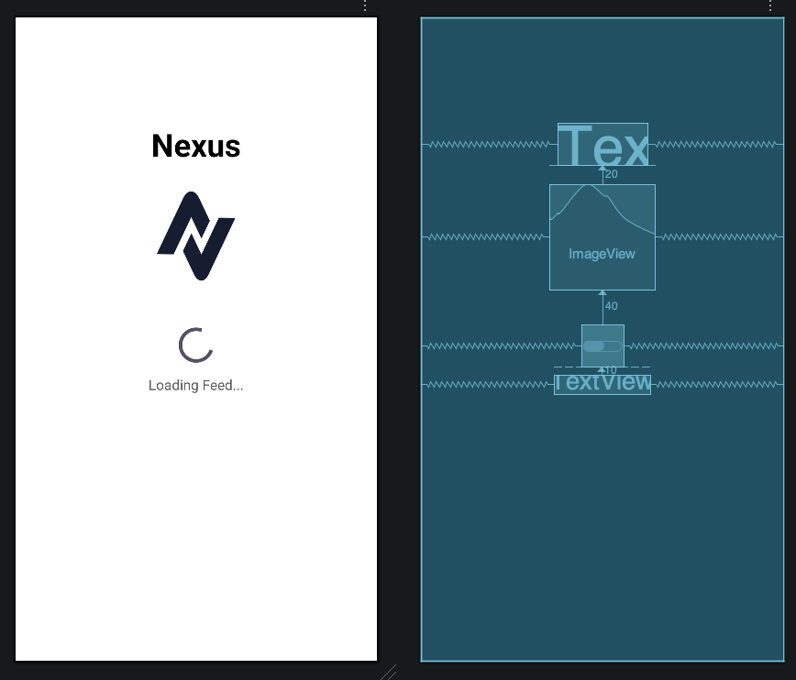
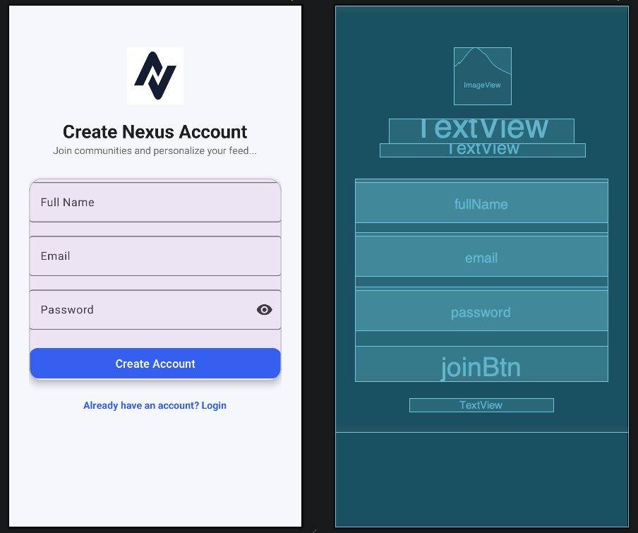
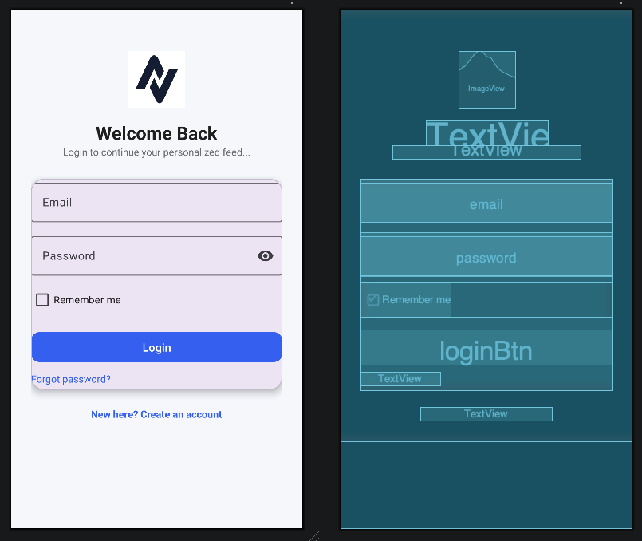
Implementation flowchart-02 (U/I part-01)
Splash Screen | Sign up | Sign in/Login

Slide 5
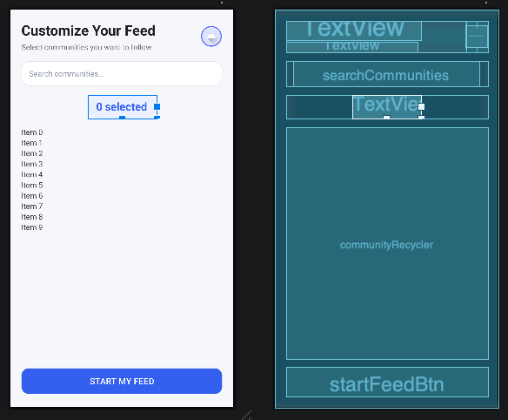
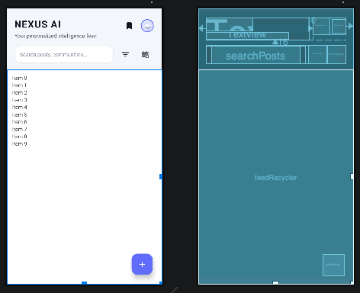
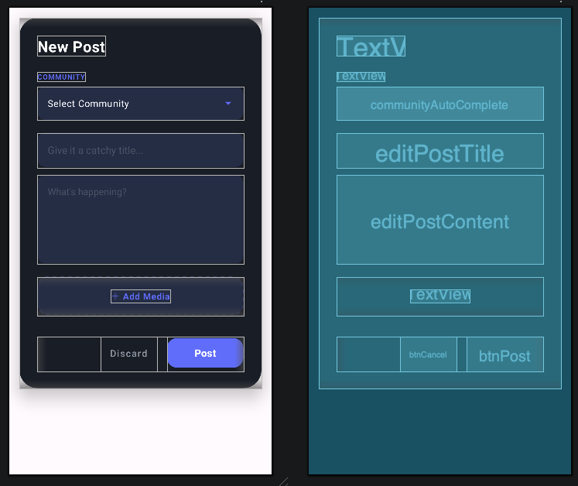
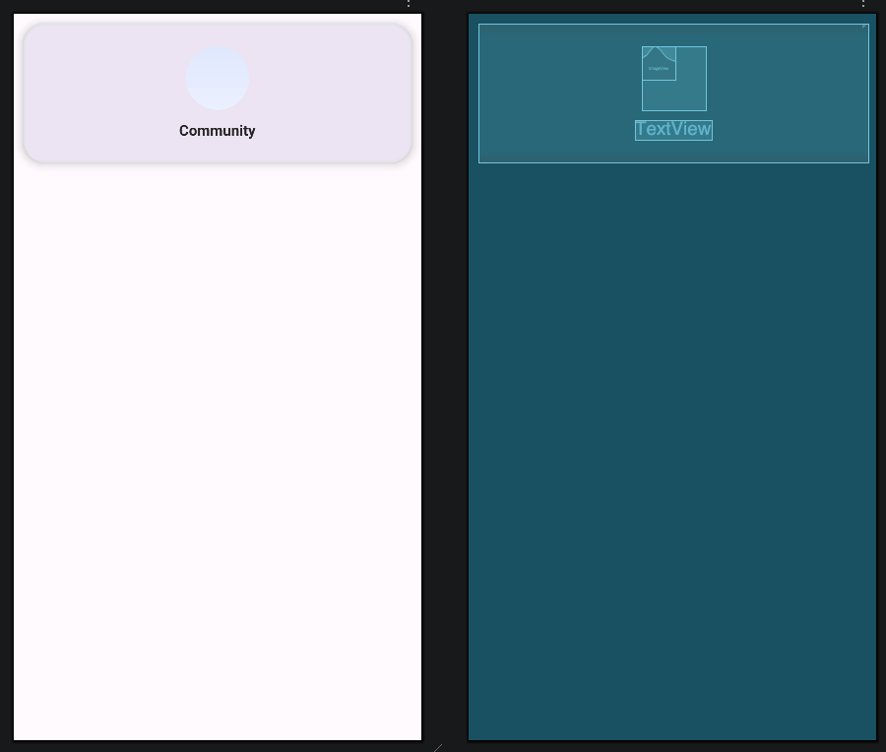
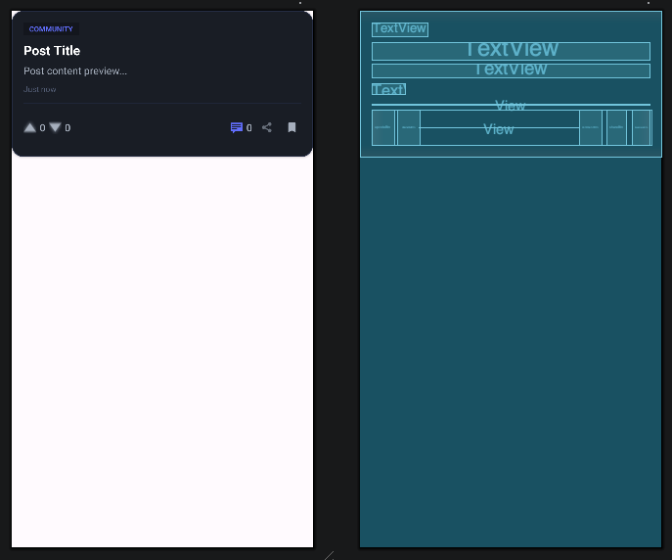
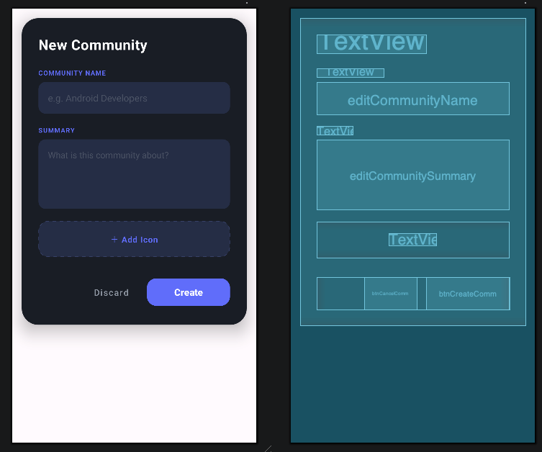
Implementation flowchart-02 (U/I part-02)
Topic selection activity | Activity Dashboard - 01 | Activity Dashboard - 02

Slide 6
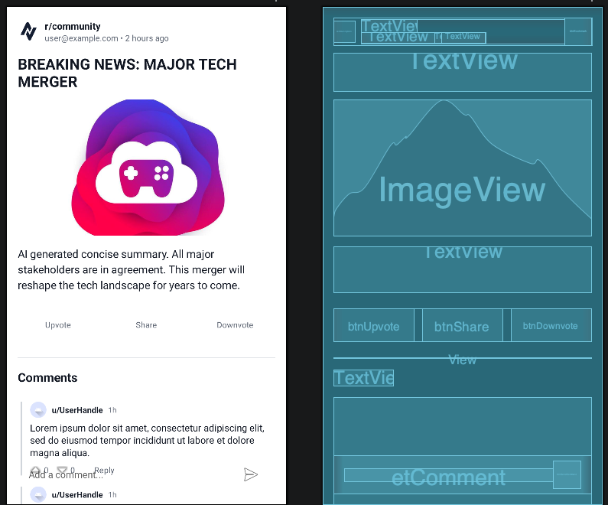
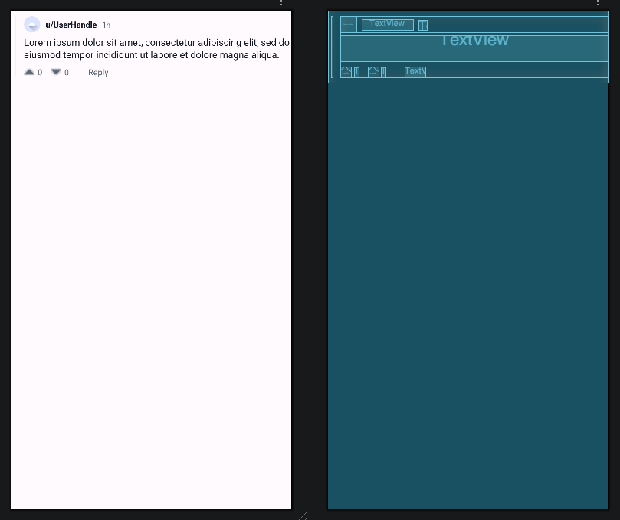
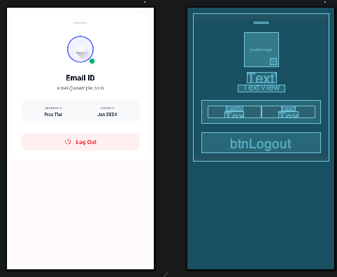
Implementation flowchart-02 (U/I part-03)
Detailed Post Activity - 01 | Detailed Post Activity - 02 | Logout (i.e., from any Page)

Slide 7

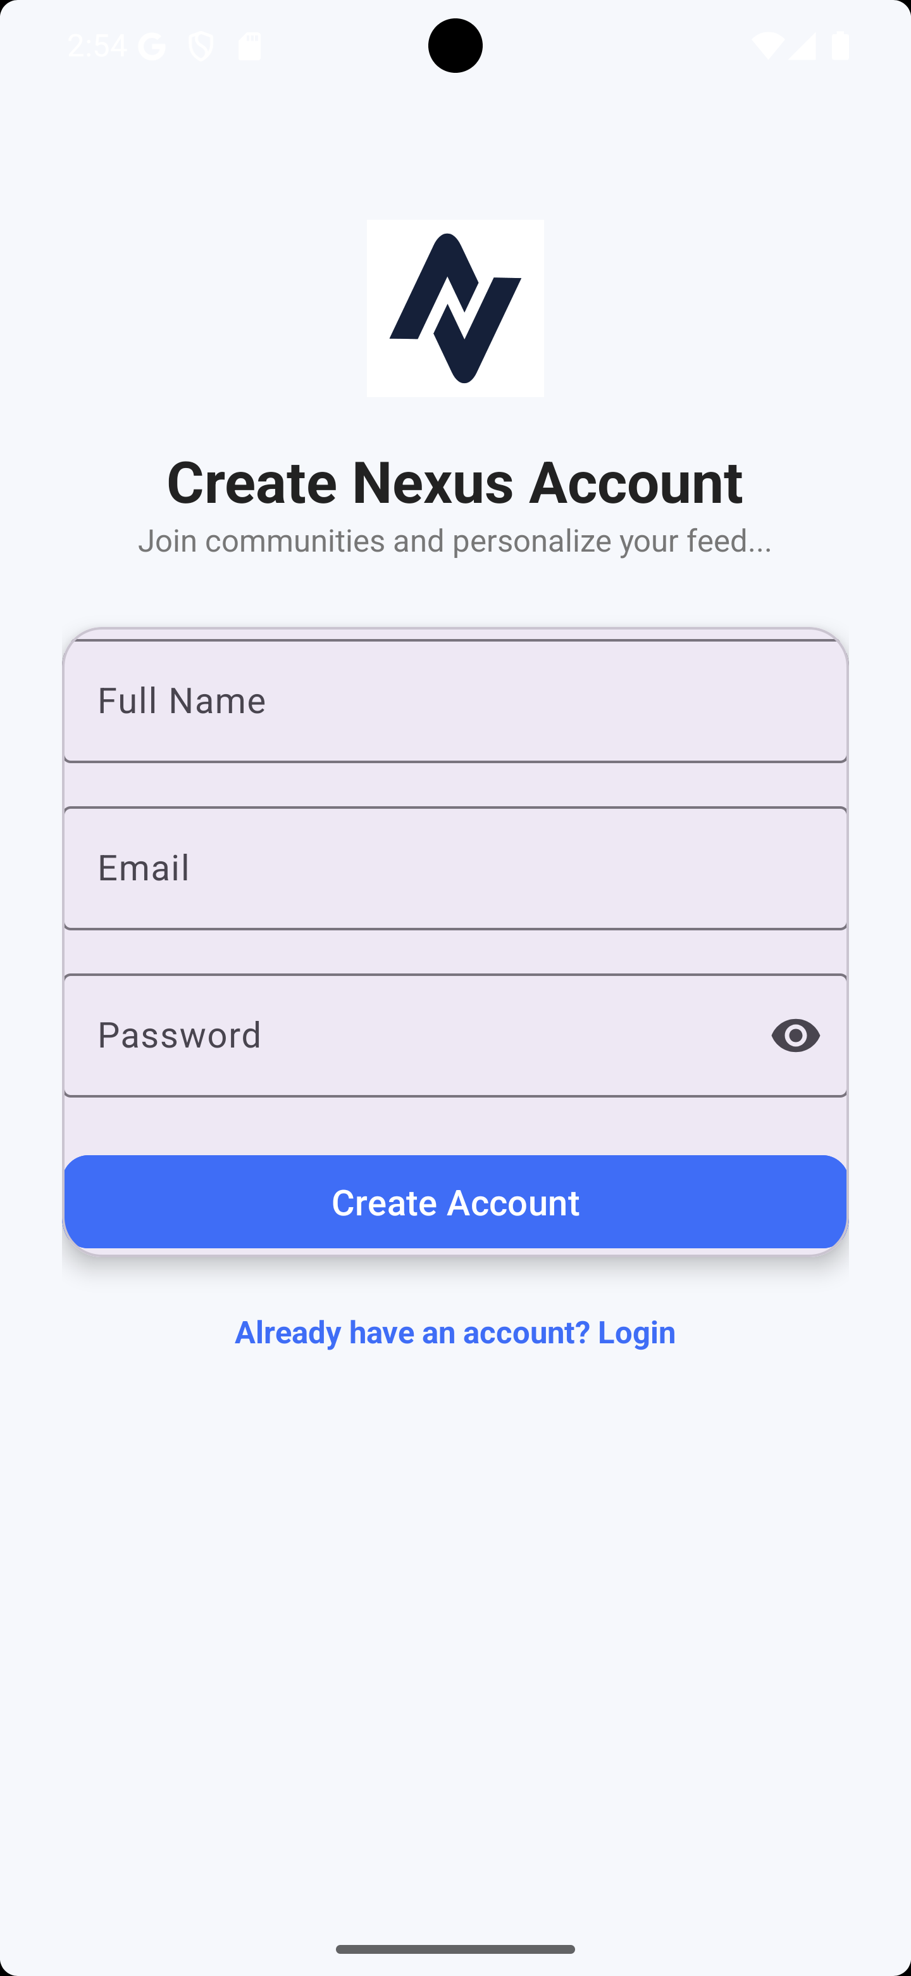
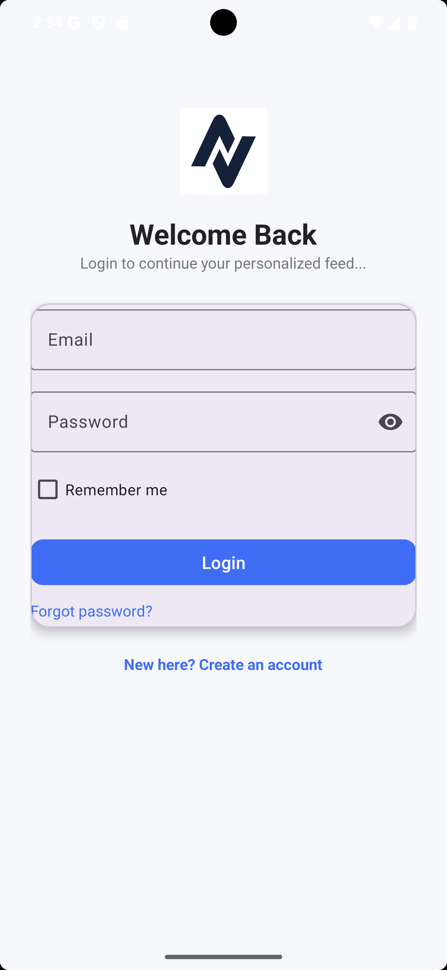
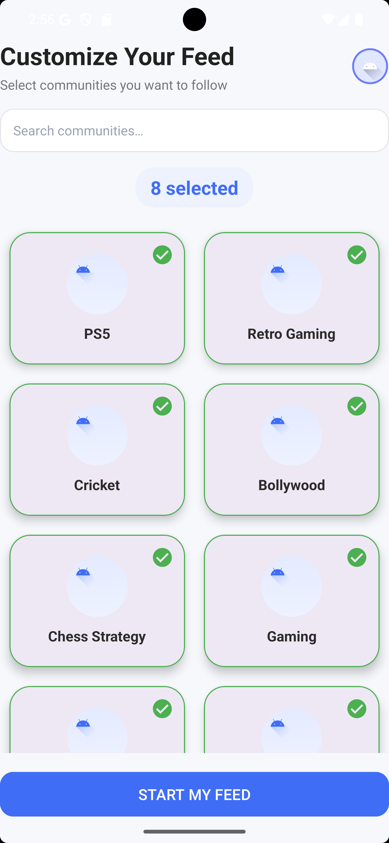
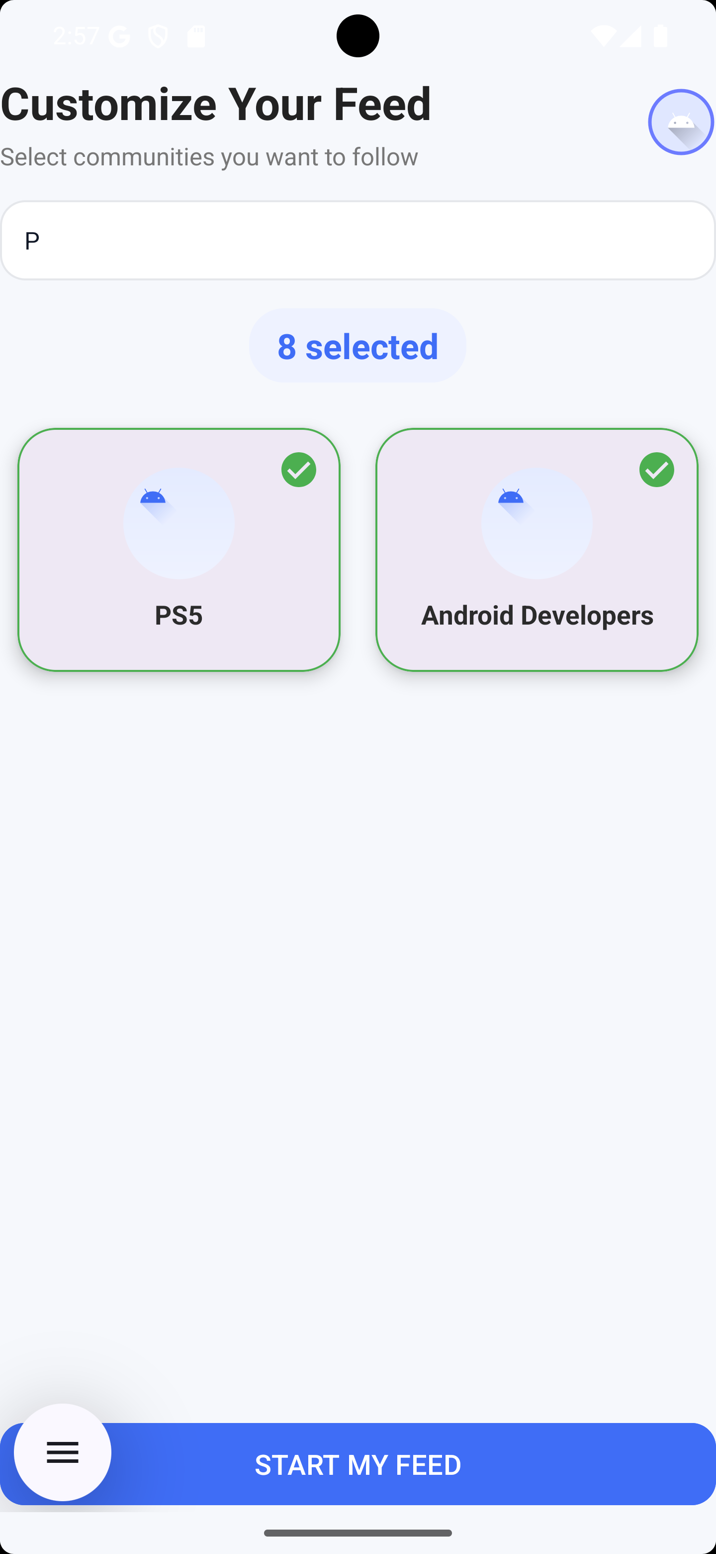
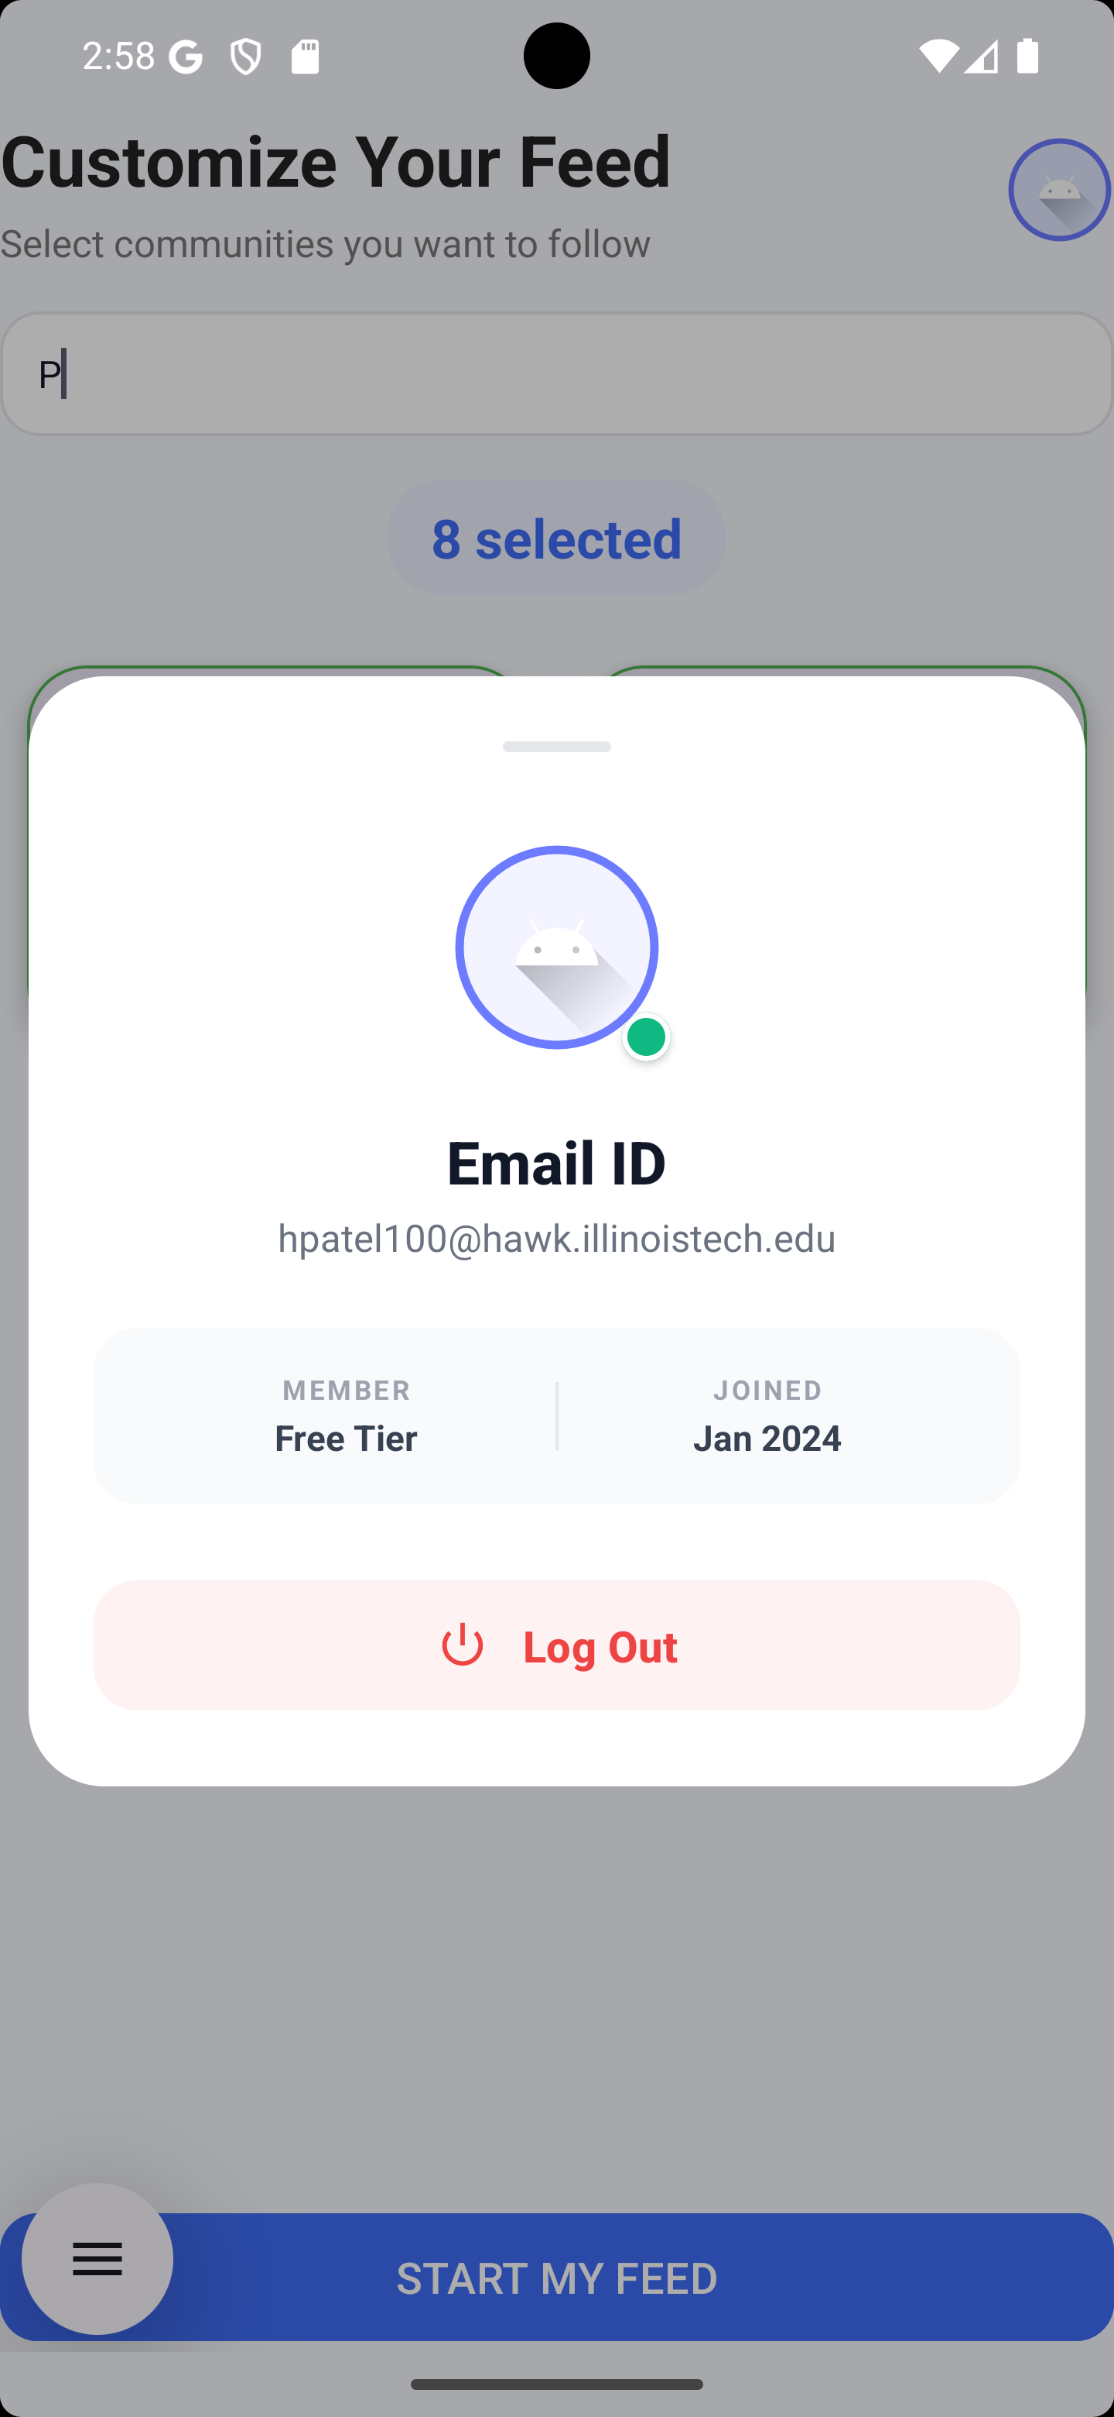
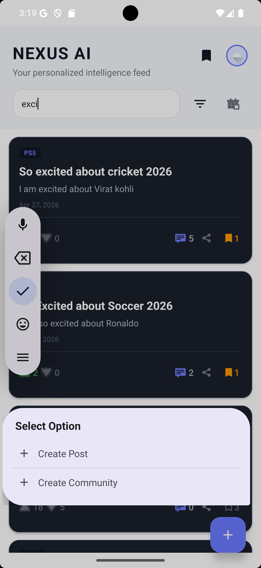
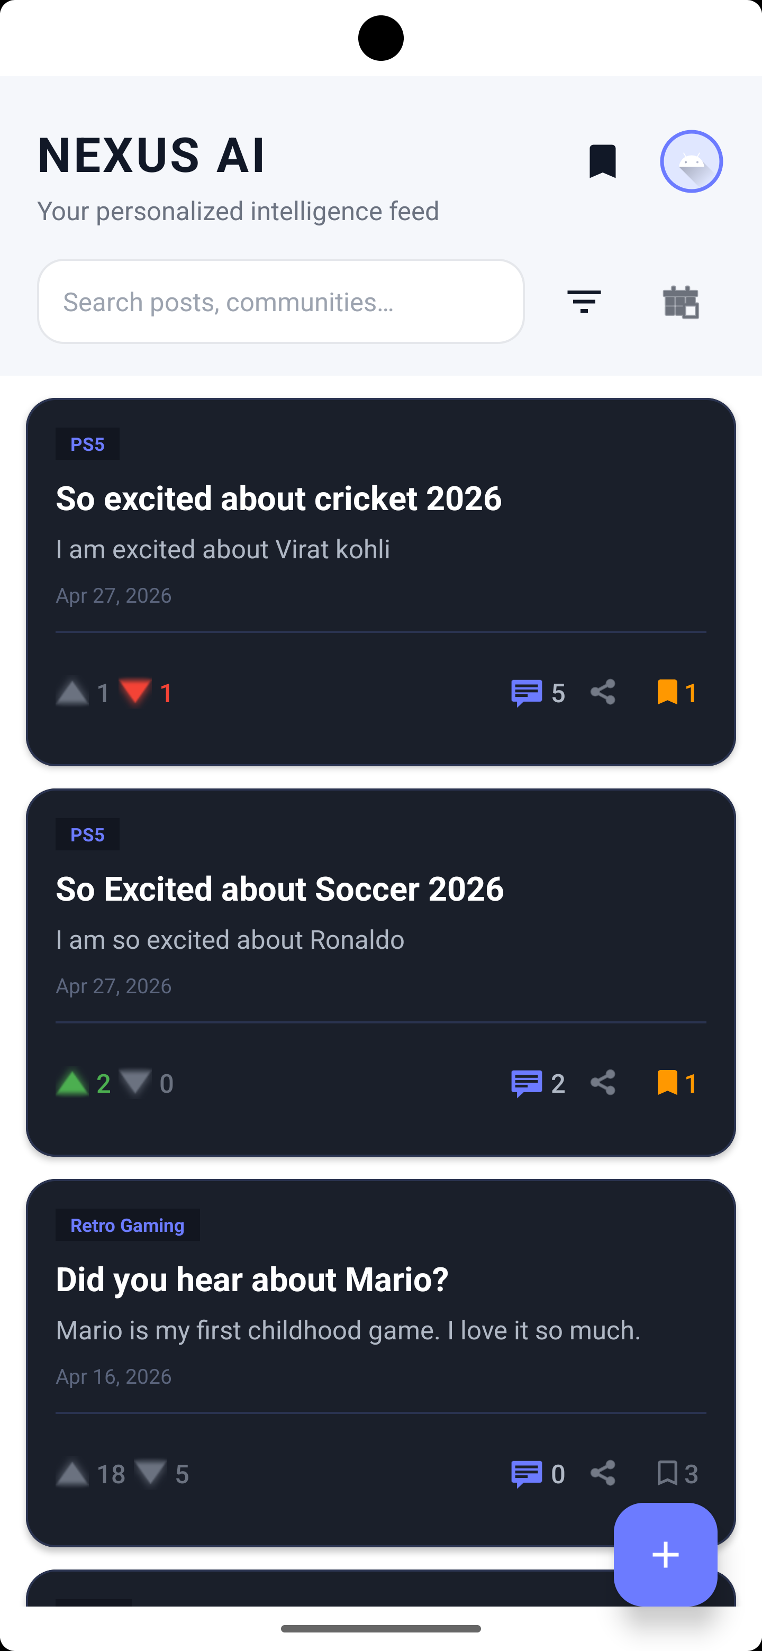
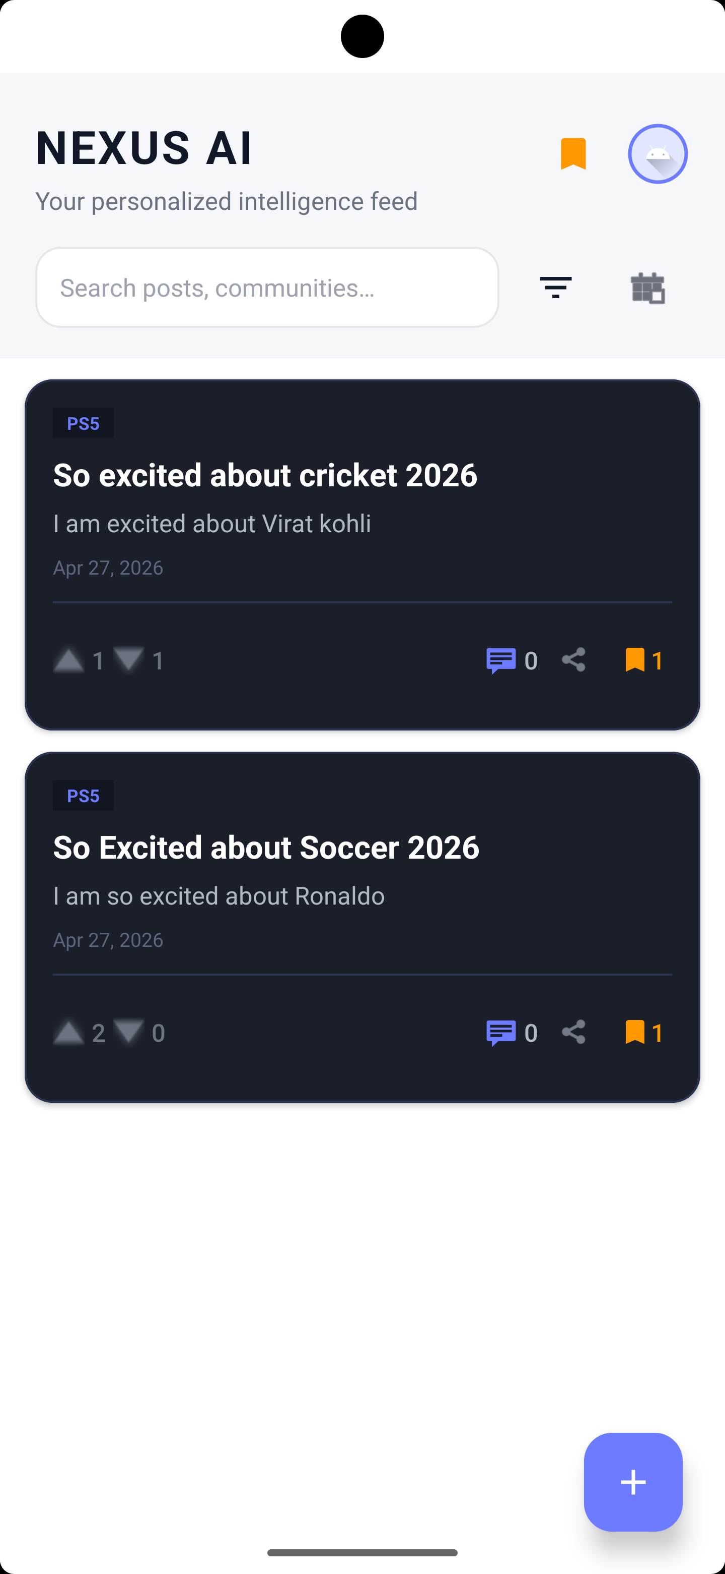
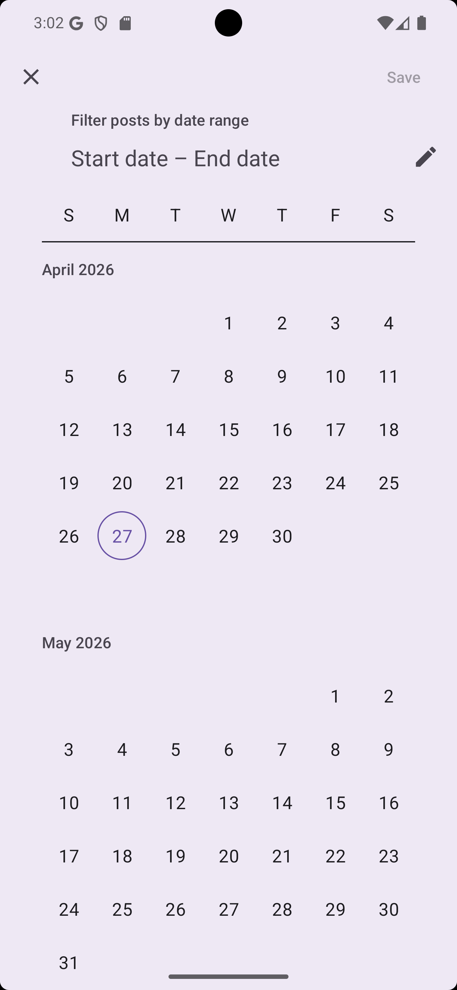
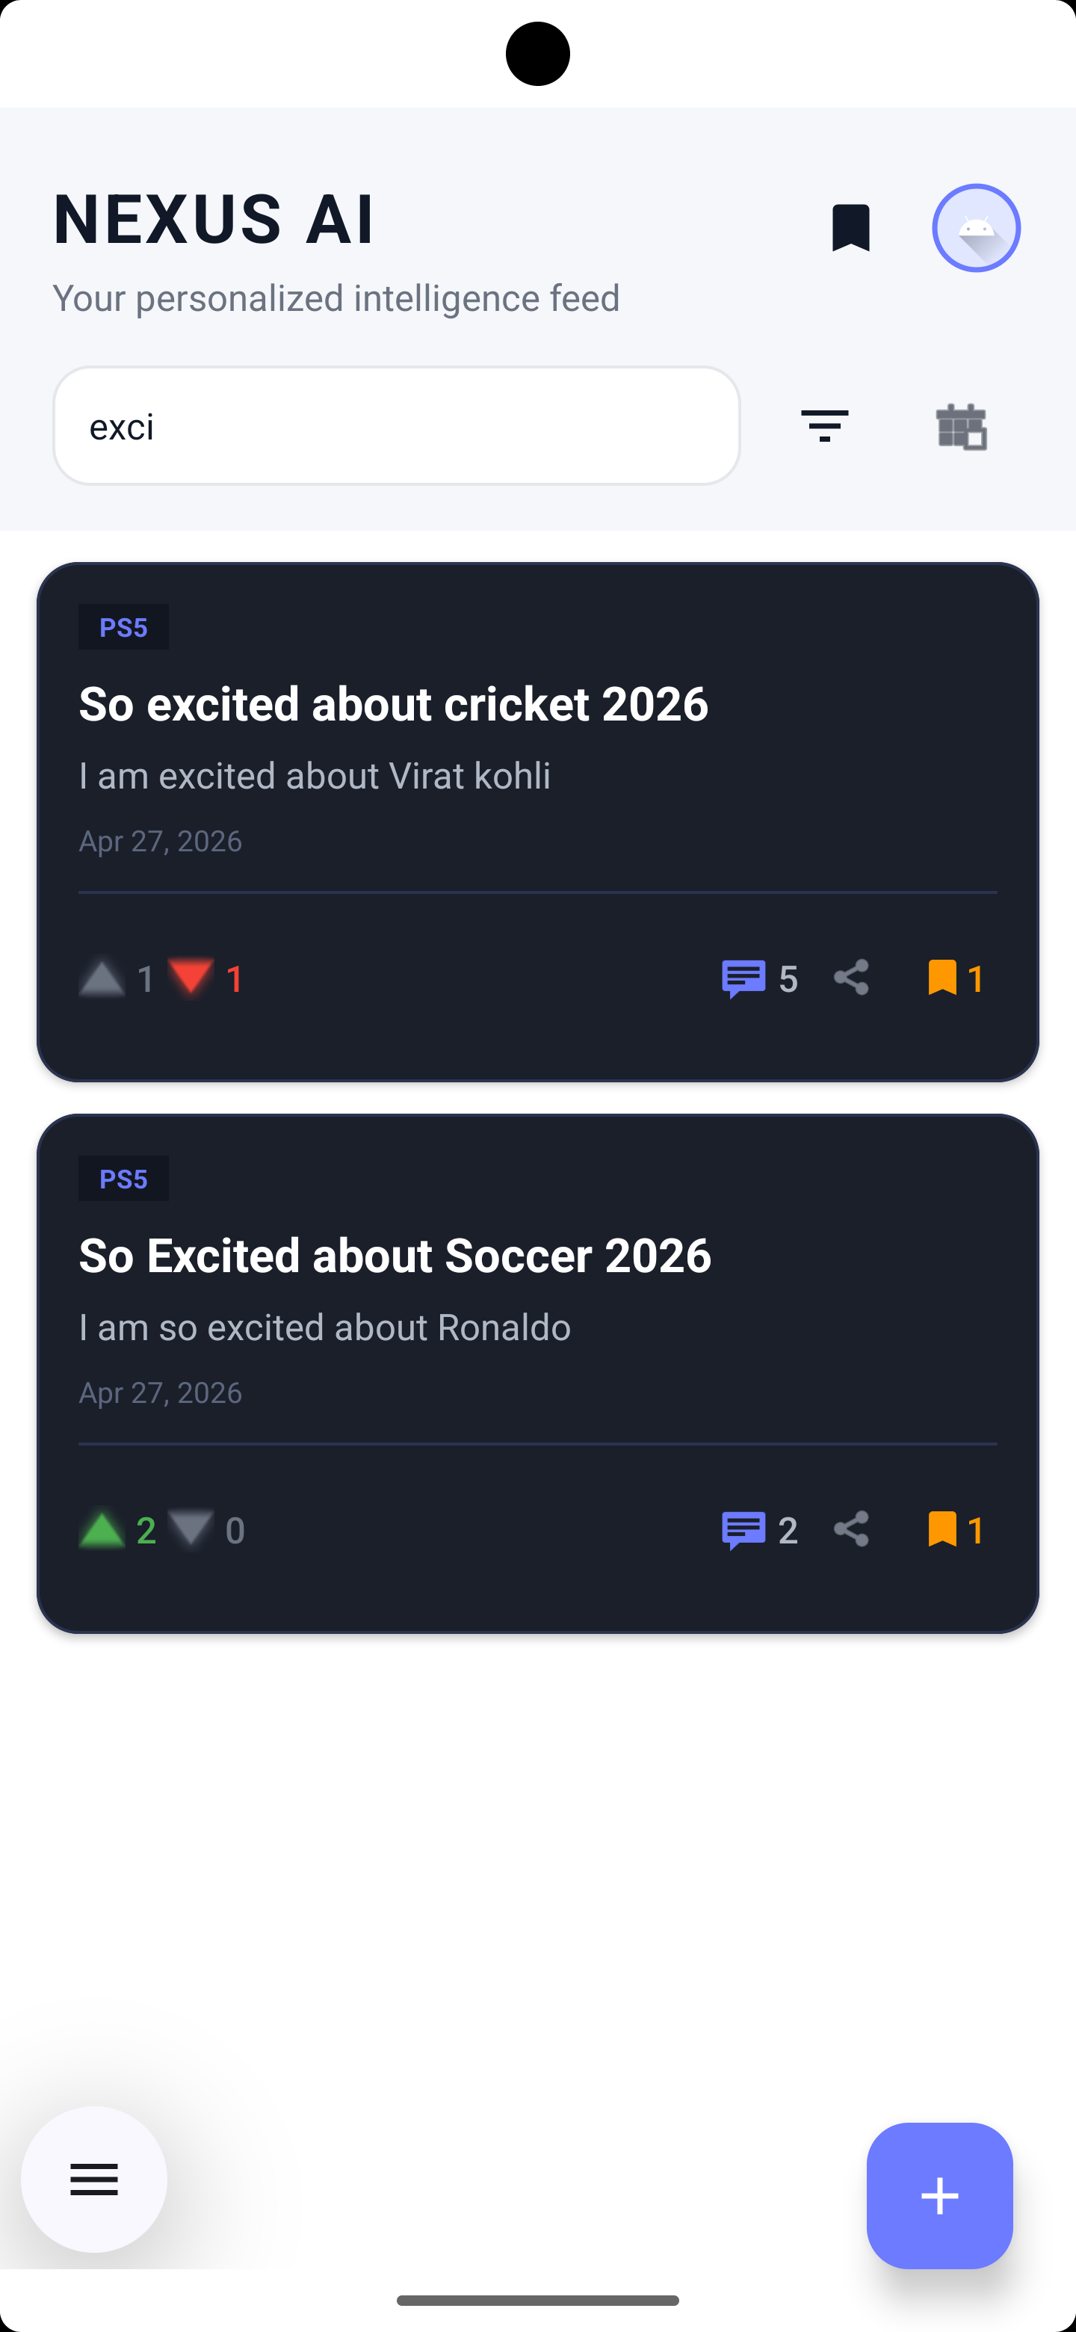
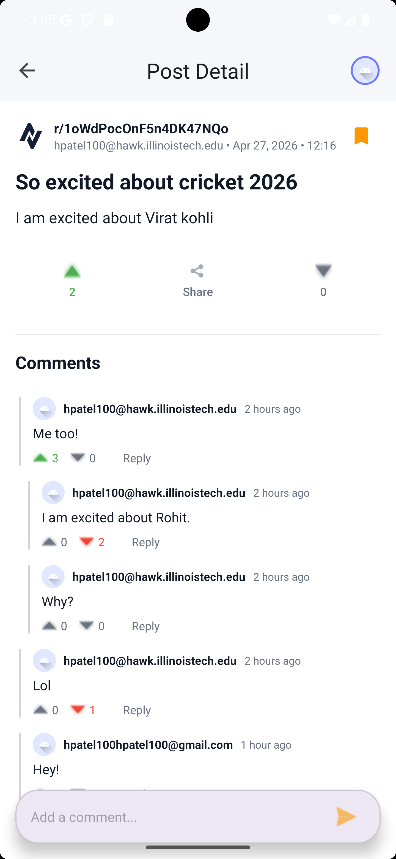
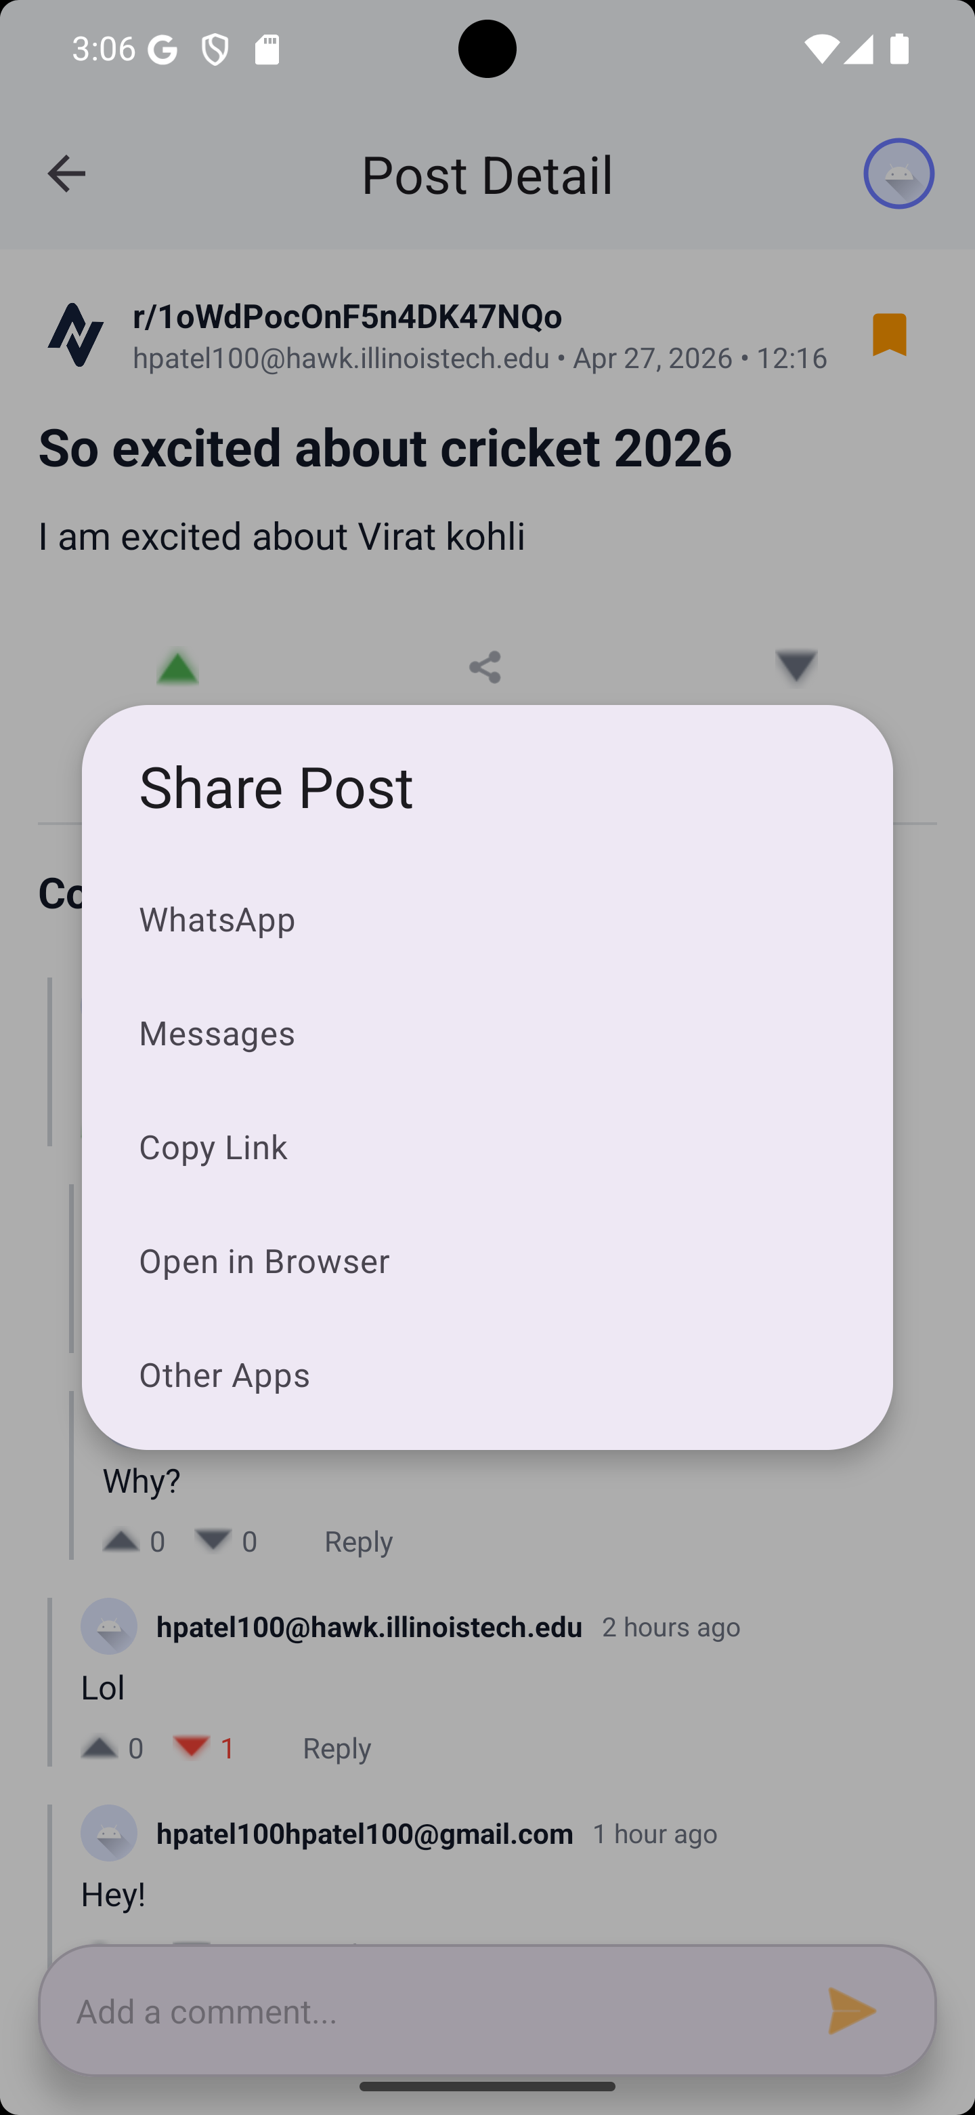
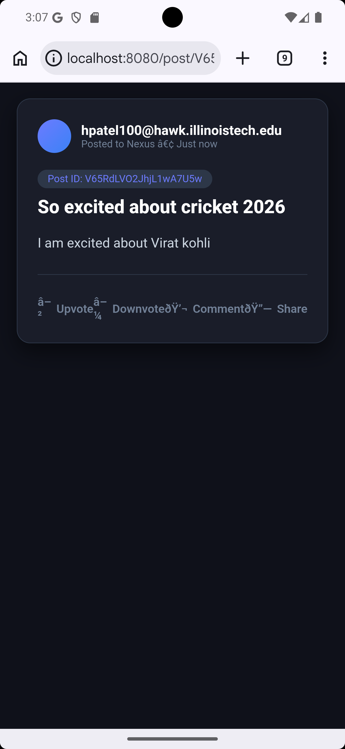
Finalized App Screenshots
Create a new post OR community
Splash Screen | Sign up | Log in | Select community | Find community | User’s profile
Main Dashboard | Bookmarked posts | Filter by date | Search posts | Detailed Post | Share the post | Shared post

Slide 8
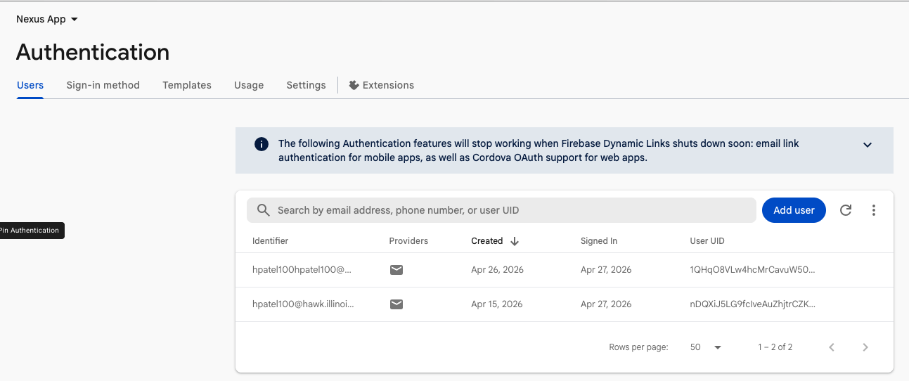
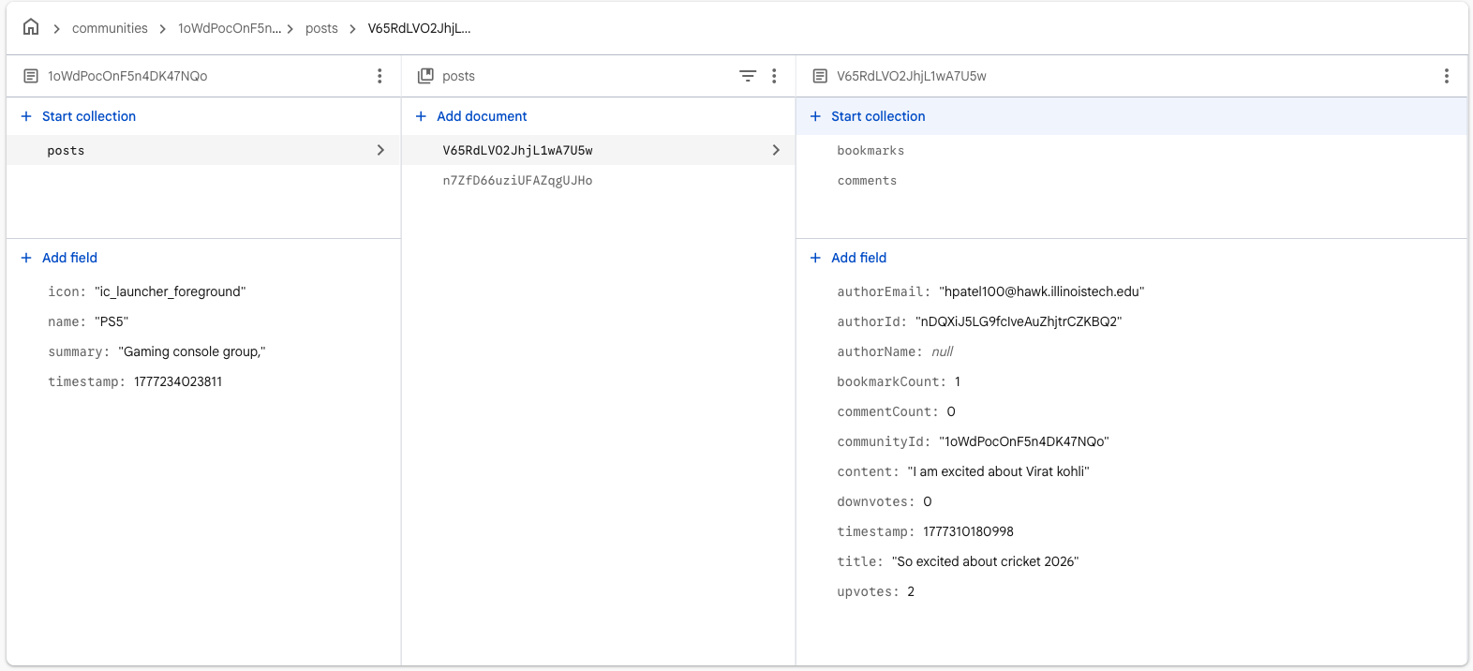
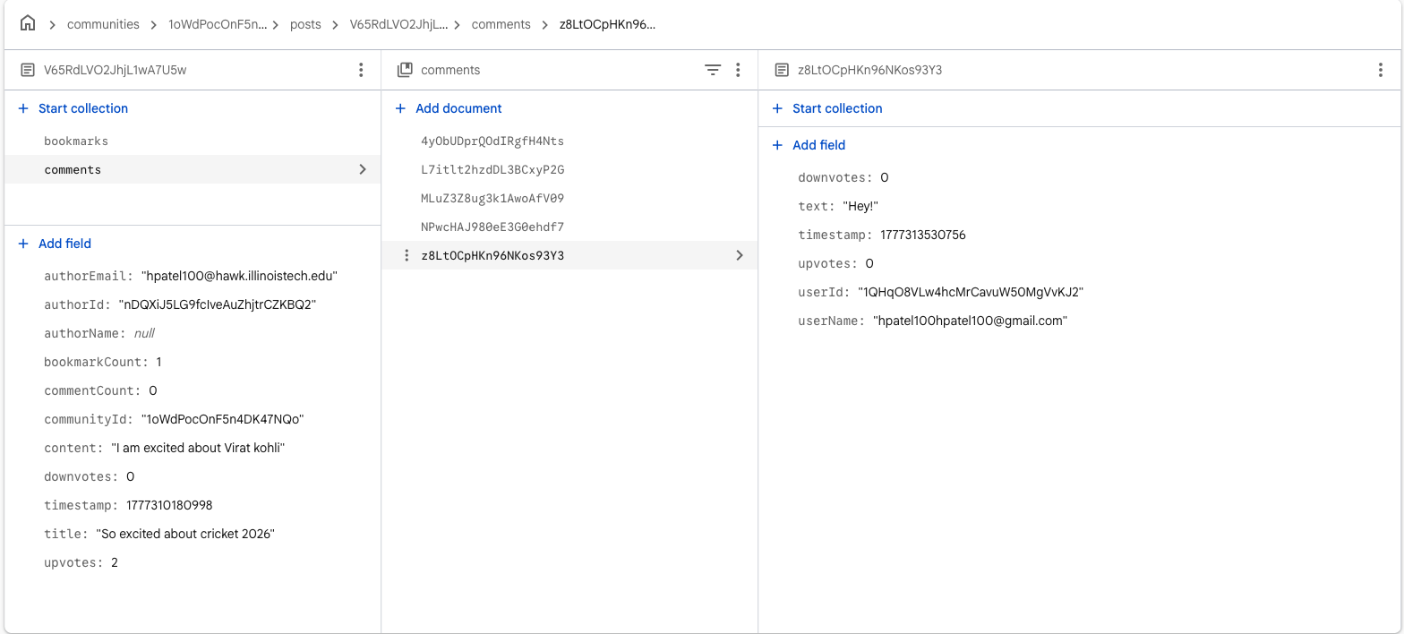
Firebase DB Implementation
User’s Authentication | Communities → Posts → Comments + Bookmarks

Slide 9
Problem areas encountered:
Like/Dislike System: Stores individual user reactions in a database for AI-based analysis and summarization.
Comment System: Saves threaded comments and tracks likes on each comment.
Local Deployment: Hosted on localhost for development and testing (no external server required currently).
U/I Design: Focus on building and refining user-friendly interface designs.
Emulator Selection: Choosing a lightweight emulator optimized for smooth performance on a MacBook (2020 model).
Future App modifications and tweak suggestions:
Live Deployment: Hosting the app and collecting real user feedback and reviews.
Performance Optimization: Integrating native libraries for faster and more efficient access.
U/I Revamp: Designing a fresh, modern interface inspired by Reddit-style user experience.
Notes:
- “Currently, Nexus focuses on building a strong core experience. - We’ve implemented a like and dislike system that stores individual user reactions, which can later be used for AI-based insights and summarization.
- The comment system supports threaded discussions, along with likes on each comment, making conversations more interactive and structured.
- Right now, the app is deployed locally on localhost for development and testing, so there’s no dependency on external servers yet.
- We’re also putting a strong emphasis on UI design—continuously refining the interface to ensure it’s clean, intuitive, and user-friendly. - Additionally, we’ve selected a lightweight emulator optimized for smooth performance, especially on a 2020 MacBook.
Looking ahead, there are a few key improvements planned. - We aim to move toward live deployment so we can gather real user feedback and improve based on actual usage.
- We also plan to optimize performance further by integrating native libraries for faster and more efficient execution.
- And finally, we’re working on a complete UI revamp—bringing in a more modern, polished design inspired by platforms like Reddit to enhance the overall user experience.
Overall, the goal is to evolve Nexus from a functional prototype into a scalable, user-driven platform.”

Slide 10
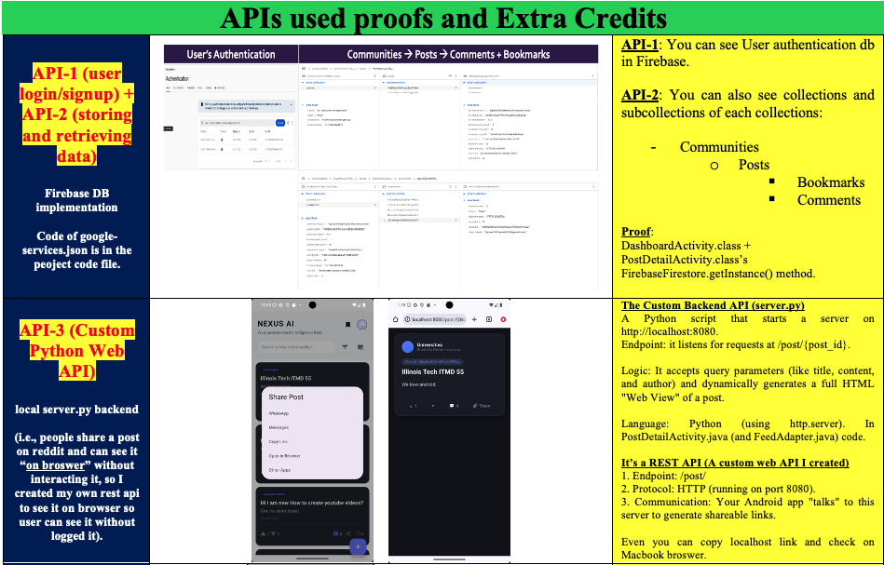
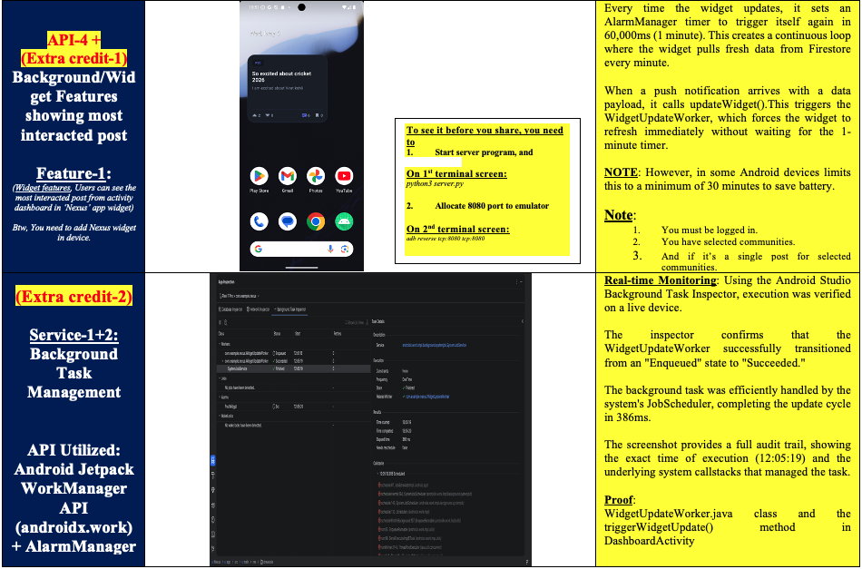
API used + Extra credits Updated on 6th May (After presentation)

Slide 11
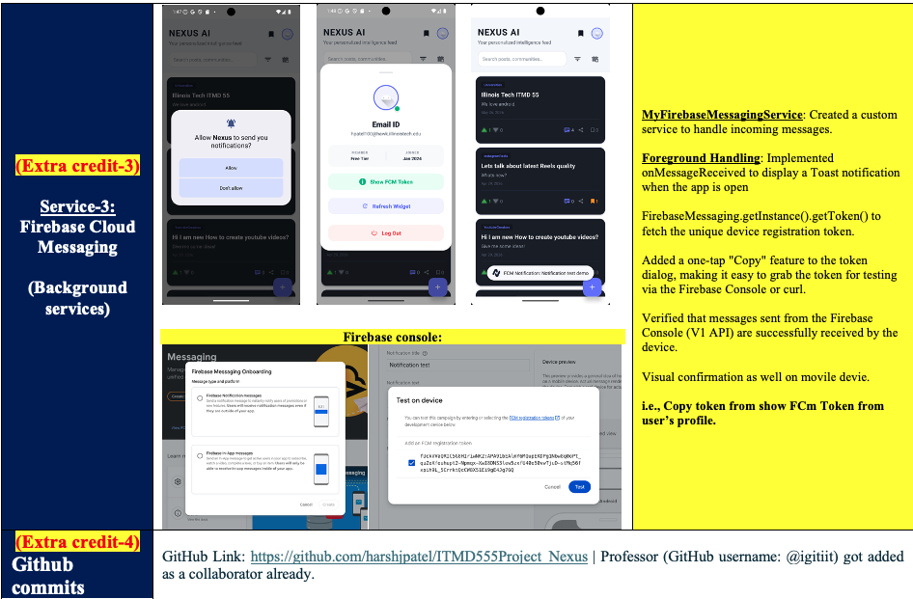
API used + Extra credits Updated on 6th May (After presentation)

