Slide 1
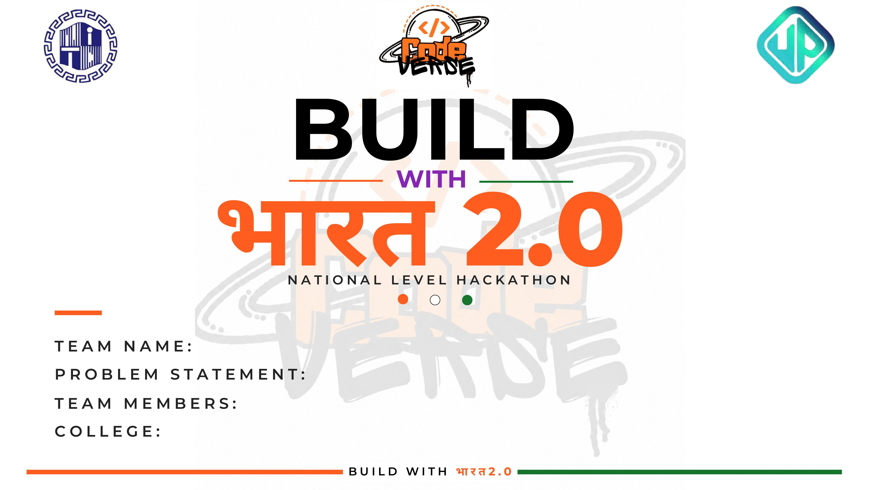
Coder’s High
Inefficient train dispatching leading to cascading delays on the Indian Railways network
Gurmehakdeep Singh , Harsh Joshi , Anmol Singh , Raunak Raj , Sandeep Singh
Amritsar Group of Colleges , Government Engineering College (ECB) Bikaner , Amritsar Group of Colleges, Marwari College (MC) Ranchi, Amritsar Group of Colleges

Slide 2
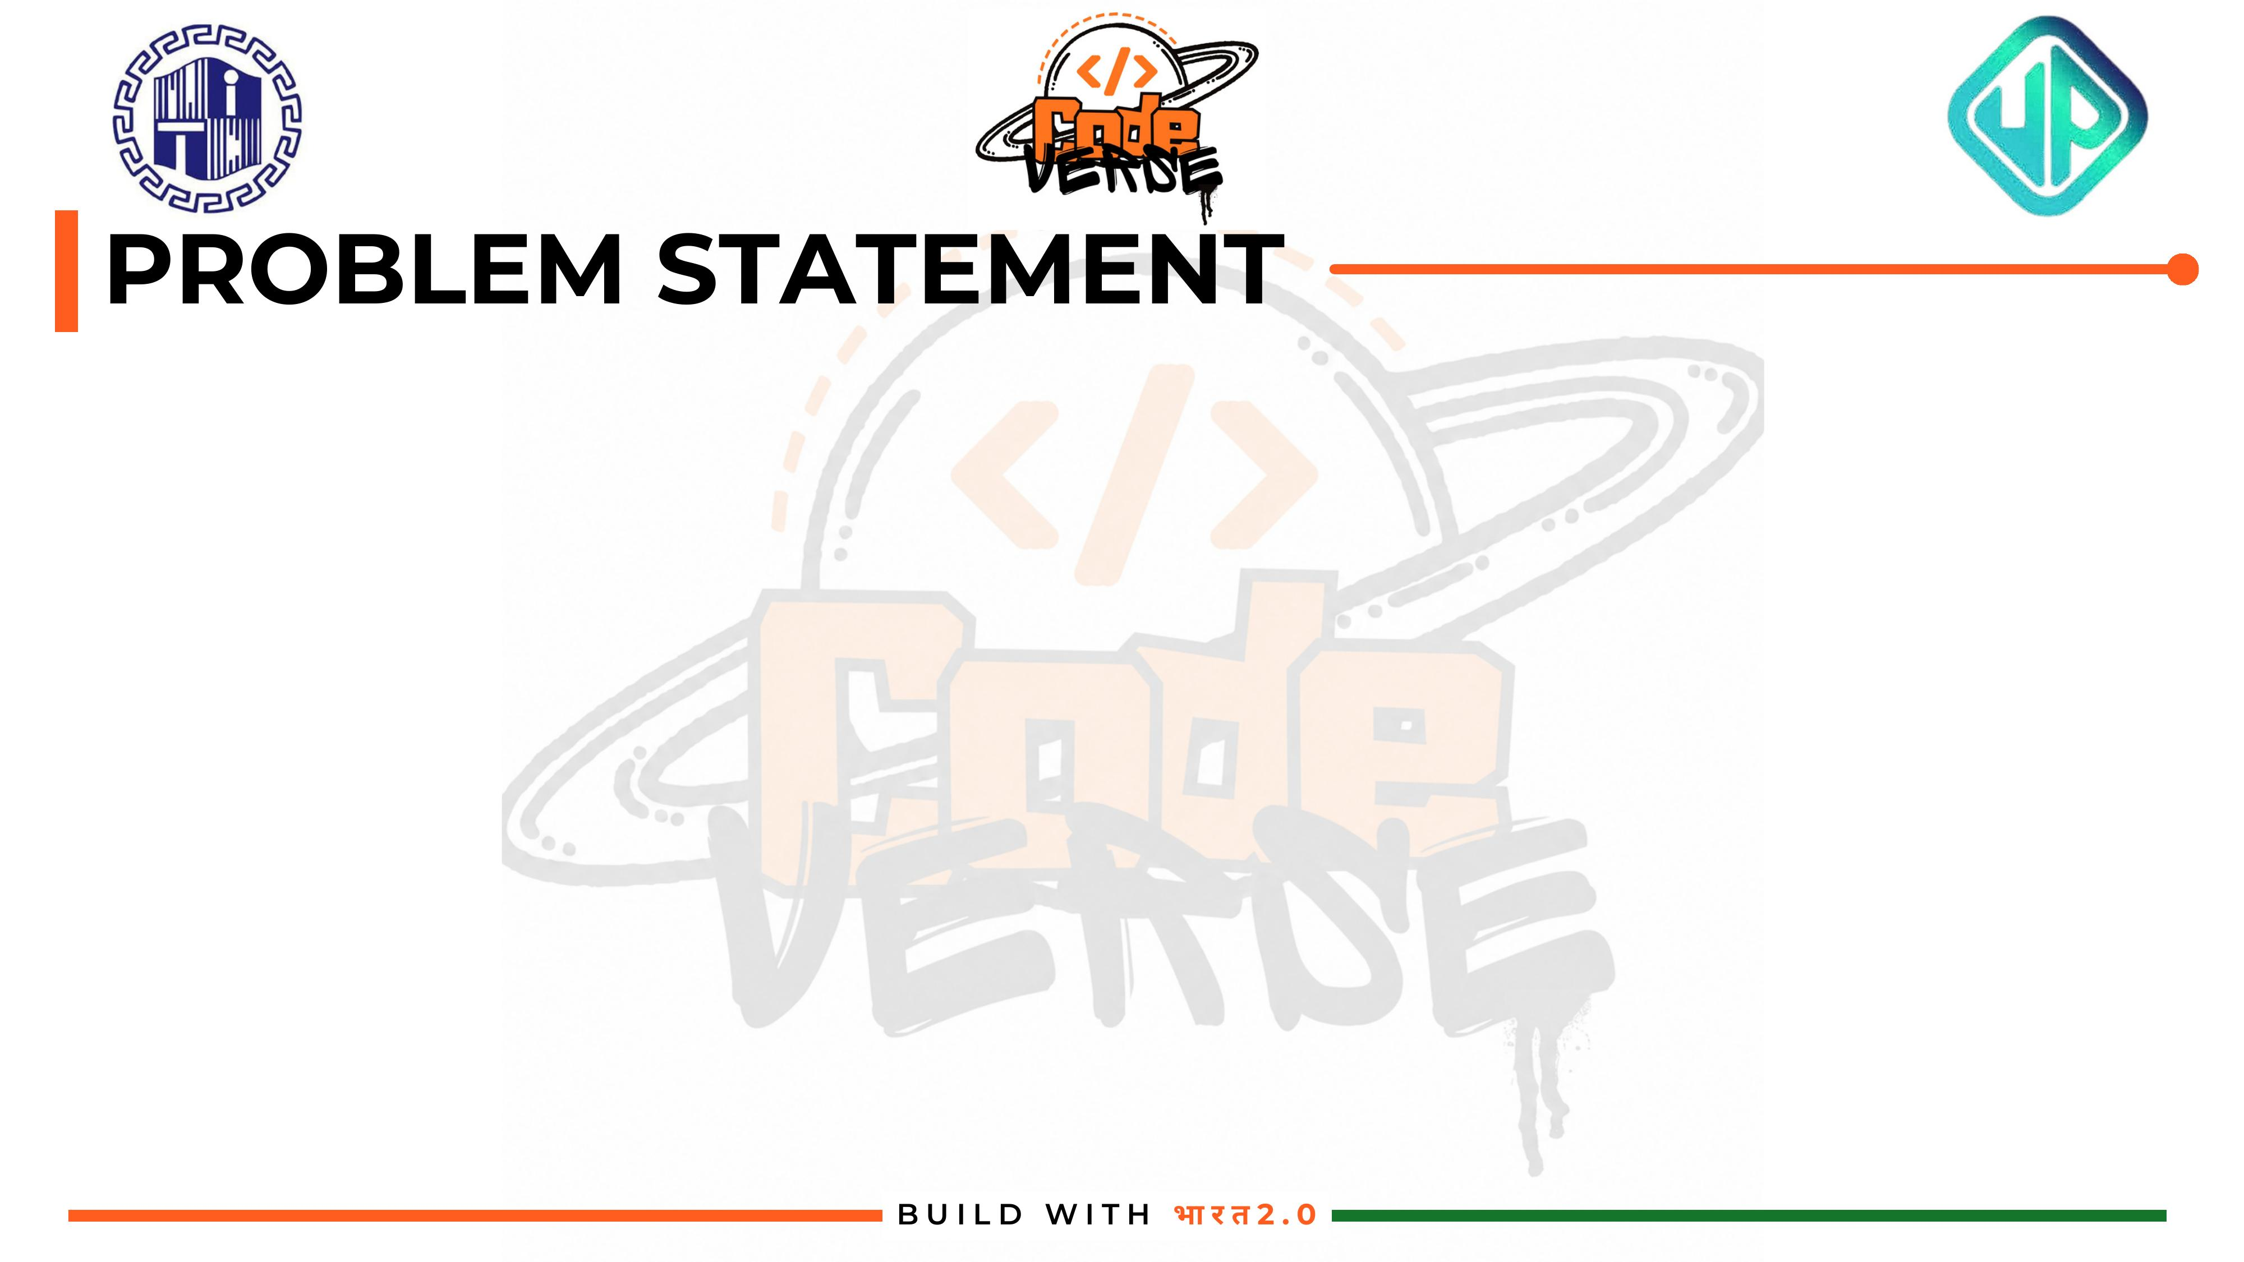
1
Massive, Shared Network
2
Reactive Dispatching
Indian Railways runs one of the world's largest, busiest rail networks, with trains of very different priorities sharing the same limited tracks.
Conflicts like crossings, overtakes, and single-track bottlenecks are mostly resolved manually, after they already start to occur.
3
Cascading Delays
4
No Predictive Layer
One unresolved conflict ripples forward, causing cascading delays and poor punctuality across the network.
There is no real-time, predictive decision-support system that simulates the network and prevents conflicts before they happen.

Slide 3

Project Aahavaan-Rail is a full-stack Digital Twin + Decision Support System that simulates the live railway network, predicts conflicts, and resolves them with AI before they cause delays.
Digital Twin Simulation
60-Min Look-Ahead
AI-Driven Optimization
Explainable Control Room
Mirrors the live railway network digitally, minute by minute, in a headless simulation engine.
Predicts track conflicts up to 60 minutes in advance, before trains reach occupied blocks.
Uses constraint optimization to auto-resolve conflicts and minimize system-wide delay.
Gives dispatchers a visual dashboard with clear reasoning behind every recommendation.

Slide 4
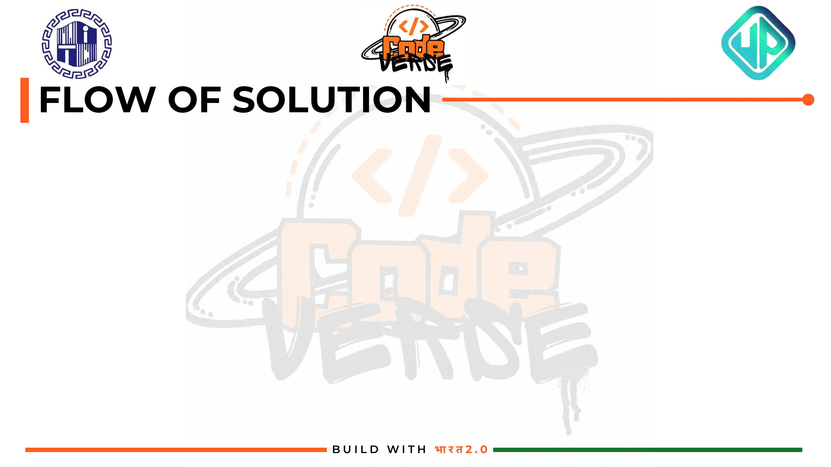
1
3
5
Live Network &
Timetable Data
60-Min Look-Ahead
Conflict Scanner
Resolution
Decision
2
4
6
Discrete Simulation
Engine (minute-by-minute)
OR-Tools CP-SAT
Optimizer
Control Room
Dashboard
Backend: FastAPI serves the simulation and optimizer through REST APIs. Frontend: Next.js control room dashboard consumes this data live.

Slide 5

Backend
Simulation Engine
FastAPI
Python
Google OR-Tools (CP-SAT)
Headless Python discrete-event engine
Track occupancy & safety rule enforcement
Frontend
Data Layer
Next.js 15
Tailwind CSS
Recharts (live delay charts)
JSON network topology
Train timetables
Telemetry data models

Slide 6




x402 + ALGORAND INTEGRATION
Per the hackathon's mandatory Agentic Solutions track, the dispatcher agent autonomously pays for premium data feeds via the x402 protocol, settled live on the Algorand blockchain.
TRIGGER
PAY
VERIFY
UNLOCK
402 Payment Required
Autonomous Micro-Payment
GoPlausible Facilitator
Data Delivered
Dispatcher agent requests premium telemetry (weather, track sensors); the data API responds with HTTP 402.
Agent signs and sends a payment on Algorand Testnet via the @x402-avm client — no human approval needed.
Payment is verified and settled on-chain through the GoPlausible Facilitator before data is released.
Agent retries the request, receives the paid data, and feeds it into the 60-min conflict scanner.
Live on Algorand Testnet (LoRA) · @x402-avm in package.json · Verifiable transaction hash provided at demo
BUILD WITH भारत 2.0

Slide 7

1
60-Min Look-Ahead Scanner — Spots bottlenecks before trains physically reach occupied track blocks — proactive, not reactive.
2
Priority-Weighted Optimization — CP-SAT solver minimizes total priority-weighted delay, not just first-come-first-served.
3
High-Fidelity Simulation — Minute-by-minute discrete engine enforces real track occupancy and safety constraints.
4
Explainable AI Dispatch Feed — Shows dispatchers why a decision was made — building trust instead of a black box.
5
Live Visual Control Room — Animated SVG track map and real-time delay charts for instant situational awareness.

Slide 8
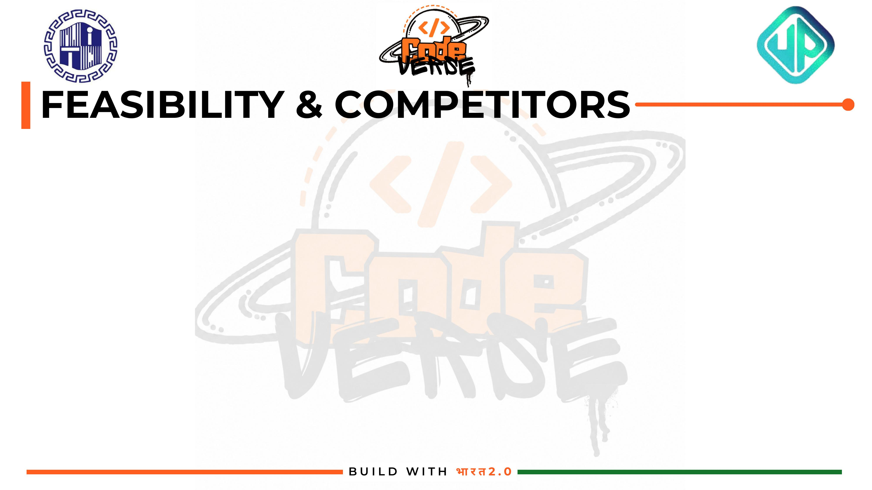
Feasibility
Challenges
Competitive Edge
Built entirely on proven, production-grade tools
FastAPI, OR-Tools, and Next.js are mature and well-documented
No exotic or unavailable technology dependencies
Modeling real-world track topology with high accuracy
Solver scalability as network size grows
Future integration with legacy signaling systems
Existing dispatch aids are largely manual or rule-based
Global rail simulators aren't tailored to Indian Railways' scale
We combine prediction, optimization, and explainability in one system

Slide 9
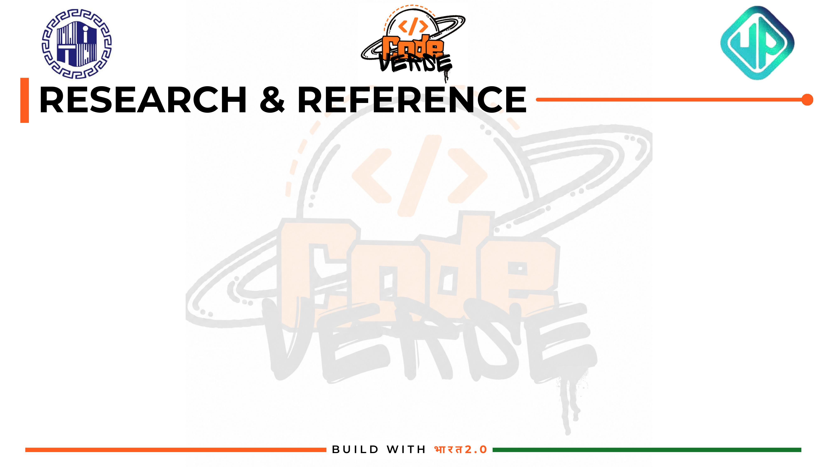
Railway Domain Precedents
Academic Foundations
CRIS Control Office Application (COA)
Freight Operations Information System (FOIS)
National Rail Plan (NRP) 2030
Corman & Meng (2015) — real-time rescheduling models
D'Ariano et al. (2007) — disjunctive precedence constraints
Lusby et al. (2011) — track allocation via CP
Pellegrini et al. (2014) — exact vs. heuristic dispatching
Tech & Solver Documentation
Global Rail Precedents
Google OR-Tools CP-SAT solver
FastAPI — REST backend framework
Next.js 15 — dashboard frontend
Recharts & Framer Motion — visualization & motion
SBB (Switzerland) — automated conflict detection
Deutsche Bahn — AI-driven capacity optimization
Network Rail (UK) — multi-train conflict resolution
GitHub Repository: github.com/harshjsh01/Digital-Twin | x402/Algorand Track Repo: github.com/marotipatre/x402-Project

