Slide 1
Case Study - UK Savoury Snacks
Shopper & Portfolio Analysis
Key Takeaways and Actions on Growth opportunities

Slide 2
Problem statement
Objective: identify the biggest growth opportunities for PepsiCo Savoury by
(a) picking the top focus categories / brands for all retailers and
(b) spotting pack / sub-segment gaps vs competitors – then turn them into clear actions for Acadia Grocers.
Questions:
Which categories and brands should drive penetration (how many buy) and AWOP (spend per buyer)?
Where are the pack and sub-segment whitespaces vs competition?
How does basket structure differ by channel, and what does it mean for Savoury?
Where can cross-category / cross-brand deals grow the category?

Slide 3
My approach and assumptions
How I worked through it
1 Read the brief
2 Clean the data
3 Explore the data
4 Size the gaps
5 Rank the actions
Turned the brief into 4 questions about who buys and how much they spend
Used the same 47 weeks in 2024 and 2025 so the comparison is fair
Checked blanks, duplicates and zero sales, then compared PepsiCo with the market
Worked out the extra sales if PepsiCo matched its usual share
Ranked each idea by size (50%), ease (30%) and fit (20%)
What I assumed, and why
Area | What I found in the data | What I assumed | Where it’s used
Time period | 2025 data stops at week 47; the last weeks of the year are the Christmas peak | Compared weeks 1–47 of 2025 with the same weeks of 2024 | All analysis slides (4–10)
Online vs in-store | There is no channel column, only four store types | Online = e-commerce and pure-play stores; in-store = large and small stores | Slides 4–7 and 9
Acadia Grocers | Acadia only sells through its online-only (pure-play) store type | Treated Acadia as an online-only retailer | Slide 9
Shoppers and spend | The sales data has no shopper counts | Used share and growth to show reach, and spend per basket to show spend per shopper | Slides 5, 7 and 10 (brand roles, baskets, levers)
Product level | Segment names mix product types with labels like ‘Private Label’ | Worked at sub-segment level (e.g. potato crisps, nuts) | Slides 4, 6 and 9
Size of the prize | There are no forecasts in the data | £ figures show the gap to PepsiCo’s usual share, not a forecast | Slides 6, 9 and 10 (£ figures)
Data quality | The data is cleaned up for the case; a small ‘unallocated’ bucket (about £5.5k) | Focused on gaps and direction rather than exact £; dropped the unallocated rows | All analysis slides

Slide 4
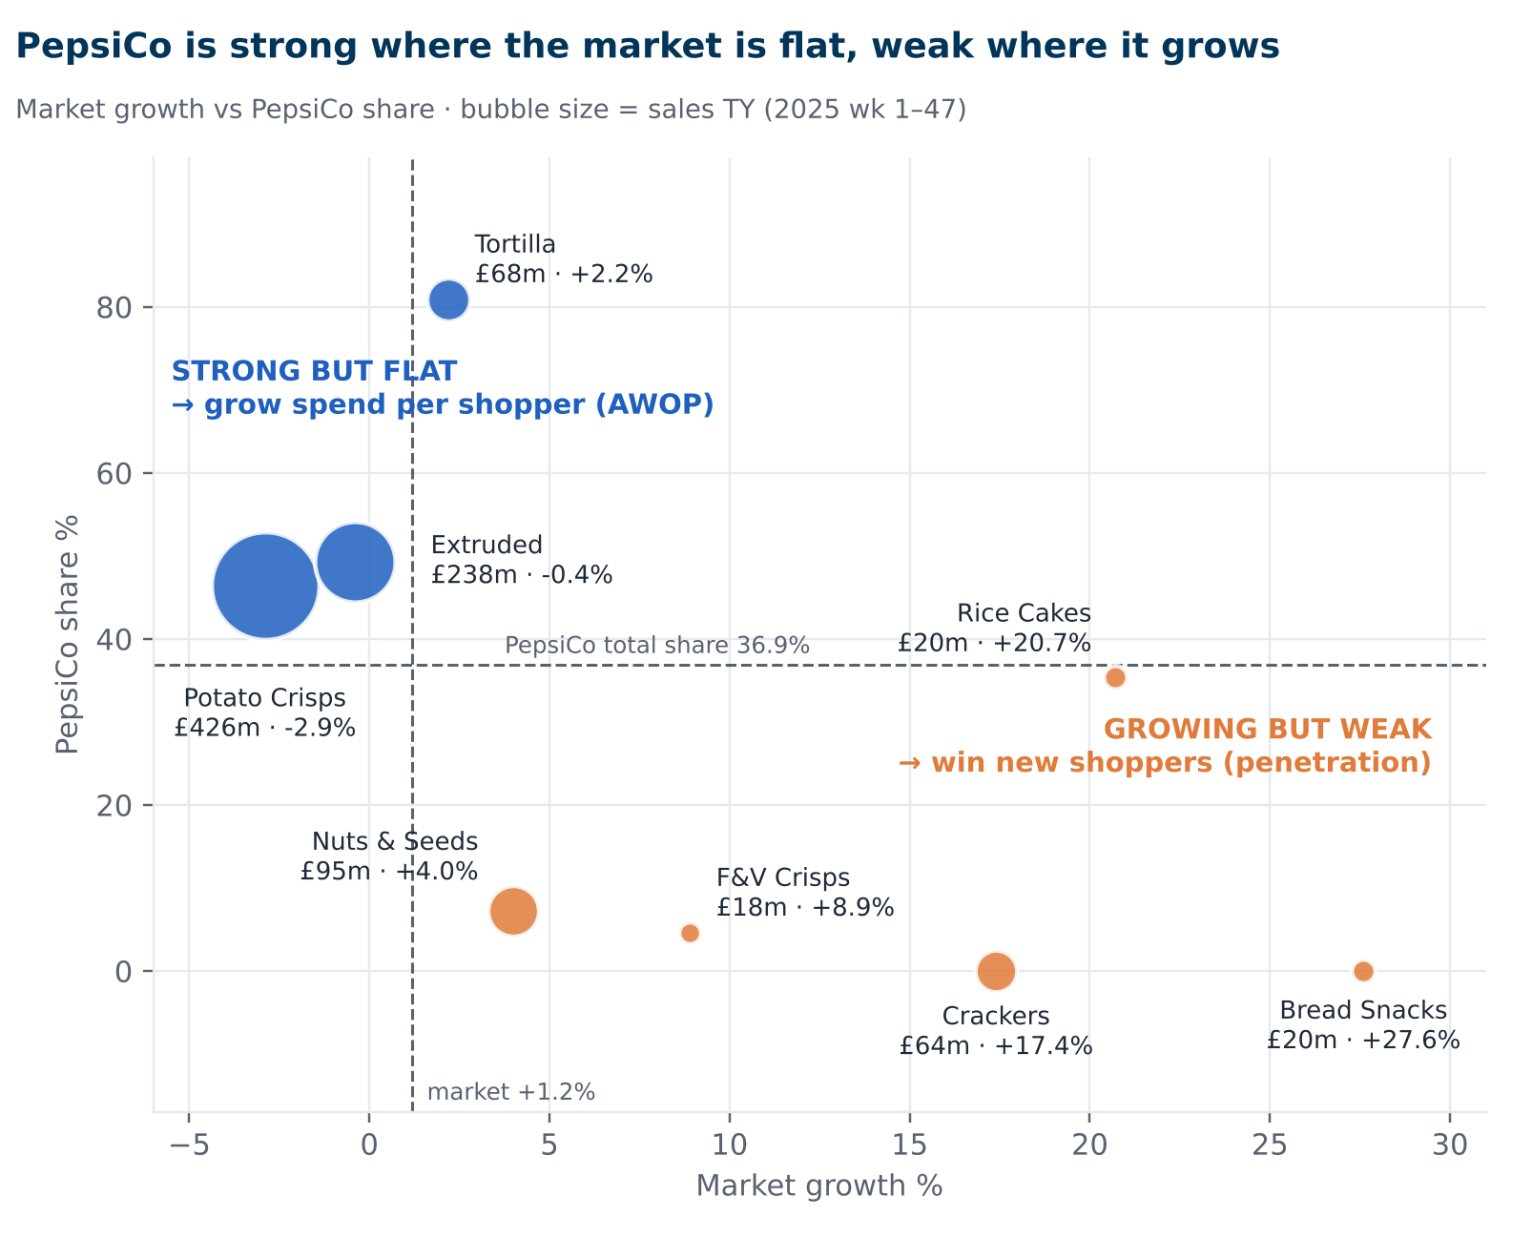
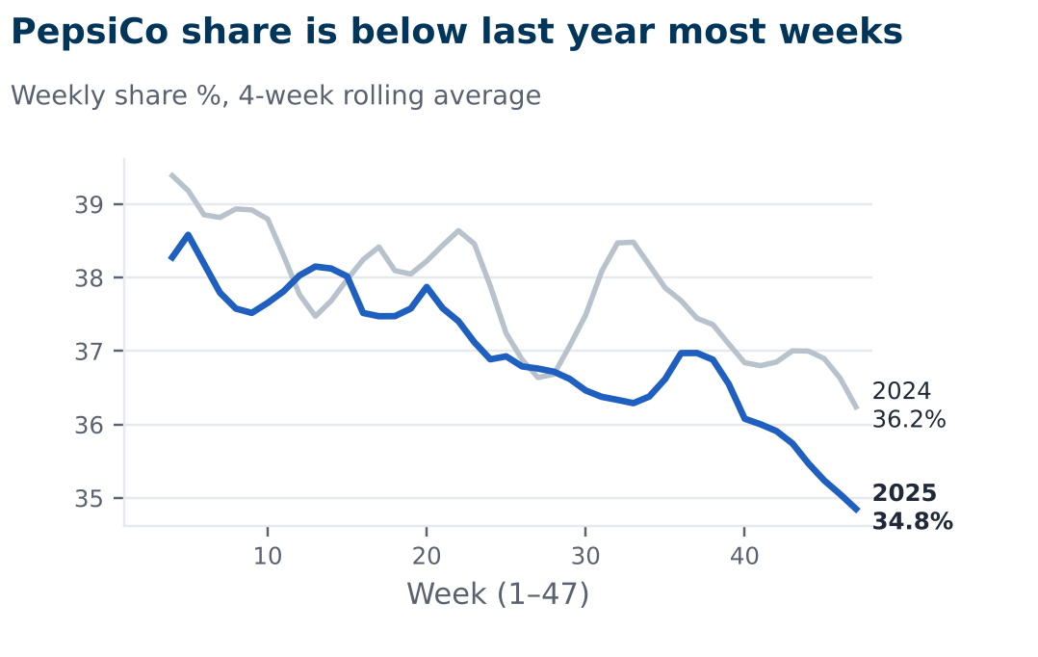
Focus categories and brands for penetration and AWOP
Key takeaways
Crisps and extruded are 62% of sales and flat; PepsiCo leads with 46–49% → grow spend per shopper (AWOP).
Nuts, rice cakes, crackers and bread snacks grow 4–28%, but PepsiCo has 0–35% → win new shoppers.
PepsiCo share fell 37.8% → 36.9% (wk 1–47) and is below last year in most weeks.

Slide 5
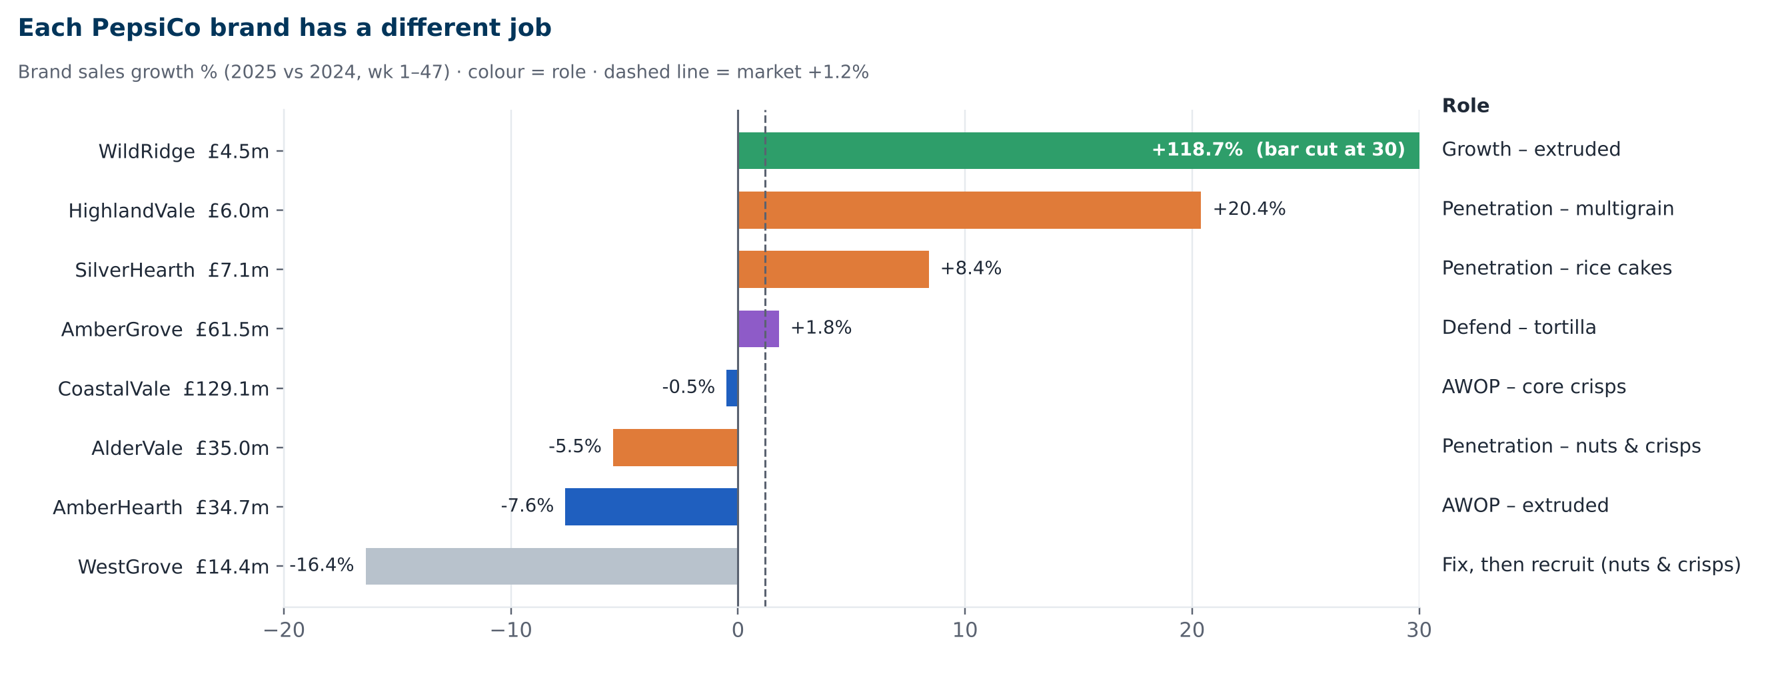
PepsiCo brands and their role
Key takeaways
Win the new shoppers in Nuts and Rice Cakes, both are growing, but PepsiCo is small (only 7% of Nuts). Need to push PepsiCo’s nut lines (AlderVale, WestGrove) and SilverHearth rice cakes.
Getting the existing shoppers to spend more on the Crisps and Extruded snacks that make up 62% of the market and PepsiCo already leads, but sales are flat. So we can sell bigger packs and multipacks of CoastalVale and AmberHearth.
Crackers and Bread Snacks are the fastest-growing (+17% to +28%), but PepsiCo doesn’t sell them, so we can keep these as a long-term option.

Slide 6
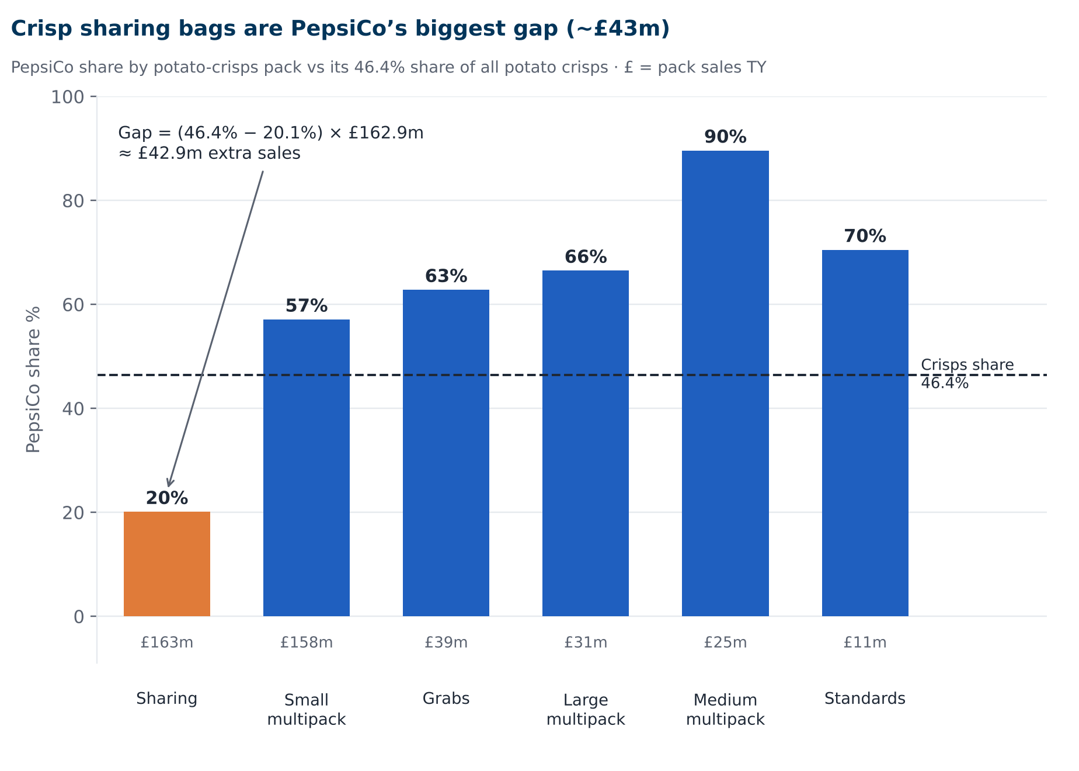
Pack and sub-segment whitespace
Key takeaways
Sharing bags: the biggest pack (38% of sales), but PepsiCo has only 26% and is priced 18% higher.
Biggest gap: crisp sharing bags, where PepsiCo has 20% vs 46% in crisps overall, worth about £43m.
Other pack gaps: extruded grab bags (PepsiCo ~0% vs 49%, £6.7m) and rice cake sharing (£1.2m).

Slide 7
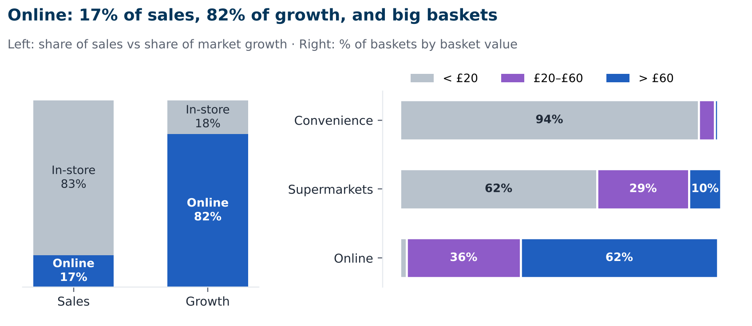
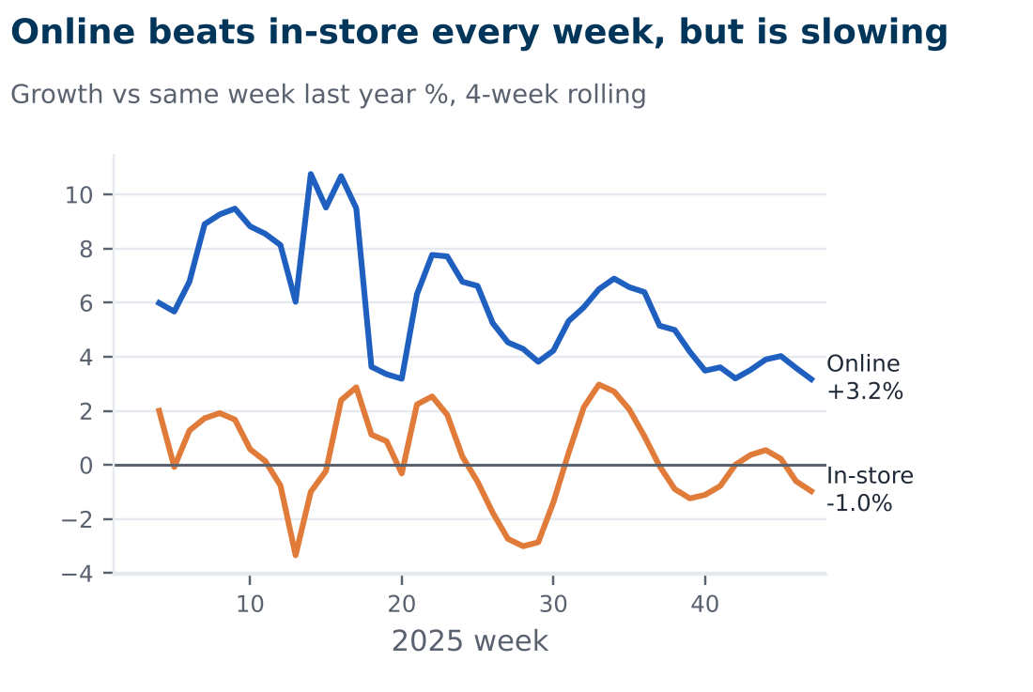
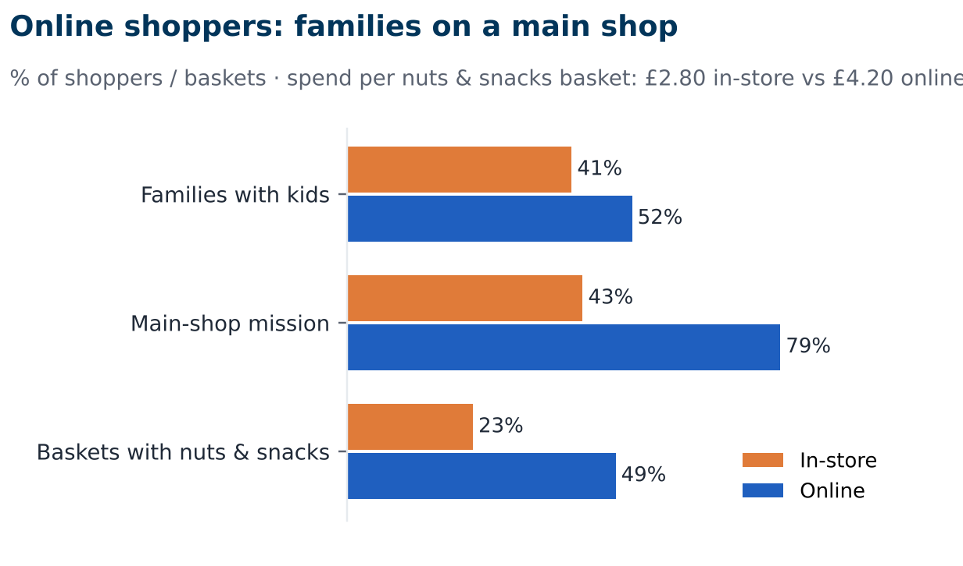
Basket structure by channel
Key takeaways
Growth: online is up 5.8% and delivers 82% of the market’s growth
Bigger baskets: 62% of online baskets are over £60 (vs 1% in convenience)
More snacks: online baskets are twice as likely to include nuts and snacks, with 1.5x the spend
Watch-out: online growth slowed from ~9–10% in spring to ~3% in the latest weeks.

Slide 8
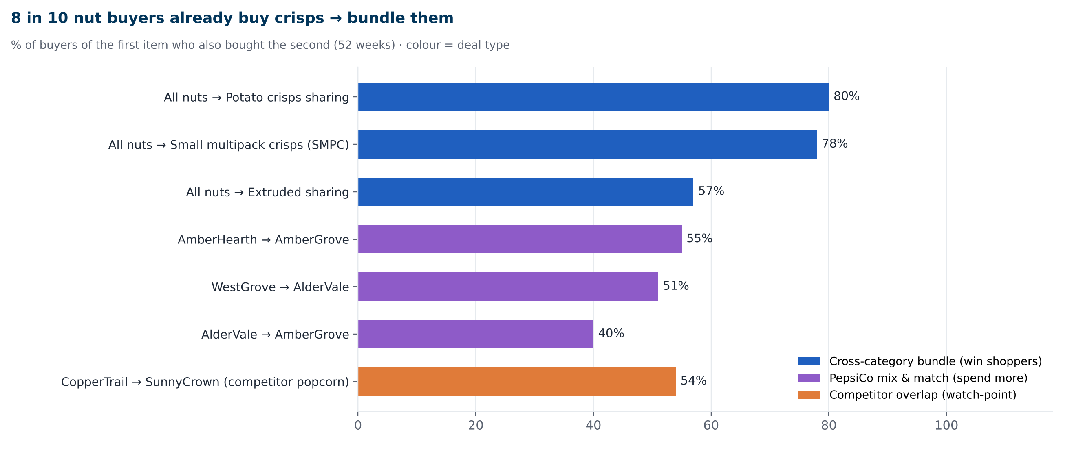
Cross-category / cross-brand deals
Key takeaways
Nuts + crisps: 8 in 10 nuts buyers also buy sharing crisps, so bundle them.
Combo deals: 40–55% already buy two PepsiCo brands, so offer mix-and-match deals online
Popcorn gap: 54% of CopperTrail buyers buy a competitor’s popcorn, which PepsiCo doesn’t offer (segment −1.4%, so a watch-point)

Slide 9
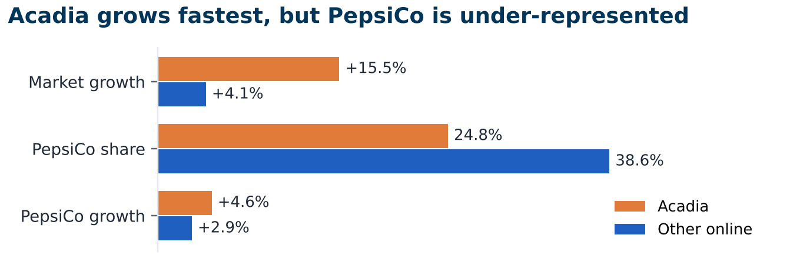
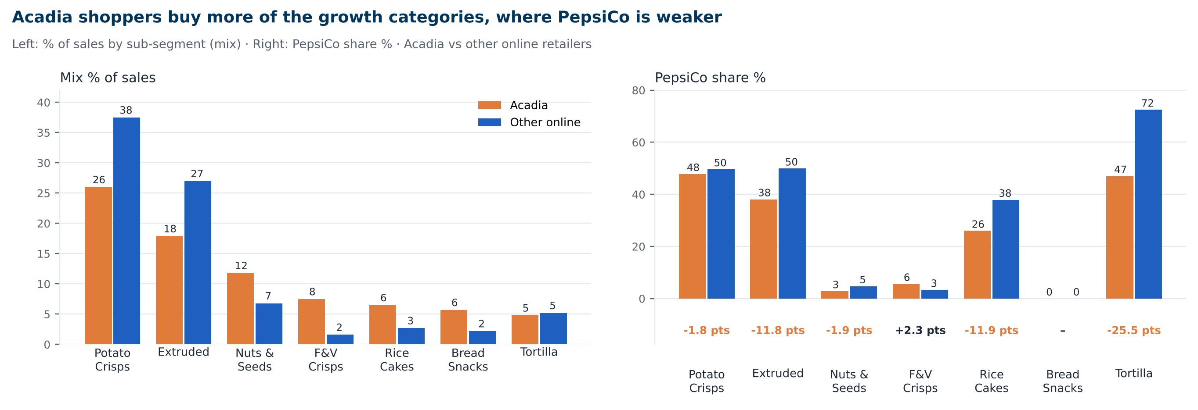
Acadia Grocers · actions
Actions
Fill gaps: more PepsiCo Extruded and Tortilla sharing packs
Match shoppers: add nuts and healthier snacks, a nuts + crisps deal, and top search spots
Worth: about £4.2m extra sales

Slide 10
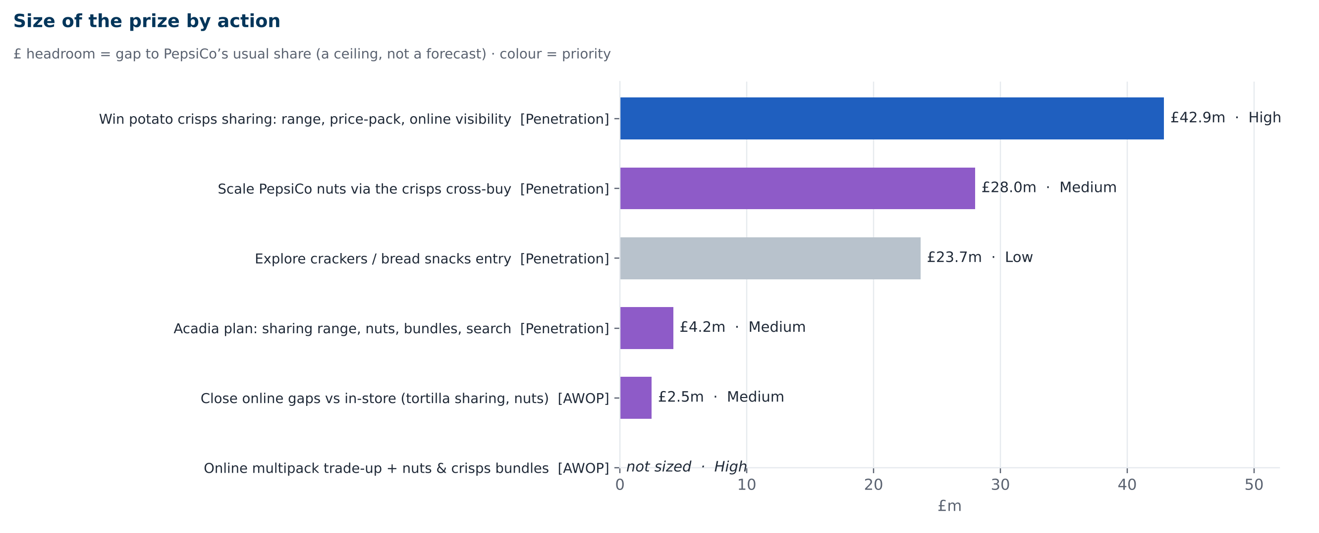
Key Recommendations
Next steps
Include more crisp sharing bags and online multipacks, the biggest gaps with brands PepsiCo already has
Run an 8-week nuts + crisps deal at Acadia; if it works, roll it out everywhere

Slide 11
Appendix · Focus categories and brands for penetration and AWOP
Sub-segment performance
Sub-segment | Sales TY | Growth | £ change | PepsiCo share | Share change (points) | Online index
Potato Crisps | £426.4m | -2.9% | -£12.9m | 46.4% | -0.2 | 88
Extruded Snacks | £238.1m | -0.4% | -£0.9m | 49.3% | -0.7 | 119
Nuts & Seeds | £94.7m | +4.0% | £3.6m | 7.2% | +1.7 | 84
Tortilla Chips | £68.2m | +2.2% | £1.5m | 80.9% | +0.1 | 78
Crackers | £64.1m | +17.4% | £9.5m | 0.0% | 0.0 | 120
Bread Snacks | £20.4m | +27.6% | £4.4m | 0.0% | 0.0 | 163
Rice Cakes | £20.1m | +20.7% | £3.5m | 35.4% | -4.0 | 213
F&V Crisps | £17.5m | +8.9% | £1.4m | 4.6% | -1.4 | 183
Total market | £1,077.4m | +1.2% | £12.4m | 36.9% | -0.9 | 100

Slide 12
Appendix · PepsiCo brands and their role
PepsiCo brand | Sales TY | Growth | Online growth | Online index | Role
CoastalVale | £129.1m | -0.5% | -0.8% | 107 | AWOP – core crisps
AmberGrove | £61.5m | +1.8% | +5.9% | 64 | Defend – tortilla
AlderVale | £35.0m | -5.5% | -1.4% | 57 | Penetration – nuts & crisps
AmberHearth | £34.7m | -7.6% | +3.7% | 104 | AWOP – extruded
WestGrove | £14.4m | -16.4% | -2.8% | 37 | Penetration – nuts & crisps
SilverHearth | £7.1m | +8.4% | +24.4% | 203 | Penetration – rice cakes
HighlandVale | £6.0m | +20.4% | +19.3% | 183 | Penetration – multigrain
WildRidge | £4.5m | +118.7% | +53.8% | 63 | Growth – extruded
Key takeaways
Win the new shoppers in Nuts and Rice Cakes, both are growing, but PepsiCo is small (only 7% of Nuts). Need to push PepsiCo’s nut lines (AlderVale, WestGrove) and SilverHearth rice cakes.
Getting the existing shoppers to spend more on the Crisps and Extruded snacks that make up 62% of the market and PepsiCo already leads, but sales are flat. So we can sell bigger packs and multipacks of CoastalVale and AmberHearth.
Crackers and Bread Snacks are the fastest-growing (+17% to +28%), but PepsiCo doesn’t sell them, so we can keep these as a long-term option.

Slide 13
Appendix · Pack and sub-segment whitespace
Pack format performance
Pack | Sales TY | % of market | Growth | PepsiCo share | Share chg (pts) | Online index | Price index
Sharing | £406.9m | 38% | +2.5% | 25.6% | -1.7 | 83 | 118
Small Multipack | £324.5m | 30% | +0.3% | 48.5% | -0.3 | 144 | 107
Medium Multipack | £62.9m | 6% | -4.1% | 68.4% | -0.7 | 154 | 104
Large Multipack | £39.9m | 4% | -6.9% | 67.2% | +1.6 | 228 | 103
Grabs | £61.6m | 6% | +4.8% | 49.6% | -1.2 | 8 | 97
Standards | £68.9m | 6% | +0.6% | 32.3% | +1.8 | 41 | 80
Total market | £1,077.4m | 100% | +1.2% | 36.9% | -0.9 | 100 | 107
Biggest PepsiCo gaps (sub-segment × pack)
Key takeaways
Sharing bags: the biggest pack (38% of sales), but PepsiCo has only 26% and is priced 18% higher.
Biggest gap: crisp sharing bags, where PepsiCo has 20% vs 46% in crisps overall, worth about £43m.
Sub-segment | Pack | Pack sales | PepsiCo share in pack | PepsiCo share in sub-segment | Fair share index | £ headroom
Potato Crisps | Sharing | £162.9m | 20.1% | 46.4% | 43 | £42.9m
Extruded Snacks | Grabs | £13.6m | 0.0% | 49.3% | 0 | £6.7m
Rice Cakes | Sharing | £14.5m | 26.9% | 35.4% | 76 | £1.2m

Slide 14
Appendix · Basket structure by channel
Sales by channel
% of baskets by basket value
Channel | Sales TY | Growth | Share of growth | PepsiCo share | Share chg (pts)
Online | £183.6m | +5.8% | 82% | 36.3% | -0.9
In-store | £893.8m | +0.3% | 18% | 37.0% | -0.8
Total Market | £1,077.4m | +1.2% | 100% | 36.9% | -0.9
Channel | < £20 | £20–£60 | > £60
Convenience | 94% | 5% | 1%
Supermarkets | 62% | 29% | 10%
Online | 2% | 36% | 62%
Shopper and nuts & snacks baskets: in-store vs online
Measure | In-store / offline | Online | Online index
Families with kids (% of shoppers) | 41% | 52% | 127
Main-shop mission (% of shoppers) | 43% | 79% | 184
Baskets with nuts & snacks (CSN) | 23% | 49% | 213
£ per nuts & snacks basket | £2.80 | £4.20 | 150
Key takeaways
Growth: online is up 5.8% and delivers 82% of the market’s growth
Bigger baskets: 62% of online baskets are over £60 (vs 1% in convenience)
More snacks: online baskets are twice as likely to include nuts and snacks, with 1.5x the spend

Slide 15
Appendix · Cross-category / cross-brand deals
Bought… | Owner | Co- bought | Owner | % of buyers | Deal type
All Nuts | Category | Potato Crisps Sharing | Category | 80% | Cross-category
All Nuts | Category | Small multipack crisps | Category | 78% | Cross-category
All Nuts | Category | Extruded Sharing | Category | 57% | Cross-category
WestGrove | PepsiCo | AlderVale | PepsiCo | 51% | PepsiCo portfolio
AlderVale | PepsiCo | AmberGrove | PepsiCo | 40% | PepsiCo portfolio
CopperTrail | PepsiCo | SunnyCrown | Valley Trail Foods | 54% | PepsiCo vs competitor
AmberHearth | PepsiCo | AmberGrove | PepsiCo | 55% | PepsiCo portfolio
Key takeaways
Nuts + crisps: 8 in 10 nuts buyers also buy sharing crisps, so bundle them.
Combo deals: 40–55% already buy two PepsiCo brands, so offer mix-and-match deals online
Popcorn gap: 54% of CopperTrail buyers buy a competitor’s popcorn, which PepsiCo doesn’t offer (segment −1.4%, so a watch-point)

Slide 16
Appendix · Acadia Grocers · actions
Acadia vs other online retailers
Actions
Measure | Acadia | Other online retailers | Gap (pts)
Market growth | +15.5% | +4.1% | +11.5
PepsiCo share | 24.8% | 38.6% | -13.7
PepsiCo growth | +4.6% | +2.9% | +1.7
Fill gaps: more PepsiCo Extruded and Tortilla sharing packs
Match shoppers: add nuts and healthier snacks, a nuts + crisps deal, and top search spots
Worth: about £4.2m extra sales
Sub-segment mix and PepsiCo share: Acadia vs other online
Sub-segment | Acadia mix | Other online mix | Mix index | PepsiCo share Acadia | PepsiCo share other online | Gap (pts)
Potato Crisps | 26.0% | 37.5% | 69 | 47.8% | 49.6% | -1.7
Extruded Snacks | 17.9% | 27.0% | 66 | 38.1% | 49.9% | -11.8
Nuts & Seeds | 11.8% | 6.8% | 173 | 2.8% | 4.7% | -2.0
F&V Crisps | 7.5% | 1.6% | 464 | 5.6% | 3.3% | +2.3
Rice Cakes | 6.5% | 2.7% | 237 | 26.0% | 37.9% | -11.9
Bread Snacks | 5.7% | 2.2% | 256 | 0.0% | 0.0% | 0.0
Tortilla Chips | 4.8% | 5.2% | 92 | 47.0% | 72.5% | -25.4

Slide 17
Appendix · Key Recommendations
Priority | Actions | Lever | £ headroom
High | Win Potato Crisps sharing: range, price-pack, online visibility | Penetration | £42.9m
High | Online multipack trade-up + nuts & crisps bundles | AWOP | not sized
Medium | Close online gaps vs in-store (Tortilla sharing, Nuts) | AWOP | £2.5m
Medium | Acadia plan: sharing range, nuts, bundles, search | Penetration | £4.2m
Medium | Scale PepsiCo nuts via the crisps cross-buy | Penetration | £28.0m
Low | Explore Crackers / Bread Snacks entry | Penetration | £23.7m
Next steps
Include more crisp sharing bags and online multipacks, the biggest gaps with brands PepsiCo already has
Run an 8-week nuts + crisps deal at Acadia; if it works, roll it out everywhere

