Slide 1
Development Of Gear Design Software Package
Guided by:-
Prof.S.G.Thorat
Shubham Khilari
Harsh Kakashaniya
Ashish Karanje
Varun Jadhav
Self Sponsored

Slide 2
Current Problem
Current gear design process involves large calculations and solving of cubic equations.
Any mistake or wrong assumption leads to repetitive calculations which takes up more time.
Fast prototyping is not possible.
Optimum design is a difficult task.
Analytical Method does not take into account advanced optimization algorithms.

Slide 3
Our Idea
Automate the gear design process.
Build a full fledged cross platform GUI Application .
Distribute among design engineers which will help them complete their work really fast and focus more on other intricacies.
To complete the design with any incomplete parameters.
So easy to use that any non-professional person can use it.

Slide 4
Features
For start the user only needs to know the Power transmitted and RPM .
The application will include design of all types of gears namely spur and helical gears.
Design will be based on both bending strength(both approaches) and wear principles.
Optimum solution considering the materials, compactness etc.
Use of advanced optimization algorithms.
Availability of change in type of finishing and manufacturing technique.

Slide 5
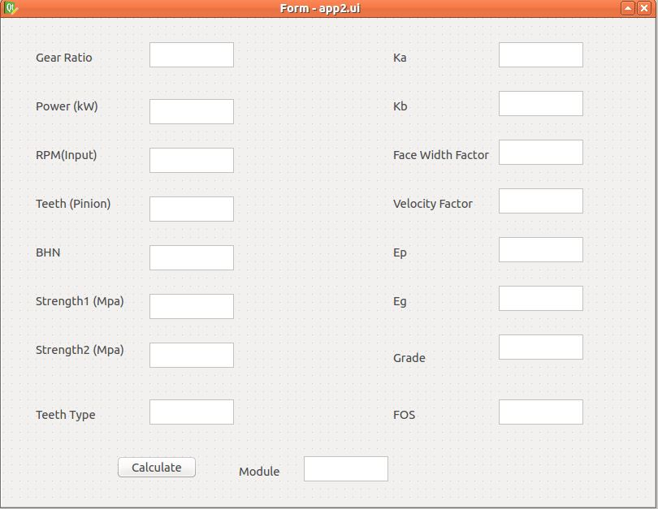
Beta version

Slide 6
Regarding parameters of Beta version
Enter the value of Power (kW) to be transmitted.
Enter the value of RPM and the gear reduction required at the output.
Values of the ultimate tensile strength of pinion (Strength1) and
Gear (Strength2) are to be entered in the corresponding boxes provided.
Enter the value of the lowest BHN among pinion and gear.
Choose the teeth type among 14.5’ Full depth Involute,20’ Full depth Involute,20’ Stub Involute system. If you do not choose the teeth type, 20’ Full Depth,Involute system is selected.

Slide 7
Continue….
7. Enter the value of Ka (Service Factor) and Kb(Load Concentration Factor).
Face width of gear =b= (Face width Factor)*(module). Enter the value of Face width Factor. Generally its 10 to 12.If nothing is entered it is assumed as 10.
Velocity co-efficient=K=x/(x+ v) where x=velocity factor and v=velocity.
Enter the value of x=velocity factor . It is usually 3 or 6. If nothing is entered then it is assumed as 6.
Enter the values of modulus of elasticity of Pinion (Ep) and Gear (Eg).

Slide 8
Continue….
Grade depends upon the manufacturing process of the gear. It varies from 1 to 12.
Grade 11 and Grade 12-Casting
Grade 8 and Grade 9-Rough and fine hobbing
Grade 6 –hobbing and rough grinding
Grade 4-Shaving and finish grinding.
If nothing is entered it is assumed as 6.
Enter the FOS required for the system to be used.
Press Calculate to obtain the optimized module for the given system of values.

Slide 9
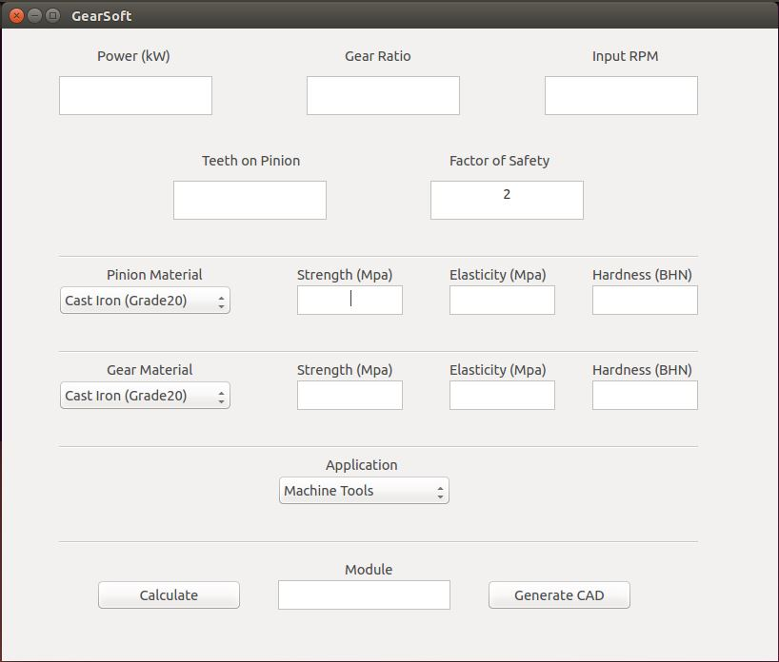
New Version

Slide 10
Features of New Version
User only needs to know maximum four parameters while designing for first time.
Materials can be selected from pre-defined material library.
Any changes in the properties of selected material can be modified temporarily.
Modified properties are then used for subsequent calculations and selection of gears.
Secondary parameters like grade, shock factor, load concentration factor, etc are accommodated within the type of application.

Slide 11
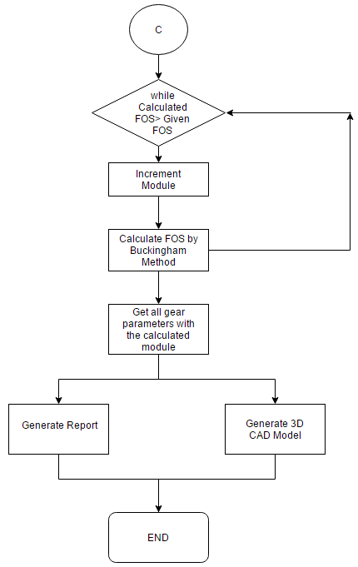
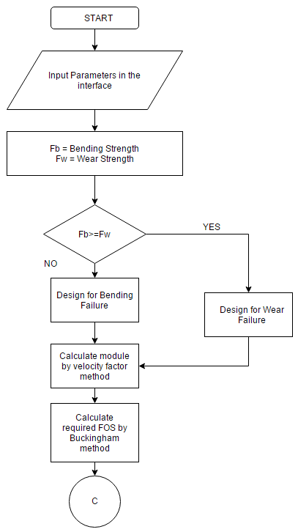
FLOWCHART – Algorithm

Slide 12
Work Completed…
Developed package for spur gear design with user friendly graphical user interface.
The package processes the input data from the user and outputs the module of the spur gear pair.
It automatically generates 3D CAD Model based on the output module.
It generates complete industrial grade report clearly tabulating the geometrical information.
The report also gives clear information of the theories and formulae used and the assumptions made during the calculations.
The package also outputs graphs considering different criteria like BHN, b-factor, Grade, power variation, speed variation, etc.

Slide 13
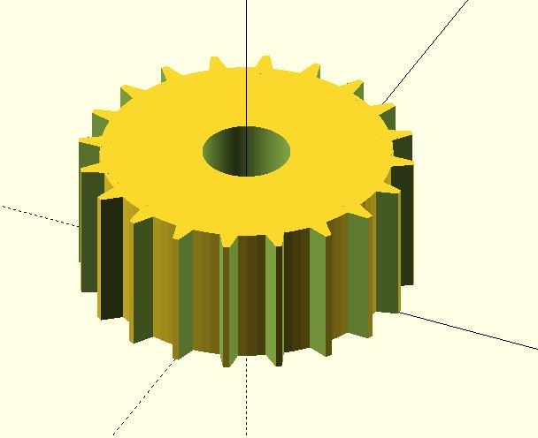
Autogenerated 3D CAD Model

Slide 14
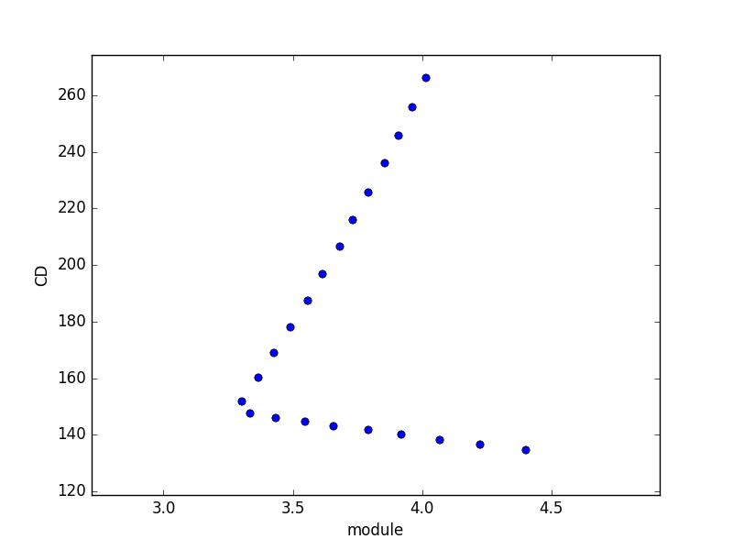
Graph Study
Centre Distance vs Module

Slide 15
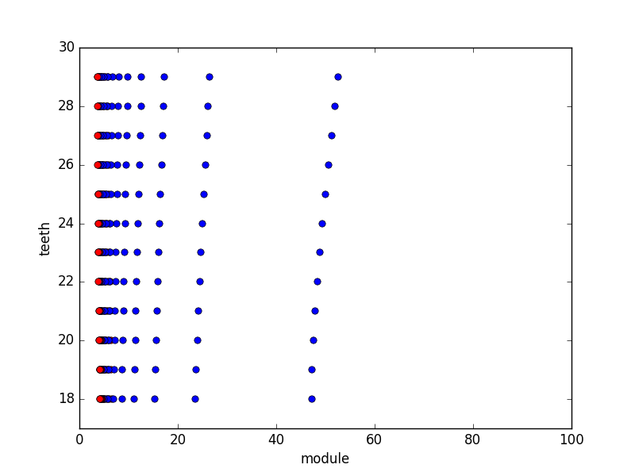
Graph Study…
Bending failure Graph by change in width factor

Slide 16
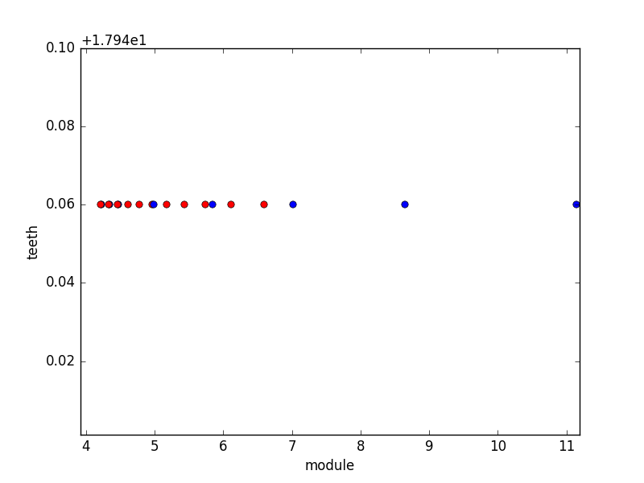
For Clear results (Zoomed)

Slide 17
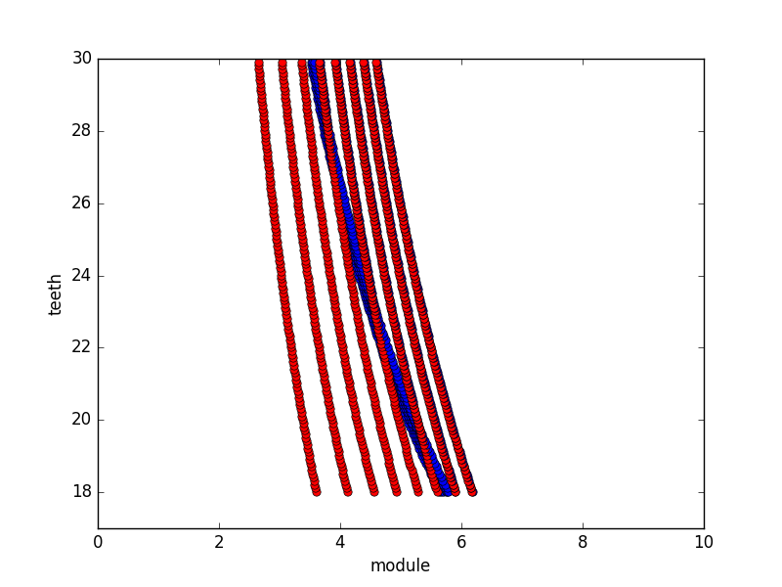
Wear Allowance

Slide 18
Conclusion
For optimized safe design face-width factor must be taken between 12 to 15.
Effect of Buckingham Load decreases with increasing power.
There exists a combination a module and number of teeth such that center distance is optimized. These values depend on power and can be obtained uniquely.
For Grade 1-5 both module with and without Buckingham load is same.
For Grade 6-12 module considering Buckingham Load =primary module +1.

Slide 19
Future Scope
Reduction of parameter : Rather than specifying several parameters we will be working on optimization with only limited fundamental parameters.
Use of industrial approach to design of gears with many practical parameters.
Automation using different type of gears and gear teeth especially helical gears.
Full generation of report which include stress theories and appropriate conclusion suggesting the feasibility of the designed gear.

Slide 20
THANK YOU…
Any questions…

