Slide 1
Cyber Security with Blockchain
  Ethereum Dapp
  Harsh Kasyap
  IIT Patna
  Course Instructor
  Dr. Somanath Tripathy

Slide 2
Issues in Bitcoin!
Allows only financial transactions
High latency (10 mins)
No provision of writing business logic
  For different applications
    Healthcare
    Land
    Business
    Education
    Voting
    …..

Slide 3
Why Ethereum?
Used for creating decentralized Apps
  Other than digital currency
High throughput (12 secs)
Enables writing business logic
  Using Smart Contracts
Comes with its own programming Lang
  Solidity

Slide 4
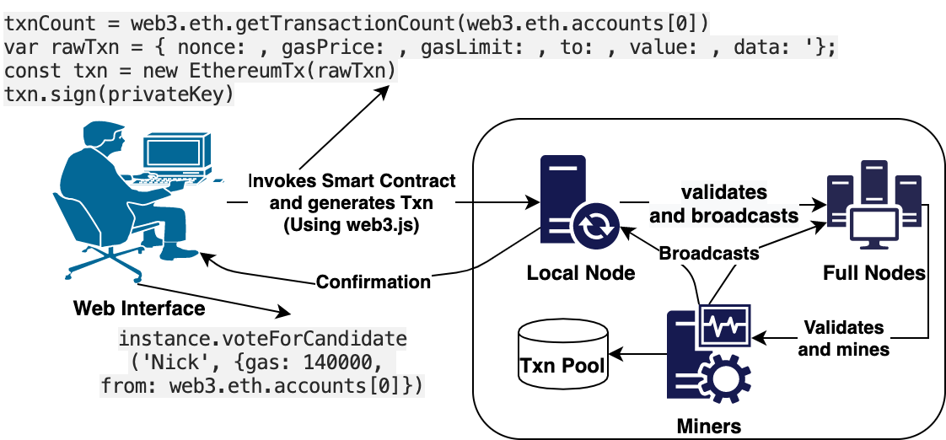
Lifecycle of Dapps

Slide 5
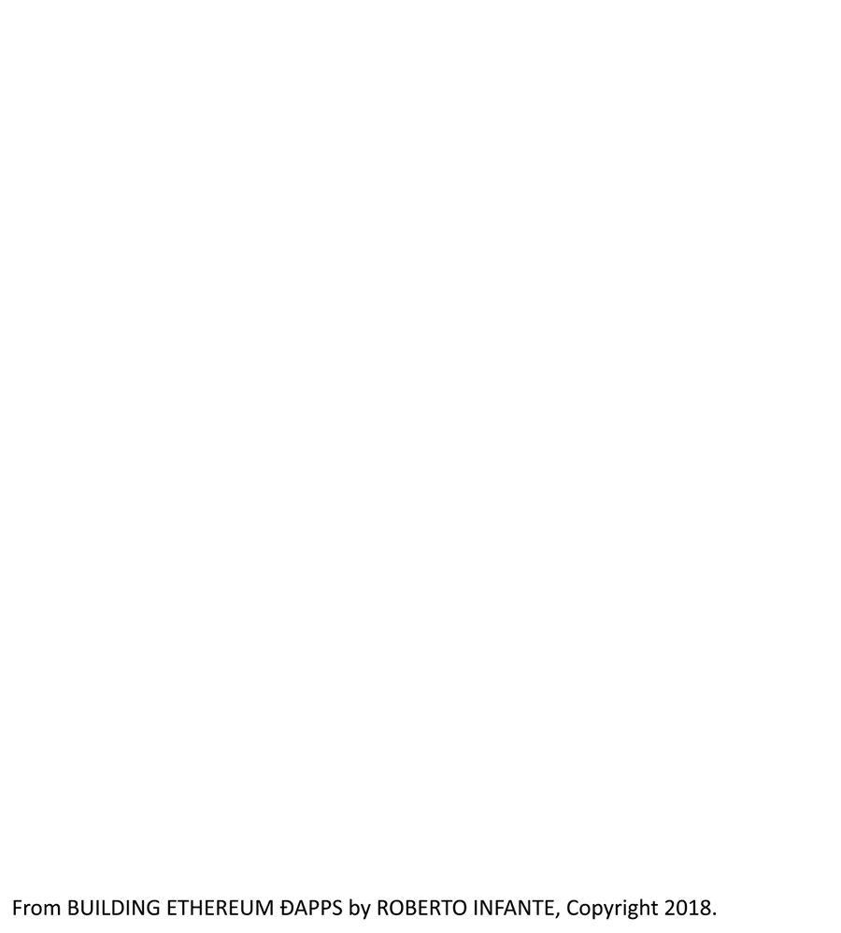
Voting application

Slide 6
Terms and Technologies
Web3.js : Communication library
Local/Parity nodes: light storage/routing
Full/Mining Nodes: storage/consensus
Nonce: number of transactions
gasPrice/gasLimit: willing to pay (GWei)
To: contract address
Value: 0 (for non-financial transaction)
Data: hash of function signature
Txn Pool: sorted by gas price

Slide 7
More about Ethereum
Ethereum client
  App that implements Ethereum
    Interface to interact with Ethereum
  Geth, Parity, Ganache
Ethereum network
  Maintained by Ethereum clients
  Mainnet
    Live production blockchain
  Testnet
    Private test network

Slide 8
Smart Contract
For writing specific business logic
Write once, Execute anywhere
Needs gas to operate
  As car needs gas to run
Language
  Solidity
IDE
  Remix IDE

Slide 9
Solidity
Statically typed language
Supports Values
  Bools, Int, Fixed Point Numbers, Address, Contract, Byte arrays, String Types, Enums, Structs, Arrays and Mappings types
Function
  function(params) {public|internal|external} [pure|view|payable] [returns ()]
Fallback functions, Events, Library
Inheritance, Abstract, Interface

Slide 10
Setup a private test net
Geth
  Ethereum client
    implemented in Go
  Installation
    Download/Refer the website
  Verify
    geth version
Ganache
  Download from here
    Quickstart Ethereum

Slide 11
Using Geth
Create a folder (eg. node1)
  to store the binary and configs of a client
Keep a genesis.json file in node1
  Copy the contents from here
Create the node
  geth --datadir node1 init genesis.json

Slide 12
Using Geth
Start the node
  geth --datadir node1 --networkid 123456 --rpc --rpcport "8545" --rpccorsdomain "*" --port 30305 "--allow-insecure-unlock" --nodiscover --rpcapi="admin,db,eth,debug,miner,net,shh,txpool,personal,web3" --ipcdisable console
Create an account
  personal.newAccount(‘your password’)
  Node is live!

Slide 13
Mining with Geth
Check current status
  eth.blockNumber: 0
  eth.getBalance(eth.accounts[0]): 0
To mine
  miner.start()
    First time, it will take some time and storage
    to generate the new DAG structure
      used in Ethash algorithm
  miner.stop()
Again check the status

Slide 14
Transfer some ethers
Create a new account
  personal.newAccount(‘your password’)
Unlock sender’s account
  personal.unlockAccount(eth.accounts[0])
Execute this command
  eth.sendTransaction({from:eth.accounts[0], to:eth.accounts[1], value: web3.toWei(5, "ether")})
It will be marked pending, check with
  eth.pendingTransactions
  Need to be mined

Slide 15
Adding more nodes
Create new node with same command
  make sure to have diff directory
  and different directory
  use the same genesis.json file
  use the same network id
In the second node
  Copy the value for admin.nodeInfo.enode
  In the first node
    Admin.addPeer(value)
Try adding a node on different system

Slide 16
Writing Smart Contract
Can use Remix IDE
  Make sure to have these plugins activated
    Solidity compiler
    Deploy and Run transactions
  Even try another of your choice
    Like VS Code extensions (juanblanco.solidity)
Use Truffle
  Writing smart contract
  Creating a user interface
  Interacting with the dapp

Slide 17
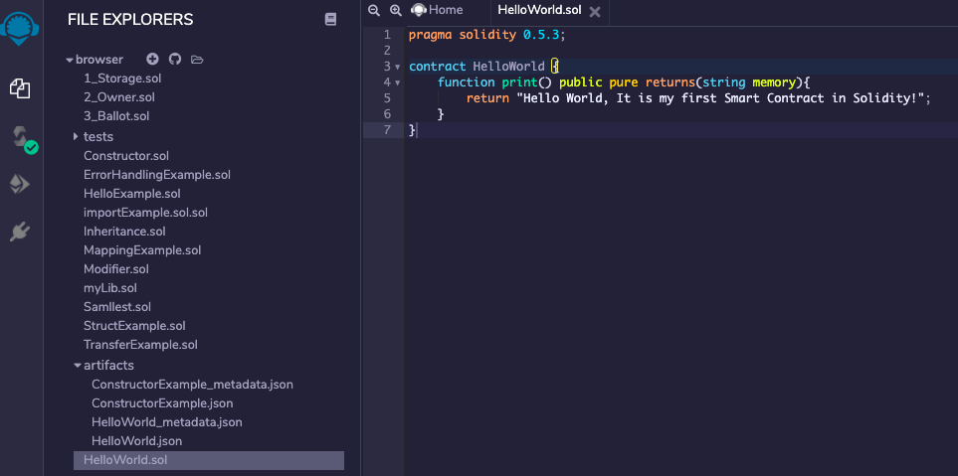
HelloWorld.sol

Slide 18
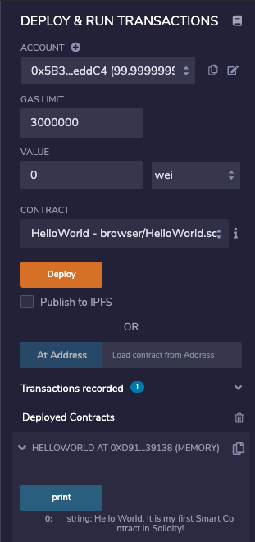
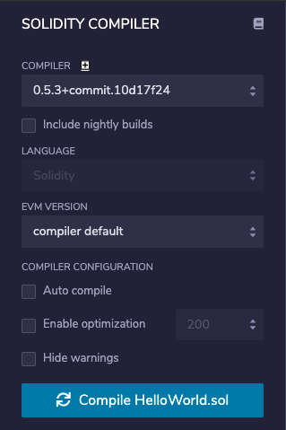
Compile and Deploy

Slide 19
Make a Dapp
Install NPM
  Check if installed
    node –v
Install truffle
  npm install -g truffle
  And, we already have ganache installed
  Metamask
    A chrome plugin

Slide 20
Visualize it!

Slide 21
Voting Dapp
Create a project directory
  mkdir voting && cd voting
truffle unbox pet-shop
  to get a running truffle box
Create
  contracts/Election.sol
  migrations/2_deploy_contracts.js
Update index.html and App.js
npm run dev
Connect with metamask and Vote!!!

Slide 22
Thanks

