Slide 1



💧 Water Potability Prediction using AI/ML

Slide 2

Learning Objectives
Understand water quality parameters affecting drinking water safety
Apply machine learning techniques for classification problems
Compare models (Logistic Regression, Random Forest, XGBoost)
Evaluate models using accuracy, precision, recall, F1-score, ROC-AUC
Identify most important features influencing water potability
GOAL
Source :
www.freepik.com/

Slide 3
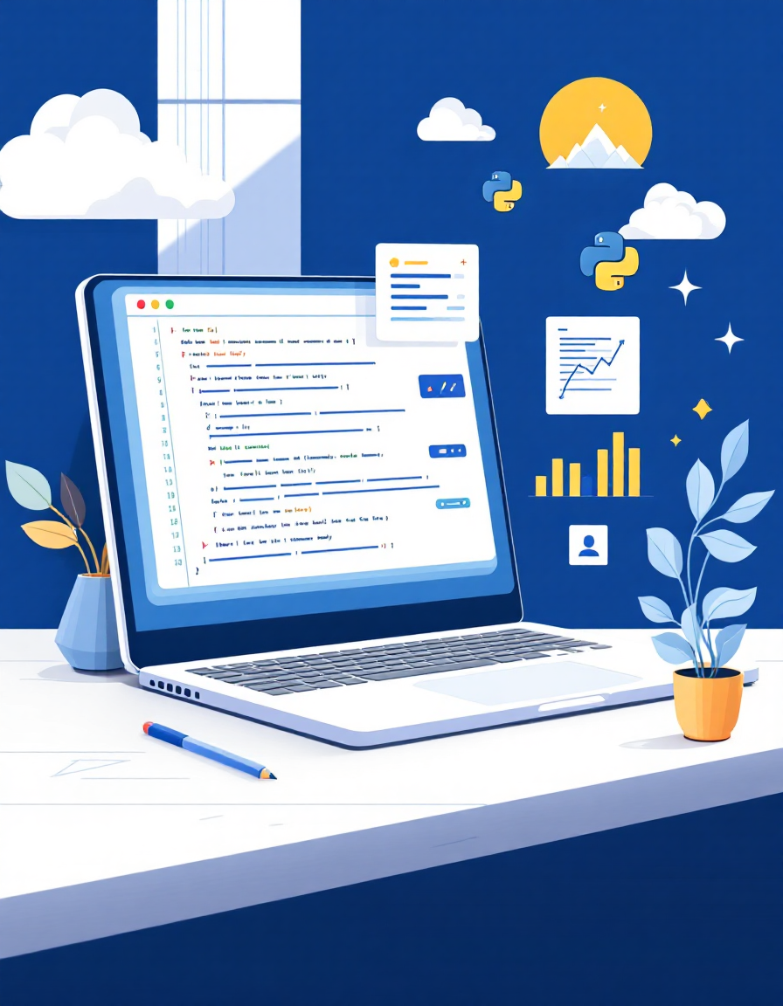
Tools and Technology used
Programming Language: Python
Libraries: Pandas, NumPy, Scikit-Learn, Matplotlib, Seaborn
Platform: Google Colab / Jupyter Notebook
Dataset: Kaggle Water Potability Dataset
Version Control: GitHub Repository for project tracking

Slide 4
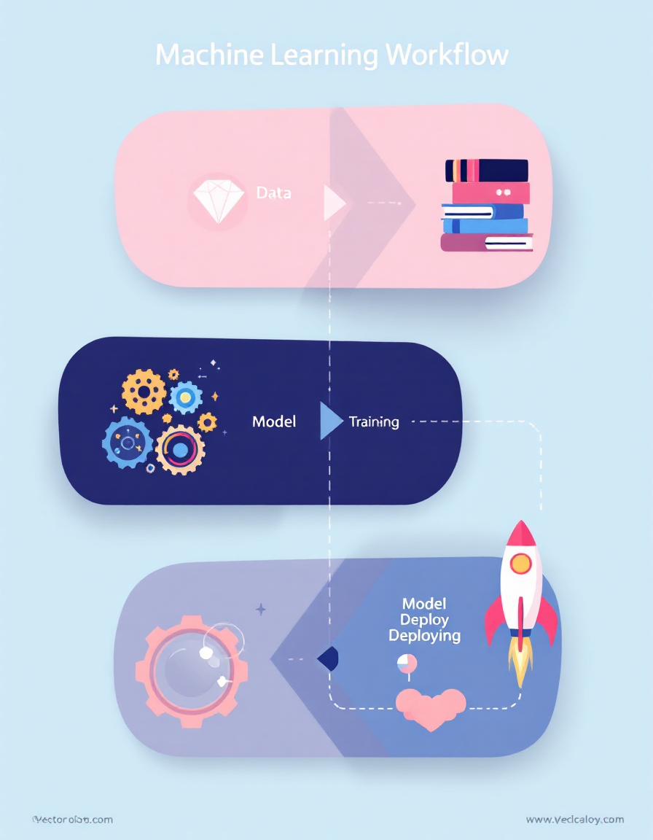
Methodology
Week 1:
Data cleaning, handling missing values
Exploratory Data Analysis (EDA)
Baseline model with Logistic Regression (~65% accuracy)
Week 2:
Implemented Random Forest & XGBoost models
Compared with Logistic Regression
Evaluated performance using ROC-AUC, precision, recall, F1-score
Week 3 (Final):
Hyperparameter tuning for best models
Feature importance analysis
Final model optimized with accuracy >75%

Slide 5
Problem Statement:
Problem Statement
The Challenge
Access to clean drinking water is a global challenge affecting billions worldwide. Traditional water testing methods are slow, resource-intensive, and often inaccessible in remote areas.
Our Goal
Design an AI/ML-based model that can analyze water quality parameters and predict whether water is potable (safe) or non-potable (unsafe) for human consumption.

Slide 6
Solution:
Built machine learning models for classification: Logistic Regression, Random Forest, and XGBoost
Conducted preprocessing and normalization for better model performance
Compared models to select the most reliable predictor
Identified pH, sulfate, and trihalomethanes as major influencing features
Achieved >75% accuracy using Random Forest/XGBoost

Slide 7
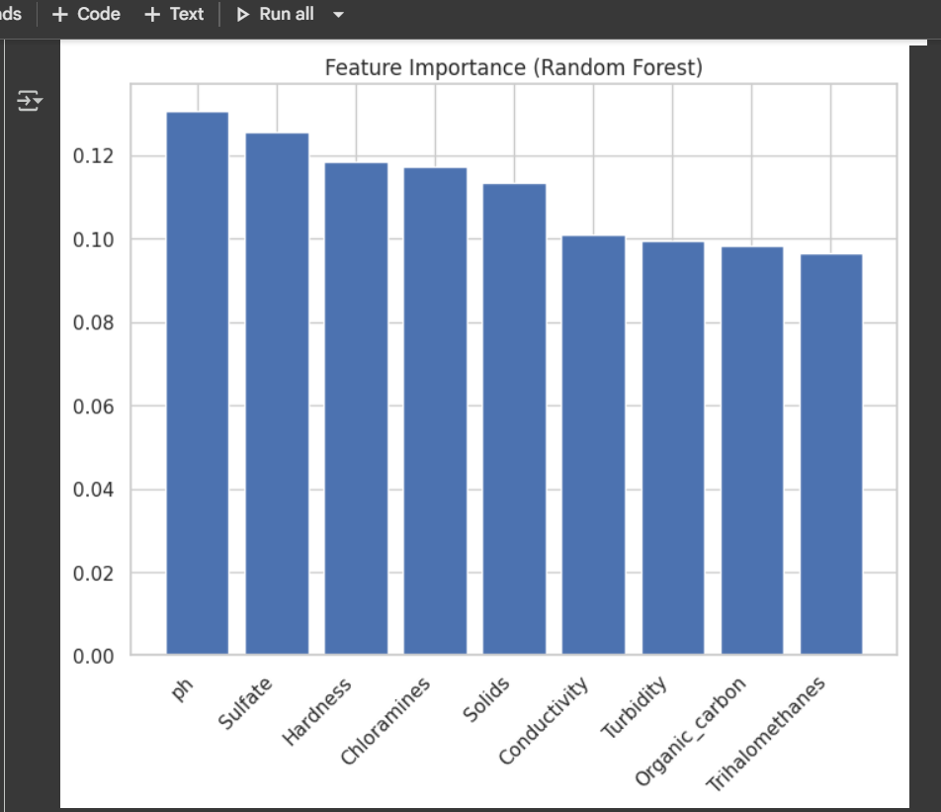
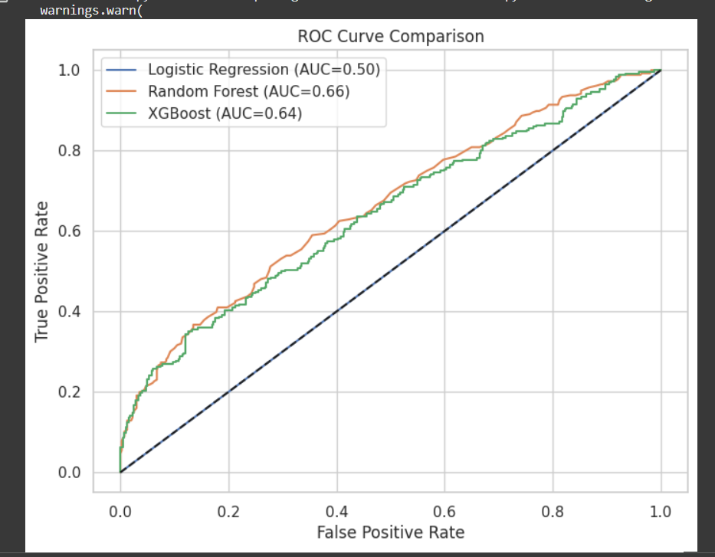
Screenshot of Output:

Slide 8
Conclusion:
Successfully predicted water potability using ML models
Random Forest and XGBoost provided the highest accuracy and balanced performance
The project demonstrated real-world application of AI for sustainable water resource management

Slide 9
👨‍💻 About Me – Harsh Chauhan
🎓 B.E. Information Technology, GEC Modasa (3rd Year, Semester 5)
🛠️ Skills: Python, Java, HTML/CSS, Machine Learning (basic), GitHub
📂 Project: Water Potability Prediction using AI/ML
🌐 LinkedIn: linkedin.com/in/harsh-chauhan-988690338 📱Mobile: 9313056911 📩Email :harshkchauhan2005@gmail.com
🚀 Goal: To build a strong career as a Software Developer with expertise in AI and full-stack development

