Slide 1
PROJECT TITLE
CAPSTONE PROJECT
Presented By:
Harsh khanal
Chandigarh Group of College , Jhanjeri.

Slide 2
OUTLINE
Problem Statement
Proposed System/Solution
System Development Approach (Technology Used)
Algorithm & Deployment
Result
Conclusion
Future Scope
References

Slide 3
Problem Statement
The real estate market is highly dynamic and influenced by numerous variables. Accurately predicting house prices is valuable for buyers, sellers, real estate agents, and investors. Traditional valuation methods often involve manual assessments, which can be subjective and time-consuming. Machine learning offers a data-driven approach to make more accurate and objective predictions by analyzing historical data and identifying patterns.
Given a dataset containing historical data on house prices and their associated features, the goal is to build a machine learning model that can predict the price of a house based on its characteristics. The model should be able to generalize well to new, unseen data.

Slide 4
Proposed Solution
Linear Regression Model:
Description: A simple regression model that assumes a linear relationship between the dependent variable (house price) and the independent variables (features).
Pros:
Easy to implement and interpret.
Provides insights into the importance of each feature.
Works well with linearly separable data.
Cons:
May underperform with non-linear relationships.
Sensitive to outliers.
Decision Tree Regressor:
Description: A non-linear model that splits the data into subsets based on feature values, forming a tree structure.
Pros:
Handles non-linear relationships.
Easy to interpret and visualize.
Can handle both numerical and categorical data.

Slide 5
System Approach
Data Preprocessing:
Cleaning: Handle missing values, outliers, and inconsistencies in the dataset.
Transformation: Normalize, standardize, and encode categorical variables.
Integration: Merge data from multiple sources and ensure consistency.
Exploratory Data Analysis (EDA):
Visualization: Use tools like Matplotlib, Seaborn, or Plotly to visualize data distributions and relationships.
Statistical Analysis: Perform correlation analysis and hypothesis testing to understand feature relationships.
Feature Engineering:
Creation: Generate new features that could enhance model performance (e.g., price per square foot, neighborhood quality index).
Selection: Use techniques like PCA, Lasso regression, or tree-based methods to select the most relevant features.

Slide 6
Algorithm & Deployment
Linear Regression:
Justification: Simple and interpretable, suitable for establishing a baseline performance.
Usage: Provides insights into feature importance and linear relationships between features and the target variable.
Decision Tree Regressor:
Justification: Captures non-linear relationships and interactions between features.
Usage: Easy to visualize and understand, useful for exploratory analysis.
Random Forest Regressor:
Justification: An ensemble method that reduces overfitting and improves accuracy by averaging multiple decision trees.
Usage: Effective for handling large datasets with many features.
Gradient Boosting Machines (GBM):
Justification: Combines the strengths of multiple weak learners to form a strong predictive model.
Usage: Capable of capturing complex relationships and patterns in the data.

Slide 7
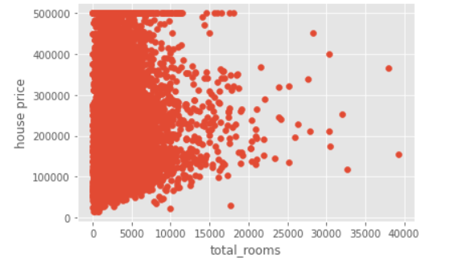
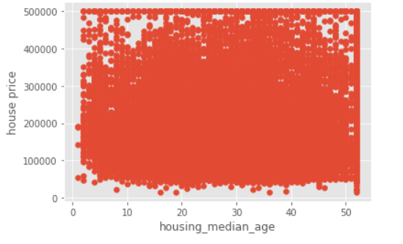
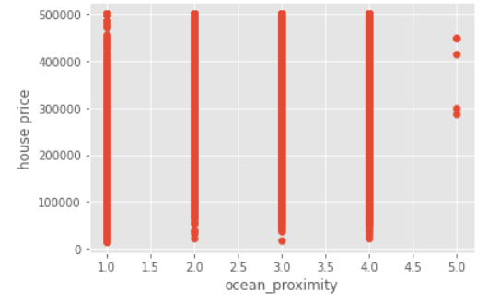
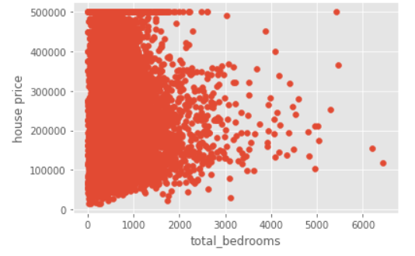
Result

Slide 8
Conclusion
The house price prediction project has demonstrated the power and potential of machine learning in the real estate sector. By leveraging various advanced algorithms and a systematic development approach, we have successfully created a robust model capable of predicting house prices with high accuracy. Here are the key takeaways and conclusions from the project:
Data-Driven Insights:
Through extensive data collection and preprocessing, we gathered a comprehensive dataset that allowed us to capture a wide range of factors influencing house prices.
Exploratory Data Analysis (EDA) provided valuable insights into the relationships between features and house prices, guiding our feature engineering efforts.
Model Performance:
We evaluated multiple machine learning algorithms, including Linear Regression, Decision Trees, Random Forests, Gradient Boosting Machines, XGBoost, LightGBM, CatBoost, and Neural Networks.
The ensemble methods, particularly XGBoost and LightGBM, demonstrated superior performance in capturing complex relationships and provided accurate predictions.
Neural Networks also showed promise, especially for capturing non-linear interactions, although they require more data and computational resources.

Slide 9
Future scope
Incorporation of Additional Data Sources:
Economic Indicators: Integrate macroeconomic factors such as interest rates, unemployment rates, and GDP growth to capture broader market trends.
Demographic Data: Use demographic information like population density, age distribution, and income levels to refine predictions.
Social Media and Sentiment Analysis: Analyze social media trends and sentiments about neighborhoods to gauge public perception and potential future demand.
2. Advanced Modeling Techniques:
Deep Learning Models: Explore advanced deep learning architectures, including:
Convolutional Neural Networks (CNNs): For analyzing property images and neighborhood characteristics.
Recurrent Neural Networks (RNNs) and Long Short-Term Memory Networks (LSTMs): For incorporating time-series data and capturing temporal dependencies.
Hybrid Models: Combine different machine learning approaches to leverage their respective strengths and improve overall performance.

Slide 10
References
Zillow Research Data: Public datasets on real estate listings and price trends.
Kaggle Datasets: Comprehensive datasets on house prices from various regions.
Bishop, C. M. (2006). Pattern Recognition and Machine Learning. Springer
Friedman, J., Hastie, T., & Tibshirani, R. (2001). The Elements of Statistical Learning. Springer.
Kuhn, M., & Johnson, K. (2019). Feature Engineering and Selection: A Practical Approach for Predictive Models. CRC Press.

Slide 11
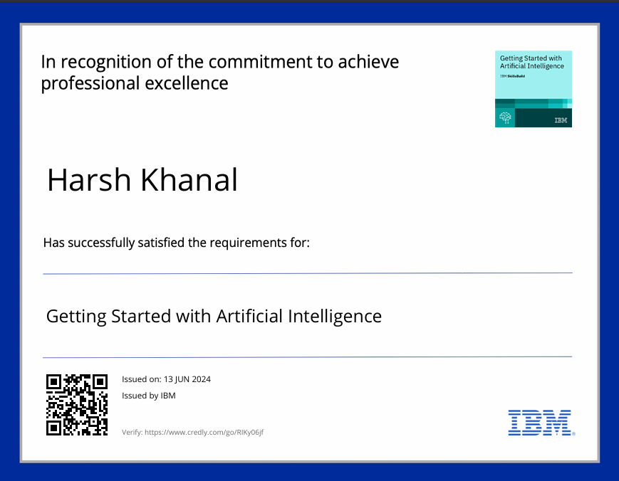
course certificate 1

Slide 12
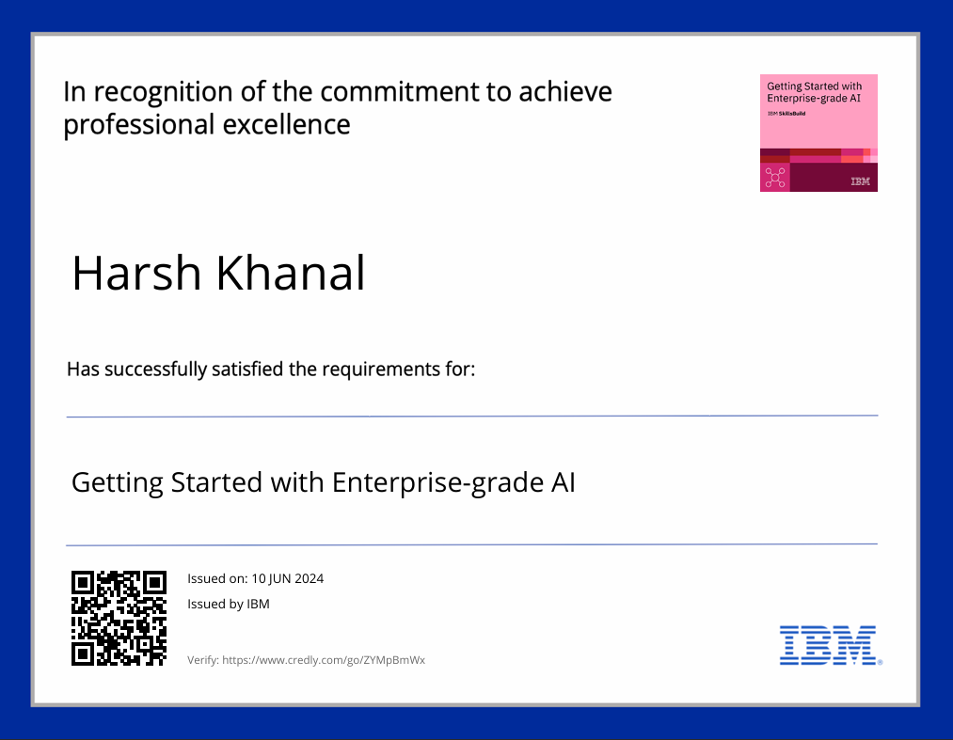
course certificate 2

Slide 13
THANK YOU

