Slide 1

Seasonal Agriculture Performance Analysis
Major Project - Data Analytics
VOIS | AICTE
Student Name: Harsh Kumar Singh
College Name: Chandigarh University
AICTE STU ID: STU6a6b571d927b91785419549

Slide 2

PROBLEM STATEMENT
Agricultural performance is influenced by seasonal environmental conditions, farming practices, resource availability and market conditions. However, raw agricultural data does not clearly reveal how performance changes across seasons.
Aim: Analyse seasonal differences in agricultural performance by identifying meaningful patterns, trends, relationships and variations across crops, regions, environmental conditions, resource usage and economic outcomes.

Slide 3
Project Description
This project analyzes 4,000 farm-level agricultural records across 3 seasons - Kharif, Rabi and Zaid - covering 8 crops and 8 states.
The analysis evaluates seasonal differences in crop yield, production, environmental conditions, resource utilization, water efficiency, market prices and profitability.
Python-based data analytics techniques were used for data cleaning, exploratory analysis, statistical analysis and visualization. Additional analyses were performed to investigate regional seasonal performance, crop-season profitability, resource usage and statistical differences in farm profit.
The objective is to transform agricultural data into evidence-based insights that can support better seasonal planning and resource allocation.
4,000
farm records
28
variables
3
seasons
8 + 8
crops and states

Slide 4

WHO ARE THE END USERS?
Farmers
Compare crop and seasonal performance and identify potentially profitable crop-season combinations.
1
Agricultural Departments
Support regional and seasonal agricultural planning.
2
Agricultural Planners
Plan resource allocation based on seasonal conditions.
3
Agriculture businesses
Understand production, market price and profitability patterns.
4
Agricultural Researchers
Investigate relationships between environmental factors and agricultural outcomes.
5

Slide 5

Technology Used
Programming
Python
Data Analysis
Pandas | NumPy
Visualization
Matplotlib | Seaborn
Statistical Analysis
SciPy
Environment
Google Colab
Dataset
Microsoft Excel
Analytical Techniques
Exploratory Data Analysis Univariate & Bivariate Analysis Multivariate Analysis
Correlation Analysis Statistical Validation Data Visualization

Slide 6
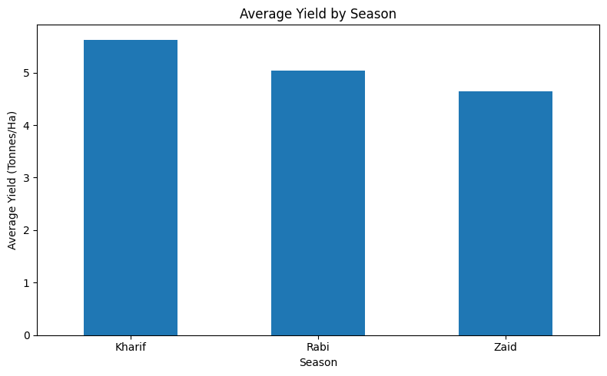
RESULTS
Overall Seasonal Performance
4,000
Farm Records
3
Seasons
8
Crops
8
States
Key Finding
Kharif recorded the highest average yield at 5.63 tonnes/ha, followed by Rabi at 5.04 tonnes/ha and Zaid at 4.64 tonnes/ha.
Kharif 5.63 t/ha
Rabi 5.04 t/ha
Zaid 4.64 t/ha
Average Yield by Season (notebook cell 24)

Slide 7
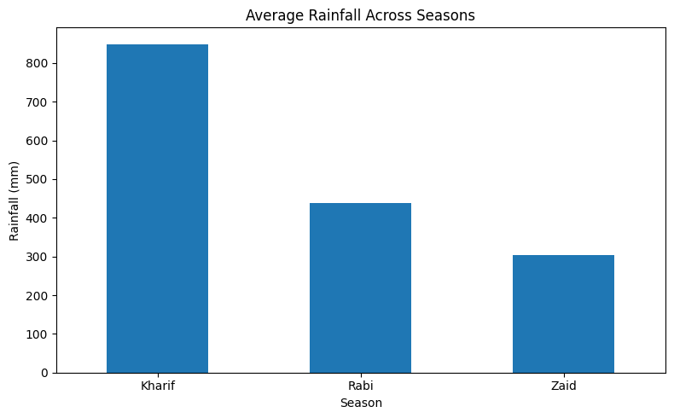
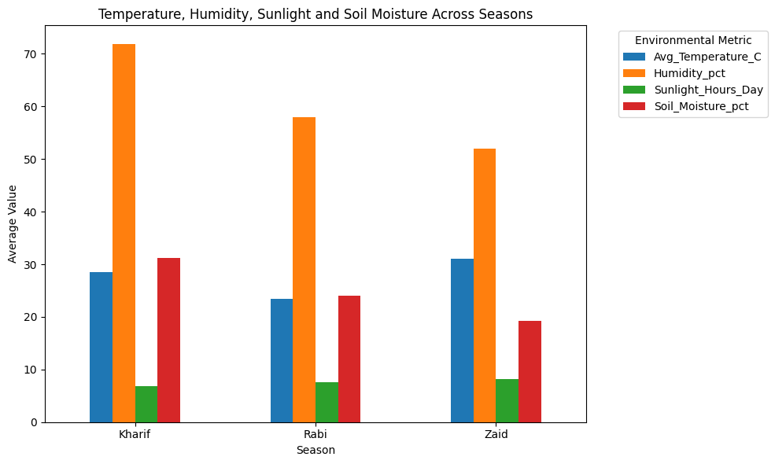
RESULTS
Environmental Conditions Across Seasons
Average rainfall by season
Temperature, humidity, sunlight, soil moisture
Rainfall Kharif 849.20 mm, Rabi 437.62 mm, Zaid 304.65 mm.
Temperature Zaid is hottest at 31.04 °C; Rabi coolest at 23.49 °C.
Humidity / soil moisture Highest in Kharif (71.81% / 31.15%).
Insight Kharif is characterized by substantially higher rainfall, humidity and soil moisture, while Zaid has the highest temperature and sunlight exposure. Rabi shows intermediate environmental conditions.
Code - environment_summary
environment_summary = df.groupby('Season').agg({
'Rainfall_mm': 'mean',
'Avg_Temperature_C': 'mean',
'Humidity_pct': 'mean',
'Sunlight_Hours_Day': 'mean',
'Soil_Moisture_pct': 'mean'
}).round(2)

Slide 8
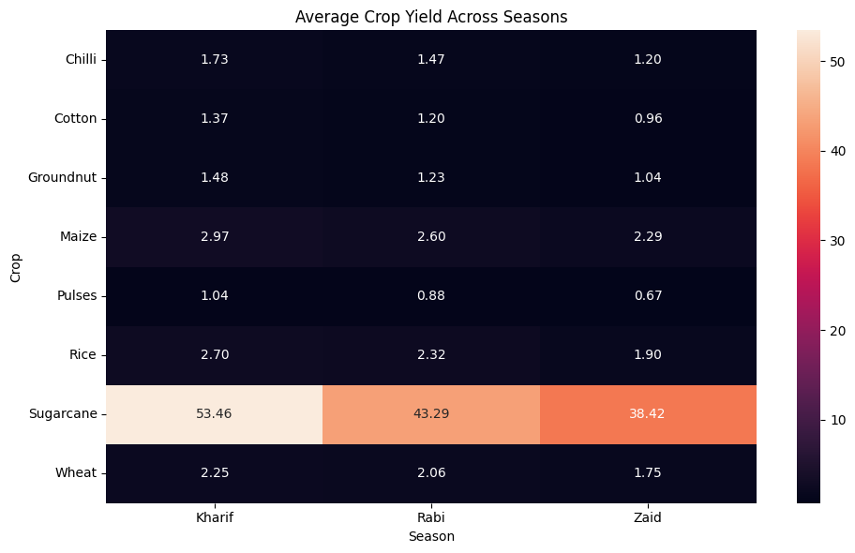
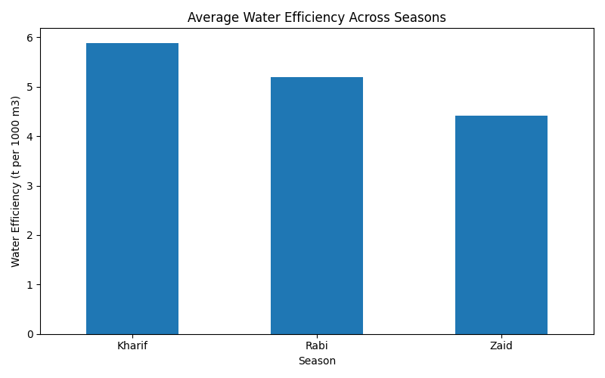
RESULTS
Crop and Resource Performance
Crop x Season yield heatmap (t/ha)
Water efficiency by season (t per 1,000 m3)
Sugarcane dominates 53.46 t/ha in Kharif vs 43.29 (Rabi) and 38.42 (Zaid) - a heatmap handles this scale far better than a grouped bar chart.
Every crop peaks in Kharif Maize 2.97, Rice 2.70, Wheat 2.25 t/ha.
Insight Kharif combines the highest average water efficiency (5.89) with the highest yield, while Zaid records the highest average water use (6,420 m3) but the lowest water efficiency (4.41).
Code - crop x season heatmap
crop_season_yield = pd.pivot_table(
df, values='Yield_Tonnes_Ha',
index='Crop', columns='Season',
aggfunc='mean').round(2)
sns.heatmap(crop_season_yield,
annot=True, fmt='.2f')

Slide 9
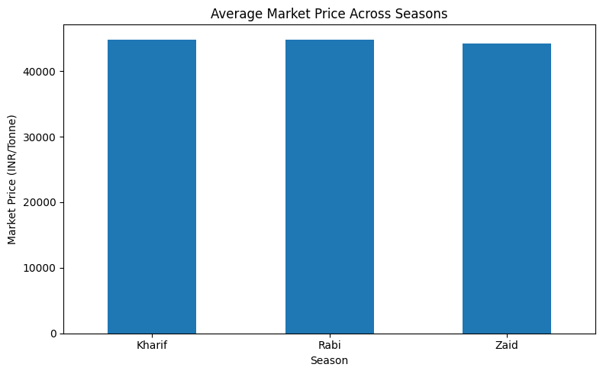
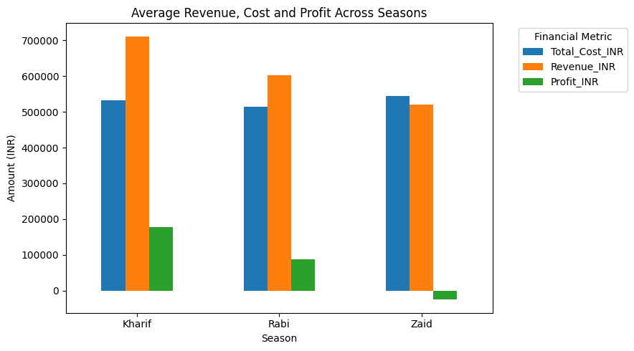
RESULTS
Economic Performance Across Seasons
Average market price by season
Revenue vs cost vs profit by season
Market price ₹44,850.91 (Kharif), ₹44,747.97 (Rabi), ₹44,212.03 (Zaid) per tonne - prices remain close across seasons, so the seasonal difference in profitability is not explained by market price alone.
Main finding Kharif generated the highest average revenue and profit, while Zaid was the only season with negative average profit because average cost (₹543,977) exceeded average revenue (₹519,172).
25.17%
Kharif margin
14.58%
Rabi margin
-4.78%
Zaid margin
Code - economic summary
economic_financials = df.groupby('Season').agg({
'Total_Cost_INR': 'mean',
'Revenue_INR': 'mean',
'Profit_INR': 'mean'
}).round(2)

Slide 10
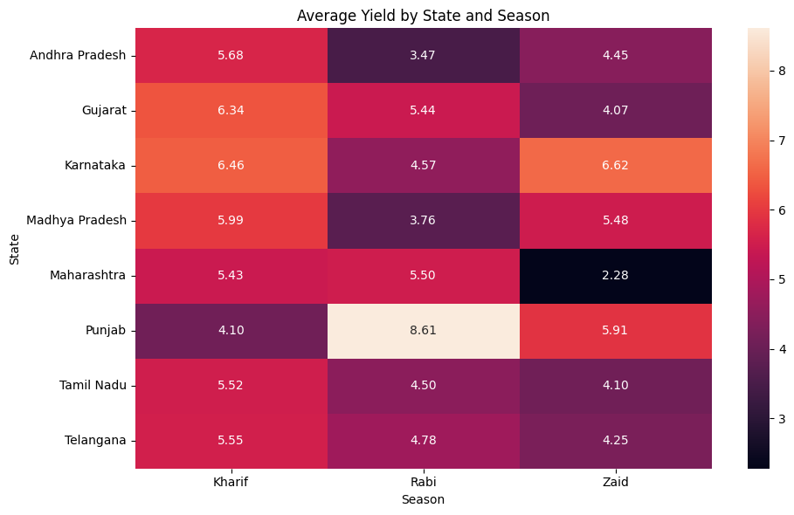
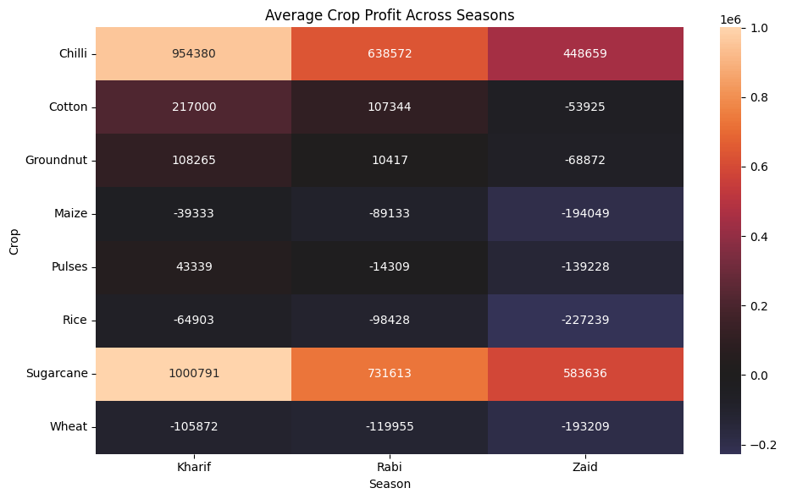
RESULTS
Regional and Statistical Analysis
State x Season yield heatmap (t/ha)
Crop x Season profitability heatmap (₹)
Regional finding Seasonal performance varies by region. Punjab records its strongest yield in Rabi (8.61 t/ha) while Karnataka records its strongest yield in Zaid (6.62 t/ha), indicating that regional conditions influence seasonal performance.
Crop finding Sugarcane and Chilli are the strongest profit-generating crops across all three seasons, while several crops show substantially weaker profitability in Zaid.
One-way ANOVA on farm profit
F = 34.29 p = 1.71 x 10⁻¹⁵
Statistically significant difference across seasons (p < 0.001).
Code - ANOVA
from scipy.stats import f_oneway
anova_result = f_oneway(
df[df['Season']=='Kharif']['Profit_INR'],
df[df['Season']=='Rabi']['Profit_INR'],
df[df['Season']=='Zaid']['Profit_INR'])

Slide 11
Future scope
Predictive Yield Forecasting
Develop models to forecast crop yield using
historical environmental and farming data.
Market Price Forecasting
Incorporate historical market data to
anticipate price movements.
Regional Recommendation System
Develop region-specific crop and
season recommendations.
Advanced Water Management
Build models to optimize irrigation
and water efficiency.
Real-Time Data Integration
Incorporate weather, soil and
satellite-based agricultural data.
Interactive Dashboard
Develop a Power BI dashboard for continuous
monitoring and decision support.

Slide 12
GitHub Link
https://github.com/harshkrsingh2/Seasonal-Agriculture-Performance-Analysis-By-Harsh-Kumar-Singh-
Seasonal Agriculture Performance Analysis
Complete Python analysis notebook, data-cleaning workflow, visualizations, statistical analysis, key insights, recommendations and conclusion.
Repository structure
Seasonal-Agriculture-Performance-Analysis By Harsh Kumar Singh/
|
|-- Harsh_Kumar_Singh__VOIS_Analysis.ipynb
|-- seasonal_agriculture_performance_dataset.xlsx
|-- README.md
|-- VOIS_Major_project_PPT_By_Harsh_Kumar_Singh

Slide 13

VOIS Course Completion Certificate
Course: Data Visualization: https: //drive.google.com/file/d/1-EhXdbMeykEmnBhAwH25nVMtxHXn2Zst/view?usp=sharing

Slide 14
Thank you
Harsh Kumar Singh
Chandigarh University
AICTE STU ID: STU6a6b571d927b91785419549
Email ID: harshkrsingh14@gmail.com

