Slide 1
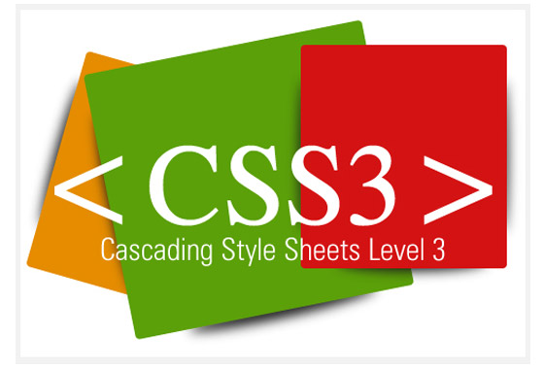


Slide 2
CSS3 Introduction
CSS3 is the latest standard for CSS.
CSS, or Cascading Styles Sheets, is a way to style and present HTML.
HTML is the meaning or content, the style sheet is the presentation of that document.
Styles don’t smell or taste anything like HTML, they have a format of ‘property: value’ and most properties can be applied to most HTML tags.

Slide 3
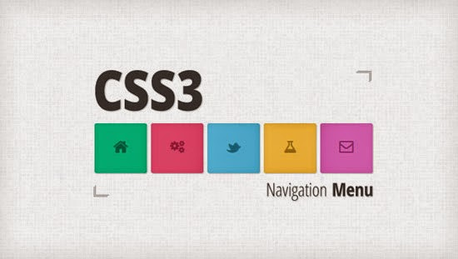
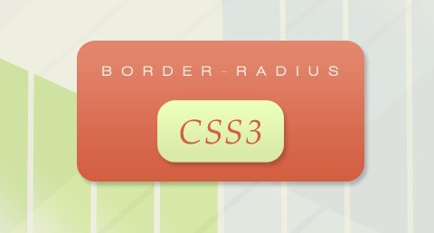
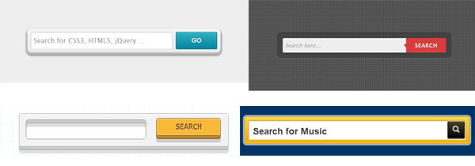

CSS3

Slide 4
CSS3 modules
Selectors
Box Model
Backgrounds and Borders
Image Values and Replaced Content
Text Effects
2D/3D Transformations
Animations
Multiple Column Layout
User Interface

Slide 5
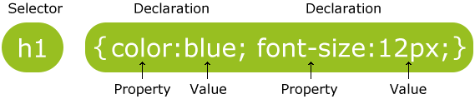
CSS3 Syntax
A CSS rule set consists of a selector and a declaration block.
The selector points to the HTML element you want to style.
The declaration block contains one or more declarations separated by semicolons.
Each declaration includes a property name and a value, separated by a colon.

Slide 6
Selectors
CSS selectors allow you to select and manipulate HTML element(s).
CSS selectors are used to "find" (or select) HTML elements based on their id, classes, types, attributes, values of attributes and much more.
Element Selectors
Class Selectors
ID Selectors

Slide 7
CSS3 Backgrounds
CSS3 contains several new background properties.
It allows greater control of the background element.
background-size
background-origin
Use multiple background images.

Slide 8
background-size Property
The background-size property specifies the size of the background image.
div { background: url(img_flwr.gif); background-size: 80px 60px; background-repeat: no-repeat; }

Slide 9
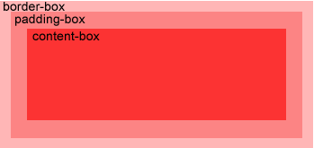
background-origin Property
The background-origin property specifies the positioning area of the background images.
The background image can be placed within the content-box, padding-box, or border-box area.

Slide 10
Background image within the content-box
div { background: url(img_flwr.gif); background-repeat: no-repeat; background-size: 100% 100%; background-origin: content-box; }

Slide 11
Multiple Background Images
body { background: url(img_tree.gif), url(img_flwr.gif); background-size: 100% 100%; background-repeat: no-repeat; }

Slide 12
Text Effects
CSS3 contains several new text features.
text-shadow
word-wrap

Slide 13

We specify the horizontal shadow, the vertical shadow, the blur distance, and the color of the shadow.
h1 { text-shadow: 5px 5px 5px #FF0000; }

Slide 14
Word Wrapping
If a word is too long to fit within an area, it expands outside.
The word-wrap property allows you to force the text to wrap - even if it means splitting it in the middle of a word
p { word-wrap: break-word; }
This paragraph contains a very long word: thisisaveryveryveryveryveryverylongword. The long word will break and wrap to the next line.

Slide 15
CSS3 Text Properties
Property | Description
hanging-punctuation | Specifies whether a punctuation character may be placed outside the line box
punctuation-trim | Specifies whether a punctuation character should be trimmed
text-align-last | Describes how the last line of a block or a line right before a forced line break is aligned when text-align is "justify"
text-emphasis | Applies emphasis marks, and the foreground color of the emphasis marks, to the element's text
text-justify | Specifies the justification method used when text-align is "justify"
text-outline | Specifies a text outline
text-overflow | Specifies what should happen when text overflows the containing element
text-shadow | Adds shadow to text
text-wrap | Specifies line breaking rules for text
word-break | Specifies line breaking rules for non-CJK scripts
word-wrap | Allows long, unbreakable words to be broken and wrap to the next line

Slide 16
CSS3 Web Fonts
Web fonts allow Web designers to use fonts that are not installed on the user's computer.
When you have found/bought the font you wish to use, just include the font file on your web server, and it will be automatically downloaded to the user when needed.
Your "own" fonts are defined within the CSS3 @font-face rule.

Slide 17
The @font-face Rule
We must first define a name for the font (e.g. myFirstFont), and then point to the font file.
To use the font for an HTML element, refer to the name of the font (myFirstFont) through the font-family property.
@font-face { font-family: myFirstFont; src: url(sansation_light.woff); } div { font-family: myFirstFont; }

Slide 18
CSS3 Links
The link element can have different style depending on which state it is.
a:link - not visited link
a:visited – visited link
a:hover - a link when the user hover the mouse over it
a:active - a link when it is pressed

Slide 19

Example - Links
a:link {color:#1BA1E2;}
a:visited {color:#00FF02;}
a:hover {color:#FF00FF;}
a:active {color:#2200FF;}

Slide 20
Rules
The following rules apply for styling links:
a:hover must be used after a:link and a:visited
a:active must be used after a:hover

Slide 21
Common Link Styling Properties
The following properties are most widely used for styling of links:
color
text-decoration
background-color
a:link{text-decoration:underline;} a:hover {background-color:#FF00FF;} a:visited {color:#00FF2D;}

Slide 22
Borders
With CSS3, you can create rounded borders, add shadow to boxes, and use an image as a border - without using a design program, like Photoshop.
border-radius
box-shadow
border-image

Slide 23
Border-radius Property - Rounded Corners
The border-radius property is used to create rounded corners.
Add rounded corners to a div element:
div { border: 2px solid; border-radius: 25px; }
This box has rounded corners!

Slide 24
Box-shadow Property
div { box-shadow: 10px 10px 5px #888888; }

Slide 25
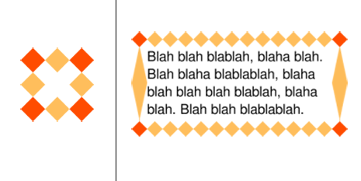
Border-image Property
With the CSS3 border-image property you can use an image to create a border.
The border-image property allows you to specify an image as a border!
The original image used to create the border below

Slide 26
Use an image to create a border around a div element
div { -webkit-border-image: url(border.png) 30 30 round; /* Safari 5 */ -o-border-image: url(border.png) 30 30 round; /* Opera 10.5-12.1 */ border-image: url(border.png) 30 30 round; }

Slide 27
CSS3 Border Properties
Property | Description
border-image | A shorthand property for setting all the border-image-* properties
border-radius | A shorthand property for setting all the four border-*-radius properties
box-shadow | Attaches one or more drop-shadows to the box

Slide 28
Gradients
CSS3 gradients let you display smooth transitions between two or more specified colors.
Earlier, you had to use images for these effects.
By using CSS3 gradients you can reduce download time and bandwidth usage.
In addition, elements with gradients look better when zoomed, because the gradient is generated by the browser.

Slide 29
Types of gradients
Linear Gradients
(goes down/up/left/right/diagonally)
Radial Gradients (defined by their center)

Slide 30

Linear Gradients
To create a linear gradient you must define at least two color stops.
Color stops are the colors you want to render smooth transitions among.
You can also set a starting point and a direction (or an angle) along with the gradient effect.
background: linear-gradient(direction, color-stop1, color-stop2, ...);

Slide 31

Radial Gradients
A radial gradient is defined by its center.
To create a radial gradient you must also define at least two color stops.
You can also specify the gradient's center, shape (circle or ellipse) as well as its size.
By default, center is center, shape is ellipse, and size is farthest-corner.
background: radial-gradient(center, shape size, start-color, ..., last-color);

Slide 32
CSS3 Transforms
With CSS3 transform, we can move, scale, turn, spin, and stretch elements.
A transformation is an effect that lets an element change shape, size and position.
You can transform your elements using 2D or 3D transformation.
CSS3
Rotate
CSS3
Scale

Slide 33
2D Transforms
translate()
rotate()
scale()
skew()
matrix()

Slide 34
Rotate()
With the rotate() method, the element rotates clockwise at a given degree.
Negative values are allowed and rotates the element counter-clockwise.
div { -ms-transform: rotate(30deg); /* IE 9 */ -webkit-transform: rotate(30deg); /* Chrome, Safari, Opera */ transform: rotate(30deg); }
The value rotate(30deg) rotates the element clockwise 30 degrees.

Slide 35
The translate() Method
With the translate() method, the element moves from its current position, depending on the parameters given for the left (X-axis) and the top (Y-axis) position.
div { -ms-transform: translate(50px,100px); /* IE 9 */ -webkit-transform: translate(50px,100px); /* Chrome, Safari, Opera */ transform: translate(50px,100px); }
The value translate(50px,100px) moves the element 50 pixels from the left, and 100 pixels from the top.

Slide 36
The scale() Method
With the scale() method, the element increases or decreases the size, depending on the parameters given for the width (X-axis) and the height (Y-axis).
div { -ms-transform: scale(2,4); /* IE 9 */ -webkit-transform: scale(2,4); /* Chrome, Safari, Opera */ transform: scale(2,4); }
The value scale(2,4) transforms the width to be twice its original size, and the height 4 times its original size.

Slide 37
The skew() Method
With the skew() method, the element turns in a given angle, depending on the parameters given for the horizontal (X-axis) and the vertical (Y-axis) lines
div { -ms-transform: skew(30deg,20deg); /* IE 9 */ -webkit-transform: skew(30deg,20deg); /* Chrome, Safari, Opera */ transform: skew(30deg,20deg); }
The value skew(30deg,20deg) turns the element 30 degrees around the X-axis, and 20 degrees around the Y-axis.

Slide 38
The matrix() Method
The matrix() method combines all of the 2D transform methods into one.
The matrix method take six parameters, containing mathematic functions, which allows you to: rotate, scale, move (translate), and skew elements.
div { -ms-transform: matrix(0.866,0.5,-0.5,0.866,0,0); /* IE 9 */ -webkit-transform: matrix(0.866,0.5,-0.5,0.866,0,0); /* Chrome, Safari, Opera */ transform: matrix(0.866,0.5,-0.5,0.866,0,0); }

Slide 39
2D Transform Methods
Function | Description
matrix(n,n,n,n,n,n) | Defines a 2D transformation, using a matrix of six values
translate(x,y) | Defines a 2D translation, moving the element along the X- and the Y-axis
translateX(n) | Defines a 2D translation, moving the element along the X-axis
translateY(n) | Defines a 2D translation, moving the element along the Y-axis
scale(x,y) | Defines a 2D scale transformation, changing the elements width and height
scaleX(n) | Defines a 2D scale transformation, changing the element's width
scaleY(n) | Defines a 2D scale transformation, changing the element's height
rotate(angle) | Defines a 2D rotation, the angle is specified in the parameter
skew(x-angle,y-angle) | Defines a 2D skew transformation along the X- and the Y-axis
skewX(angle) | Defines a 2D skew transformation along the X-axis
skewY(angle) | Defines a 2D skew transformation along the Y-axis

Slide 40
3D Transforms
CSS3 allows you to format your elements using 3D transforms.
rotateX()
rotateY()

Slide 41

The rotateX() Method
The element rotates around its X-axis at a given degree.
div { -webkit-transform: rotateX(120deg); /* Chrome, Safari, Opera */ transform: rotateX(120deg); }

Slide 42

The rotateY() Method
With the rotateY() method, the element rotates around its Y-axis at a given degree.
div { -webkit-transform: rotateY(130deg); /* Chrome, Safari, Opera */ transform: rotateY(130deg); }

Slide 43
3D Transform Methods
Function | Description
matrix3d (n,n,n,n,n,n,n,n,n,n,n,n,n,n,n,n) | Defines a 3D transformation, using a 4x4 matrix of 16 values
translate3d(x,y,z) | Defines a 3D translation
translateX(x) | Defines a 3D translation, using only the value for the X-axis
translateY(y) | Defines a 3D translation, using only the value for the Y-axis
translateZ(z) | Defines a 3D translation, using only the value for the Z-axis
scale3d(x,y,z) | Defines a 3D scale transformation
scaleX(x) | Defines a 3D scale transformation by giving a value for the X-axis
scaleY(y) | Defines a 3D scale transformation by giving a value for the Y-axis
scaleZ(z) | Defines a 3D scale transformation by giving a value for the Z-axis
rotate3d(x,y,z,angle) | Defines a 3D rotation
rotateX(angle) | Defines a 3D rotation along the X-axis
rotateY(angle) | Defines a 3D rotation along the Y-axis
rotateZ(angle) | Defines a 3D rotation along the Z-axis
perspective(n) | Defines a perspective view for a 3D transformed element

Slide 44
CSS3 Transitions
We can add an effect when changing from one style to another, without using Flash animations or JavaScripts.
CSS3 transitions are effects that let an element gradually change from one style to another.
To do this, you must specify two things:
The CSS property you want to add an effect to
The duration of the effect.
div { -webkit-transition: width 2s; /* For Safari 3.1 to 6.0 */ transition: width 2s; }

Slide 45
Animations
We can create animations which can replace Flash animations, animated images, and JavaScripts in existing web pages.
The @keyframes rule is where the animation is created.
Specify a CSS style inside the @keyframes rule and the animation will gradually change from the current style to the new style.

Slide 46
Animation. . .
When an animation is created in the @keyframe rule, you must bind it to a selector, otherwise the animation will have no effect.
Bind the animation to a selector (element) by specifying at least these two properties:
the name of the animation
the duration of the animation
div { -webkit-animation: myfirst 5s; /* Chrome, Safari, Opera */ animation: myfirst 5s; }

Slide 47
CSS3 Multiple Columns
We can create multiple columns for laying out text - like in newspapers!
Multiple column properties:
column-count
column-gap
column-rule

Slide 48
Create Multiple Columns
The column-count property specifies the number of columns an element should be divided into:
Example
Divide the text in a div element into three columns:
div { -webkit-column-count: 3; /* Chrome, Safari, Opera */ -moz-column-count: 3; /* Firefox */ column-count: 3; }

Slide 49
Multiple Columns Properties
Property | Description
column-count | Specifies the number of columns an element should be divided into
column-fill | Specifies how to fill columns
column-gap | Specifies the gap between the columns
column-rule | A shorthand property for setting all the column-rule-* properties
column-rule-color | Specifies the color of the rule between columns
column-rule-style | Specifies the style of the rule between columns
column-rule-width | Specifies the width of the rule between columns
column-span | Specifies how many columns an element should span across
column-width | Specifies the width of the columns
columns | A shorthand property for setting column-width and column-count

