Slide 1
Presentation Agenda
Cloud computing and delivery models
Security concerns in cloud
Intel’s proposition for cloud security

Slide 2
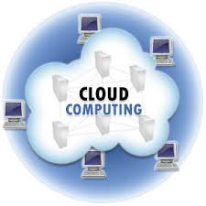
Cloud Computing:
On-Demand Self Service
Broad Network Access
Resource Pooling
Rapid Elasticity
Measured Service
Five Essential characteristics
Three Service models
Software as a Service (SaaS)
Platform as a Service (PaaS)
Infrastructure as a Service (IaaS)
Cloud Computing is a model for enabling ubiquitous, convenient, on demand access to a shared pool of configurable computing resources (networks, servers, storage, applications and services) that can be rapidly provisioned and released with minimal management effort or service provider interaction
Four Deployment models
Private Cloud
Community Cloud
Public Cloud
Hybrid Cloud

Slide 3
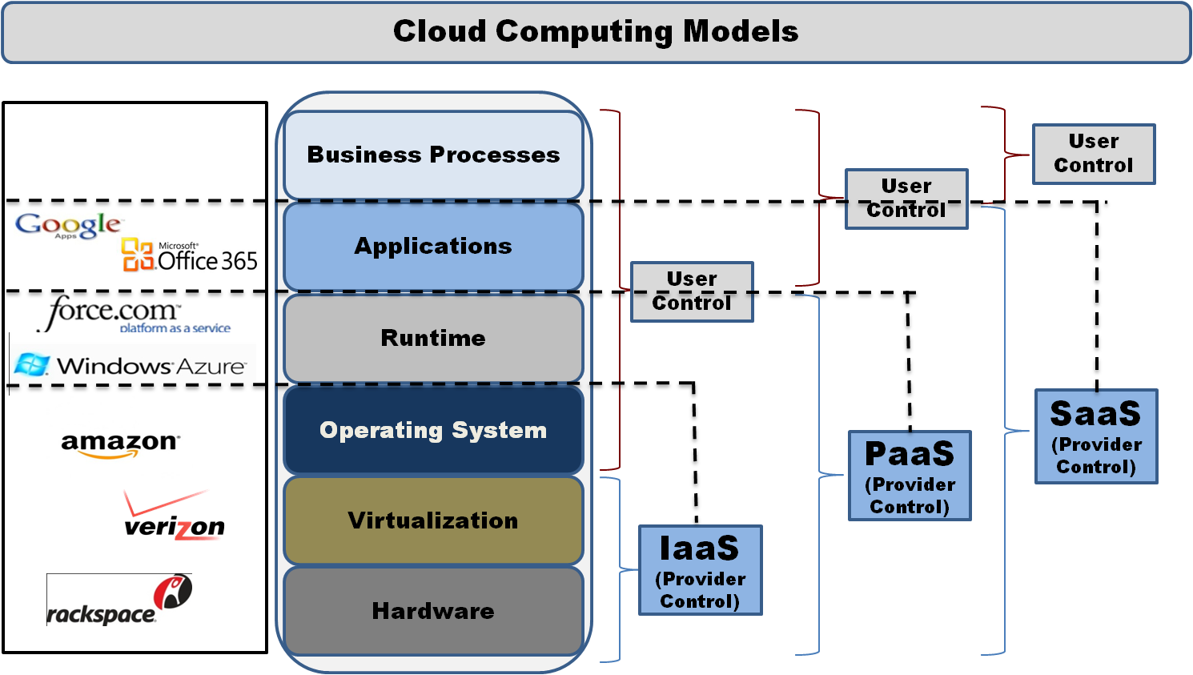
Cloud Computing Models

Slide 4
Security concerns in cloud

Slide 5
Vulnerabilities in Cloud
Vulnerability | Description | Layer
Insecure interfaces and APIs | Weak credentials, Insufficient authorization checks, Insufficient input data validation | SPI
Unlimited allocation of resources | Inaccurate modelling of resources usage can lead to over provisioning | SPI
Data related | Data colocation with intruders, in different jurisdictions, Incomplete data wipe, data backup by untrusted providers, | SPI
Virtual machines | Uncontrollable migration, uncontrolled snapshots, Visibility of VMs IPs | I
Virtual networks | Sharing of virtual bridges by several VMs | I

Slide 6
Combat the Security Challenges
Security challenges for applications in the cloud
Multiple logins/ Weak security:
Users have different credentials for each cloud application, stored natively in those applications.
Users tend to create weak passwords when there are too many passwords to remember
This compromise the security when application is accessible from outside the firewall
Manual Provisioning:
Users access is not automatically provisioned/ de-provisioned with cloud applications
Users access remains even after they are not in the organization
This increase the cost of administering users due to lack of automated process
Lack of visibility:
There is no centralized view of ‘who has access to what’ when users access cloud
This results in SaaS users lacking oversight or authorization leading to sensitive data leakage and compliance risks
The traditional solutions have to retrieve access logs from each cloud apps and have them consolidate and correlated for visibility
Single factor authentication:
In case of on premise applications, a single factor authentication may be sufficient
Stronger authentication is required for critical applications in cloud so as to have a higher confidence in identity proofing and user validation

Slide 7
Intel’s Proposition for Cloud Security

Slide 8
Security solution features
Control:
Manages the identity lifecycle with policy driven automatic account provisioning/ de-provisioning to cloud apps
Minimizes the risk of unauthorized access by enforcing user identity and context based authorization, eliminating passwords through federation trust
Visibility:
Centralized management and reporting of user access. Monitors users, administrators and API access activity
Strong authentication:
Built in OTP solution for multi-factor authentication
Compliance:
Maintains audit records of identity life-cycle events and correlates user cloud activity with on premise logs for compliance
Detecting and deleting orphan accounts
Connectors:
In-built Identity and cloud connector with a choice of authentication sources (LDAP, RDBMS, SAML, Social networks, etc).
Cloud connectors to allow federated SSO and integration with IdM systems with support of standards like SAML, OAuth and OpenID.

Slide 9
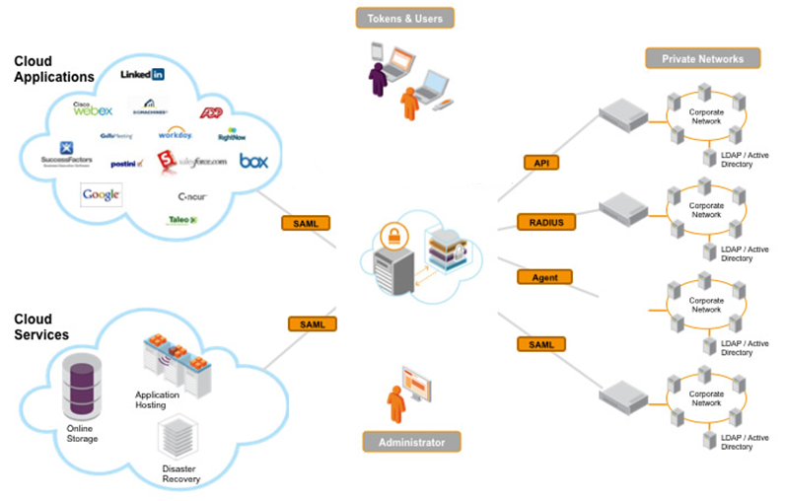
Intel’s Proposition
Solution combining user account provisioning, cloud federation/ SSO and strong multi factor and context based authentication
Intel Federated IAM

Slide 10
Intel’s Proposition (Cont.)
Intel IAM
Provisioning
SSO
OTP
STS
Compliance/ Governance
Provisioning
Distribution, Synchronization, Compilation and follow-up of identity and attribute information
Federation/ SSO
Standard based federation to cloud apps for both IdP or SP scenarios
OTP
Two factor strong authentication based on static/ dynamic risk factors
STS
Brokered authentication using STS based on SAML standards for identity federation
Compliance
Better control over user’s access through monitoring and role management

Slide 11
Intel’s Proposition (Cont.)
Intel IAM provisioning module
Google
Provisioning Policy
Salesforce.com
IdM/ AD
IAM Provisioning module
Dynamic Perimeter
Provisioning
Accounts
Cisco WebEx
Enterprise Perimeter
Box
Bring secured, monitored cloud endpoints under enterprise IT control
Two-way provisioning: Connected systems are both source and receiver of identity & attribute information
Policy based: Leverage the rules/ policies within company regarding handling of identity & attribute information
Connection: Communicate by web service or directly with all modern databases/ AD/ LDAP

Slide 12
Intel’s Proposition (Cont.)
Intel IAM Federation/ SSO module
Google
Provisioning Policy
IdM/ AD
Salesforce.com
IAM SSO module
Dynamic Perimeter
Portal/ Apps
Internal session
Provisioning
Accounts
Cisco WebEx
SSO Request
User browser
Enterprise Perimeter
Box
Bring secured, monitored cloud endpoints under enterprise IT control
Single Sign On: Seamless sign on for enterprise users to cloud applications
Connectors: Connectors to common identity sources (AD/ LDAP) and to SaaS/ PaaS platforms
Control: Web based administrative console to create, monitor, and control SSO access
Federation: Federated authentication and authorization based on SAML, XACML, OAuth, OpenID
Risk based access: Transaction is assessed using static/ contextual. The risk assessment determines whether a user’s request to access information should be permitted, denied or permitted with some further authentications.

Slide 13
Intel’s Proposition (Cont.)
Intel IAM Federation/ SSO module
Identity Connectors
Cloud Connectors
Ability to connect to authentication sources
Authentication sources include: LDAP, JDBC database, AD, OpenID, Social network, SAML, X.509, OTP
Retrieve user information from IdP to cloud IM for SSO
Connectors to enable trusted federation with SaaS
Cloud connectors like: SAML, Proprietary SaaS connectors, Token based
Application Adapter
Cloud Authenticators
Used in a service provider mode
Internal apps can be integrated for SSO by token approach
Users choose the IdP they want to authenticate with for accessing the application
Intel IAM OTP module
Authentication: Leverage existing enterprise identity repository for two-factor authentication
Tokens: OTP server delivers software tokens to desktops/ mobiles
Dynamic enforcement: Security policy is dynamically enforced on factors: Geo-location, IP address, etc

Slide 14
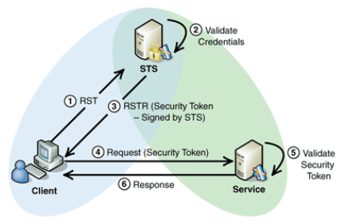
Intel’s Proposition (Cont.)
Intel IAM Flexible STS module
Flexible STS: Validate and issue a variety of identity formats between applications and services
Interoperability: Ties together applications running on disparate OS platforms
Identity mediation: Identity mediation service for establishing trust and facilitating compliance by managing identities
STS module use case
Client sends an authentication request with accompanying credentials to STS
STS verifies and issues a security token to assert client’s authentication with STS
Client sends the token to the web service/ SaaS application
SaaS verifies the token and authenticates the client into cloud

Slide 15
Intel’s Proposition (Cont.)
Intel IAM compliance/ governance module
Establish better control of user’s access
Understand who users are, and their roles and responsibilities
Ensure authorised access to applications
Define processes for review, approval, exception, & remediation
Active Directory Integration: In-built AD connector, transparently communicates with AD
Identity collection and unification: Unified view of users. Collection, aggregation and correlation of identities with account, group and role
Access reviews: Who access what, ensure access is on user profile, enable policies, periodic reviews
Role management: Role creation, discovery, modeling, suggestion and reviews
Location Independence: Seamless management of access across the application infrastructure
Reporting and Analytics: Standard reports on user activity, application utilization, password strength alerts, application access requests and access reviews
Policy management: Library of policies, control standards, procedures and assessments mapped to regulatory guidelines
Compliance measurement: Automated assessment of cloud security controls implementation
Identity collection and unification: Unified view of users. Collection, aggregation and correlation of identities with account, group and role
Access reviews: Who access what, ensure access is on user profile, enable policies, periodic reviews
Role management: Role creation, discovery, modeling, suggestion and reviews
Location Independence: Seamless management of access across the application infrastructure
Reporting and Analytics: Standard reports on user activity, application utilization, password strength alerts, application access requests and access reviews

Slide 16
Thank You

