Slide 1
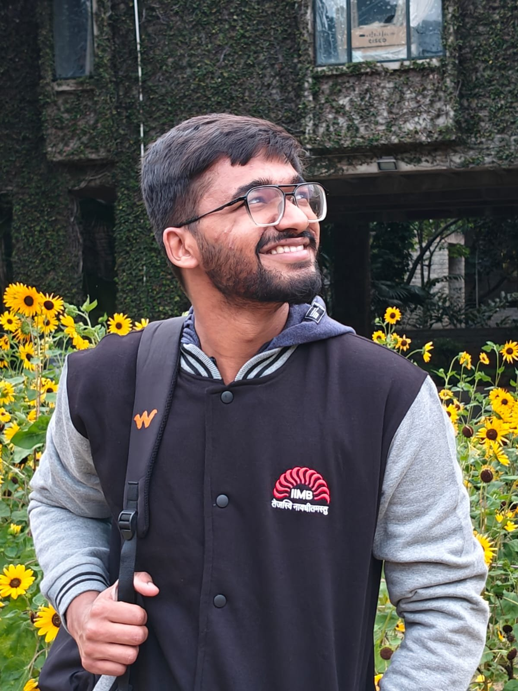

e-START Course 2 · Disaster Resilience & Community Health
Harsh Makhija
Exploring impact
through curiosity.
Indian Institute of Management Bangalore (IIMB)
Jaipur, Rajasthan · Studying in Bengaluru

Slide 2
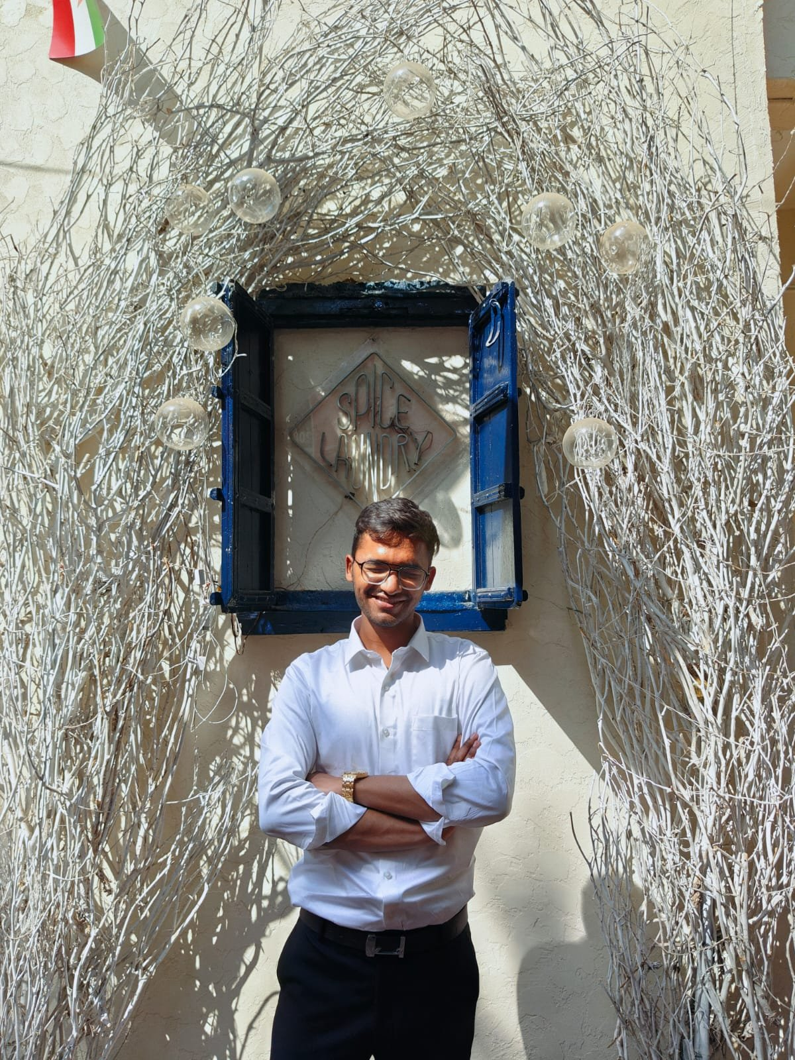




WHO I AM
Academic
BBA Digital Business & Entrepreneurship, IIMB
Impact
Founder — Aham Aatm Deepah Association
Builder
Co-founded Last Life e-sports · 12K+ users
Tech
AI dashboards, Git, No-code/Low-code

Slide 3
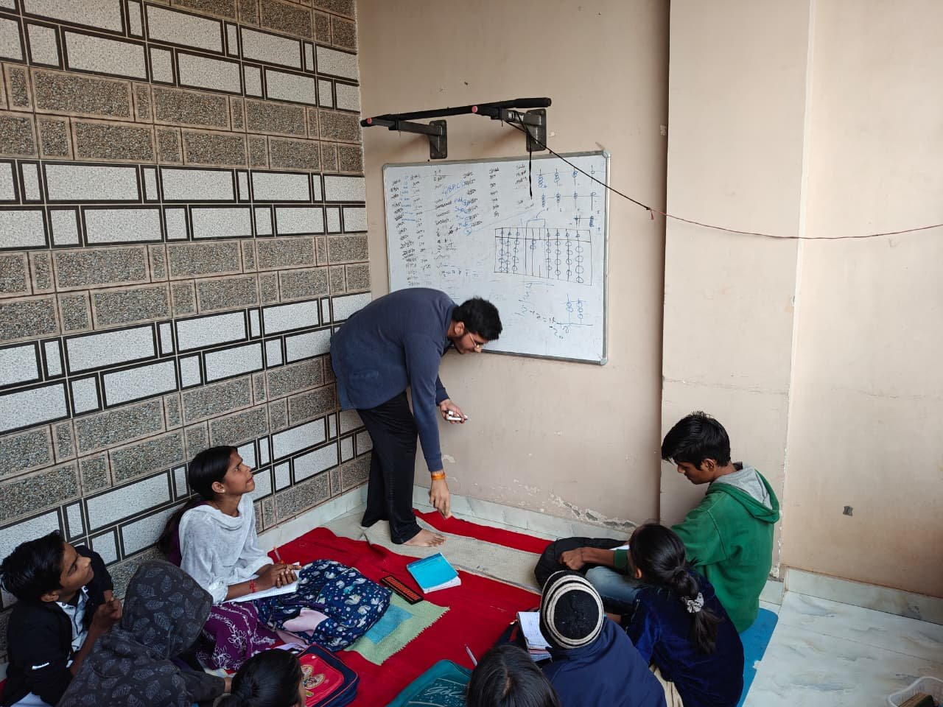
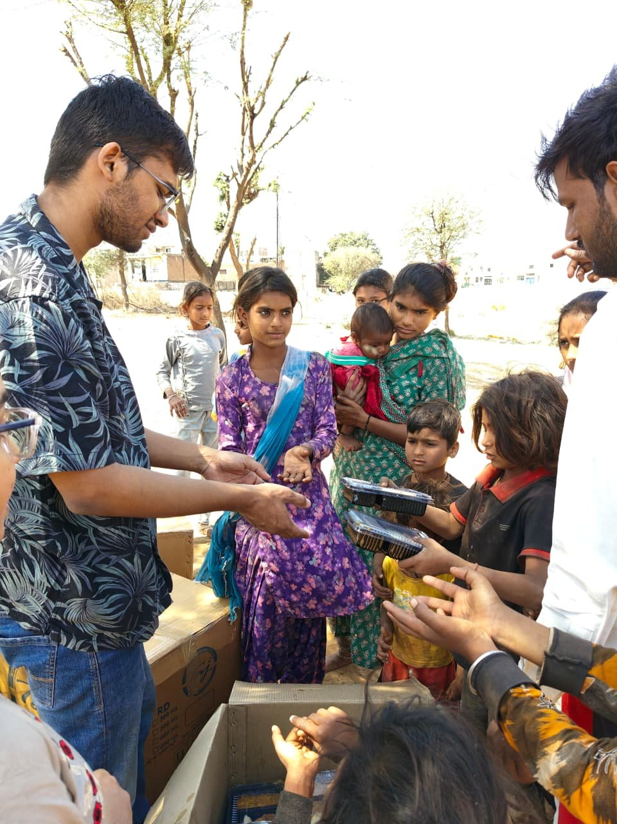
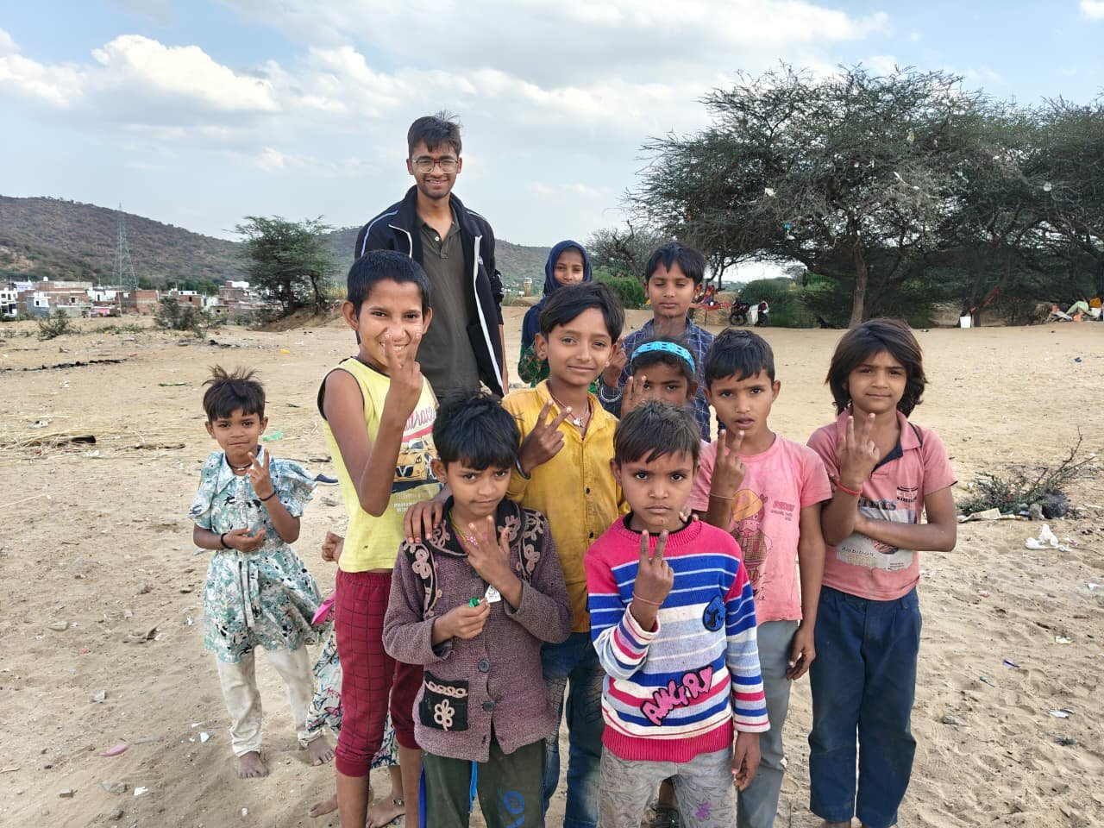
WHERE CURIOSITY BECOMES ACTION
Aham Aatm Deepah Association — my NGO in Rajasthan
📚 Shiksha Project
🤝 Healing Society
✌️ Community Bond
Teaching kids under open skies
Food & hygiene drives in need
Friendships built on trust

Slide 4


MY DUAL CONTEXT
Two very different Indias shaped how I see problems.
JAIPUR, RAJASTHAN
BENGALURU, KARNATAKA
— The arid north — desert heat, scarce water
— Heritage-rich but resource-constrained
— Saw firsthand: community vulnerability during crisis
— Home of my NGO & ground-level work
— India's tech capital — rapid urbanisation
— Flash floods, lake crises, density challenges
— Where I study innovation & business systems
— Where I ask: can tech solve what growth breaks?
Curiosity: What does resilience actually look like across different geographies?

Slide 5



Let's Connect!
Happy to exchange ideas, experiences & perspectives 🌏
Harsh Makhija
BBA DBE · IIM Bangalore
linkedin.com/in/harshmakhija24
harsh.makhija24@iimb.ac.in
@imperfectarjuna

