Slide 1
JAVA PROJECT- PONG GAME
Ashish Bhatia - 17IT201
Harsh Maru - 17IT215
Sachin K. Prajapati- 17IT234
Shivam Kumar - 17IT240

Slide 2
UML DIAGRAMS
Class Diagram
Use Case
Collaboration
Activity Diagram
State Diagram
Sequential Diagram
Object Diagram

Slide 3
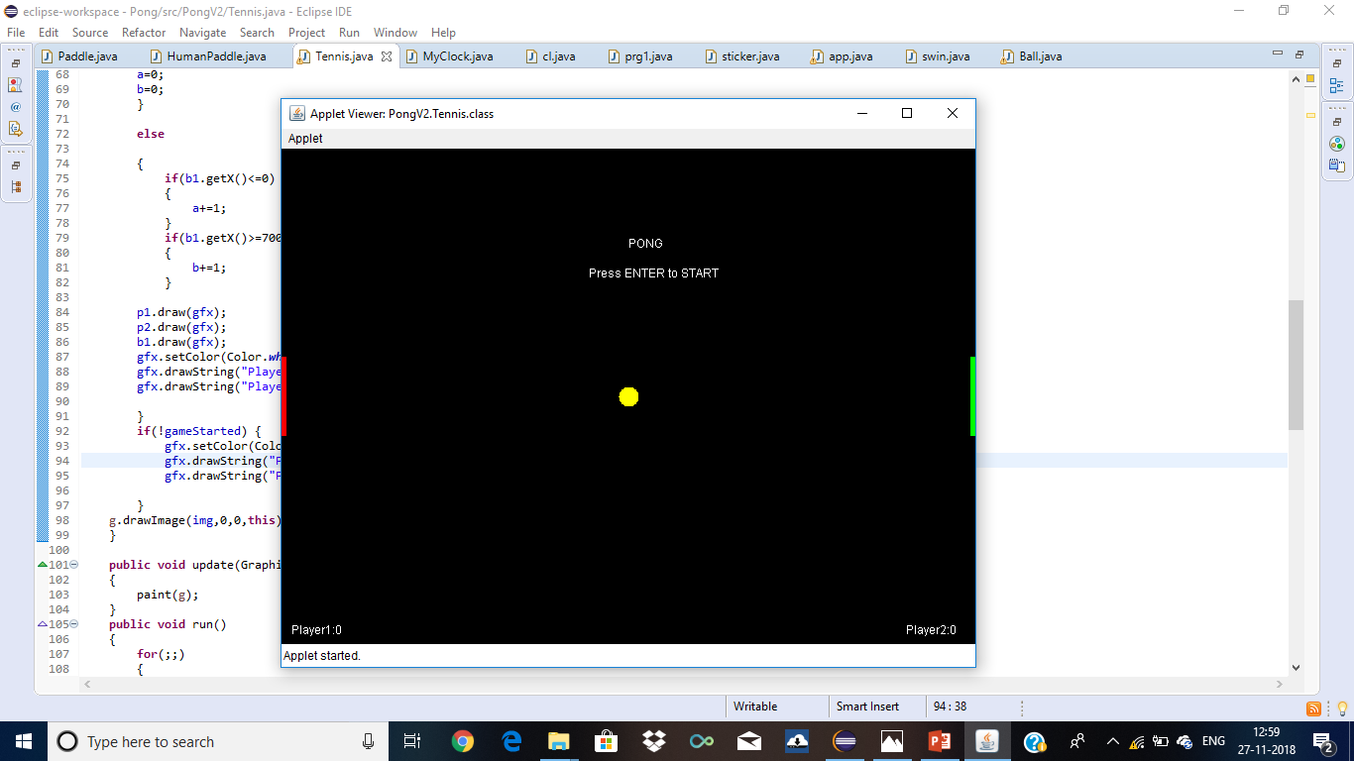
Starting Image

Slide 4

Game Started

Slide 5
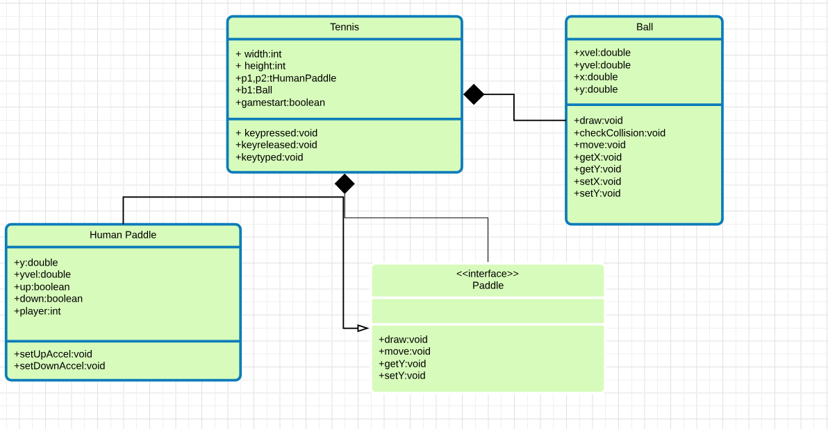
Class Diagram

Slide 6
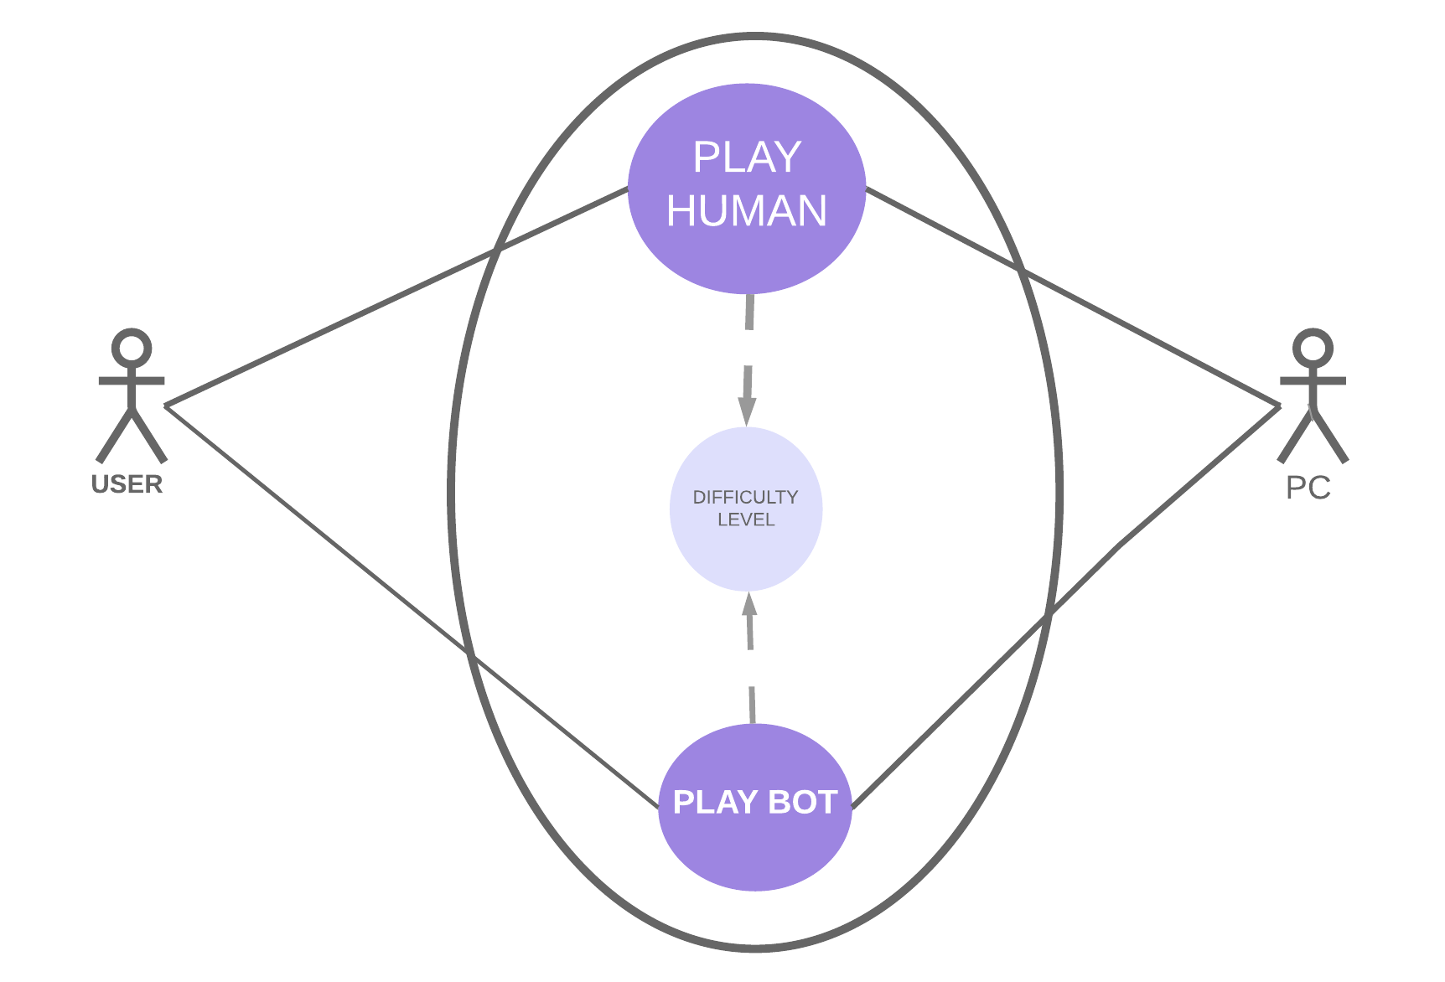
Use Case Diagram

Slide 7
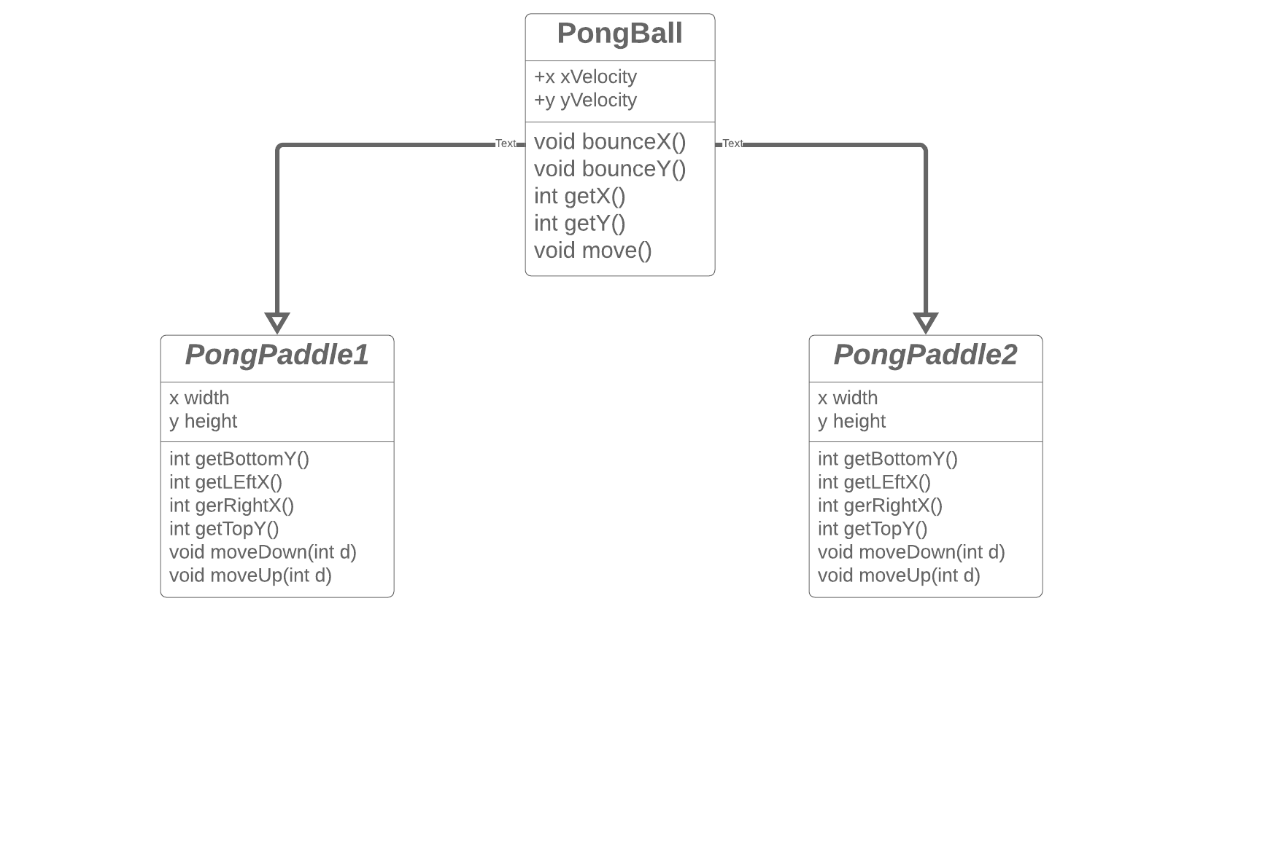
Object Diagram

Slide 8
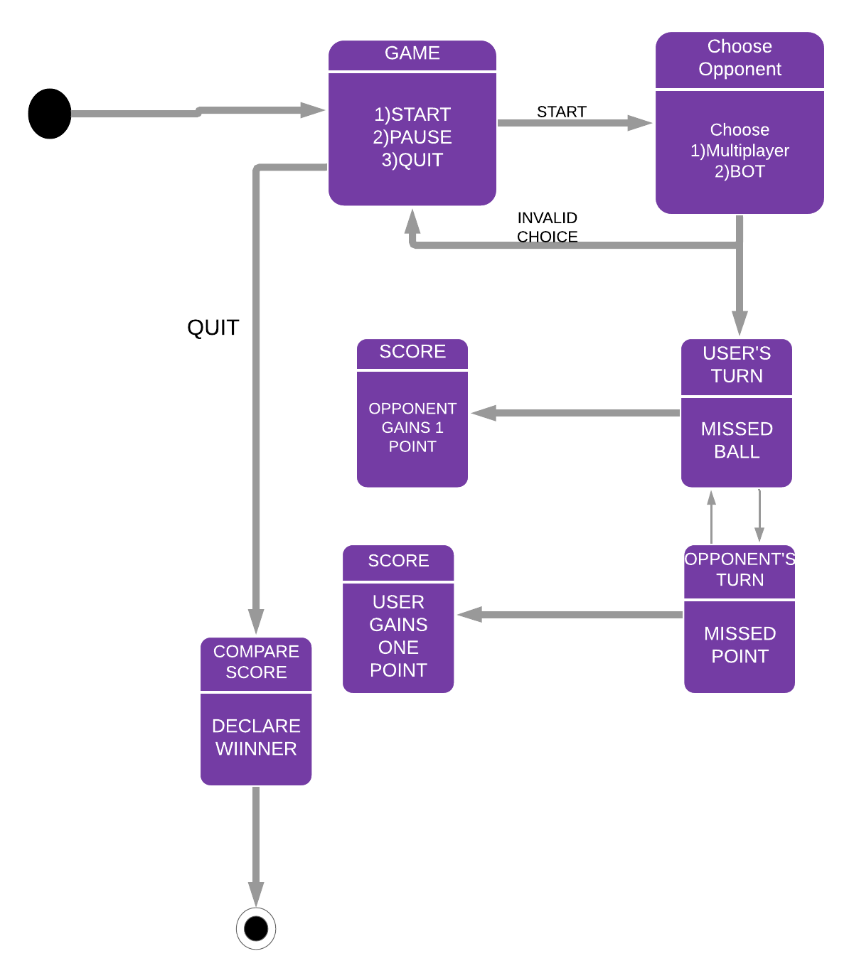
State Diagram

Slide 9
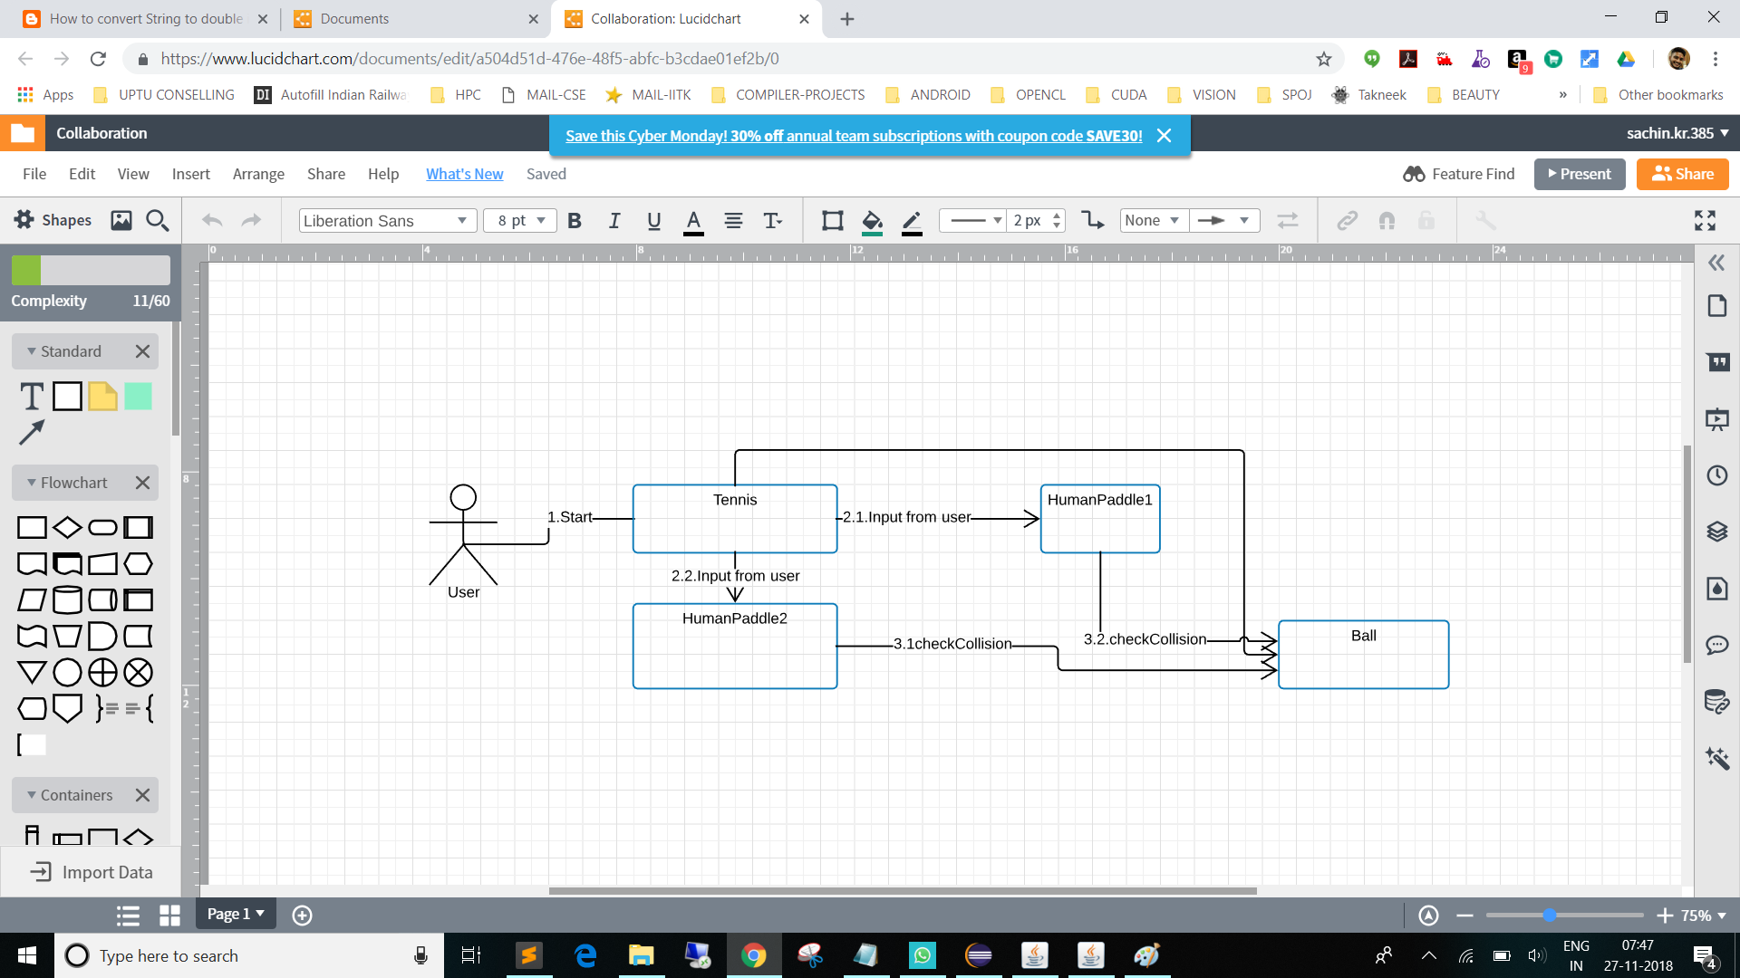
Collaboration Diagram

Slide 10
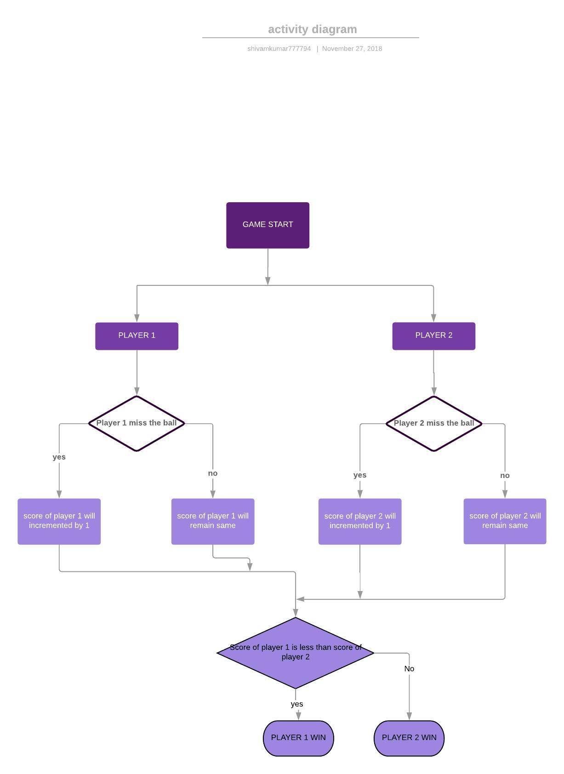
Activity Diagram

Slide 11
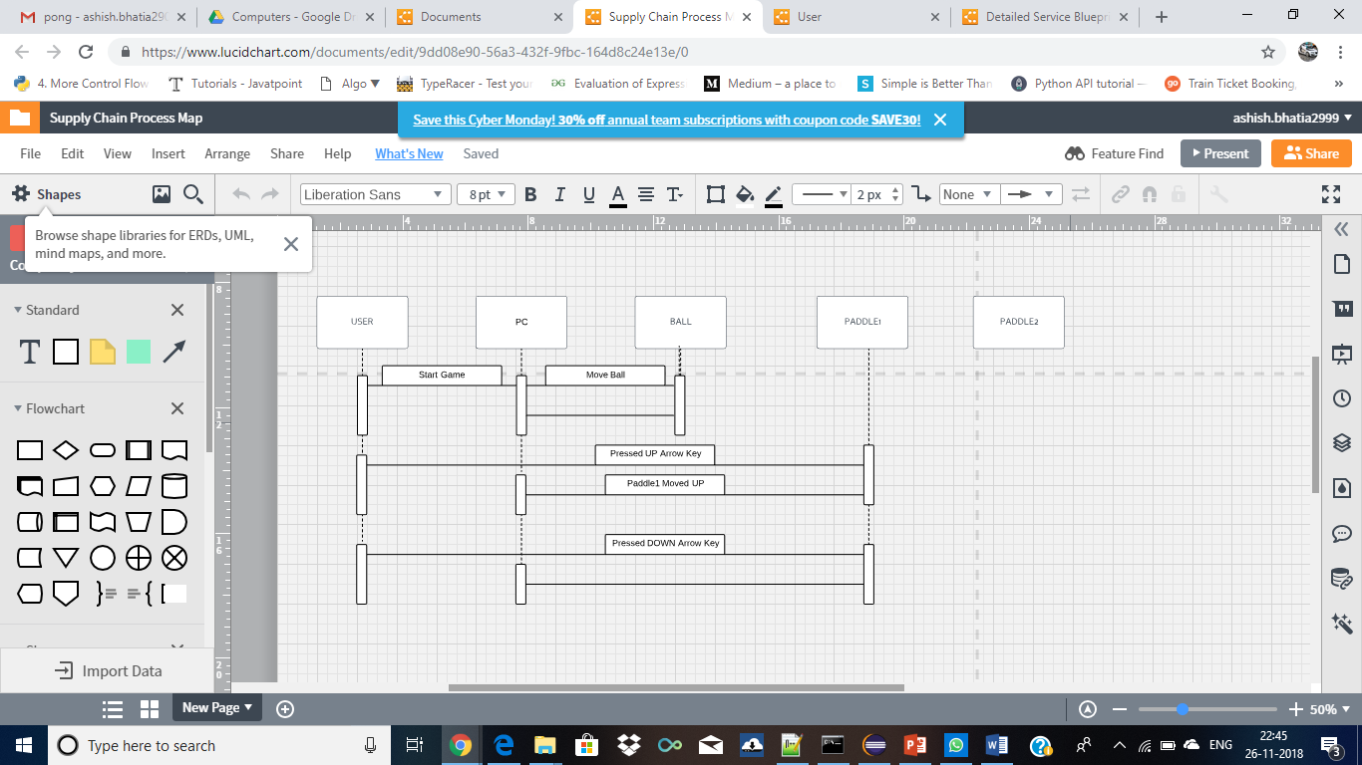
Sequence Diagram

Slide 12
Thank You!!!

