Slide 1

Web Crawler using BASH
Akash Rao - 17IT205
Harsh Maru - 17IT215
Pranav P - 17IT229
Shashank KV - 17IT140

Slide 2
HISTORY OF WEB CRAWLING
First Web Crawlers
Here’s a brief history of the first generation of web crawlers.
1. RBSE spider – developed and used by the NASA funded Repository Based Software Engineering (RBSE) program in the year 1994, at the University of Houston, Clear Lake. It was built by David Eichmann of NASA using the languages Oracle, C, and wais. The primary purpose of this crawler was indexing and statistics source. At the time when this crawler was built, size of the web was just about 100,000 web pages.
2. WebCrawler – created by Brian Pinkerton of the University of Washington and launched on April 20, 1994, WebCrawler was the first search engine that was powered by a web crawler. According to Wikipedia, WebCrawler was the first web search engine to provide full text search.
3. Archive.org – Internet Archive, also known as The Wayback Machine, used Heritrix as its web crawler for archiving the entire web. Written in Java, it has a free software license accessible either via a web browser or through a command line tool. It is also worth noting that Heritrix is not the only crawler that was used in building the Internet Archive. In fact, most of the data has been donated by Alexa Internet, which crawls data for its own purposes with a crawler called ia_archiver.

Slide 3
Second Generation Crawlers
The second generation crawlers are either a) focused crawlers or b) large scale crawlers. Focused crawlers were site specific, personally customized and relocatable crawlers such as SPHINX and Mercator. Search engine providers such as Google, Lycos and Excite developed crawlers that were capable of global-scale crawling and indexing of data.

Slide 4
Topic
Implementing a BASH Web Crawler to crawl through a given Wikipedia url and crawl through all links in the given Wikipedia url and store the web pages.
After processing the stored web pages and extracting the words inside each file and saving them in form of an indexer in which each file has an alphabetically sorted list of words in which each line has the word and the number of times that word has shown up in that file.
Merkle Quadtree

Slide 5
PROJECT
PART I – Web Crawler
Web Crawling is an Internet BOT that systematically browses the World Wide Web ,typically for the Web Indexing.
PART – II - Indexer
After crawling web pages and saving them on disk,we process the files and extract the words inside each file and save them in form of an indexer in which each file has an alphabetically sorted list of words in which each line has the word and the number of times that word has shown up in that file.

Slide 6
Web Crawler
Web crawler, sometimes called a spider or spiderbot and often shortened to crawler, that systematically browses the World Wide Web, typically for the purpose of Web indexing (web spidering).
Web search engines and some other sites use Web crawling or spidering software to update their web content or indices of others sites' web content. Web crawlers copy pages for processing by a search engine which indexes the downloaded pages so users can search more efficiently.
Crawlers consume resources on visited systems and often visit sites without approval. Issues of schedule, load, and "politeness" come into play when large collections of pages are accessed. Mechanisms exist for public sites not wishing to be crawled to make this known to the crawling agent. For example, including a robots.txt file can request bots to index only parts of a website, or nothing at all.

Slide 7
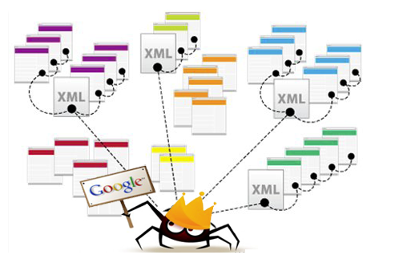

Slide 8
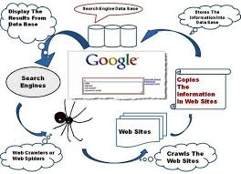

Slide 9
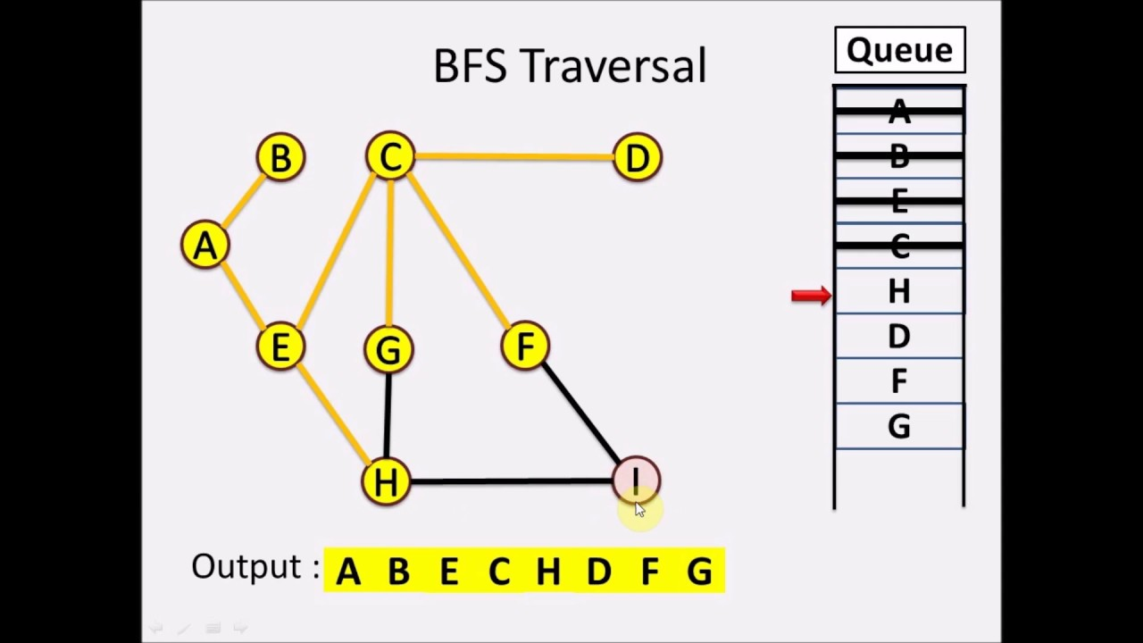
Breadth First Search
Implementation of Breadth First Search to crawl through the given Wikipedia BFS.

Slide 10
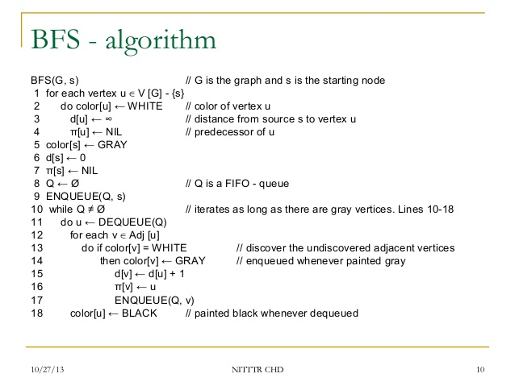

Slide 11
USES
Editor’s use programs to find repetitive words as repetition of words creates a hesitation to the reader and for an average reader repetition will be boredom and will preferably discontinue to read. Repetition leads loss of impact of individual words. It weakens the body of writing.
Such programs are used in web app penetration testing,finding malicious chat rooms.
Check the authencity of Wikipedia pages
Build celebrity rankings.
Automatic Site Maintenance – Block and navigation errors
SEO- Search Engine Optimization

Slide 12
Thank You!!!

