Slide 1
Online Examination System
Presented by:-
Harsh Kumar
Mca-II
roll No- 413

Slide 2
Introduction
The Online Examination System will permit to take and give online examination and maintaining master information and generating various reports of test. The main users of the project are Student and System Administrator. From an end-user perspective, the Examination System Project consists of two functional elements:
Member module for giving examination and checking results.
Administration module for Manging members, examination, question bank and view the reports.

Slide 3
Objective
To reduce the hectic job of assessing the answers given by the candidates manually.
To allow faculty to create tests and answer key.
To allow automatic grading and manual grading which can be recorded per test.

Slide 4
Project Scope
Online Examination System is designed for Institutes like schools, colleges, universities and training institutes.
It reduces the time of taking examinations of the Students manually.
Allow students to see or display his answers after the exam is finish.
The type of questions is only multiple choice.

Slide 5
Software requirements
Language: Java 8 or above
Database: SQLite
IDE: IntelliJ IDEA
Libraries: Jfoneix, FontAwesomeFx, JavaFX
Tool: SceneBuilder

Slide 6
Modules
Login Module
In this module user can login to the Application by entering login ID and password. After Login the system links to Profile page.
Student login module
Administrator login module
Dashboard module
Only Administrator and Examiner can access this module. Here administrator or examiner can view student details, Marks report, examination report, etc.

Slide 7
Modules(contd.)
3. Question Bank Module
Questions bank will have a program to add questions of respective subjects. Here Examiner can upload questions for Quiz.
4. Results module
In this module students and examiners will get instant results. Results will be displayed in charts as soon as the test finishes.

Slide 8
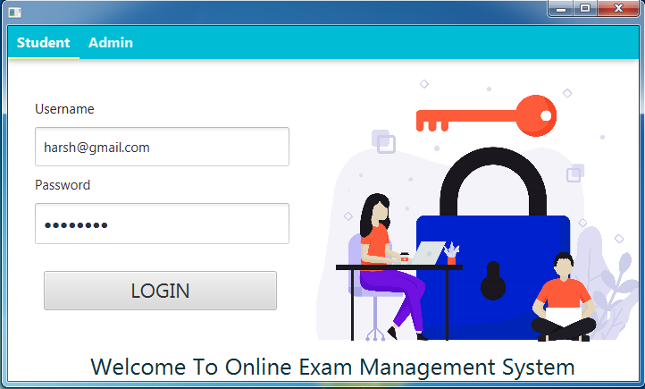
Screenshots
Student Login Page

Slide 9
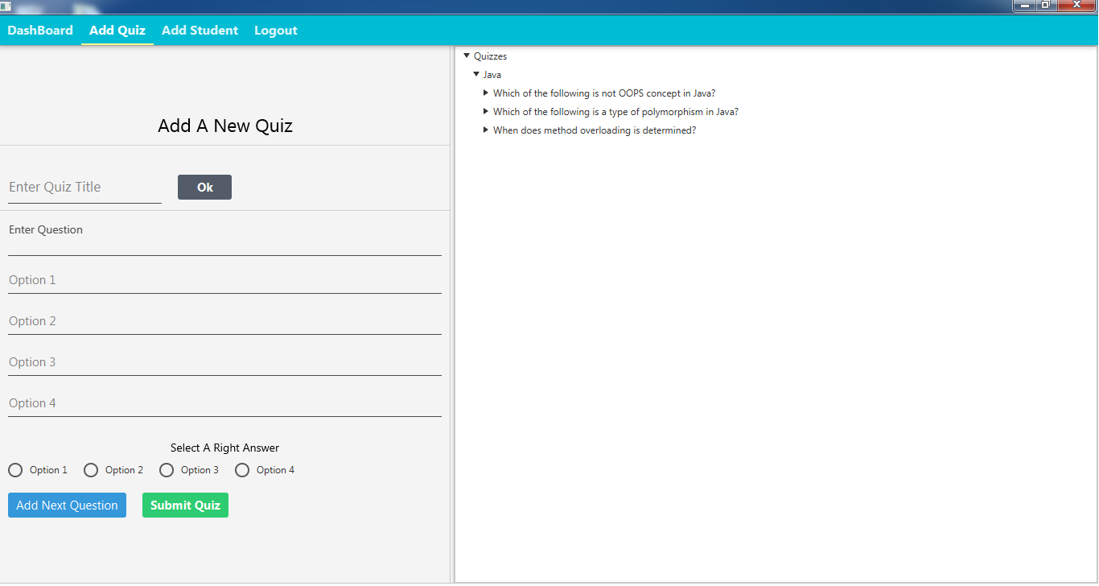
Admin Module: Add Quiz

Slide 10
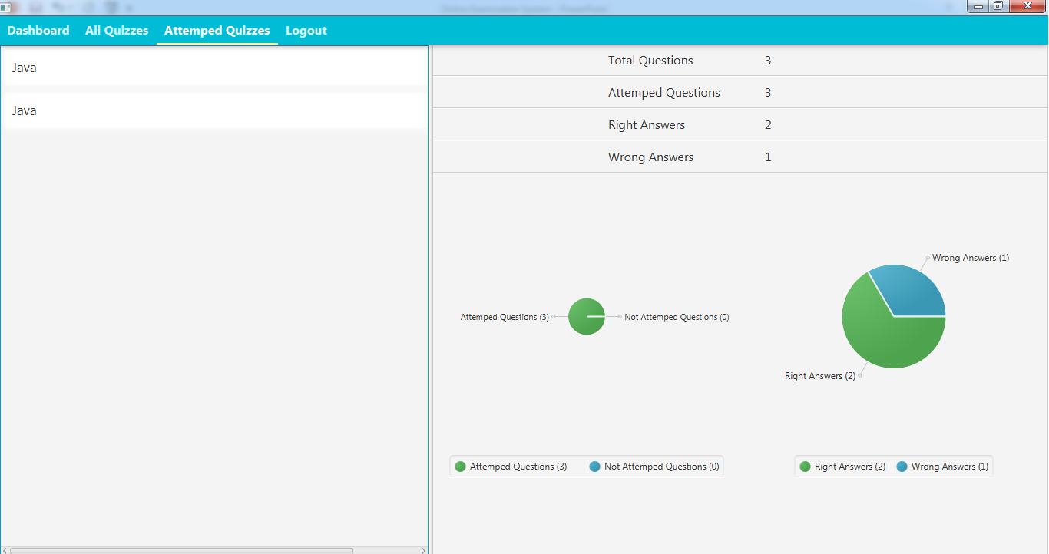
Student Module: Attempted Quiz

Slide 11
Limitations
In the case of system crash exams will be not taken.
It creates problem if internet connection is slow.

Slide 12

Thank You
Follow my Repository
on

