Slide 1
Servlets, Sessions, and Cookies

Slide 2
Cookies and Privacy
Cookies are good
  Remember who you are and your preferences
  Session tracking
Cookies are bad
  When developer is not careful
  (store password, credit card info, etc…)
  When people abuse them
  (track information about you)

Slide 3
The Big Picture
Making Web Applications Better
For the Developer
  More features, better API, ...
  Time-To-Market (beat your competitors)
For the End-User
  Better Continuity
  Better User Experience

Slide 4
Why Java Servlets Instead of CGI?
Efficient, Convenient, Powerful, Portable, Secure, Inexpensive
  Lightweight threads instead of OS threads created
  Single copy of code brought into memory for all threads versus per thread
  Data (session state) can be stored across threads within servlet container
  Java is portable and secure
  Requires little expense once servlet container integrated with web server

Slide 5
Servlet Structure
Java Servlet Objects on Server Side
Managed by Servlet Container
  Loads/unloads servlets
  Directs requests to servlets
Request → doGet()
Each request is run as its own thread

Slide 6
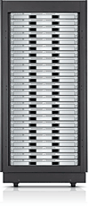

Web App with Servlets
GET …
Servlet
doGet()
…
…
HEADERS
BODY
Servlet Container

Slide 7
5 Simple Steps for Java Servlets
1. Subclass off HttpServlet
2. Override doGet(....) method
3. HttpServletRequest
  getParameter("paramName")
4. HttpServletResponse
  set Content Type
  get PrintWriter
  send text to client via PrintWriter
5. Don't use instance variables

Slide 8

Servlet/JSP Container
Java Servlet 2.4
JavaServer Pages 2.0
Tomcat is the basis for the official reference implementation

Slide 9
HelloWorld.java
import java.io.*;
import javax.servlet.*;
import javax.servlet.http.*;
public class HelloWorldExample extends HttpServlet {
public void doGet(HttpServletRequest request,
HttpServletResponse response)
throws IOException, ServletException
{
response.setContentType("text/html");
PrintWriter out = response.getWriter();
out.println("<html>");
out.println("<head>");
out.println("<title>Hello World!</title>");
out.println("</head>");
out.println("<body bgcolor=\"white\">");
out.println("<h1>Hello World!</h1>");
out.println("</body>");
out.println("</html>");
}
}

Slide 10
RequestHeaderExample.java
import java.io.*;
import java.util.*;
import javax.servlet.*;
import javax.servlet.http.*;
public class RequestHeaderExample extends HttpServlet {
public void doGet(HttpServletRequest request,
HttpServletResponse response)
throws IOException, ServletException
{
response.setContentType("text/html");
PrintWriter out = response.getWriter();
Enumeration e = request.getHeaderNames();
while (e.hasMoreElements()) {
String name = (String)e.nextElement();
String value = request.getHeader(headerName);
out.println(name + “ = “ + value );
}
}
}

Slide 11
Servlet Lifecycle
(Creation)
Single instance created
init() method called
You can override init() in your subclass of HttpServlet to do some initial code....
init() is NOT called again on further requests

Slide 12
Servlet Lifecycle
(Service Method)
On each request, the server spawns a new thread and calls service()
service() checks HTTP request type and calls appropriate doXXXX (Get, Post, Put...)
don't override service (unless you really know what you're doing)

Slide 13
Servlet Lifecycle
(doGet(), doPost())
Real meat of the web app is here
doPost() can call doGet(), or viceversa
no doHead()... system uses headers of doGet() result

Slide 14
Servlet Lifecycle
(destroy())
For some reason (servlet idle, etc) the server may want to remove the servlet from memory
destroy() allows you to close DB connections, wrap up, etc...
Don't count on destroy to write persistent state (server may crash before you ever get here!)

Slide 15
Accessing Request Components
getParameter("param1")
getCookies() => Cookie[]
getContentLength()
getContentType()
getHeaderNames()
getMethod()

Slide 16
Environment Variables
JavaServlets do not require you to use the clunky environment variables used in CGI
Individual functions:
  PATH_INFO req.getPathInfo()
  REMOTE_HOST req.getRemoteHost()
  QUERY_STRING req.getQueryString()
  …

Slide 17
Setting Response Components
Set status first!
  setStatus(int)
HttpServletResponse.SC_OK...
  sendError(int, String)
  sendRedirect(String url)

Slide 18
Setting Response Components
Set headers
  setHeader(…)
  setContentType(“text/html”)
Output body
  PrintWriter out = response.getWriter();
  out.println("<HTML><HEAD>...")

Slide 19
J2EE API
http://java.sun.com/j2ee/1.4/docs/api/index.html
HttpServletResponse, HttpServletRequest, HttpServlet, HttpSession...

Slide 20
Developing Servlets
(Start w/ baby steps)
Install Tomcat
Run Tomcat
Run examples

Slide 21
Creating Your Own Servlet
Write new servlet (e.g. Hi.java)
Make sure Tomcat jar files are in your classpath
Compile servlet (javac Hi.java)
Edit web.xml
Restart the Tomcat Server/Servlet Container
http://<host>:8080/<webappname>/servlet/Hi

Slide 22
Debugging
use out.println to the html
print to a socket on localhost...

Slide 23
Continuity Problem
Session: A user sits down, enters a website, does some work, exits
HTTP Stateless
  Does Keep-Alive Help?

Slide 24
Client vs. Server Side
Client Side
  Store Variable=Value Bindings in HTML Page, or Cookies
Server Side
  Store Variable=Value Bindings in DB/Server Memory
  Store Session ID on Client Side, to identify Client

Slide 25
Three Typical Solutions
Cookies
URL Rewriting
Hidden Fields

Slide 26
HTTP Cookies Grab-bag
Lifetime
  Session – not written to file system
  Persistent – written to user preferences
Only returns cookie to requesting domain
Cookie must be specified by content
No special characters in cookie

Slide 27
HTTP Cookies
1239865610
String sID = makeUniqueString();
Hashtable sessionInfo = new Hashtable();
Hashtable globalTable = findTableStoringSessions();
globalTable.put(sID, sessionInfo);
Cookie sessionCookie = new Cookie("JSESSIONID", sID);
sessionCookie.setPath("/");
response.addCookie(sessionCookie);

Slide 28
HTTP Cookies
1239865610
String sID = makeUniqueString();
Hashtable sessionInfo = new Hashtable();
Hashtable globalTable = findTableStoringSessions();
globalTable.put(sID, sessionInfo);
Cookie sessionCookie = new Cookie("JSESSIONID", sID);
sessionCookie.setPath("/");
response.addCookie(sessionCookie);

Slide 29
HTTP Cookies
1239865610
String sID = makeUniqueString();
Hashtable sessionInfo = new Hashtable();
Hashtable globalTable = findTableStoringSessions();
globalTable.put(sID, sessionInfo);
Cookie sessionCookie = new Cookie("JSESSIONID", sID);
sessionCookie.setPath("/");
response.addCookie(sessionCookie);

Slide 30
HTTP Cookies
1239865610
String sID = makeUniqueString();
Hashtable sessionInfo = new Hashtable();
Hashtable globalTable = findTableStoringSessions();
globalTable.put(sID, sessionInfo);
Cookie sessionCookie = new Cookie("JSESSIONID", sID);
sessionCookie.setPath("/");
response.addCookie(sessionCookie);

Slide 31
HTTP Cookies
1239865610
JSESSIONID → 1239865610
String sID = makeUniqueString();
Hashtable sessionInfo = new Hashtable();
Hashtable globalTable = findTableStoringSessions();
globalTable.put(sID, sessionInfo);
Cookie sessionCookie = new Cookie("JSESSIONID", sID);
sessionCookie.setPath("/");
response.addCookie(sessionCookie);

Slide 32
HTTP Cookies
1239865610
JSESSIONID → 1239865610
PATH → /
String sID = makeUniqueString();
Hashtable sessionInfo = new Hashtable();
Hashtable globalTable = findTableStoringSessions();
globalTable.put(sID, sessionInfo);
Cookie sessionCookie = new Cookie("JSESSIONID", sID);
sessionCookie.setPath("/");
response.addCookie(sessionCookie);

Slide 33
HTTP Cookies
1239865610
Set-Cookie: JSESSIONID=1239865610; path=/;
String sID = makeUniqueString();
Hashtable sessionInfo = new Hashtable();
Hashtable globalTable = findTableStoringSessions();
globalTable.put(sID, sessionInfo);
Cookie sessionCookie = new Cookie("JSESSIONID", sID);
sessionCookie.setPath("/");
response.addCookie(sessionCookie);

Slide 34
HTTP Cookies
Cookie: JSESSIONID=1239865610;
// On request
String sID = request.getCookie("JSESSIONID");
Hashtable globalTable = findTableStoringSessions();
Hashtable sInfo = (Hashtable) globalTable.get(sID);

Slide 35
HTTP Cookies
Cookie: JSESSIONID=1239865610;
// On request
String sID = request.getCookie("JSESSIONID");
Hashtable globalTable = findTableStoringSessions();
Hashtable sInfo = (Hashtable) globalTable.get(sID);

Slide 36
HTTP Cookies
1239865610
Cookie: JSESSIONID=1239865610;
// On request
String sID = request.getCookie("JSESSIONID");
Hashtable globalTable = findTableStoringSessions();
Hashtable sInfo = (Hashtable) globalTable.get(sID);

Slide 37
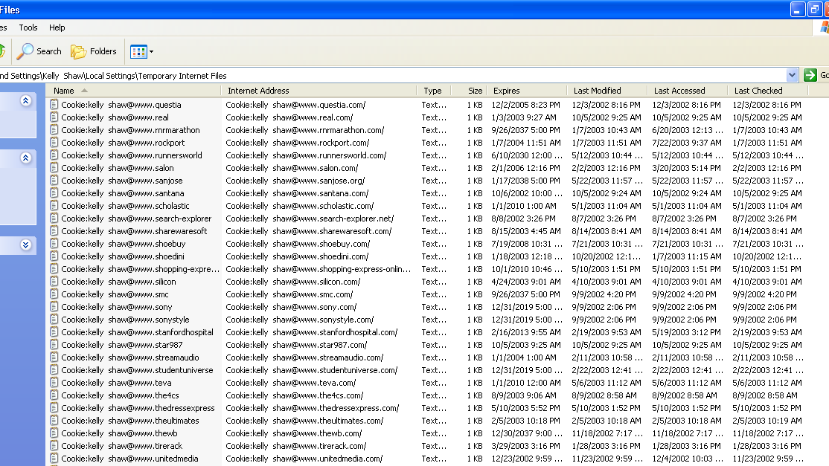
In-Browser Cookie Management

Slide 38
URL Rewriting
Rewrite all URLs in response to contain SessionID
  http://foo.com/servlet/cart?id=123xyz
Parse out session ID from request line
encodeURL() in HttpResponse object will rewrite session-id onto URL
Limitations
  Always include ?sessionID=238423984
  e.g. http://www.amazon.com/exec/obidos/subst/home/
  home.html/103-0036360-1119059

Slide 39
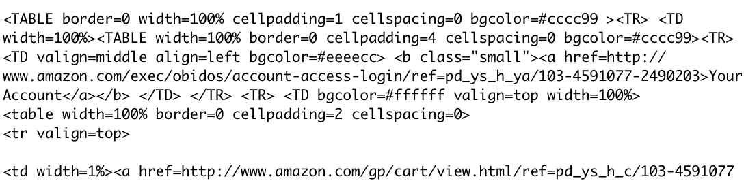
URL Rewriting

Slide 40
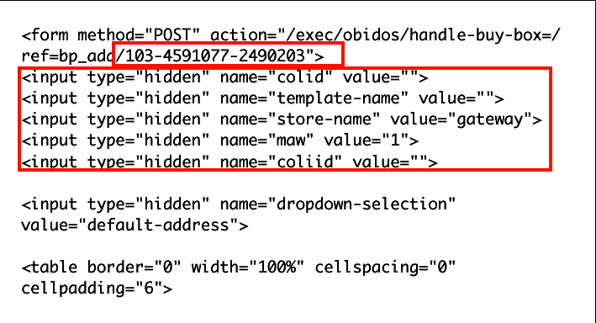
Hidden Form Fields
<input type=“hidden” name=“session” value=“...”>

Slide 41
Java Servlet Solution
Session tracking API built on top of URL rewriting or cookies
  Look up HttpSession object associated with current request (or create new one)
    All cookie/URL rewriting mechanics hidden
  Look up information associated with a session
  Associate information with a session

Slide 42
Look up Session Info
HttpSession session = request.getSession(true);
ShoppingCart sc = (ShoppingCart)
session.getAttribute("shoppingCart");
if (cart == null) {
cart = new ShoppingCart();
session.setAttribute("shoppingCart", cart);
}
...
// do something with your shopping cart object

Slide 43
HttpSession Methods
public String getId()
public boolean isNew()
public long getCreationTime()
public long getLastAccessedTime()
public int getMaxInactiveInterval()
public void setMaxInactiveInterval(int secs)
public void invalidate()

Slide 44
Associate Info w/ Session
HttpSession session = request.getSession(true);
session.setAttribute("referringPage",
request.getHeader("Referer"));
ShoppingCart cart =
(ShoppingCart)session.getAttribute("previousItems");
if (cart == null) {
cart = new ShoppingCart();
session.setAttribute("previousItems", cart);
}
String itemID = request.getParameter("itemID");
if (itemID != null) {
cart.addItem(Catalog.getItem(itemID));
}

Slide 45
Session Termination
Automatic! After a long enough interval (getMaxInactiveInterval)

Slide 46
Session Tracking
Session ID = 123XYZ
Shopping Cart sc
[item 1=324]
Request
Amazon
Servlet Container

Slide 47
Session Tracking
Session ID = 123XYZ
Shopping Cart sc
[item 1=324]
Amazon
Response:
Set-Cookie: sid=123XYZ
Servlet Container

Slide 48
Session Tracking
Request:
Set-Cookie: sid=123XYZ
Session ID = 123XYZ
Shopping Cart sc
[item 1=324]
Amazon
Servlet Container

Slide 49
Session Tracking
Request:
Set-Cookie: sid=123XYZ
Session ID = 123XYZ
Shopping Cart sc
[item 1=324
item 2=115]
Amazon
Servlet Container

