Slide 1
SEMANTIC NETS
BY HARSH MITTAL
2K19CSUN01092
CSE4B

Slide 2
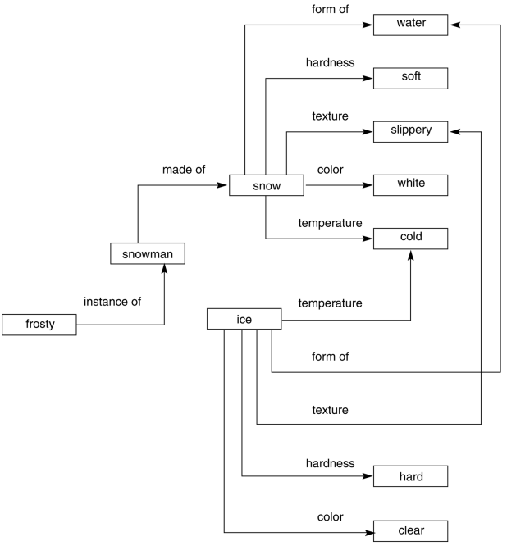
A brief look at semantic networks
=
A semantic network is often used as a form of knowledge representation. It is a directed graph consisting of vertices which represent concepts and edges which represent semantic relations between the concepts.

Slide 3
Semantic nets consist of nodes, links and link labels. In these networks diagram, nodes appear in form of circles or ellipses or even rectangles which represents objects such as physical objects, concepts or situations.
Links appear as arrows to express the relationships between objects, and link labels specify relations.
Relationships provide the basic needed structure for organizing the knowledge, so therefore objects and relations involved are also not needed to be concrete.
Semantic nets are also referred to as associative nets as the nodes are associated with other nodes

Slide 4
Semantic Networks Are Majorly Used For
Representing data
Revealing structure (relations, proximity, relative importance)
Supporting conceptual edition
Supporting navigation

Slide 5
Main Components Of Semantic Networks
Lexical component: nodes denoting physical objects or links are relationships between objects; labels denote the specific objects and relationships
Structural component: the links or nodes from a diagram which is directed.
Semantic component: Here the definitions are related only to the links and label of nodes, whereas facts depend on the approval areas.
Procedural part: constructors permit the creation of the new links and nodes. The removal of links and nodes are permitted by destructors.

Slide 6
Advantages Of Using Semantic Nets
The semantic network is more natural than the logical representation;
The semantic network permits using of effective inference algorithm (graphical algorithm)
They are simple and can be easily implemented and understood.
The semantic network can be used as a typical connection application among various fields of knowledge, for instance, among computer science and anthropology.
The semantic network permits a simple approach to investigate the problem space.
The semantic network gives an approach to make the branches of related components
The semantic network also reverberates with the methods of the people process data.
The semantic network is characterized by greater cognitive adequacy compared to logic-based formalism.
The semantic network has a greater expressiveness compared to logic.

Slide 7
Disadvantages Of Using Semantic Nets
There is no standard definition for link names
Semantic Nets are not intelligent, dependent on the creator
Links are not alike in function or form, confusion in links that asserts relationships and structural links
Undistinguished nodes that represent classes and that represents individual objects
Links on object represent only binary relations
Negation and disjunction and general taxonomical knowledge are not easily expressed.

Slide 8
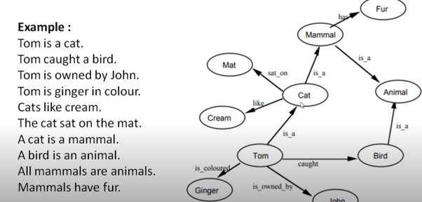

Slide 9

THANKYOU

