Slide 1
Context Level
Request
Customer
Response
Request
0.0
Admin
Online Food Delivery
Response
Request
DeliveryBoy
Response

Slide 2
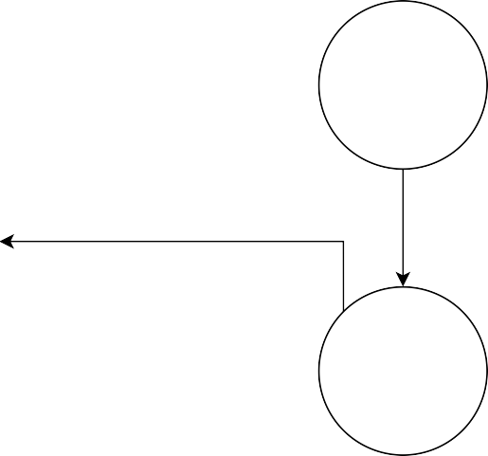
1st Level
Request For Registration
Registration Details
1.0
1.0
Registration Successful
Register
User id, Validation Message
Request for Login
Login Details
Customer
Customer
Login Successful Or Not
Valid Or Invalid Message
Request for Login
2.0
Login Details
Admin
1.1
Admin
Login Successful Or Not
Login
Valid Or Invalid Message
Request for Login
Login Details
DeliveryBoy
DeliveryBoy
Valid Or Invalid Message
Valid Or Invalid Message

Slide 3

1st Level
Request For Viewing Category Details
1.2
Category Details
3.0
View Category
Explore Category
Response For Viewing Category Details
FoodCategory
Customer
Menu
4.0
Request For Viewing Item Details
Explore Items
Item Details
View Item
Response For Viewing Item Details

Slide 4
1st Level
Request For Show Item Details
5.0
Check For Search Details
Display Search Results
Search Item
Response
Customer
Menu
6.0
Request
Select Items
Select Food Item
Show Item Details
Response

Slide 5
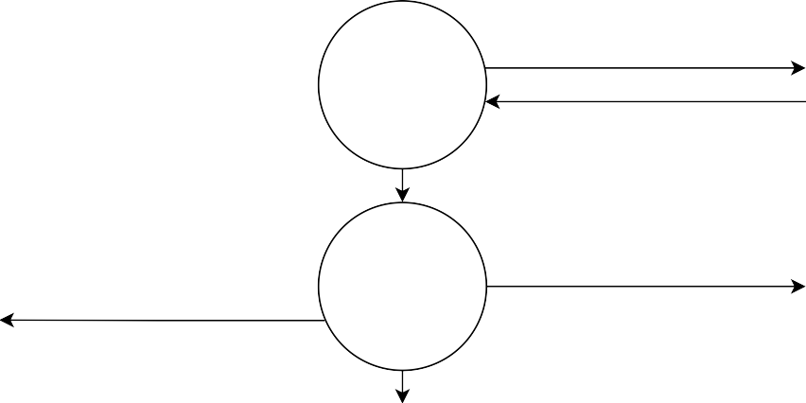
1st Level
Select Item For Cart
7.0
Request For Add Item To Cart
Cart
Comfirmation Of Item Added To Cart
Add to Cart
Response
Confirm Delivery Details
8.0
Request For Confirm Order
Customer
Order
Order
OrderID
Response For Order Confirmation
9.0
Select Payment Method, Payment Information
Request For Confirm Payment
Payment
Payment
Payment Confirmation Or Not
Response

Slide 6
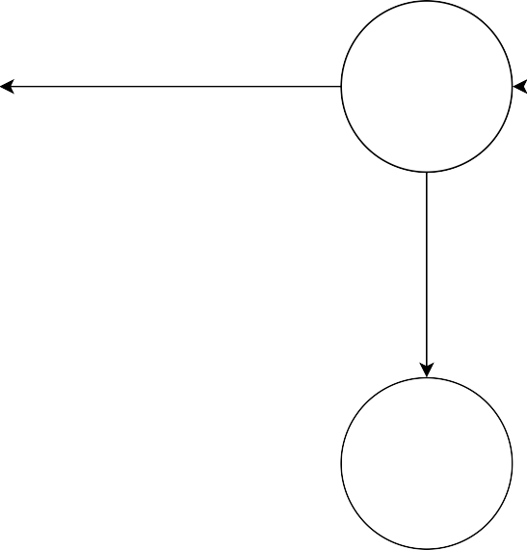
1st Level
Request For Submit Feedback
Customer
10.0
Feedback
Response For Feedback Confirmation
Review
Request For View Customer Feedback, Manage Feedback
11.0
Admin
Manage Feedback
Response

Slide 7
1st Level
Request For View And Manage User
12.0
User Details
Display User Details, Confirmation of User Manage
Manage User
Response
Customer
Admin
DeliveryBoy
13.0
Request for view and manage delivery boy
Manage DeliveryBoy
Delivery boy Details
Display delivery boy details, confirmation of Delivery Boy Manage
Response

Slide 8
1st Level
Request For View And Manage Category
Category Details
14.0
Display Category Details, Confirmation of Category Manage
Manage Category
Response
FoodCategory
Admin
Menu
15.0
Request for view and manage items
Manage Item
Item Details
Display Item details, confirmation of Item Manage
Response

Slide 9
1st Level
Request For View And Manage Order
Order Details
16.0
Display Order Details, Confirmation of Order Manage
Manage Order
Response
Order
Admin
Payment
17.0
Request for view and manage Payment
Manage Payment
Payment Details
Display Payment details, confirmation of Payment Manage
Response

Slide 10
1st Level
Request For View Order Details
18.0
Deliver the Order
Display Order Details, Confirmation of Order
Deliver Order
Response
Order
DeliveryBoy
Payment
19.0
Collect Payment of COD
Payment Management
Confirm Payment Status (Online Payment)
Response
Response

Slide 11
1st Level
Request For Logout Confirmation
Admin
Response For Logout Confirmation, Session Termination
Request For Logout Confirmation
20.0
Customer
Response For Logout Confirmation, Session Termination
LogOut
Request For Logout Confirmation
DeliveryBoy
Response For Logout Confirmation, Session Termination

Slide 12
